Slide 1

Group Member 4:
Benefits and Implications of Digital Sleep Hygiene Intervention
Student ID: 2434363
Name: AJAY BAVABAHI MAYANI

Slide 2

Introduction
AI-based sleep-tracking app with personalised feedback
Behavioural nudges to reduce late-night smartphone use (Vu and Tagliabue, 2025)
Designed for university students and young workers
Aims to improve sleep hygiene, boost wellbeing, and support healthier digital habits
Notes:
It is an AI-based intervention with behavioural nudges aimed at assisting young adults in controlling their late-night behaviour with their smartphones and enhancing their sleep hygiene. It targets a high-risk segment of the student population and young employees who face increasing challenges in sleep because of some academic and work pressures and excessive use of digital gadgets.

Slide 3
Individual Health Benefits
Increases sleep duration and quality through AI-guided routines (Verma et al., 2023)
Reduces stress and anxiety linked to poor sleep
Improves daytime alertness and cognitive performance
Notes:
This intervention makes people get more high-quality and prolonged sleep, which is linked to minimized stress and anxiety symptoms. According to research, 70% students maintain proper focus when they get sufficient sleep. The decrease in late-night smartphone consumption causes an increase in alertness and sensitive thinking of the users, which was proved by the findings of the NSF and Sleep Foundation.

Slide 4
Behavioural Benefits
Cuts down on smartphone addiction during late-night use with nudges (Vu and Tagliabue, 2025).
Promotes thoughtful and deliberate device utilization.
Healthy behaviours are being rewarded through gamification (Ilhan et al., 2022).
Helps the young adult to develop a long-lasting habit.
Notes:
Nudges with behaviour support users to reduce the nature of late-night scrolling, which is one of the problems of regular students. Over 60% of people state they are used to bedtime phone use habitually. The app enhances responsible digital behavior and rewards accomplishments. Gamification makes people more motivated, and thus they can keep healthier practices as they go along.

Slide 5
Academic/Workplace Benefits
Improves concentration, attention, and mental functioning (Aziz et al., 2025).
Enhances performance and productivity.
Minimizes work-related absenteeism.
Favorable to general educational performance, as well as professional output.
Notes:
Sleep improves concentration, retention of memories, and problem-solving solving which are important to students and young employees. Research indicates that individuals who are well rested make fewer errors and are more efficient with tasks. This intervention facilitates academic performance and productivity at the workplace, enabling participants to deliver their performance to the best of their abilities all the time.

Slide 6
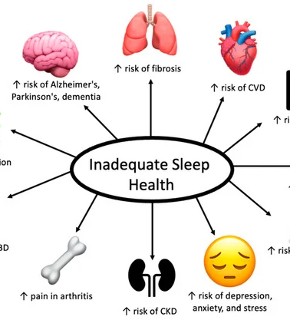
Social Benefits
A better mood strengthens human relations.
Encourages favorable interpersonal interaction.
Promotes healthy sleeping among peers.
Minimizes social interferences due to lack of sleep (Simon and Walker, 2018).
(Feingold and Smiley, 2022)
Notes:
Sleep is helpful in regulating emotions and mood, which enables one to interact more healthily with peers and colleagues. The participants can have an impact on their social circle by having a role model for good sleep hygiene. Sleep deprivation is minimized to reduce irritability and fatigue, to promote better social, academic, and workplace involvement.

Slide 7
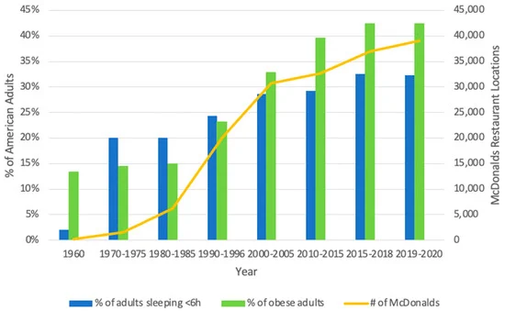
Economic Benefits
Reduced healthcare costs from fewer sleep-related issues
Cost-effective, app-based, and scalable intervention (Vollert et al., 2022)
Preventive approach lowers long-term mental health treatment expenses
Efficient use of university and public health resources
(Feingold and Smiley, 2022)
Notes:
The intervention can eliminate such complications as insomnia and anxiety by enhancing sleep hygiene, thus lowering the use of healthcare. The artificial intelligence software is an inexpensive, scalable application. Preventive measures of good health in the long run are achievable at an early age, which will help students and health authorities in society.

Slide 8
Policy Implications
Integrate
Integrate digital health tools into university wellness policies
Encourage
Encourage institutional support for tech-based sleep interventions (Verma et al., 2023)
Provide
Provide evidence to inform national guidelines on sleep and technology use
Promote
Promote adoption of preventive digital health strategies
Notes:
The intervention is beneficial to university wellness programs because it will introduce AI sleep applications as a part of the current student health programs. Pilot studies can inform national policies of sleep hygiene and responsible technology use. Preventive digital health strategies require institutional backing, imperative to scaling and maintenance.

Slide 9
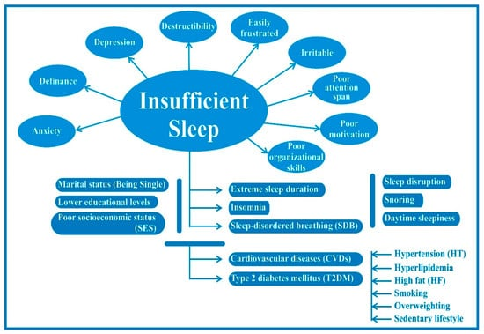
Research Implications
Study digital health interventions in real-world student and workplace settings
Generate data for AI-behavioural research and sleep science (Aziz et al., 2025)
Identify effective strategies for improving sleep hygiene
Contribute to evidence-based best practices in digital health promotion
(Chattu et al., 2018)
Notes:
This intervention creates an open area where scientists would use it to research the impacts of an AI-guided app on behaviour in everyday life. Obtained data may guide sleep science as well as digital health strategies to help researchers determine which methods should be used to enhance sleep hygiene and embrace healthy digital lives among young adults.

Slide 10
Educational Implications
Educate students on sleep hygiene and responsible technology use (Aziz et al., 2025)
Integrate content into health education modules or wellness workshops
Promote awareness of the effects of late-night smartphone use (Karasneh et al., 2022)
Encourage adoption of lifelong healthy digital habits
Notes:
The intervention aids in educational efforts, which are to teach students about sleep hygiene and the conscious use of technology. It may be incorporated into university wellness programs/workshops, making students aware of the effects of poor sleep and establishing behaviors that lead to continued physical and mental health in the long term.

Slide 11
Long-Term Public Health Impact
Decrease the poor sleep hygiene in young adults (Vollert et al., 2022).
Reduced long-term psychopathology associated with sleep deprivation.
Promote healthy use of technology among the young people (Karasneh et al., 2022).
Fund more community health programs to support the well-being.
Notes:
This intervention can decrease the chances of developing mental health problems (anxiety and depression) by enhancing sleep health and minimizing the use of smartphones at night among young adults. It fosters responsible tech practices, which help embrace a wellness culture and promote national and university-level objectives in the field of public health.

Slide 12
Summary
Individual, technology-based, and evidence-based treatment.
The benefits are spread across health, behaviour, academic/work, policy, research, and education.
Funds the sustainable public health promotion among the youths.
Notes:
It is a digital-based sleep hygiene intervention that offers a customised, interactive, and evidence-based way of sleeping enhancement with young adults. It creates impacts in various areas, such as health, behaviour, academics, policy, research, and education, facilitating the promotion of sustainable public health and the creation of healthy lifelong use of technology.

Slide 13
References
Aziz, S., A M Ali, A., Aslam, H., A Abd-alrazaq, A., AlSaad, R., Alajlani, M., Ahmad, R., Khalil, L., Ahmed, A. and Sheikh, J. (2025). Wearable Artificial Intelligence for Sleep Disorders: Scoping Review. Journal of Medical Internet Research, [online] 27, p.e65272. doi:https://doi.org/10.2196/65272.
Ben Simon, E. and Walker, M.P. (2018). Sleep loss causes social withdrawal and loneliness. Nature Communications, [online] 9(1). doi:https://doi.org/10.1038/s41467-018-05377-0.
Ilhan, A.E., Sener, B. and Hacihabiboglu, H. (2022). Improving Sleep-Wake Behaviors Using Mobile App Gamification. Entertainment Computing, [online] 40, p.100454. doi:https://doi.org/10.1016/j.entcom.2021.100454.
Karasneh, R.A., Al-Azzam, S.I., Alzoubi, K.H., Hawamdeh, S., Jarab, A.S. and Nusair, M.B. (2022). Smartphone applications for sleep tracking: rating and perceptions about behavioral change among users. Sleep Science, [online] 15(1), pp.65–73. doi:https://doi.org/10.5935/1984-0063.20210007.
Verma, R.K., Dhillon, G., Grewal, H., Prasad, V., Munjal, R.S., Sharma, P., Buddhavarapu, V., Devadoss, R., Kashyap, R. and Surani, S. (2023). Artificial intelligence in sleep medicine: Present and future. World Journal of Clinical Cases, [online] 11(34), pp.8106–8110. doi:https://doi.org/10.12998/wjcc.v11.i34.8106.
Vollert, B., Müller, L., Jacobi, C., Trockel, M. and Beintner, I. (2022). Effectiveness of an app-based short intervention to improve sleep: Randomized Controlled Trial (Preprint). JMIR Mental Health, [online] 10. doi:https://doi.org/10.2196/39052.
Vu, T.H. and Tagliabue, M. (2025). Active nudging towards digital well-being: reducing excessive screen time on mobile phones and potential improvement for sleep quality. Frontiers in Psychiatry, [online] 16. doi:https://doi.org/10.3389/fpsyt.2025.1602997.
Chattu, V., Manzar, Md., Kumary, S., Burman, D., Spence, D. and Pandi-Perumal, S. (2018). The Global Problem of Insufficient Sleep and Its Serious Public Health Implications. Healthcare, [online] 7(1), p.1. doi:https://doi.org/10.3390/healthcare7010001.
Feingold, C.L. and Smiley, A. (2022). Healthy Sleep Every Day Keeps the Doctor Away. International Journal of Environmental Research and Public Health, 19(17), p.10740. doi:https://doi.org/10.3390/ijerph191710740.

Slide 14
Thank You!

