Slide 1
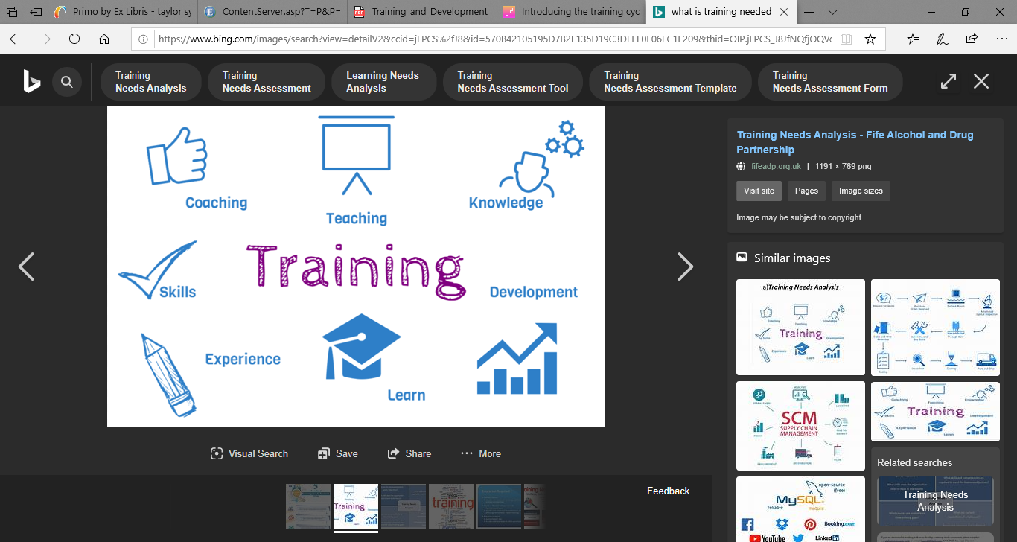
What is training needed for? and why is it important to employees and the organization we work for?

Slide 2


So how do companies best determine what training is best for their company?

Slide 3
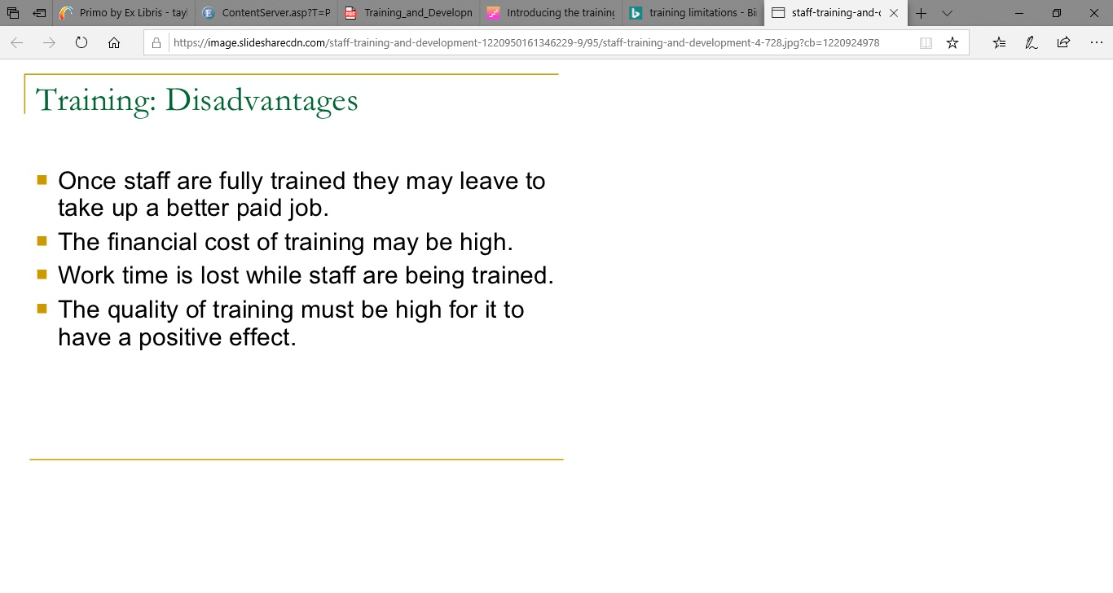
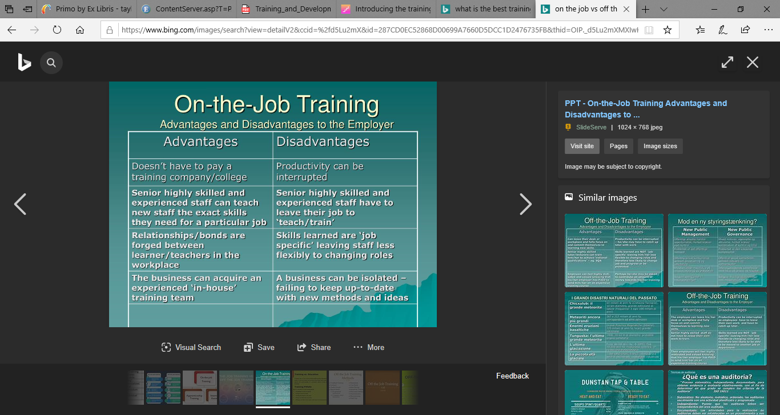

Slide 4


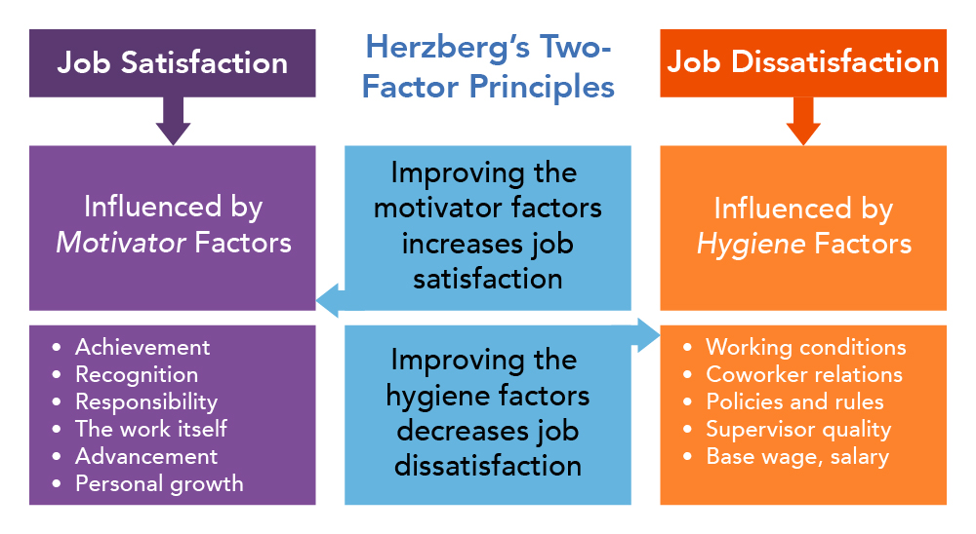
Training difference between the city and county of Swansea and Amazon, and Herzberg's hygiene factors.
VS
AND

Slide 5
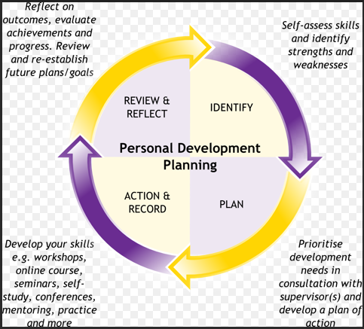
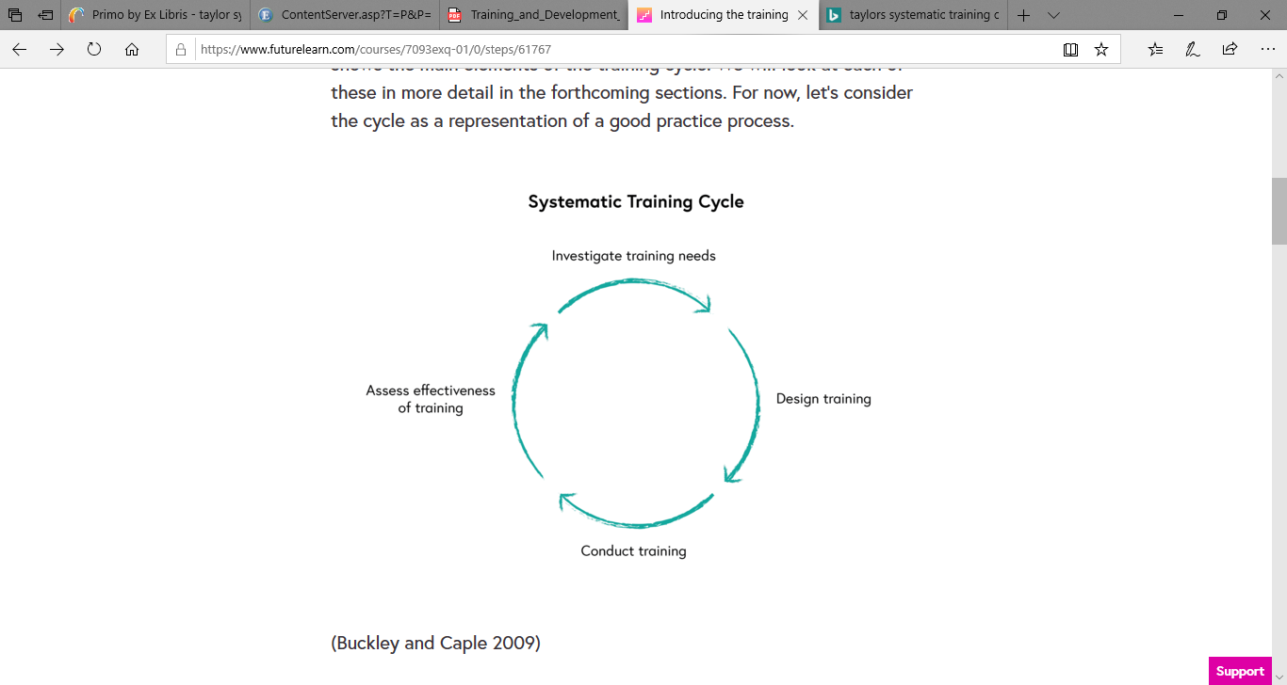
Personal Development plans, and the Systematic Training Cycle.

Slide 6
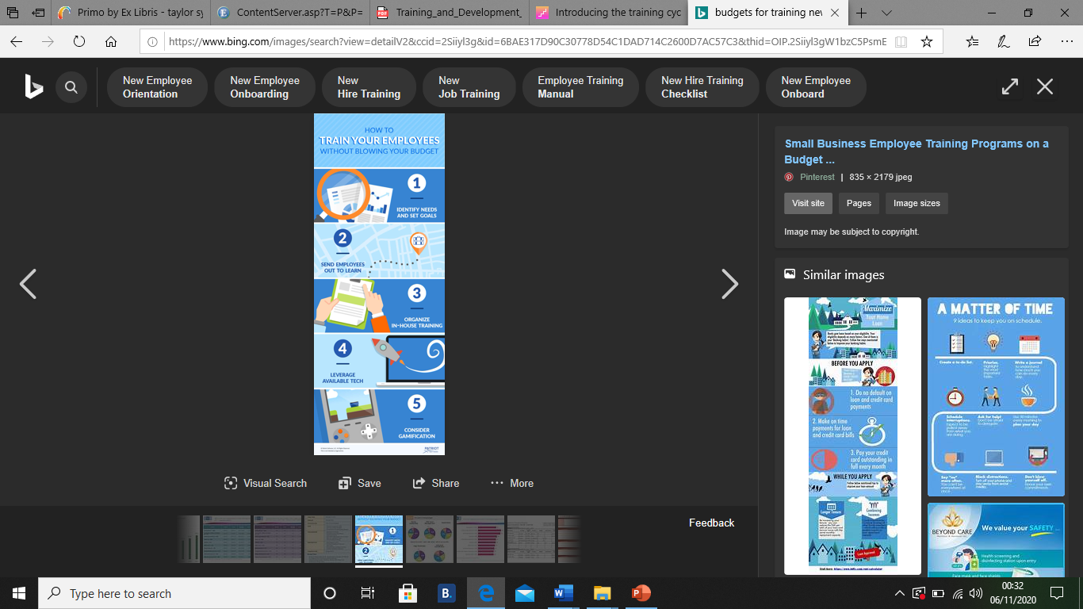

Limitations to training.

Slide 7


Slide 8
References.
BBC (2020) Available at: https://www.bbc.co.uk/bite size/guides/zrm3382/revision/4. Assessed: 31st October (2020).
BBC Bitesize (2020) Available at: https://www.bbc.com/worklife/article/20200212-the-real-ways-your-career-can-survive-automation. Assessed: 3rd November (2020).
Dr Dhawan. S. ( )The systematic approach to training. Available at: (http://www.top-consultant.com/articl es/the%20systematic%20approach%20to%20training.pdf. (Assessed: 1st November 2020).
Hughes, Ashley M. (n.d.). A checklist for facilitating training transfer in organizations. International Journal of Training & Development, 22(4), 334–346. https://doi.org /10.1111/ijtd.12141 . Assessed: 31st October (2020).
International Journal of Training & Development, 2018, Vol.22 (4), p.334-346. Assessed: 1st November (2020).
Joseph E. Gawel (1996), Herzberg’s theory of Motivation and Maslow’s Hierarchy of Needs. Available at: https://scholarworks.umass.edu/cgi/viewcontent.cgi?article=1066&=&context=pare&=&sei-redir=1&referer=https%253A%252F%252Fscholar.google.co.uk%252Fscholar%253Fhl%253Den%2526as_sdt%253D0%25252C5%2526q%253Dherzberg%252Btheory%2526oq%253Dherzberg%252Bthe#search=%22herzberg%20theory%22 . Assessed: 6th November 2020)
Khan, R., Khan, F. & Khan, M. (2011). Impact of training and development on effectiveness: moderating role of knowledge management process. European Journal of Training and Development, 37(5), 472-488. Assessed: 31st October (2020).
Marko Koster (2002), Human resource development: The limitations of the systematic training cycle, Munich, GRIN Verlag, https://www.grin.com/docume nt/25300. Assessed: 31st October 2020).
O’Herron, P., and Simonsen, P. (1995, May). Career development gets a charge at Sears Credit. Personnel Journal, 74 (5), 103-106. Assessed: 1st of November (2020).
Rubinstein. P (2020) BBC Beyond the 9 till 5 Available at: https://www.bbc.com/worklife/article/20200212-the-real-ways-your-career-can-survive-automation. Assessed: 31st October (2020).
Swansea Council Training and Development Policy (2018). Available at: file:///C:/Users/damoe/AppData/Local/Packages/ Microsoft.MicrosoftEdge_8wekyb3d8bbwe/TempState/Downloads/Training_and_Development_Policy__February_2018_%20(1).pdf (Assessed: 1st November 2020).
Tools Hero, (2020), Herzberg Two factor Theory of motivation. Available at: https://www.toolshero.com/psychology/two-factor-theory-herzberg/ . Assessed: 6th November 2020).
Working for Swansea Council (2019). Available at: https://www.swansea.gov.uk/workingforswanseacouncil. (Assessed: 1st November 2020).

