Slide 1

End of life,
Euthanasia and assisted Suicide
Student ID: 2026016
2026240
Module name: Living with care-The Older Person
Module code: BMHP6009_BIRM
Assignment: Task1
Lecturer’s name: Joanne Davies
By Nadejda Iachimovschi and
Aurelia Denicu

Slide 2
Introduction:
End of life
End of life and palliative care
Planning end of life
Gaps between the need and availability of end-of-life care
Euthanasia and assisted suicide
Legislation, policy and theories of ageing
Notes:
2

Slide 3

Palliative Care vs. End-of-Life Care
Option available for people who suffer from severe illness
Palliative care and end-of-life care have a lot in common for the reason that both forms of care are for people living with serious illnesses, and both object to improving quality of life.
End-of-life care is for persons diagnosed with a fatal illness who have six months or less to live. In contrast, palliative care is for people at any phase of serious illness, even as early as the day of diagnosis, who are still pursuing curative treatment.
(Samaritans, 2023)
Notes:
3

Slide 4
End-of-life care includes:
End of life delivered by :
End of life place :
Support from family or carer.
Pain control
Eligible for high-quality care
Respect wishes and preferences for a place to receive care
Respect wishes and preferences for where to die.
Eligible for high-quality care
Die with dignity
Hospital doctors
and nurses.
GP
Community nurses.
Hospice staff and counsellors.
Social care staff.
Physiotherapists.
Occupational therapists or complementary therapists.
At home- Services such as visiting nurses, as well as special equipment, such as a hospital bed or bedside commode, can be arranged to be at home.
In hospitals- they have access to medical professionals who understand the needs of a dying person.
Nursing homes- skilled nursing facility provides various health and personal care services.
(National Health Service, 2022)
(National Institute on Aging, 2022)
Notes:
4

Slide 5
Palliative care includes:
Palliative care provided by :
Palliative care place :
Medical care
Education and Advocacy
Social support
Spiritual support
Financial and legal support
Symptom relief
Support for family and carer
Doctor and nurse.
Palliative-trained, board-certified physician.
Nurse practitioner.
Social worker and care coordinator.
Spiritual support counsellor.
Certified home health aide.
Volunteer
Occupational therapists
At home
In hospitals
Outpatient office
Nursing homes
Care home
(Cleveland Clinic, 2022)
(Samaritans,2023)
(Marie Curie ,2022)
Notes:
5

Slide 6
An Active Care plan in order​
​
That includes a note for DNR (Do not Resuscitate)​
Advance Directive and Power of Attorney.​
To specify the beliefs, religion and religious way of the individual​
To respect preferences of care
​
Advance Directive/Living Will – legal document of wishes or decisions
Where and by who to receive care
Planning for end of life
(agespace,2023)
Notes:
6
6
6
6
6
6
6
6
6
6

Slide 7
The gap between need and availability of end-of-life care.
Need of end-of-life care:
Physical needs,
Mental and emotional needs,
Spiritual needs,
Practical needs,
Support and love from family and friends,
Right to die with dignity.
(NIH,2019)
Availability of end-of-life care:
Home
Hospice
Paid care givers
(NIH,2022)
Not enough
Notes:
7
7
7
7
7
7
7
7
7

Slide 8


Euthanasia is a method to end the patient’s life. The goal is to reduce the suffering of people with terminal illnesses, and the doctor gives a large dose of sedatives or medicine to relax muscles, leading to the patient’s death.
Euthanasia
(National Health Service, 2023a)
Assisted suicide is considered when a terminally ill person is prescribed strong sedatives, even if the prescriber knows the patient intends to use the drugs to commit suicide.
Assisted suicide
(National Health Service, 2023b)
Notes:
8

Slide 9
History of Euthanasia
In America:
Euthanasia was first used around 1800, on people that were hanged and not died and were in sever agony and pain, their legs were pulled to help them die quicker and alleviate the pain.
In the 19th century Morphine was used for pain treatment and to kill
In mid 19th century Chloroform was first used to ease pain and later death.
With votes against it the bill was defeated.
Doctors around the globe were pro euthanasia stating that they will be happy to help ease people's suffering and have a quicker end.
Doctors that offered Euthanasia were jailed.
Vatican was the only place that allowed Voluntary Euthanasia or assisted suicide in 1957.
In England:
In 1935, the euthanasia movement was founded and hoped the decision to die, should not be a medical one.
In 1936 a bill included voluntary euthanasia was introduced where anyone with a terminally or incurable illness, in severe pain that is over 21, with mental capacity, having two witnesses and assessed by several doctors could apply for it.
(A. Hiatt,2016)

Slide 10
History of assisted suicide
In the 13th century any form of suicide was forbidden as it was considered against God's will.
In 1915, Dr. Harry Haiselden (Chicago, IL) recommended that the parents of a newborn with severe physical abnormalities not consent to a potentially life-saving surgery ,with the agreement of the parents, the baby died without treatment.
(Indian J Palliat Care. 2021)
In 1938, a euthanasia society was established in the U.S., to lobby for assisted suicide.
Physician-assisted suicide became legal in Switzerland in 1937, if the doctor ending the patient’s life had nothing to gain.
(MedicalNewsToday.2023)
In 1997 assisted-suicide became legal in US and in 1999 non-active euthanasia became legal in us
In 2002 assisted suicide became legal in Belgium.

Slide 11



Laws governing Euthanasia and Assisted Suicide United Kingdom
In England and Wales under section 2(1) The suicide act 1961 (Legislation.gov.uk,2023)
In the United Kingdom, euthanasia and assisted suicide are considered illegal and can be persecuted by laws. (NHS,2023)
In Northern Ireland section 3 of the 1966 Criminal Justice Act (Legislation.gov.uk,2023)
Scotland under the Misuse of drugs Act 1971
(Legislation.gov.uk,2023)
Notes:
11

Slide 12






Laws governing Euthanasia and Assisted Suicide other countries
Assisted Suicide
Euthanasia
Switzerland: Swiss Criminal Code 1942 authorizations persons to assist in another’s suicide if the intention for action so is not selfish.
Australia: Voluntary Assisted Dying Act 2017
Luxembourg: Right to Die with Dignity Act 2009
Colorado(End of Life Options Act 2016 ), California (End of Life Option Act 2015), Washington (Death with Dignity Act 2008), Washington DC (Death with Dignity Act 2017), etc.
New Zealand:End of Life Choice Act 2019
Belgium: Belgian Act on Euthanasia 2002
(BMA, 2021)

Slide 13
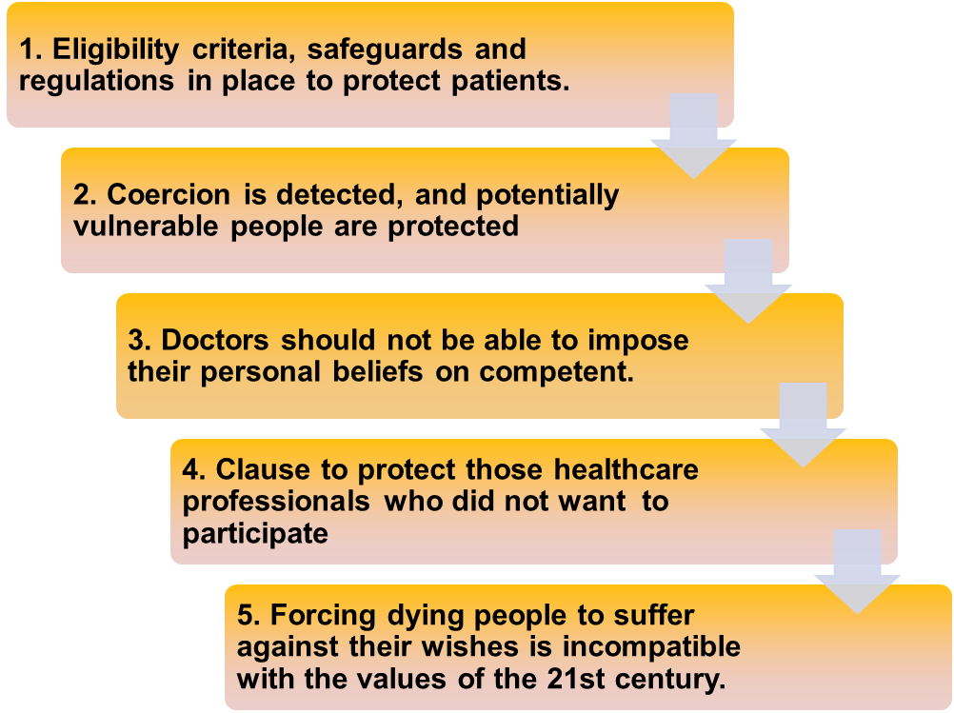
Arguments FOR Assisted Suicide and Euthanasia
(British Medical Association,2021a)

Slide 14
1. Law gives a concrete message to society.
Arguments AGAINST Assisted Suicide and Euthanasia
2. It is impossible to be sure that the decision was made voluntarily and without constraint.
3. The doctor's power to administer lethal preparations undermines doctor-patient trust.
4. Assisted dying is not a role for hard –pressed doctors.
5.Qualitative palliative care instead of legalised assisted suicide or euthanasia.
(British Medical Association,2021b)
Notes:
14

Slide 15
Legislation, policy and theories of ageing, which are relevant to older people approaching the end of their lives
Policies:
Money matters
Health and wellbeing
Care and support
Housing and homes
Active communities
Ageism and equalities
(AgeUK,2023)
Theories:
Disengagement theory of aging
Activity theory of aging.
(Nickerson, 2023; NIH,2017)
Legislations:
Human Rights Act 1998
Equality Act 2010
(ageUK,2017)
Notes:
15
15
15
15
15
15
15
15
15
15

Slide 16
Disengagement Theory of Aging
Activity Theory of aging
VS
Withdrawn from society and social activities
Loss of skills and ego change
Retiring from job roles
Loss of space in social life, resulting in crisis and demoralization
(C. Nickerson,2023)
Improve quality of life
Maintain an active life
Adress health issues
Continue to work
Have hobbies
Enjoy life
Continue care
(NIH,2017)

Slide 17
Conclusion
In conclusion, my opinion giving everybody the right to have a good death through euthanasia is acceptable as a universal principle, and that euthanasia is therefore morally acceptable.
(BBC,2014)
Also assisted suicide should be legalised because it will give people the right to choose how their life will end, but to be supervised and assessed to ensure that it will be because of terminal and painful illness and not for other reasons such as severe depression.
(NIH,2019)
But Euthanasia and assisted suicide can also be dangerous in the wrong hands because people can take advantage of the power that they provide and can be used for the wrong reasons
(J. A., Gerontol, 2017).

Slide 18

Recommendations
Older people's rights should be respected as they are an attribute to society.​
The legislation, policies and theories should be applied for older people wellbeing.​
They need to have the right to decide how their end of life will be and their wishes to be respected (ageUK,2023).
Euthanasia and Assisted suicide should be made legal everywhere, to help people with terminal illness that are in agony, to have a quicker and painless death. ​
But they should be use with care as people can take advantage of it and cause more harm than good. If the individual is unable to decide for himself, family or next to kin should decide

Slide 19
Reference list:
A., Hiatt. (2016) The history of Euthanasia Movement, Available at: The History of the Euthanasia Movement | JSTORY Daily (Accessed:22October2023).
Agespace.(2023) What is End of Life Planning and Care? Available at:End of life planning and care - Age Space (Accessed: 22October2023).
AgeUK.(2017) Briefing: Human rights of older persons and their comprehensive care Available at: age-uk---human-rights-of-older-persons-and-their-comprehensive-care---july-2017.pdf (ageuk.org.uk) (Accessed:22October2023).
AgeUK.(2023) Our policy positions Available at: Policy positions | Age UK (Accessed: 22October2023).
BBC. (2014) Pro-euthanasia arguments Available at: BBC - Ethics - Euthanasia: Pro-euthanasia arguments (Accessed: 22October2023).
British Medical Association, (2021a) Key arguments used in the debate on physician-assisted dying Available at: https://www.bma.org.uk/media/4394/bma-arguments-for-and-against-pad-aug-2021.pdf (Accessed: 15 October 2023)
British Medical Association, (2021b) Physician-assisted dying legislation around the world Available at: https://www.bma.org.uk/media/6706/bma-where-is-pad-permitted-internationally.pdf (Accessed at:15October2023)
C., Nickerson. (2023) Disengagement Theory Of Aging Available at: Disengagement Theory of Aging (simplypsychology.org) (Accessed: 22October2023).
Cleveland Clinic, (2022) Palliative Care Available at: https://my.clevelandclinic.org/health/articles/22850-palliative-care (Accessed: 21October2023)
Legislation.gov.uk, (2023) Criminal Justice Act (Northern Ireland) 1966 Available at: https://www.legislation.gov.uk/apni/1966/20/part/II#:~:text=%283%29%20On%20a%20charge%20of%20murder%2C%20it%20shall,adduce%20or%20elicit%20evidence%20tending%20to%20such%20proof. (Accessed:15October2023)
Legislation.gov.uk, (2023) Misuse of Drugs Act 1971 Available at: https://www.legislation.gov.uk/ukpga/1971/38/scotland (Accessed :15October2023)
Legislation.gov.uk, (2023) Suicide Act 1961 Available at: https://www.legislation.gov.uk/ukpga/Eliz2/9-10/60 (Accessed :15October2023)
Marie Curie (2022) What is palliative care? Available at: https://www.mariecurie.org.uk/help/support/diagnosed/recent-diagnosis/palliative-care-end-of-life-care?msclkid=6e091061219d1ee2cb19755506809024 (Accessed: 21October2023)
MedicalNewsToday.(2023) What are euthanasia and assisted suicide? Available at: Euthanasia and assisted suicide: What are they and what do they mean? (medicalnewstoday.com) (Accessed: 22 October 2023).
National Health Service, (2022) What end of life care involves Available at: https://www.nhs.uk/conditions/end-of-life-care/what-it-involves-and-when-it-starts/ (Accessed: 21October2023)
National Institute on Aging, (2022) Different Care Settings at the End of Life Available at: https://www.nia.nih.gov/health/different-care-settings-end-life (Accessed: 21October2023)
NHI. (2014) The Impact of Activity Interventions on the Well-Being of Older Adults in Continuing Care Communities Available at: The Impact of Activity Interventions on the Well-Being of Older Adults in Continuing Care Communities - PMC (nih.gov) (Accessed: 22October2023).
NHS, (2023) Euthanasia and assisted suicide Available at: https://www.nhs.uk/conditions/euthanasia-and-assisted-suicide/ (Accessed: 15October23).
NIH. (2019) Pros and Cons of Physician Aid in Dying Available at: Focus: Death: Pros and Cons of Physician Aid in Dying - PMC (nih.gov) (Accessed: 22October2023).
NIH. (2022) Different Care Settings at the End of Life Available at:Different Care Settings at the End of Life | National Institute on Aging (nih.gov) (Accessed: 22October2023).
NIH.(2021) Regulating Death: A Brief History of Medical Assistance in Dying Available at: Regulating Death: A Brief History of Medical Assistance in Dying - PMC (nih.gov) (Accessed: 22October 2023).
Samaritan, (2023) Palliative Care vs. End-of-Life Care: What’s the Difference? Available at: https://www.samaritannj.org/palliative-care/palliative-care-vs-end-life-care/ (Accessed: 21October2023).

