Slide 1
Advocacy and BAME groups
SJSS6004 Advocacy and PCP
Session 3
September 2020
Phillip Morgan

Slide 2
Matters for Your Consideration before viewing this resource:
Peer Group/Personal Reflection
Why do ‘we’ feel the need to label people?
Is difference a part of power and control?
What does is say about ‘our’ culture(s) when we label?
If someone/a group is ‘other’ than ‘the norm’ does this:
  Lessen their value?
  Consider ‘value’ as a concept (£? Ability?)
Who makes (or breaks) these judgements of
  Value
  Worth
  importance

Slide 3

Question….
What do YOU think the issues might be about Mental Health services and people from BAME backgrounds?

Slide 4
BMER and Mental Health
People from BME groups living in UK are:
more likely to be diagnosed with mental health problems
more likely to be diagnosed and admitted to hospital – particularly Afro-Caribbean people
more likely to experience a poor outcome from treatment
more likely to disengage from mainstream mental health services
more likely to be socially excluded
Poor access to non-drug treatments

Slide 5
WHY?
“Western concepts of mental health as a separate entity may seem alien to many people - who see it as an intrinsic part of a person’s overall well-being. Mental health is associated with faith, spirituality, family life, employment, housing, hope, safety and fulfilment”.
https://jamanetwork.com/journals/jama/fullarticle/2767029

Slide 6
Breaking the circles of fear
Black people see using mental health services as a degrading and alienating experience: the last resort. They perceive that the way services respond to them mirror some of the controlling and oppressive dimensions of other institutions in their lives, e.g. exclusion from schools, contact with police and the criminal justice system.

Slide 7
Fear
There is a perception that mental health services replicate the experiences of racism and discrimination of Black people in wider society, particularly instances where individuals have experienced the more controlling and restricting aspects of treatment. A service user talks about her experience of seeking help from mental health services as a Black person:

Slide 8
Fear
“…Coming to mental health services was like the last straw… you come to services disempowered already, they strip you of your dignity…you become the dregs of society”
(Service User, quoted in Keating et al, 2002)

Slide 9
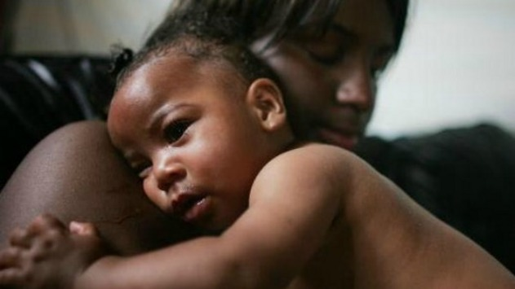
Poor Practice…
Example of poor practice by mental health professionals dealing with a black woman:
“There is one thing that I’ve done that I’ve felt really uncomfortable about … It was a pre-planned assessment on a woman who had given birth to a baby two or three weeks earlier. They knew she was at home.

Slide 10
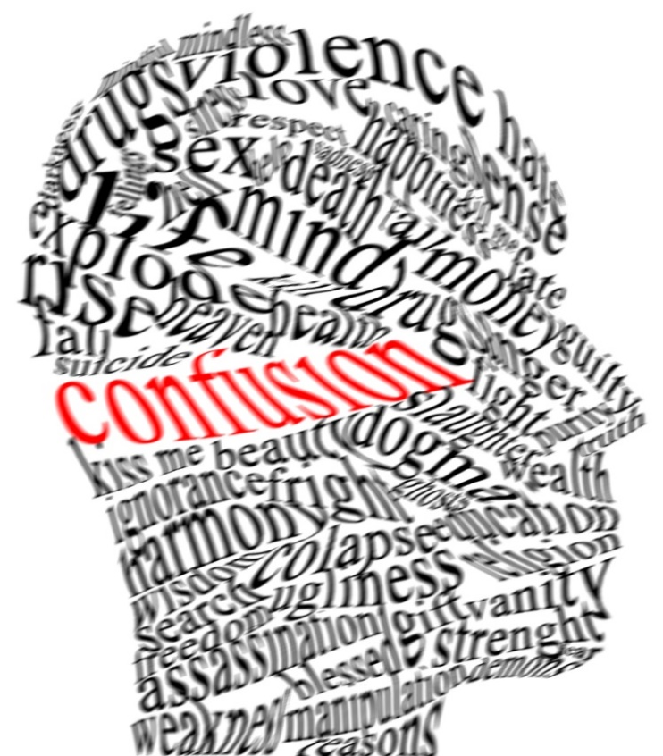
Power
We went in forced entry. Myself, a sergeant and one of my female colleagues and I felt really uncomfortable. He [the psychiatrist] asked this lady several questions that she got right and he got wrong! General knowledge questions like, ‘What’s the date?’ and ‘Who’s the Prime Minister?’

Slide 11
Power & Control
And she was getting them right and he was going ‘Is that right?’ You know you sort of really felt quite awkward but at the end of it, it ended up in a free for all and I felt really quite awkward having to manhandle a female. …[She was] quite vulnerable, quite large but she also had a babe in arms.

Slide 12
Abuse of power?
So we had to not only manhandle her to remove the baby, which obviously at three weeks old [was] incredibly fragile and I felt quite awkward doing that. We found all the other professionals took one step back. As soon as it came to hands on. There must have been about eight people in that room

Slide 13
Abuse of power?
and only three moved forward … ASWs, two ambulance officers, staff psychiatrist, the social worker for the lady. There was doctor – there must have been four or five other professionals there and they all stepped back. It was just automatically – the police will deal with that. I mean not only did they leave us to wrestle with the woman they didn’t even assist to take the baby” (Police Officer).

Slide 14

Reflect on this….
What elements of practice would you question?
What changes do you think would have enhanced good practice?
What part do you think ‘culture’ played in this scenario?

Slide 15
MH advocacy for BME groups
Research studies have found:
Advocacy services are frequently inaccessible to BME groups
WHILE AT THE SAME TIME:
Users and carers from BME groups are dissatisfied with MH services – controlling of their experiences and methods of expression
Afro-Caribbean individuals are over-represented in MH hospitals and facilities

Slide 16
MH advocacy for BME groups
Word ‘advocacy’ frequently misunderstood by BME groups – lack of awareness of what it means so low uptake
Translation is an essential component
Lack of BME user-led services and advocates
Listen

Slide 17

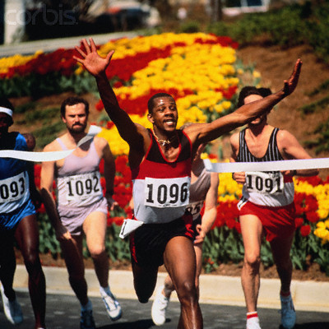
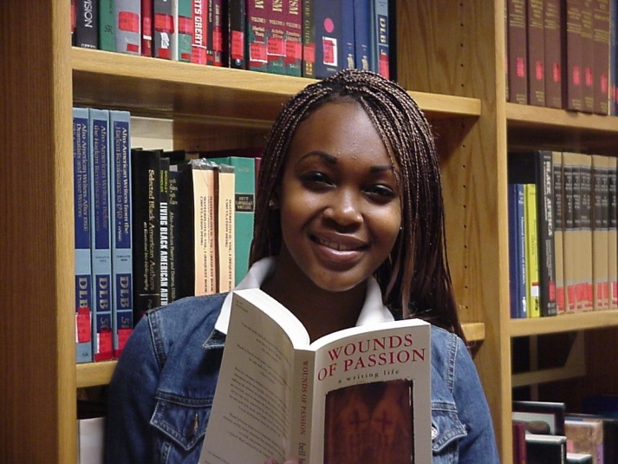
Tensions
“I have so much difficulty in getting white professionals to see me as a black person. I feel they see me as a stereotype and not as a person”

Slide 18
Abuse of power?
“The reality is I see myself as ‘normal’ but a lot of people don't see me as normal. I see other people who have similar experiences as me but they are not seen as mentally ill… I often question if it is my culture, gender, or age that gets a negative reaction”

Slide 19
Tensions
Low expectations of disempowered communities create climate of cynicism
Much advocacy in BME communities is informal – through families & communities of faith etc
Black advocates felt their work intrinsically and inevitably involved challenging mainstream practice
(Joseph Rowntree Foundation, 2019)

Slide 20
Good practice in advocacy for BME communities
Needs to challenge double discrimination of racism and mental health issues
Facilitate access to culturally appropriate services
Empower Black service users to identify their own needs
More independent and accessible – and black-led advocacy services

Slide 21
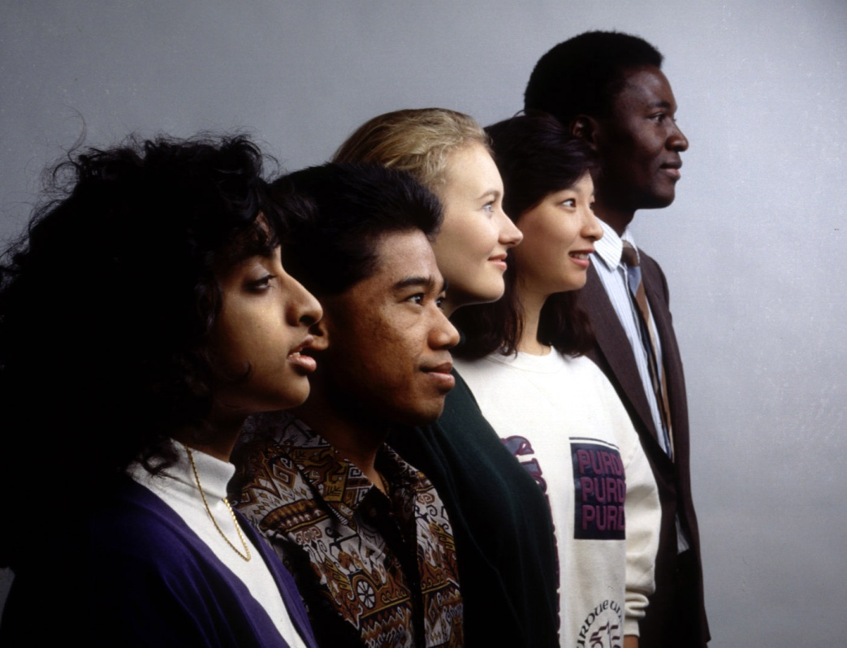
Good practice….
Should reflect service users’ cultural background, language & gender
Promote 5 themes: identity, faith, anti-racism, gender and spirituality

Slide 22

Consider in your peer study groups where Black Lives Matter locates within Advocacy & PCP:
https://blacklivesmatter.com/whatmatters/

Slide 23
References
Henderson, R. ‘Mental Health Advocacy and Empowerment in Focus’ in, Ryan,T and Pritchard, J. (eds) Good Practice in Adult Mental Health. London: Jessica Kingsley Publishers, 2005
World Health Organisation. Advocacy for Mental Health. Geneva: World Health Organisation, 2003
Rethink Factsheet: Black and mnjinority ethnic communities and mental illness.

Slide 24
References
Barnes, D et al. Independent Specialist Advocacy in England and Wales: recommendations for good practice. Durham: University of Durham, 2002
Hawkins, J. (2002) Voices of the Voiceless: Person-Centred approaches and people with learning difficulties, Ross-on-Wye: PCCS Books
Keating, F et al. Breaking the Circles of Fear. London: Salisbury Centre for Mental Health, 2002.
Wetherell, A. Advocacy, That’s Counselling isn’t it?, www.arwtraining.com

Slide 25
Useful websites
Mind – www.mind.org.uk
Mind helps people take control of their mental health. We do this by providing high-quality information and advice, and campaigning to promote and protect good mental health for everyone
Colourmind – www.colourmind.co.uk
Colour Mind is the website of the Mental Health Race Equality Team for Central Lancashire.

Slide 26
Rethink – www.rethink.org
Working to help everyone affected by severe mental illness recover a better quality of life
www.actionforadvocacy.org.uk
taking action to help people say what they want, secure their rights, represent their interests and obtain services they need.

Slide 27
The Joseph Rowntree Foundation is an endowed charity that funds a large, UK-wide research and development programme aimed to understand the root causes of social problems, to identify ways of overcoming them. www.jrf.org.uk
Advocacy Really Works – training and development for the MH advocacy sector.
www.arwtraining.com

