Slide 1
Dance training 1
Fitness PowerPoint
By Eva Court, Sienna Toppar, David Walker, Matthew Davies

Slide 2

Introduction:
What does fitness mean in dance?
In dance, fitness means having flexibility, coordination, strength, endurance and control to be able to perform movements safely and expressively. It’s about supporting technique, not just being in shape.
Fitness in dance is essential because it helps you to have long-term participation, improves performance and decreases the risk of injury.
In this PowerPoint we will be discussing the importance of fitness in dance and key components of fitness associated with dance.

Slide 3
Key components of fitness for dancer: (Eva)
Health related components:
Muscular strength- “The amount of force a muscle can exert against a resistance” (BBC 2023)
Muscular endurance- “The ability to use voluntary muscles repeatedly without tiring” (BBC 2023)
Body composition- “The percentage of a person’s body weight” (BBC 2023)
Flexibility- “The range of motion at a joint” (BBC 2023)
Cardiovascular endurance- “The ability of the heart, lungs and blood to transport oxygen” (BBC 2023)
Skills related components
Agility- The ability to change the position of the body quickly and control the movement (BBC 2023)
Speed- The ability to put body parts into motion quickly (BBC 2023)
Power- The ability to perform strength performances quickly (BBC 2023)
Balance- The ability to maintain the body’s center of mass above the base of support (BBC 2023)
Reaction time- The time taken to respond to a stimulus (BBC 2023)
Coordination- The ability to use 2 or more body parts at the same time (BBC 2023)

Slide 4
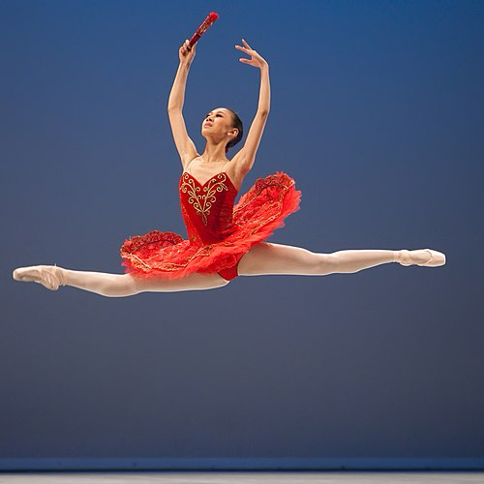
Flexibility: (Sienna)
Why is having flexibility important for dancers?
Flexibility is important in dance because it allows you to have a better range of motion and also reduces the risk of injury by letting the body move through positions safely. Flexibility also helps to improve joint mobility and muscle length which then directly helps your movement quality. Acro unlimited say’s “Overstretching and using incorrect techniques can damage the muscles and ligaments, leading to chronic pain or even permanent injury” (acro unlimited 2025)
There are 2 types of flexibility:
Dynamic flexibility – “the range of motion in a joint when it is moving” (Lee, s 2025)
Static flexibility – “the range of motion in a joint when it is not moving” (Lee, s 2025)

Slide 5
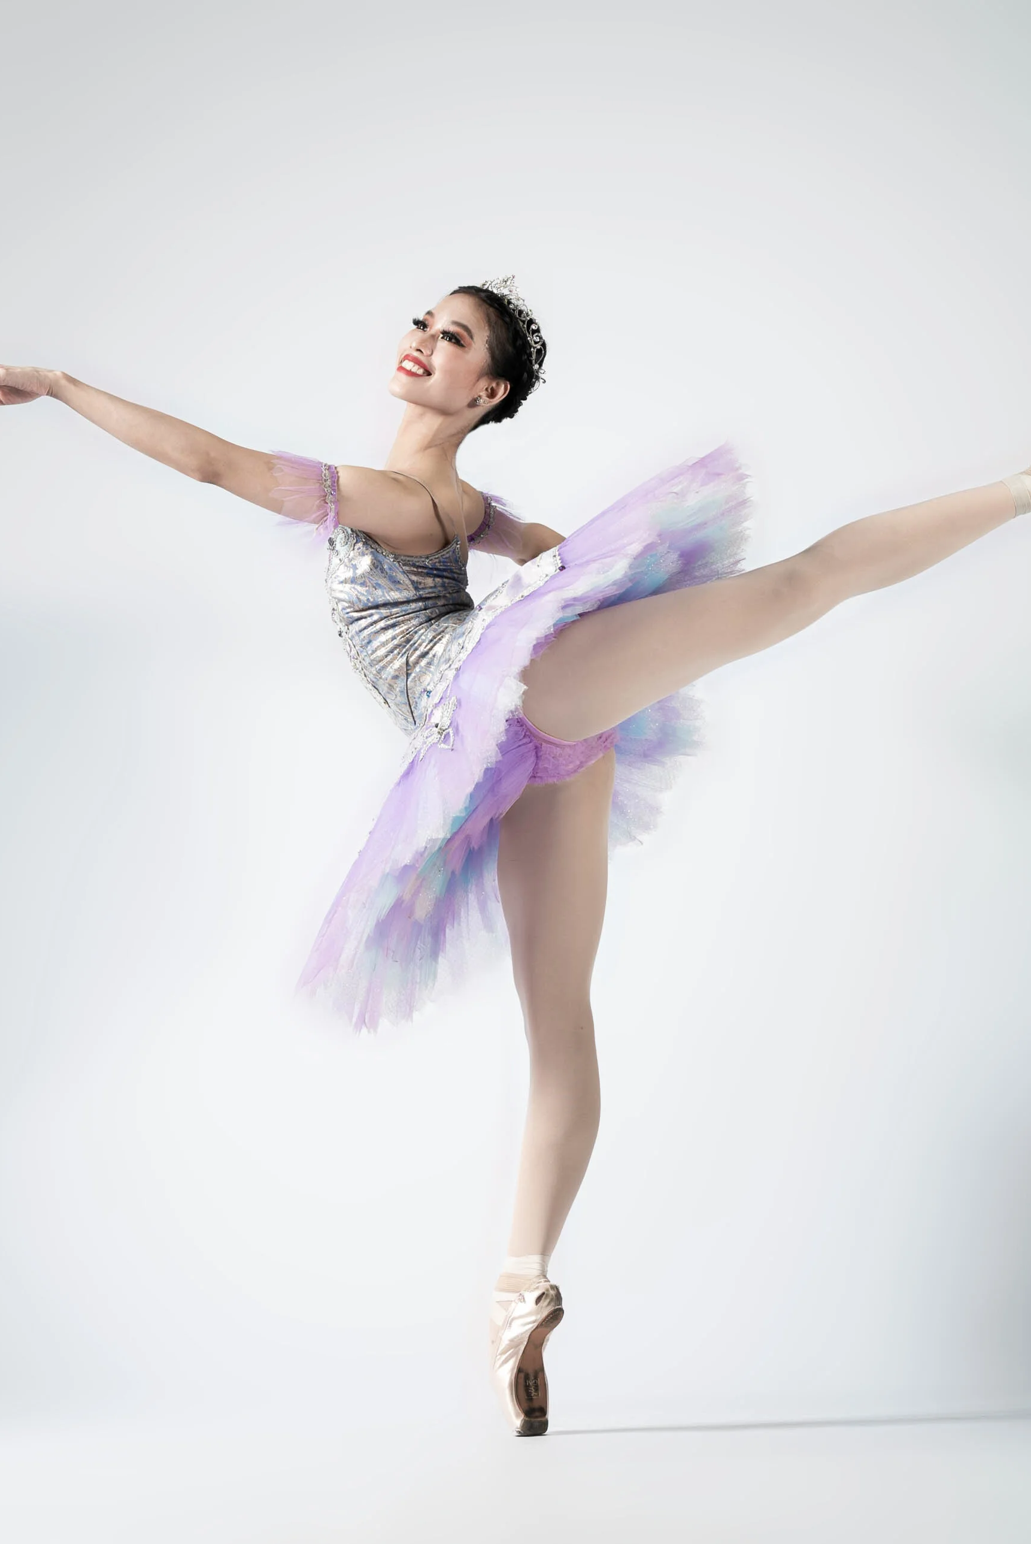
Mobility: (Sienna)
Why is mobility important for a dancer?
Mobility helps the dancer to move freely, transition and have clean lines whilst reducing the risk of injury and stiffness. Flexibility also plays a role in mobility as flexibility allows for your joints to be able to go through a range of motions. Good mobility can helps dancers to complete difficult choreography, express themselves through movement and reduce the risk of injury. Sarah Lee say’s “several factors can affect a dancers mobility, including: age…Training…Injury…Genetics”. (Lee, S 2025)

Slide 6
Movement in dance | Why flexibility is important for it
Split leap | Flexibility is important for a split leap because flexible hip flexors, hamstring and adductors let the legs fully open, it allows the body to jump higher producing a more aesthetically pleasing leap and helps to maintain balance on the landing.
High kick | Flexibility is important for a high kick because more hip flexibility helps you to get the leg higher, it allows smoother and more precise kicks, and proper alignment is easier when the joints are able to move freely.

Slide 7
Movement in dance | Why mobility is important
Splits | Mobility is important for the splits because if you don’t have hamstring and hip mobility the legs wont be able a straight line, mobility in muscles ad joints prevent strains or tears and it also helps your pelvis and hips stay level for a balanced split.
Arabesques | Mobility is important for an arabesque because back and hip mobility helps the leg to lift higher without adjusting your form, mobile ankles, hips and spine helps for you to stay balanced and it helps prevent strain on any muscles or joints.

Slide 8
Strength and Muscular endurance: (Eva)
Why is having strength important for dancers and musical theatre performers?
Strength is crucial “to assist in the control and execution of movements” in dance (Kalogridis 2023). Strength is also essential for components such as balance and posture as it adds technicality and an artistic presentation of the movements adding to the overall performance quality. Having strength as a dancer is also important for injury prevention, Sharpen Dance Training states, “while flexibility allows for a greater range of motion, it is the muscular strength that provides joint stability and support.” This shows that it supports flexibility by ensuring safe ranges of motion and helps dancers maintain endurance during long performances. Strength is essential for dancers because it stabilizes joints, prevents injury and adds control to movements.
Why is having muscular endurance important for dancer and musical theatre performers?
Muscular strength is important for dancers as it sustains performance, prevents fatigue, improves control and supports stamina. “Muscular strength creates speed and force, making for more powerful movement.” (Anker 2016) Muscular strength is the foundation for powerful, fast movements. It’s what gives dancers and performers the force and speed needed to execute specific movements. Having muscular strength as a dancer and musical theatre performer is also essential for long performances as having that strength will allow the performer to not feel as fatigued throughout and at the end of the show, allowing them to perform regularly.

Slide 9
By Eva
Movement in dance: | Why strength is important for it:
Pirouettes | Having core strength stabilize your body when turning in either jazz or ballet. Mayes (2024) states “during pirouettes, the core muscles help you maintain balance and control as you spin”. Which shows that you need core strength to achieve pirouettes.
Jumps and leaps | To execute jumps and leaps in jazz or ballet strength in the core, legs and ankles are need to get that high elevation and the jump itself. “Good core strength and alignment are critical.” (Sage Island 2023)
Movement in dance: | Why muscular endurance is important for it:
Routine (Stamina) | Muscular endurance is crucial when performing a routine as it allows the dancer to sustain a high amount of energy without feeling fatigued.
Fast footwork (Tap) | To paraphrase from Paula 2025, having muscular endurance allows the muscles specifically in the calves, ankles, and shins to perform rapid, repetitive movements over an extended period without fatiguing or causing the technique to become sloppy.

Slide 10
Cardiovascular fitness (Dai)
The importance of Cardiovascular endurance
Increases the ability to be able to perform long and intense routines for an extended period of time. This is important in dance and performing as a whole, due to an audience being affected by the fatigue or lapse in intensity of a performer on stage.
Studies suggest that the best kind of exercise for improving cardiovascular endurance is interval training, such as circuit. This sort of training is high intensity for a period with short breaks in between exercises.
Why this works?
Very rarely would a dancer go for a slow 45-50 min jog so interval training where you’d do 3-5 minutes of high intensity with breaks between sets improves the strength of a performer’s lungs and heart.

Slide 11
Power in Dance
Power in Dance is the combination of strength and power in a movement to create impactful and controlled movement.
The four sources of power are:
Gravity Power, which is constantly at work pushing us towards the floor.
Muscular Power, utilized when engaging various muscles to move the body.
Centrifugal Force, which is power created on the outside of a turn.
Centripetal Force, which is power created on the inside of a turn.
Power in dance is important as it helps with your ability for leaps and jumps, it also helps with the control of the return after.
Power is also very important in the dynamics of dancing to create an impactful and enjoyable routine andf for performers.

Slide 12
Types of Exercise to improve power for dance
Planks and Russian twists for core strength (especially in lifts)
Kettlebell swings
Box Jumps
Jump squats
Overall body weight intense exercises work well for improving power which adds to balance and dynamic in dance and performance.

Slide 13
Applying training principles to dance:
Applying training principles to dance ensures that physical conditioning is purposeful, effective and specific to a performer or performances demands. Principles such as specificity, progression and recover should be integrated into a dancers training program to improve performance and reduce injury risk.
Specificity requires training to show the movement patterns, energy and muscular demands of dance styles. This training could be exercises such as repeated jumps, balances and explosive movements (Stevenson 2025) Progressive overload will allow dances to gradually increase training loads, intensity and volume to improve without excessive fatigue (Haff and Triplett 2015).
Variating training methods such as combining cardiovascular training, interval training and resistance based muscular conditioning will support physical development and mirrors the intermittent nature of dance performance (Steveson 2025). Beneficial recovery is equally as important as insufficient rest can affect technique, coordination and muscular control increasing injury risk (ACSM 2018)
When all these principles are applied through a needs analysis, structured programming and appropriate exercise, dancers can improve their endurance, strength, power and movement efficiently while sustaining long term performance quality (Stevenson 2025)

Slide 14
Conclusion
In conclusion, fitness plays a vital role in dance performance, as it supports both technical ability and expressive movement. Key components such as flexibility, mobility, strength, muscular endurance, cardiovascular fitness and power all contribute to a dancer’s ability to perform safely, confidently and effectively. By developing these areas of fitness, dancers can improve performance quality, reduce the risk of injury and maintain long term participation in dance and musical theatre.

Slide 15
Reference:
Acro Unlimited (2025). FLEXIBILITY - Acro Unlimited. [online] Acro Unlimited. Available at: https://acrounlimited.com/portfolio-items/flexibility/ [Accessed 10 Feb. 2026].
ACSM (2025). ACSM’s Guidelines for Exercise Testing and Prescription. [online] ACSM. Available at: https://acsm.org/education-resources/books/guidelines-exercise-testing-prescription/ [Accessed 7 Feb. 2026].
Anker, S. (2016). Muscular Strength for Dancers. [online] Presenting Denver. Available at: https://presentingdenver.org/muscular-strength-for-dancers/ [Accessed 7 Feb. 2026].
BBC (2019). Health, fitness and exercise - Edexcel - Revision 2 - GCSE Physical Education - BBC Bitesize. [online] BBC Bitesize. Available at: https://www.bbc.co.uk/bitesize/guides/zxd4wxs/revision/2 [Accessed 7 Feb. 2026].
Blog, T.B. (2015). Cardio Training For Dancers – The Ballet Blog. [online] theballetblog.com. Available at: https://theballetblog.com/portfolio/cardio-training-for-dancers/ [Accessed Feb. 2026].
December 23, G.P. and 2015 (2015). Four ways to use power in dance. [online] Delta.Dance. Available at: https://delta.dance/2015/12/four-ways-to-use-power-in-dance/ [Accessed 10 Feb. 2026].
Lee, S. (2025). Mobility in Dance: The Key to Fluid Movement. [online] Numberanalytics.com. Available at: https://www.numberanalytics.com/blog/mobility-in-dance-theory [Accessed 10 Feb. 2026].
Mayes, I.M. (2024). Why a Strong Core is Essential for Every Ballet Dancer | Core Stability Exercises. [online] Ballet with Isabella. Available at: https://balletwithisabella.com/posts/why-a-strong-core-is-essential-for-every-ballet-dancer/ [Accessed 7 Feb. 2026].
Rodrigues-Krause, J., Krause, M. and Reischak-Oliveira, Á. (2015). Cardiorespiratory Considerations in Dance: From Classes to Performances. Journal of Dance Medicine & Science, 19(3), pp.91–102. doi:https://doi.org/10.12678/1089-313x.19.3.91.
sageisland (2021). 6 Tips for Improving Your Dance Jumps. [online] Evolution Dance Complex. Available at: https://www.evolutiondancecomplex.com/six-tips-for-improving-your-dance-jumps/ [Accessed 7 Feb. 2026].
Stevenson, A. (2026). Dance Fitness Lecture.
Up, S. (2024). The Crucial Role of Strength in Dance: Beyond Flexibility - Sharpen Up! [online] Sharpen Up! Available at: https://www.sharpenupdtt.com/the-crucial-role-of-strength-in-dance-beyond-flexibility/ [Accessed 7 Feb. 2026].

Slide 16
Bibliography (all)
https://theballetblog.com/portfolio/cardio-training-for-dancers/
https://acrounlimited.com/portfolio-items/flexibility/
https://www.numberanalytics.com/blog/mobility-in-dance-theory
https://delta.dance/2015/12/four-ways-to-use-power-in-dance/
https://pubmed.ncbi.nlm.nih.gov/26349502/
https://www.sharpenupdtt.com/the-crucial-role-of-strength-in-dance-beyond-flexibility/
https://www.evolutiondancecomplex.com/six-tips-for-improving-your-dance-jumps/
https://balletwithisabella.com/posts/why-a-strong-core-is-essential-for-every-ballet-dancer/
https://www.bbc.co.uk/bitesize/guides/zxd4wxs/revision/2
https://presentingdenver.org/muscular-strength-for-dancers/

