Slide 1



Politics and Policing: Influence, Priorities & Trust
By Mark Skelton
Student Number: 2414812
Notes:
Hello, I’m Mark Skelton. Following my paper on Policing and the Political Landscape, this presentation will be further exploring how political influence shapes policing, affects local priorities, and impacts public trust and engagement.

Slide 2
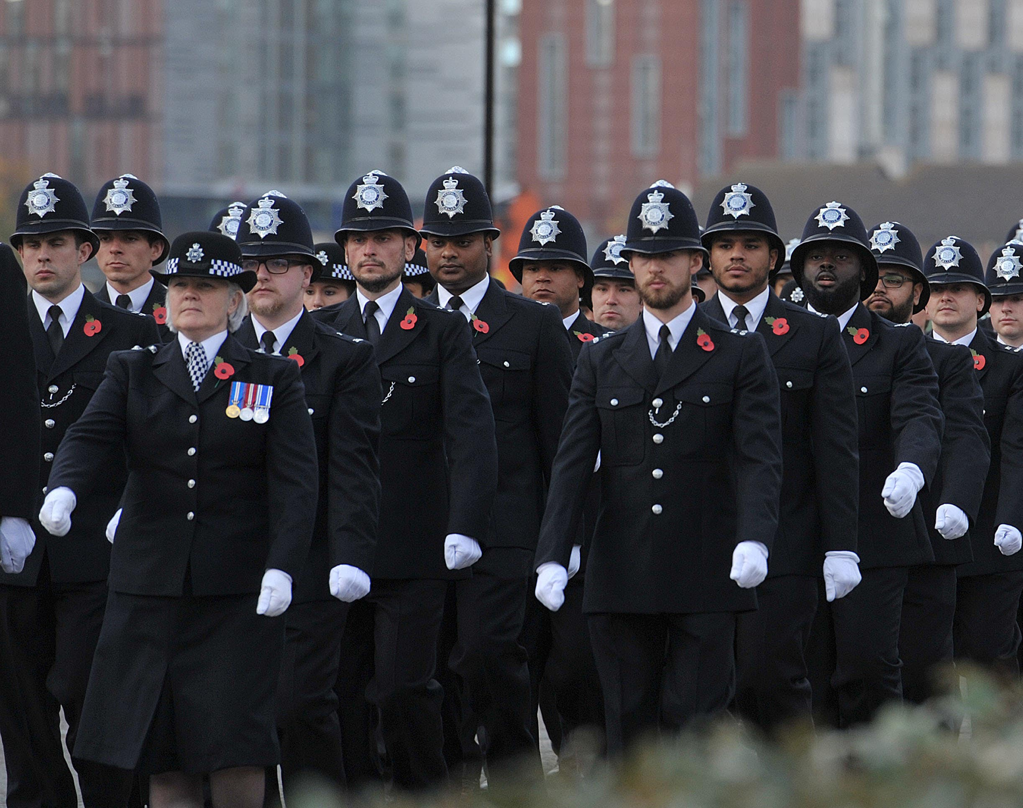
Contents
P. 3- The political independence of the Police
P.8- The influence of politics on policing priorities
P.13- The impact of politics on public engagement and trust in law enforcement
P.17- Conclusion
P.19- Reference List

Slide 3
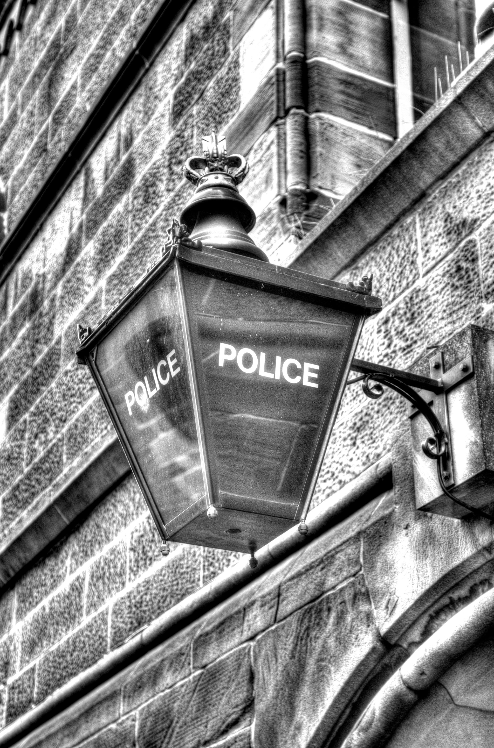
The political independence of the Police

Slide 4
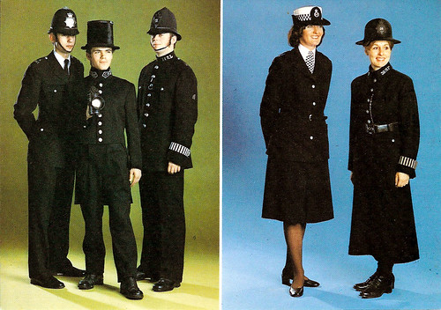
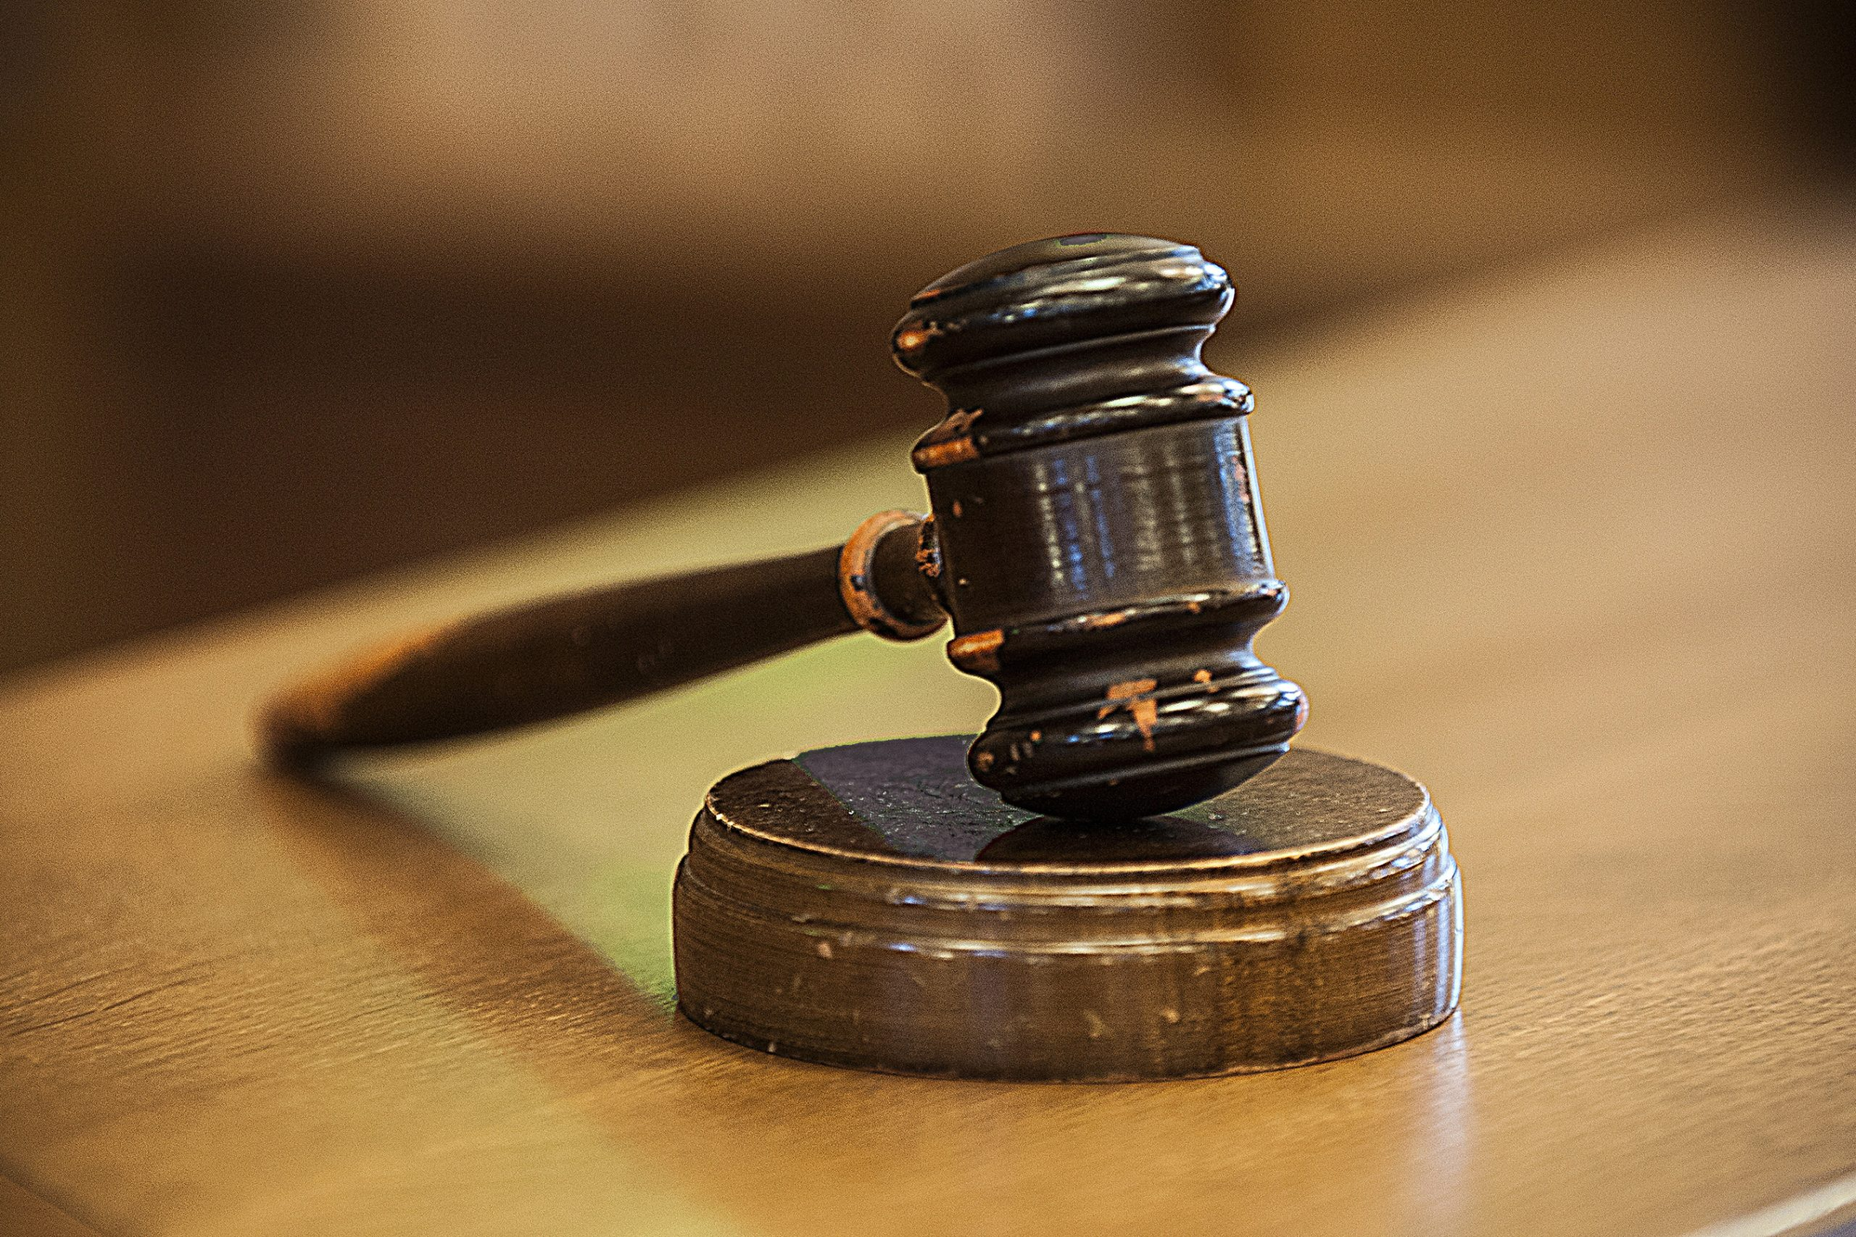
The Metropolitan Police Act of 1829- established policing as an impartial service, dedicated to upholding the law, free from political interference (Home Office 2012)
This stance later affirmed in the 1968 Blackburn judgment (R v Metropolitan Police Commissioner, ex-parte Blackburn [1968])
This principle faces mounting challenges amid the evolving dynamics of modern party politics, where partisan interests often complicate efforts to uphold impartiality and public trust
This Photo by Unknown Author is licensed under CC BY-SA
This Photo by Unknown Author is licensed under CC BY-ND
Notes:
The Metropolitan Police Act of 1829, introduced by Sir Robert Peel, created the UK’s first professional force. Peel’s fifth policing principle outlined impartial service to the law, free from political interference (Home Office, 2012). This ideal was upheld in the case R v Metropolitan Police Commissioner, ex-parte Blackburn [1968], confirming that chief constables answer to the law, not political actors (1968).
However, this principle is increasingly tested by modern political dynamics. In the July 2024 general election, policing was a major theme, with all political parties pledging strategic changes and investment in policing as well as legislative amendments (Magistrates Association, 2024).
These varied pledges demonstrate that policing is not merely reactive to societal needs-political decisions drive strategic policing priorities, creating a complex and often contradictory relationship between governance and operational independence.

Slide 5
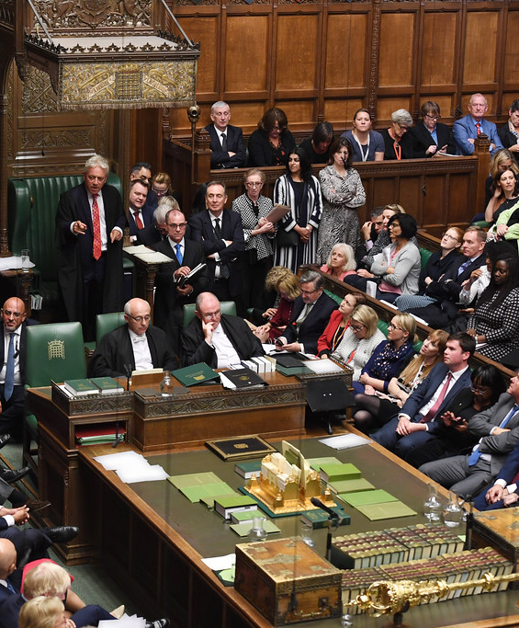
  Reiner (2019) and Grieve (2024)- policing is inherently political, though this is different to politicisation
  Long and Cullen (2007)- modern policing designed to serve the distinct needs of local communities- a democratic endeavor, reflecting public interests and reinforcing civic trust
  Shannon (2021)- PCC paradox- democratic accountability vs political control
  Brain (2013)- PCCs a move from professionalism to partisan responsiveness
  Loader (2014)- Peelian Principles outdated
This Photo by Unknown Author is licensed under CC BY-NC
Notes:
•Robert Reiner (2019) argues that policing reflects the values of those in power—meaning it's embedded in the dominant political ideology of any given time.
•John Grieve (2024) traces this all the way back to the roots of policing, showing that the supposed neutrality of law enforcement has always been more myth than reality.
•Both assert that policing is inherently political, though crucially, they distinguish political context from politicisation. While policing must work within a political context, such as enforcing laws passed by governments, politicisation refers to the deliberate bending of policing toward partisan agendas.
•Long and Cullen (2007) argue that modern policing arose from local constables’ failure to manage disorder, often leading to military intervention and tragic outcomes. The Metropolitan model aimed to avoid coercion by grounding legitimacy in public consent. They argue that policing was designed to reflect community needs—a democratic effort to foster civic trust and responsive governance.
• Ian Shannon (2021) explores how reforms like Police and Crime Commissioners (PCCs), though aimed at improving democratic accountability, may actually undermine legitimacy by introducing a political dynamic, effectively highlighting a form of ‘legitimacy paradox’- pitting democratic accountability against political control.
• This reflects Reiner (2019) and Grieve’s (2024) warning: institutionalised political influence risks undermining trust when it harms fairness or effectiveness.
• For Shannon (2021) legitimacy isn't just about legal oversight—it’s built on fairness and effectiveness. If reforms result in scandals, poor recruitment, or weakened oversight, public trust erodes.
• Shannon’s (2021) concern regarding the introducing of PCCs is that chief officers may now feel too anxious or constrained to challenge questionable political priorities, potentially weakening policing outcomes.
• Timothy Brain (2013) supports the concerns of Shannon, calling the shift to PCCs a “constitutional change,”, marking the end of de-politicised policing by introducing a politicised structure with influence over police priorities.
• For Brain, the risk is that visibility and representation rise, but so do dangers like short-termism, populism, and the loss of impartiality.
• Ian Loader (2014) calls for civic policing: not just enforcing the law but building democratic values and earning the public’s allegiance.
• He critiques what he claims are outdated Peelian principles, too narrowly centered on police–public interactions.
Loader’s (2014) critique echoes concerns from Shannon (2021), Reiner (2019), and Grieve (2024), highlighting civic policing as a counterbalance to politicisation. By anchoring policing in democratic culture rather than partisan agendas, Loader promotes institutional accountability and public allegiance. This vision aligns with Long and Cullen’s (2007) focus on community-responsive governance rooted in public consent.

Slide 6
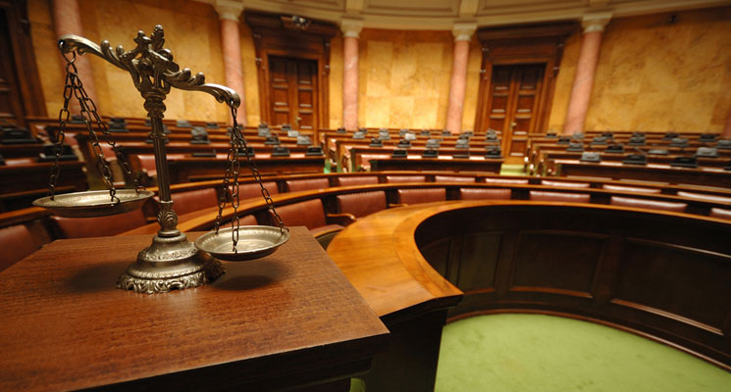
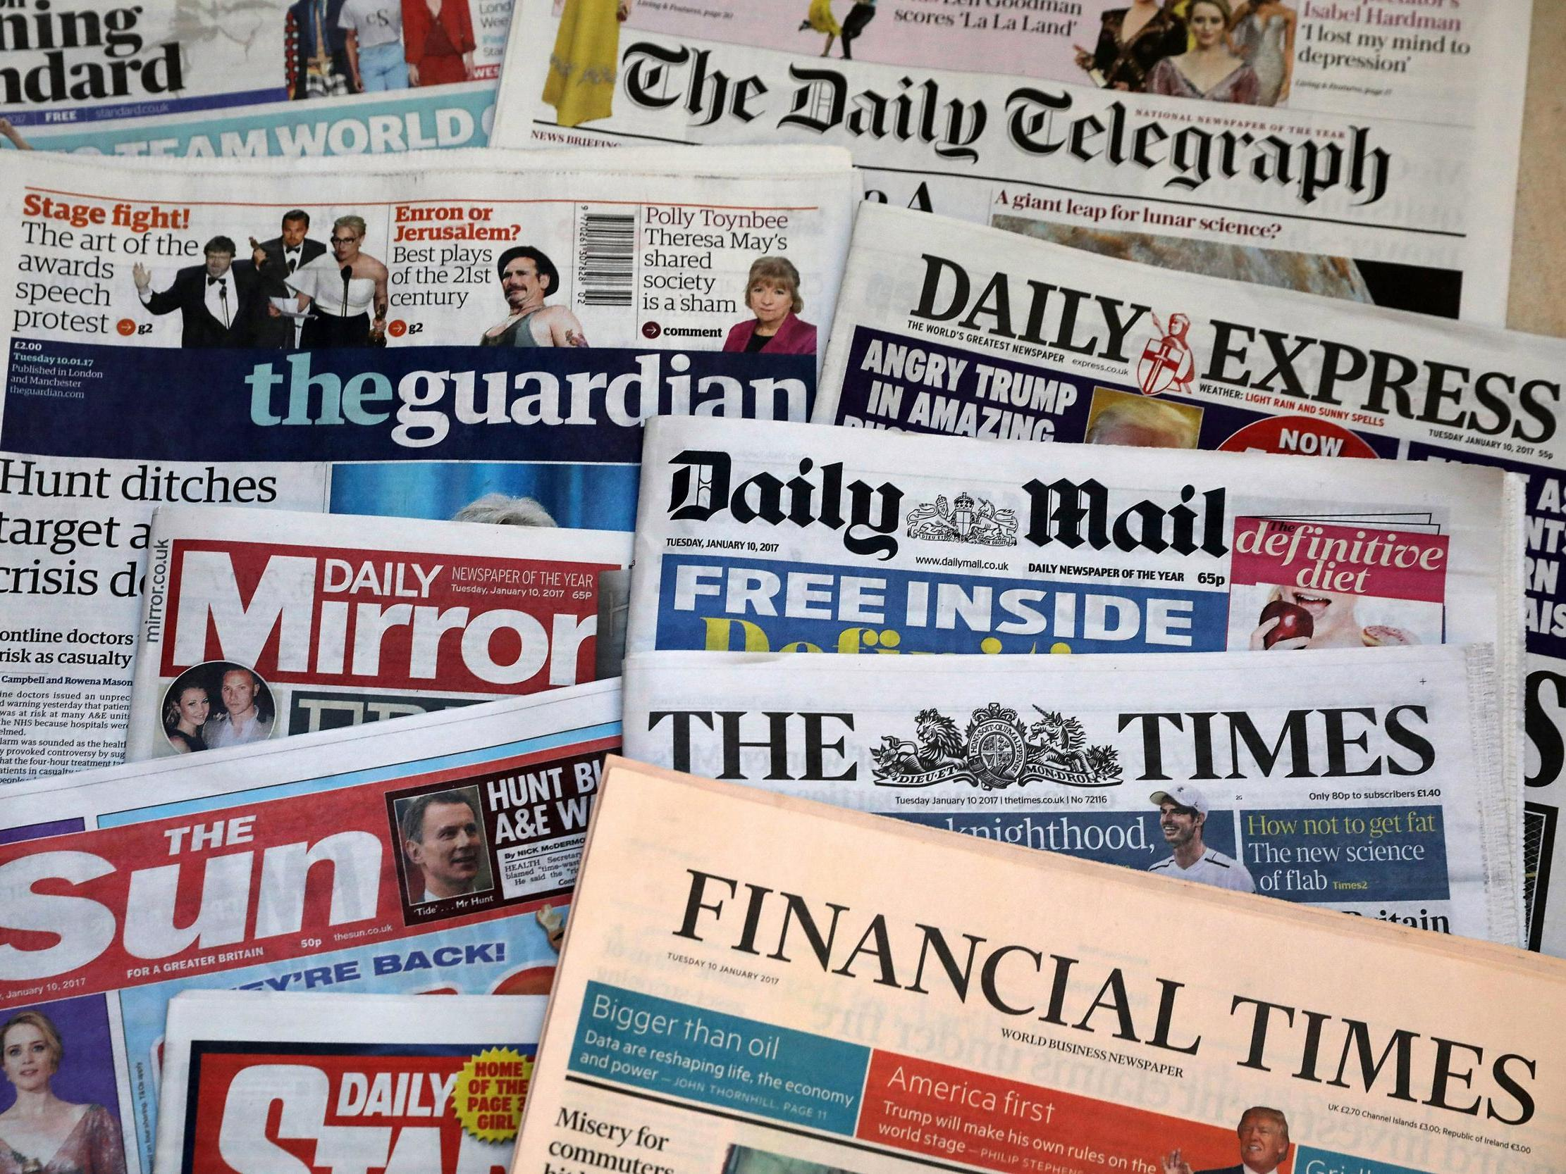
Worrall (2014, P.51)- ‘The police, perhaps more than any other government entity, function in a complex political environment’
Caless and Owen (2016)- PCCs didn’t politicise but formalised an already political system
Stenning (2007)- Operational policing decisions can be shaped by subtle political pressures exerted by the media, judiciary, and various political actors
This Photo by Unknown Author is licensed under CC BY-NC-ND
Notes:
• Worrall (2014) argues that political influence in policing has both advantages and drawbacks. It allows public input but also opens the door to populism, short-termism, and resource strain. He reinforces that policing is inherently political, that neutrality is aspirational but arguably unattainable.
• This mirrors Grieve’s (2024) warning that ideologically driven reforms may conflict with the public interest, and Brain’s (2013) view that such political involvement can weaken police legitimacy.
• Caless & Owens (2016) argue that PCCs didn’t create politicisation—they legitimised and formalised it. They support the assertion of Shannon that budget cuts and staffing decisions risk becoming political tools.
• Stenning (2007) describes police governance as a continuum between independence and accountability, cautioning that subtle pressures—from media, judiciary, or political actors—can shape operational decisions. He notes that UK police independence emerged from judicial interpretation, not fear of political control—particularly in debates over whether government funding implies a master-servant relationship relevant to liability in misconduct cases.
Stenning sees influence operating at multiple levels. Arrest and prosecution rely on officers’ discretion; while rarely acting under direct orders, officers must apply the law independently amid external pressures.

Slide 7

Politics is inextricably woven into the fabric of policing
As the Peelian principle says, “the police are the public and the public are the police”(Home Office, 2012)
The task is not to eliminate, but to manage in ways that safeguard legitimacy
Notes:
Together, these historical and academic insights reinforce the central argument: policing is inherently political. As the Peelian principle says, “the police are the public and the public are the police” (Home Office, 2012)—public accountability demands some political presence. But that influence must protect—not erode—legitimacy, fairness, and effectiveness.

Slide 8
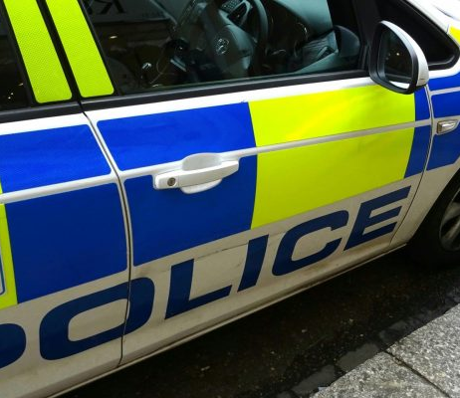
The influence of politics on policing priorities

Slide 9
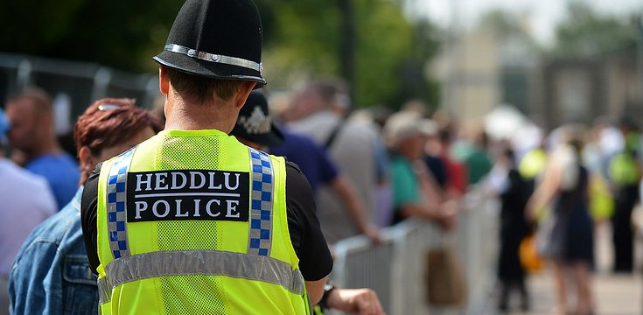

Police Reform and Social Responsibility Act 2011- Intended to enhance police-public relations via PCCs and locally tailored plans (Home Office, 2010)
However, it is debatable that this shift has successfully aligned policing priorities with community needs
Barber Review 2022 (Barber 2022): national policing strategies often overshadow local concerns, and national consistency is coming at the cost of local responsiveness
Notes:
• When the Police Reform and Social Responsibility Act was introduced in 2011, its goal was simple—bring policing closer to the people. PCCs were intended to strengthen the bond between communities and police by giving the public a greater say in setting local priorities (Home Office, 2010) .
• However, has this shift delivered on its promise?
• Barber (Barber, 2022) : identified a growing disconnect between national strategies and local community needs. National policing priorities, such as SOC and counterterrorism, were found to often overshadow local concerns, such as ASB and neighbourhood safety- suggesting that national consistency is coming at the cost of local responsiveness.

Slide 10
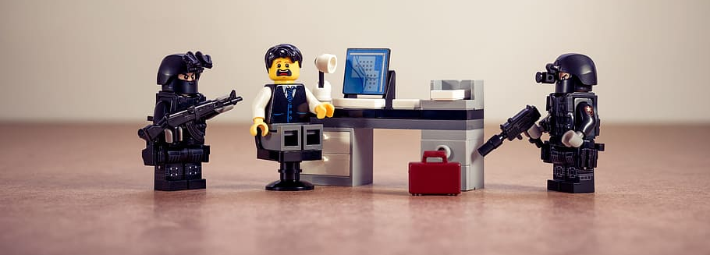
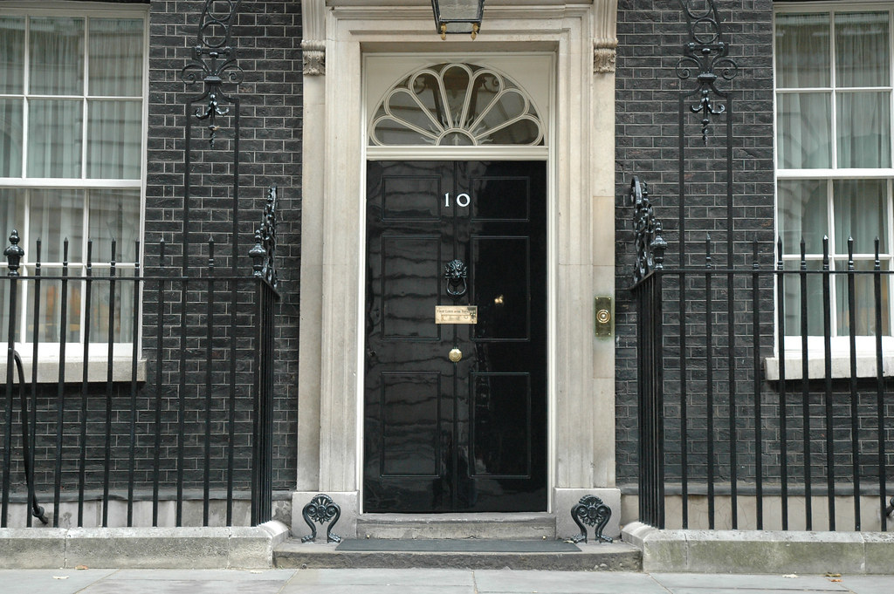
Worrall (2014)- PCCs versus national government. Level and political actor determine which priority wins
Lister and Rowe (2015)- politicised policing issues that resonate with more electorally influential groups, rather than those most affected by crime
Brain (2013)- questions impartiality of PCCs and Chief Constables aligning with electoral promises
Brain (2103) also highlights that PCCs often prioritise “seen” policing to satisfy public expectations. This risks diverting resources away from complex but essential operations that lack immediate political visibility
Notes:
• For Worrall (2014), the structural level and political actor determine where the most influence is felt, and which priority wins over.
• Lister and Rowe (2015) argue that efforts to broaden electoral appeal can marginalise vulnerable communities. This dynamic may skew policing priorities toward concerns of electorally dominant groups, rather than those most impacted by crime.
• Brain (2013) critiques PCCs, warning that reforms intended to ensure impartiality may instead entrench politicisation by tying Chief Constables to electoral promises.
• He notes that PCCs often favour “seen” policing—visible patrols and responses to antisocial behaviour—as these often align more with public opinion.
• The Public Accounts Committee (2019) supports this view, showing how high-visibility issues often dominate political discourse, particularly during election campaigning.
• But this can come at a cost—complex but critical operations like serious organised crime can be underfunded and overlooked, even though their long-term impact is substantial.

Slide 11

Reiner (2019)- policing no longer bound to local or national boundaries
Threats such as cross border crime, cyber crime and terrorism are global in nature
Local issues can be de-prioritised to deal with national and global threats, further fragment the focus of policing
Strategic Review of Policing 2020 (Higgins, 2020)- whilst engagement and visibility still matter to the public, they rank ‘serious harm’ as a priority over low-level issues.
Notes:
• For Reiner (2019), policing no longer exists solely within national boundaries.
• National and global threats like cross border and organised crime, major events and terrorism mean local forces are drawn into national and international frameworks of cooperation. Criminal activity is no longer confined by national borders—it now has global reach.
• These horizontal pressures—between local, national, and transnational obligations—further fragment the focus of policing.
• Local issues may be deprioritised, not from neglect, but because officers are tasked with navigating an increasingly complex web of strategic demands.
• The Strategic Review of Policing 2020 (Higgins, 2020) revealed that whilst the public believe policing has withdrawn from some communities, the public tended to rank serious harm—violent and sexual crime—above low-level issues.
• Engagement and visibility still matter, but the public are increasingly aware of the broader challenges policing faces.
• This insight highlights a need for better public dialogue—not just about what policing is, but what it realistically can be.

Slide 12
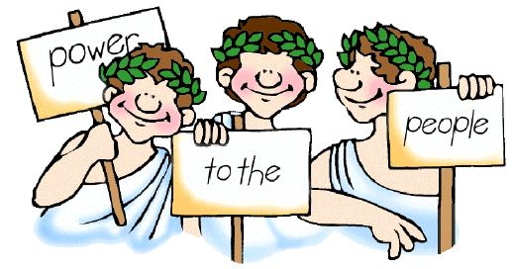
The pressures facing modern policing are many, varied and often conflicting
Localism does not = fairness
Policing must be democratically informed but operationally protected
Notes:
• These examples reveal the multifaceted pressures confronting modern policing—requiring forces to be locally responsive, globally aware, accountable to political structures, and operationally independent, all at once.
• Localism doesn’t automatically lead to fairness. Democratic mechanisms like PCCs must be matched with safeguards that prevent populist distortion.
• Ultimately, policing must be democratically informed—but operationally protected, to ensure that political influence—whether local, national, or international—does no skew policing priorities.

Slide 13
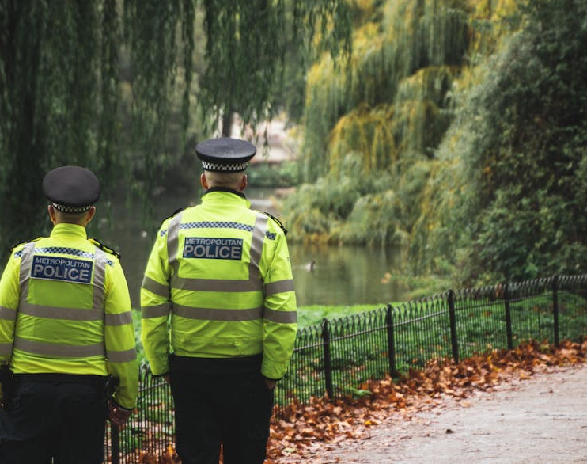
The impact of politics on public engagement and trust in law enforcement

Slide 14
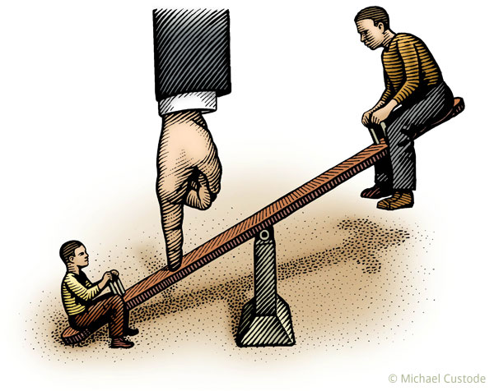

HMICFRS 2024 polarisation of politics can erode perceptions of the police as neutral protectors (HIMCFRS, 2024)
Javid & Morrell (2019)- Confidence is multidimensional, rooted in fairness, integrity, respectful treatment
Media narratives can have a significant impact on trust
Hough (2012) - Legitimacy is built through fair process, not just successful outcomes
legitimacy is a moral relationship, not one solely based on crime statistics
Notes:
• As HMICFRS (HMICFRS, 2024) warns, as politics and society become more polarised, policing can become entangled in perceived bias, eroding perceptions of police impartiality. If the public view police as political actors rather than neutral protectors, it can weaken trust and reduce public cooperation.
• Javid & Morrell (2019) reject the idea of confidence as a single measure, showing it’s shaped by fairness, integrity, respectful treatment, and wider community sentiment.
They highlight indirect factors—like media and local context—that cause confidence to vary across groups, even when crime rates fall. This calls for moving beyond metrics to focus on how policing feels to the public.
• Hough (2012), like Javid and Morrell (2019), argues that political actors often define success through crime statistics, overlooking the importance of fair treatment. In unequal societies, legitimacy hinges on policing that feels just and inclusive—not merely efficient.
• This reframes legitimacy as a moral relationship, challenging performance-based conceptions common in political narratives.

Slide 15
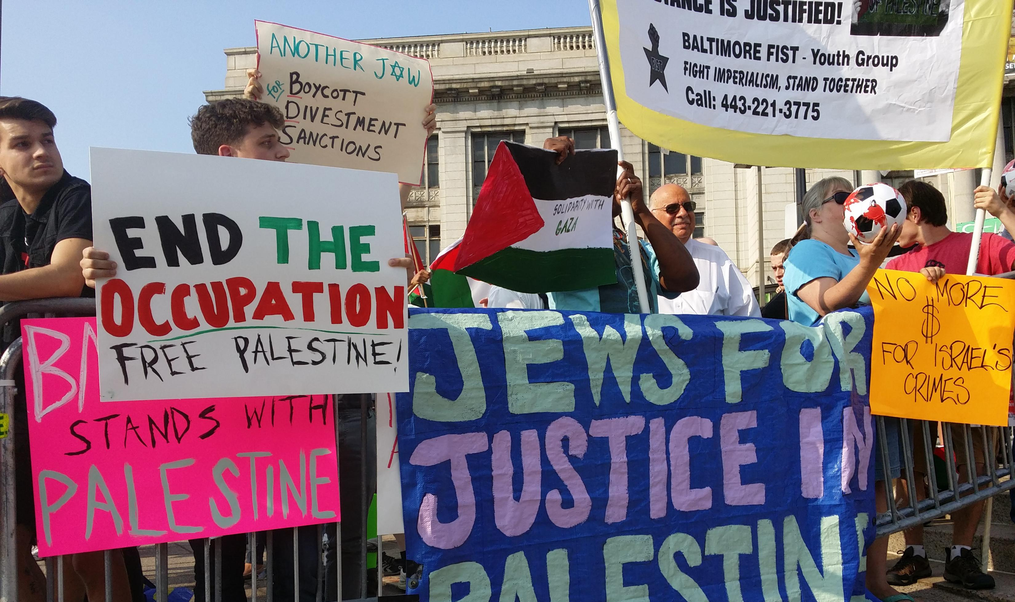
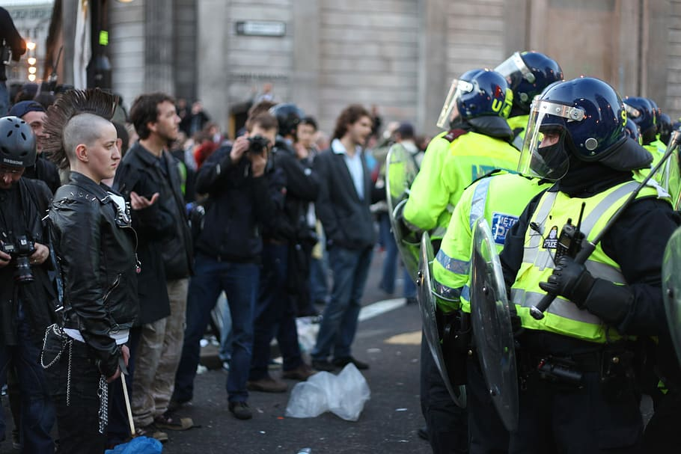
Hanway & Hambly (2023)- poor-quality interactions erode both trust and confidence
O’Reilly (2022)- politically contentious roles—protests, pandemic enforcement—strain legitimacy
Central decisions can politicise policing, alienating communities
Proscription of Palestine Action designation faced domestic and international backlash (United Nations, 2025)(Sky News, 2025) (MSN, 2025)
Parallels with Miners Strike in 1984 (UK Parliament, 2022)
‘Two Tier’ Policing (Brown, 2024)
Operation Brocks- £53 million spent since Oct 3023 (France, 2025)
Notes:
• Hanway & Hambly (2023) make a vital distinction: trust and confidence aren't the same.
• Even when crime falls, poor-quality police encounters—dismissive attitudes and inadequate investigations—can erode both.
• People judge policing through everyday experiences, which often carry more weight than abstract crime stats.
• We often focus on high-profile events, but routine encounters shape public trust more consistently.
• Even one dismissive officer can have lasting impact on community confidence
• O’Reilly (2022) highlights the dangers of politicising policing—especially around politically contentious issues..
• When police enforce controversial or centrally imposed policies, their neutrality is questioned.
• A recent example is Home Secretary Yvette Cooper’s 2025 decision to designate Palestine Action as a terrorist organisation.
• This drew criticism from MPs, NGOs, and the UN, with concerns it could criminalise free expression (United Nations, 2025) (MSN, 2025) (Sky News, 2025).
• Legal experts warn that protest groups could be targeted under national security laws.
• This is not without precedent- in the Hansard enquiry, claims were made that during the 1984 Miners’ Strike, the police were used to suppress and undermine Trade Union activity (UK Parliament, 2022).
• The policing of the Miners Strike raised civil liberties concerns, with tactics such as mass arrests and surveillance being used to suppress dissent (UK Parliament, 2022).
• Another example is the UK-wide rioting in August 2024, following the murder of three children in Southport. The police response revived claims of ‘Two Tier’ policing—alleging tougher treatment of right-wing individuals compared to those on the left. Although denied by government and Police Chiefs, influential figures such as MP’s Robert Jenrick, Nigel Farage, as well as Elon Musk pointed to earlier unrest, including Black Lives Matter and Pro-Palestine protests, suggesting ethnic minorities are policed differently from white Britons (Brown, 2024).
•While there is no evidence to substantiate ‘Two Tier’ policing, its repeated use by high-profile voices highlights the power of such narratives in shaping public perception (Brown, 2024).
• Local forces are often be caught in the middle, tasked with enforcing laws that may be unpopular or divisive, which can damage trust and may take valuable resources away from local priorities.
• An example of this is the cost of Operation Brocks, the Met Police response to the Middle East conflict. According to figures released in early 2025, The Metropolitan Police had spent over £53 million policing pro-Palestine protests in London since October 2023, This includes more than 70,000 officer shifts (France, 2025).
• Commissioner Sir Mark Rowley expressed concern that these resources could have been better used tackling issues like phone theft, violent crime, and burglary.
These figures highlight the strain that internationally influenced demands place on policing, pulling resources away from local priorities.
• While the protests have largely been peaceful, the scale and frequency have prompted calls for more stringent conditions on future demonstrations, again risking framing operational police decisions as having a political agenda (France, 2025).

Slide 16
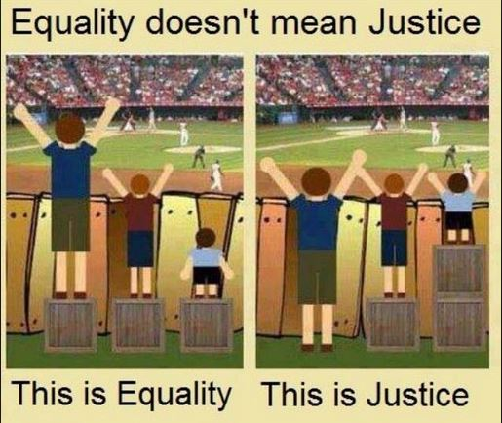

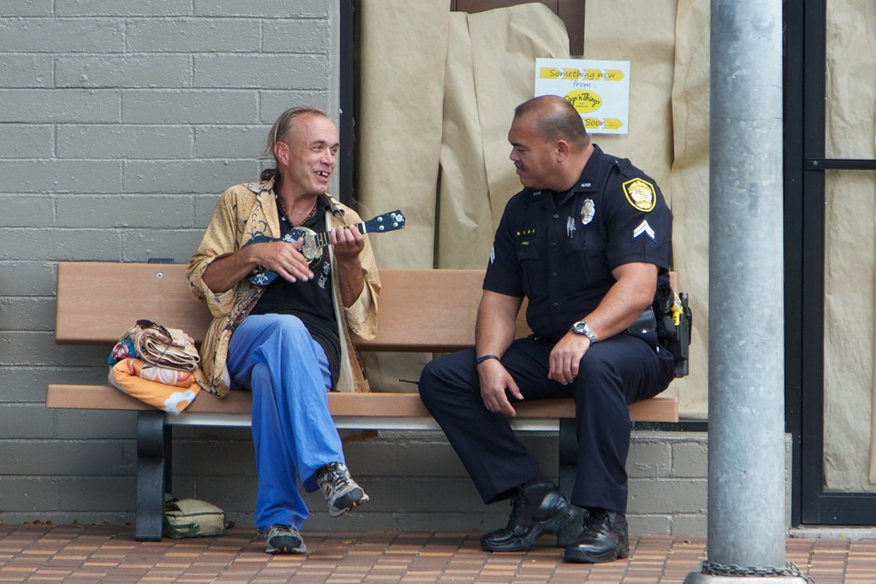
Legitimacy stems from perceived fairness, equal treatment, and community alignment
Public confidence is fluid—not guaranteed by performance alone
Structural safeguards must account for political risk and social diversity
Ultimately, legitimacy isn’t just earned through arrests or visibility, It’s built through trust, fairness, and representation
If the police are to serve all communities effectively, they must guard against becoming instruments of political control
Produced by Bing
Notes:
• These perspectives and examples highlight that legitimacy isn’t just about crime control or visibility.
• It’s socially shaped—by fairness, representation, and shared values.
• A single high-profile decision or event, made locally or centrally, can shift public trust across entire communities.
• To earn trust, policing must be perceived as ethical, inclusive, responsive and without political bias—not simply effective

Slide 17
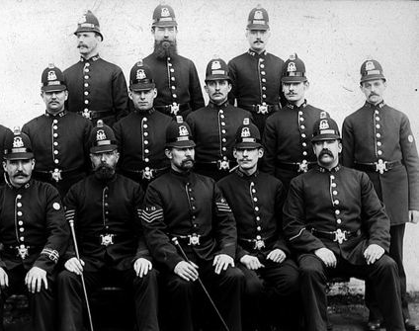
Conclusion
This Photo by Unknown Author is licensed under CC BY-NC-ND

Slide 18


Modern policing operates political and globally influenced world. It is political by its very nature
Legitimacy hinges on fairness and ethical conduct, not just performance
Enforcement of controversial / politically motivated laws can damage trust in the police
The challenge is not to remove politics for policing, but to foster transparency and safeguard neutrality
Notes:
In conclusion, policing today operates in a politically and globally charged environment. Scholars stress that legitimacy depends not just on crime control, but on fairness, ethics, and public engagement. Politically driven decisions risk undermining public trust. The goal isn’t to remove politics from policing, but to manage it responsibly—ensuring influence supports public values, not partisan aims.
Transparency, neutrality, and embedding policing in democratic frameworks are vital to restoring confidence and legitimacy with the public.

Slide 19
Reference List
Barber, M., 2022. Strategic Review of Policing in England and Wales, London: City of London Corporation.
Brain, T., 2013. A Future for Policing in England and Wales. Oxford: Oxford University Press.
Brown, F., 2024. UK riots: What does 'two-tier' policing mean - and does it exist?. [Online] Available at: https://news.sky.com/story/uk-riots-what-does-two-tier-policing-mean-and-does-it-exist-13191977 [Accessed 22 July 2025].
Caless, B. & Owens, J., 2016. Governance: the Police and Crime Commissioner and police accountability . In: Police and Crime Commissioners . Bristol: Bristol University Press, pp. 11-36.
France, A., 2025. Met Police spends over £53 million on pro-Palestine protests ‘instead of fighting crime’ in London. [Online] Available at: https://www.standard.co.uk/news/london/met-police-pro-palestine-protests-cost-london-sadiq-khan-b1209261.html [Accessed 22 July 2025].
Grieve, J., 2024. 25 Years of increased politicisation of UK policing reform. International Journal of Police Science and Management, Volume 26, pp. 460-469.
Hanway, P. & Hambly, O., 2023. Public perceptions of policing: review of research and literature, London: Home Office.
Higgins, A., 2020. Policing and the Public: Understanding Public Priorities, Attitudes and Expectations. The Strategic Review of Policing in England and Wales, London: The Police Foundation .
HMICFRS, 2024. An Inspection into Activism and Impartiality in Policing, London: Home Office.
Home Office, 2010. Policing in the 21st Century: Reconnecting police and the people , London: Crown.
Home Office, 2012. Definition of Policing by Consent. [Online] Available at: https://www.gov.uk/government/publications/policing-by-consent/definition-of-policing-by-consent [Accessed 22 July 2025].
Hough, M., 2012. Researching trust in the police and trust in justice: a UK perspective. Policing and Society, 22(3), pp. 332-345.

Slide 20
House of Commons Public Accounts Committee, 2019. The Impact of Funding and Oversights Arrangements. London, s.n.
Javid, B. & Morrell, K., 2019. Public Confidence in the Police- A Critical Review and Interrogation of Construct Clarity. In: Critical Perspectives on the Management and Organization of Emergency Services. New York: Routledge, pp. 255-269.
Lister, S. & Rowe, M., 2015. Electing Police and Crime Commissioners in England and Wales: Prospecting for the Democratisation of Policing. Policing and Society, An International Journal of Research and Policy., pp. 358-337.
Loader, I., 2014. In Search of Civic Policing: Recasting the 'Peelian' Principles. Criminal Law and Philosophy, Volume 10, pp. 427-440.
London Economic, 2025. Yvette Cooper urged to scrap plans to ban Palestine Action. [Online] Available at: https://www.thelondoneconomic.com/news/yvette-cooper-urged-to-scrap-plans-to-ban-palestine-action-395040/ [Accessed 9 July 2025].
Long, M. & Cullen, S., 2007. Democratic Policing. In: Comparative Policing: The Struggle for Democratization. s.l.: Sage Publications, pp. 277-303.
Magistrates Association, 2024. What the election manifestos say about justice. [Online] Available at: https://www.magistrates-association.org.uk/blog/what-the-election-manifestos-say-about-justice/# [Accessed 22 July 2025].
MSN, 2025. Full list of MPs who voted against banning Palestine Action as terrorist group. [Online] Available at: https://www.msn.com/en-gb/news/other/full-list-of-the-26-mps-who-voted-against-banning-palestine-action-as-terrorist-group/ar-AA1HQstY [Accessed 9 July 2025].
O'Reilly, C., 2022. Doing the right thing? Value Conflicts and Community Policing. Policing and Society: An International Journal of Research and Policy, 33(1), pp. 1-17.
Paxton, B. & Haddon, C., 2024. Institute for Government. [Online] Available at: https://www.instituteforgovernment.org.uk/explainer/manifesto [Accessed 22 July 2025].
R v Metropolitan Police Commissioner, ex-parte Blackburn (1968).

Slide 21
Reiner, R., Bowling, B. & Sheptycki, J., 2019. The Politics of the Police. 5th ed. Oxford: Oxford University Press.
Shannon, I., 2021. Democratic Oversight and Political Direction of Chief Police Officers in England and Wales: Implications for Police Legitimacy. Policing: A Journal of Policy and Practice, 15(2), pp. 912-926.
Sky News, 2025. MPs vote to proscribe Palestine Action as terrorist organisation. [Online] Available at: https://news.sky.com/story/mps-approve-plans-to-proscribe-palestine-action-as-terrorist-organisation-13391291 [Accessed 9 July 2025].
Stenning, P., 2007. The Idea of the Political ‘Independence’ of the Police: International Interpretations and Experiences.. In: Police and Government Relations: Who’s Calling the Shots?. Toronto: University of Toronto Press, pp. 183-256.
UK Parliament, 2022. Miners Strike 1984-85: UK-wide Inquiry. [Online] Available at: https://hansard.parliament.uk/Commons/2022-06-29/debates/232B075F-FAC9-4C77-A310-8E601A0A9731 [Accessed 9 July 2025].
United Nations, 2025. UN experts urge United Kingdom not to misuse terrorism laws against protest group Palestine Action. [Online] Available at: https://www.ohchr.org/en/press-releases/2025/07/un-experts-urge-united-kingdom-not-misuse-terrorism-laws-against-protest [Accessed 9 July 2025].
Worrall, J., 2014. The Politics of Policing. In: The Oxford Handbook of Policing. Oxford: Oxford University Press, pp. 49-97.

Slide 22
https://www.wallpaperflare.com/photo-of-body-of-water-and-city-at-night-lights-landscape-seattle-wallpaper-hbhuv
https://www.independent.co.uk/news/uk/home-news/met-police-racism-black-asian-b2204229.html
https://media.istockphoto.com/id/466303356/photo/chester-police-station.jpg?s=1024x1024&w=is&k=20&c=E9wdZwaBidjluO133OjXb6Ax3o0-2zPDd4L6inYSFdY=
https://www.flickr.com/photos/31363949@N02/7708912458
https://carolinapublicpress.org/70098/court-north-carolina-elections-appointment-power-constitution/
https://www.flickr.com/photos/uk_parliament/48797925786/
http://fity.club/lists/suggestions/newspapers-uk/
https://pixabay.com/en/braid-rattan-wicker-basket-woven-62779/
https://buzz.bournemouth.ac.uk/2020/01/appeal-for-witnesses-following-attempted-thefts-in-bournemouth/
https://stateofwales.com/2021/04/police-elections-2021-what-does-a-police-crime-commissioner-do/
https://openclipart.org/detail/170352/extended-community-circle-by-josephluis-170352
https://www.wallpaperflare.com/search?wallpaper=investigation
https://www.flickr.com/photos/number10gov/4581073867
https://www.wallpaperflare.com/map-wold-map-technology-world-scaner-digital-time-zone-wallpaper-tghdw/download/4096x2304
http://learn.e-limu.org/topic/view/?c=46
https://www.pexels.com/photo/2-securities-walking-beside-dried-leaves-3075600/
https://www.fairpayzone.com/2018/06/cool-hand-zuck-what-we-have-here-is.html
https://www.publicdomainpictures.net/en/view-image.php?image=31992&&picture=ill-put-all-my-trust-in-you
https://pxhere.com/es/photo/774767
https://www.piqsels.com/en/public-domain-photo-sdzyj
https://learn.e-limu.org/topic/view/?t=248&&c=46
https://www.flickr.com/photos/mikedunford/6855358834/
https://noloseytu.blogspot.com/2017/05/
https://www.wallpaperflare.com/illustration-of-black-and-gray-map-world-map-dark-continents-wallpaper-hgwdx/download/3840x2160
https://pxhere.com/zh/photo/1532601

