Slide 1

Making a PowerPoint presentation

Slide 2
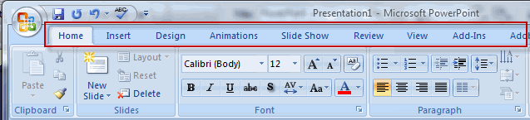
The tool bar
Home – similar functions to Word
Insert – pictures, film, hyperlink, tables, charts
Design – themes of the slides, background
Animations – moving objects in the slide
Slide show – see the show
Review
View
Add ins

Slide 3
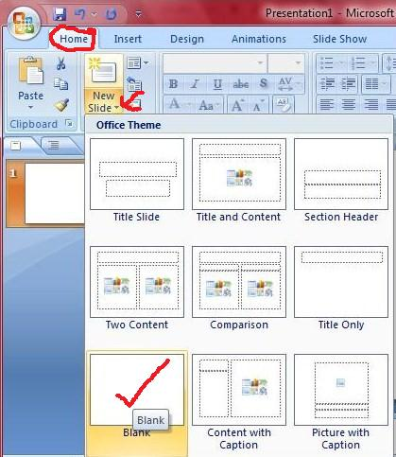
New slide and slide types

Slide 4
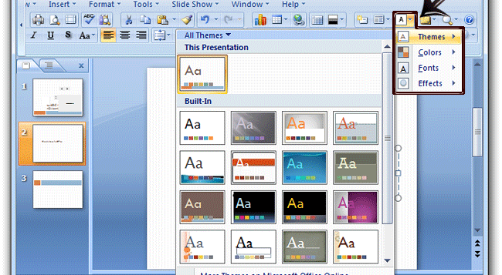
Choosing a theme

Slide 5
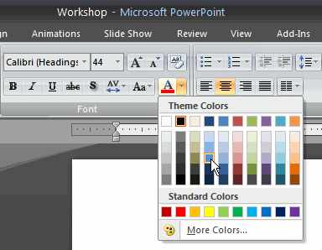
Colours and fonts
Choose contrasting colours
Choose a clear bold font

Slide 6
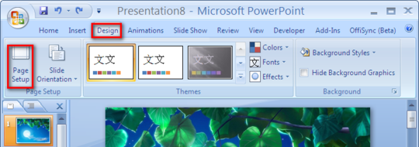
Backgrounds
Go to design, background styles
Choose style or insert a picture
Widen picture in page set up, if necessary

Slide 7
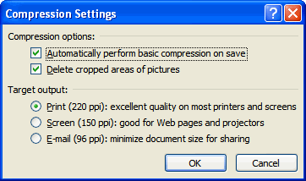

Inserting pictures
Pictures from
  your file
  From clip art
  from online
Adjusting your pictures

Slide 8
Inserting more info
Header and footer
Page number
Date
Time
Title or author
Text box
Hyperlink

Slide 9
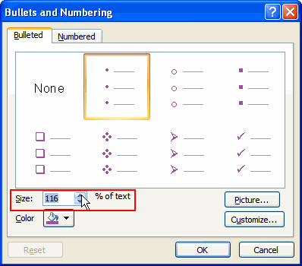

Lists
Bullet points
  Customize bullet points
Number lists
  Customize number list

Slide 10
Animations
4 types
  Entrance – how something arrives on the slide
  Emphasis – draws attention to something
  Exit – how something leaves the slide
  Motion – determines a path of movement in the slide
Animations can be customised

Slide 11
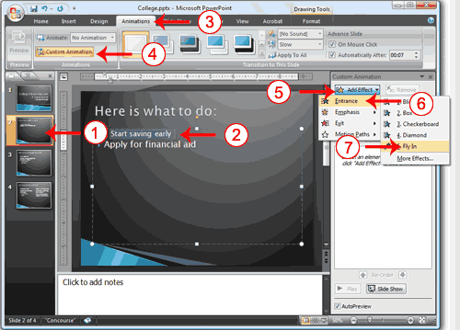
To animate
Highlight part of the slide
that you want to animate
Choose ‘Animation’ tab
Choose ‘Custom animation’ in tool bar
Then ‘Add effect’ appears
  Choose which of the 4 types of animation you want.
  Then select what effect from submenu
Select ‘AutoPreview’ to see the animation

Slide 12
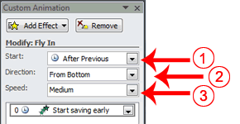
To adapt your effect

Slide 13

Transitions
Alters how the slides appears in the show
Choose ‘Animations’
Select type of transition you want
Then set timings on the toolbar
  Select ‘on click’ or ‘mouse over’
  Timing in seconds
  Then ‘apply to all’ or just that slide

Slide 14
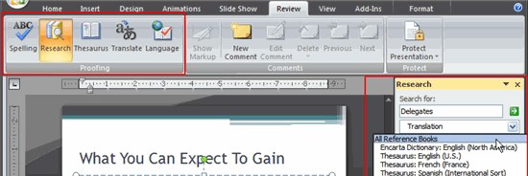
Review tab
Spelling, thesaurus etc

Slide 15
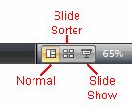
Viewing your slides
Normal – with or without side bar
Sorter – view of all at the same time
Slide show – as a show

Slide 16
Save as…
Save as PP
Save as ‘show’
Save as pictures – Jpeg (add in)

