Slide 1
Soapbox car project
Lottie Hughson, Carys Thomas, Fern Makey, Ev Cadby, Dylan Edge
2502248, 2512785, 2501474, 2501643, 2501613

Slide 2
Brief
Tasks given
Construct a soap box car
1500 word report
10 minute presentation
Aims
Work as a team to complete task
Construct a soap box car that met all regulations and kept in budget
Relevance
Real world scenarios
Budget - £500
Rules to follow and deadlines to meet
Size limits –
Max length – 2500mm
Max width – 1500mm

Slide 3
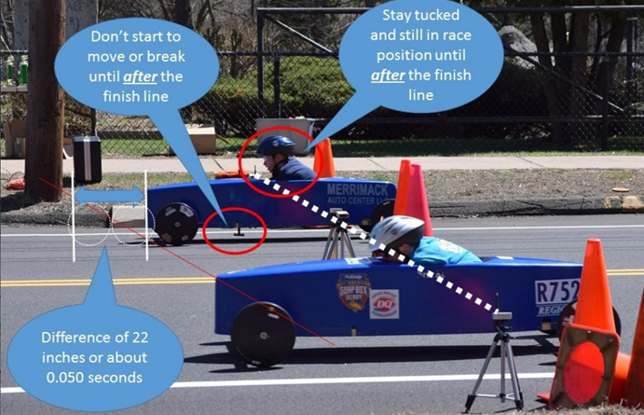
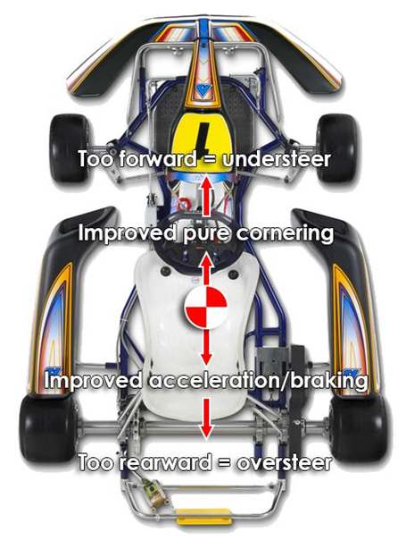
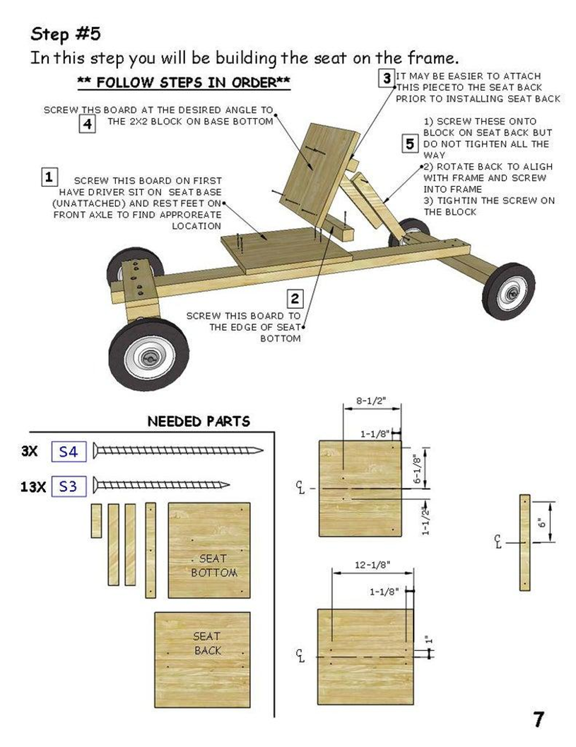
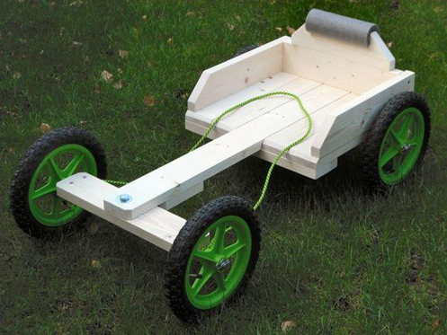
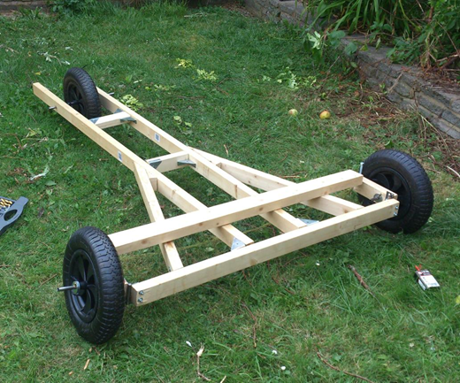

Slide 4
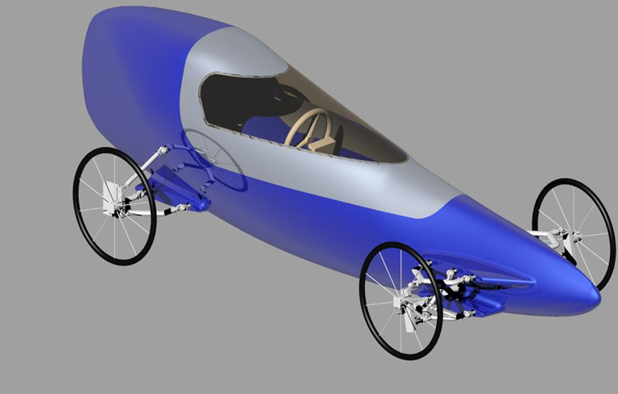
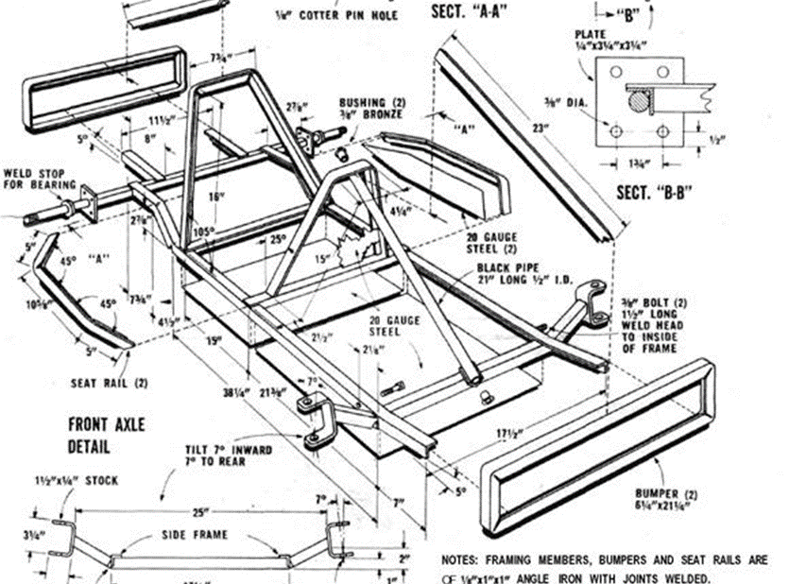
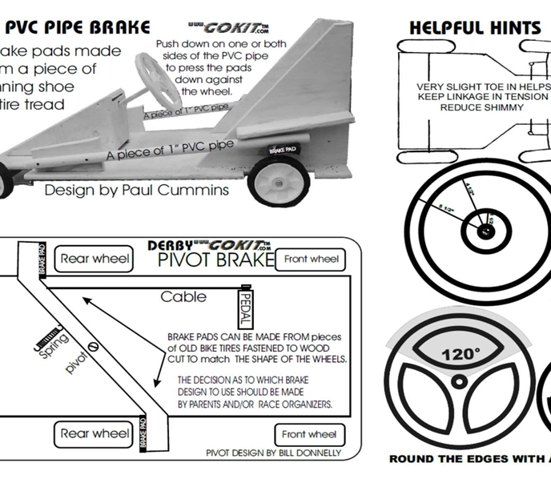
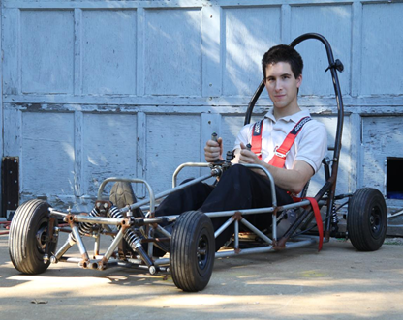
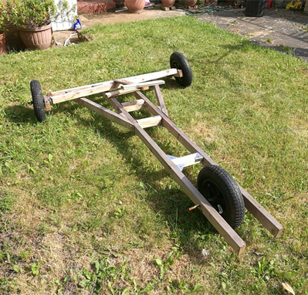
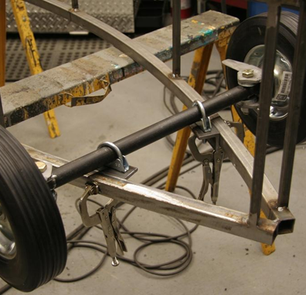

Slide 5
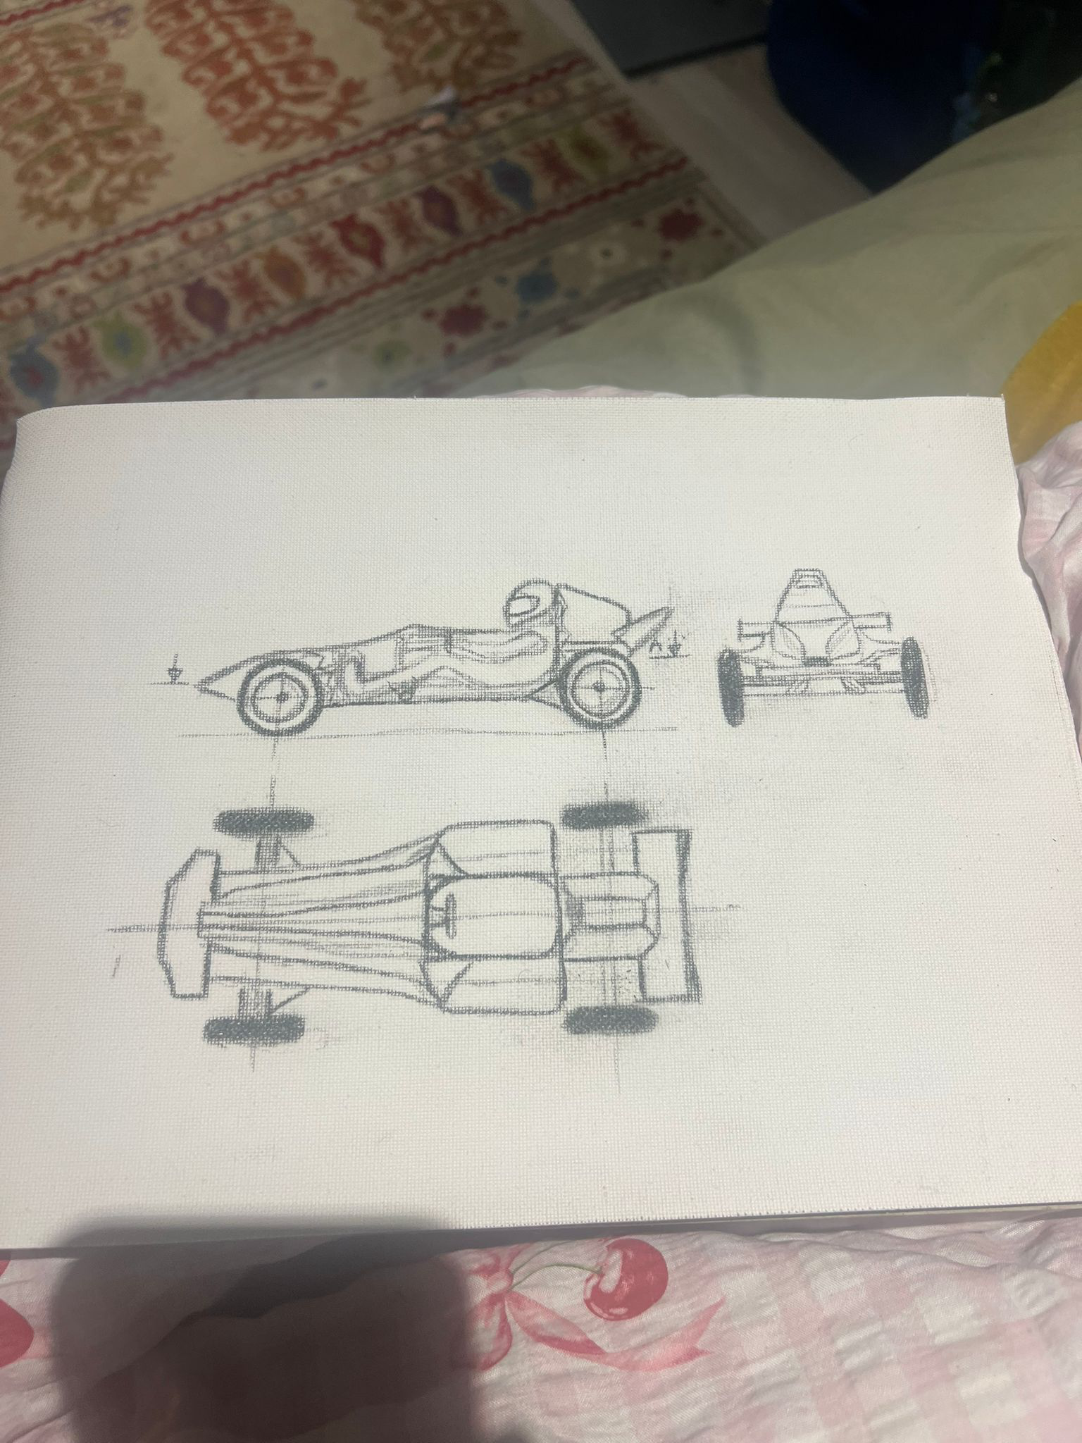
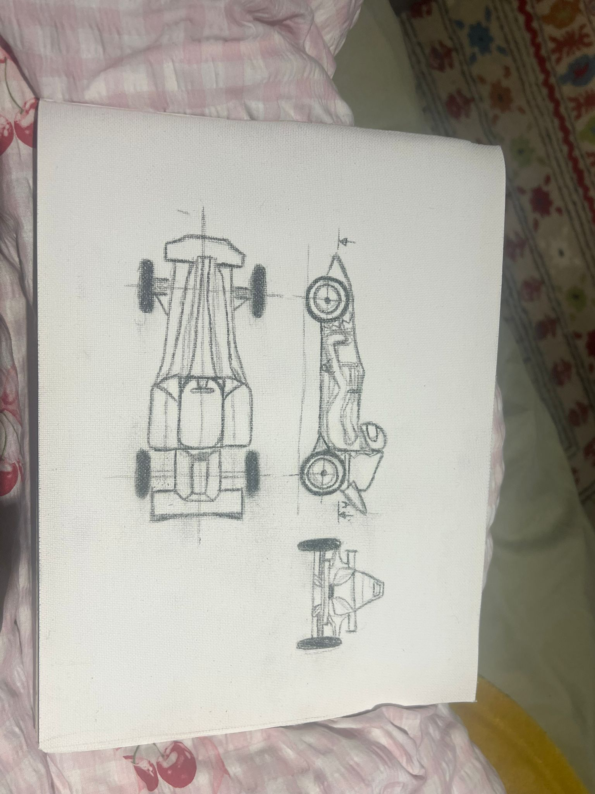
Drawings

Slide 6
Chassis
Wooden frame
Budget - £50-£80
Pros
Cons
Tin frame
Budget - £60-£200
Pros
Cons

Slide 7
Wheels
Wheelbarrow wheels
Budget - £15
Pros
Cons
BMX wheels
Budget - £97.65
Pros
Cons
Go kart wheels
Budget – £218
Pros
cons

Slide 8
Steering Systems
Rope steering
Budget - £21.99
Pros
Cons
Pivot front axle –
Budget - £85.50
Pros
Cons
Full linkage
Budget - £96
Pros
cons

Slide 9
Braking systems
Friction pad on tyre
Budget - £10-£30
Pros
Cons
Bicycle brake
Budget - £20-£50
Pros
Cons
Disc brake
Budget - £30-£80
Pros
cons

Slide 10
Improvements
What worked well?
Teamwork
Deadlines
Future project, different budget and rules

Slide 11
Conclusion
Aims of project
Final design
Cost analysis
Future work

