Slide 1
Introducing Leadership – Case Study
Sir Alex Ferguson

Slide 2
Today’s Objectives
To consider the leadership role of Sir Alex Ferguson
Use Adair’s ‘Action centred leadership’ model to evaluate Sir Alex Ferguson and his leadership of Manchester United Football Club

Slide 3
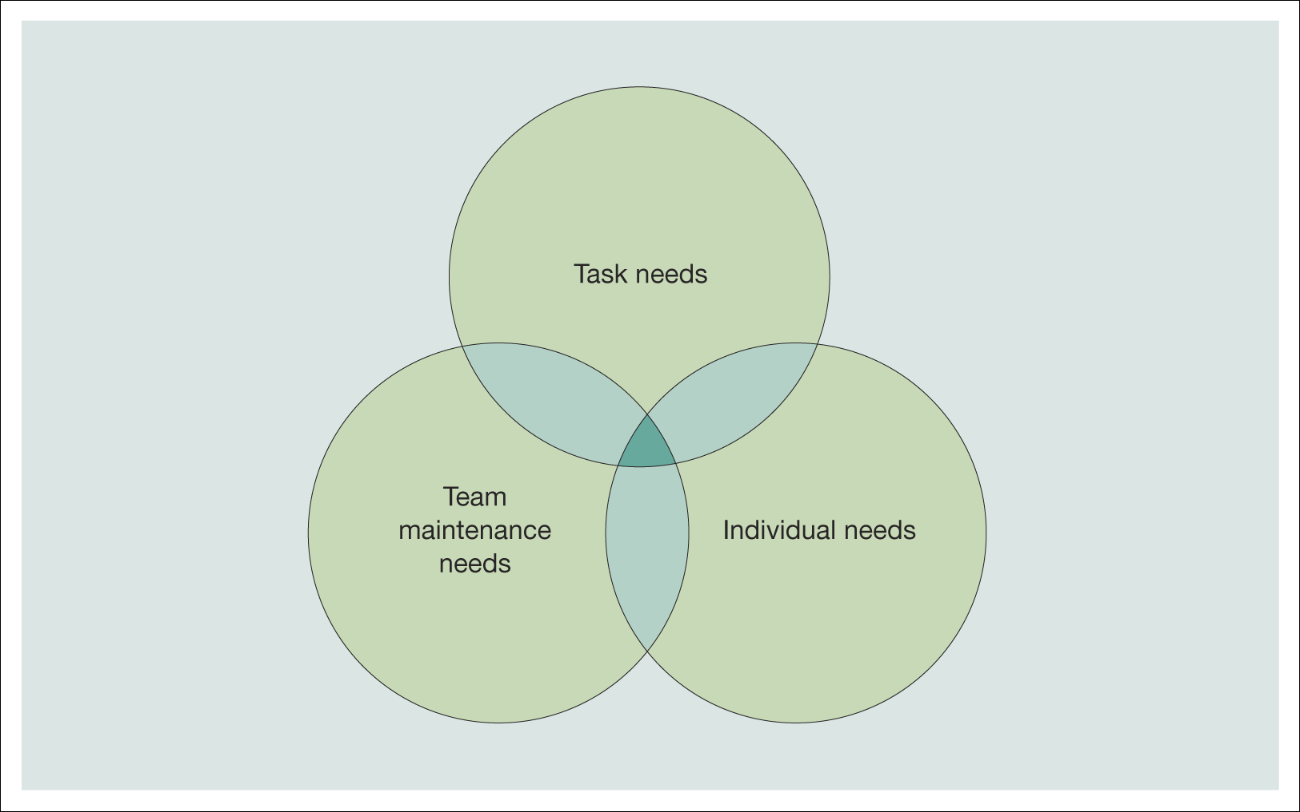
2. The Functional approach:
Action-centred leadership - Adair
Figure 10.2 Interaction of needs within the group
Source: Adair, J., Action-Centred Leadership, Gower Press (1979), p. 10. Reproduced with permission from Gower Publishing Ltd.
Notes:
The second approach doesn’t look at the leader’s personality but at the leadership functions, hence the functional approach.
There’s an element of leadership in every group - here we examine how the leader’s behaviour affects or is affected by followers. Examine the content of leadership. By making leaders better at those functions which will impact upon the group, we can make better leaders and improve group performance. Leaders can therefore be trained, skills and abilities learned, honed and perfected.
You don’t have to be a manager or the boss to be a leader

Slide 4
2. Action-centred leadership: task functions
Achieving the objectives of the work group
Defining group tasks
Planning the work
Allocation of resources
Organisation of duties and responsibilities
Controlling quality and checking performance
Reviewing progress
Notes:
The next approach is based on guru John Adair – this examines what leaders actually do – how effective they are depends on their ability to juggle three competing needs:
The needs of the task
Need to maintain the team
Individual needs of group members
Here are the task needs

Slide 5
2. Action-centred leadership: team functions
Maintaining morale and building team spirit
The cohesiveness of the group as a working unit
Setting standards and maintaining discipline
Systems of communication within the group
Training the group
Appointment of sub-leaders
Notes:
The team needs

Slide 6
2. Action-centred leadership: individual functions
Meeting the needs of the individual members
of the group
Attending to personal problems
Giving praise and status
Reconciling conflicts between group needs
and needs of the individual
Training the individual
Notes:
The needs of the individual team members

Slide 7
https://www.youtube.com/watch?v=i9CwQtBQo74

