Slide 1

Pilates & Nutrition Studio for Women’s
Student name: Karina Pozdniakova
Student ID: 2317086
Module Code: LCBB5013
Lecturer: Toyin Adisa

Slide 2
Introduction
Elevate Studios is boutique Pilates and wellness business based in Peterborough
The Studio focused on Women’s health, fitness and lifestyle
It combines small group Pilates training with healthy food options
The aim is to create a convenient and supportive wellness environment (NHS, 2023, UKActive, 2025).

Slide 3
Business Idea
Women's only Pilates Studio In Peterborough
Small Group reformer and mat-based classes
Calm and supportive atmosphere
Focusing on improving physical and mental health

Slide 4
Services Offered
Reformer Pilates classes in small groups
Mat based Pilates sessions
One to one personalised training sessions
Post work out healthy meals and drinks
Smoothies, protein shakes and balanced nutrition meals

Slide 5

Unique Selling Point
Unique combination of Pilates and nutrition services
Saves time for busy customers
Supports recovery and overall wellbeing
Personalised and high-quality experience ( British Nutrition Foundation,2024).

Slide 6
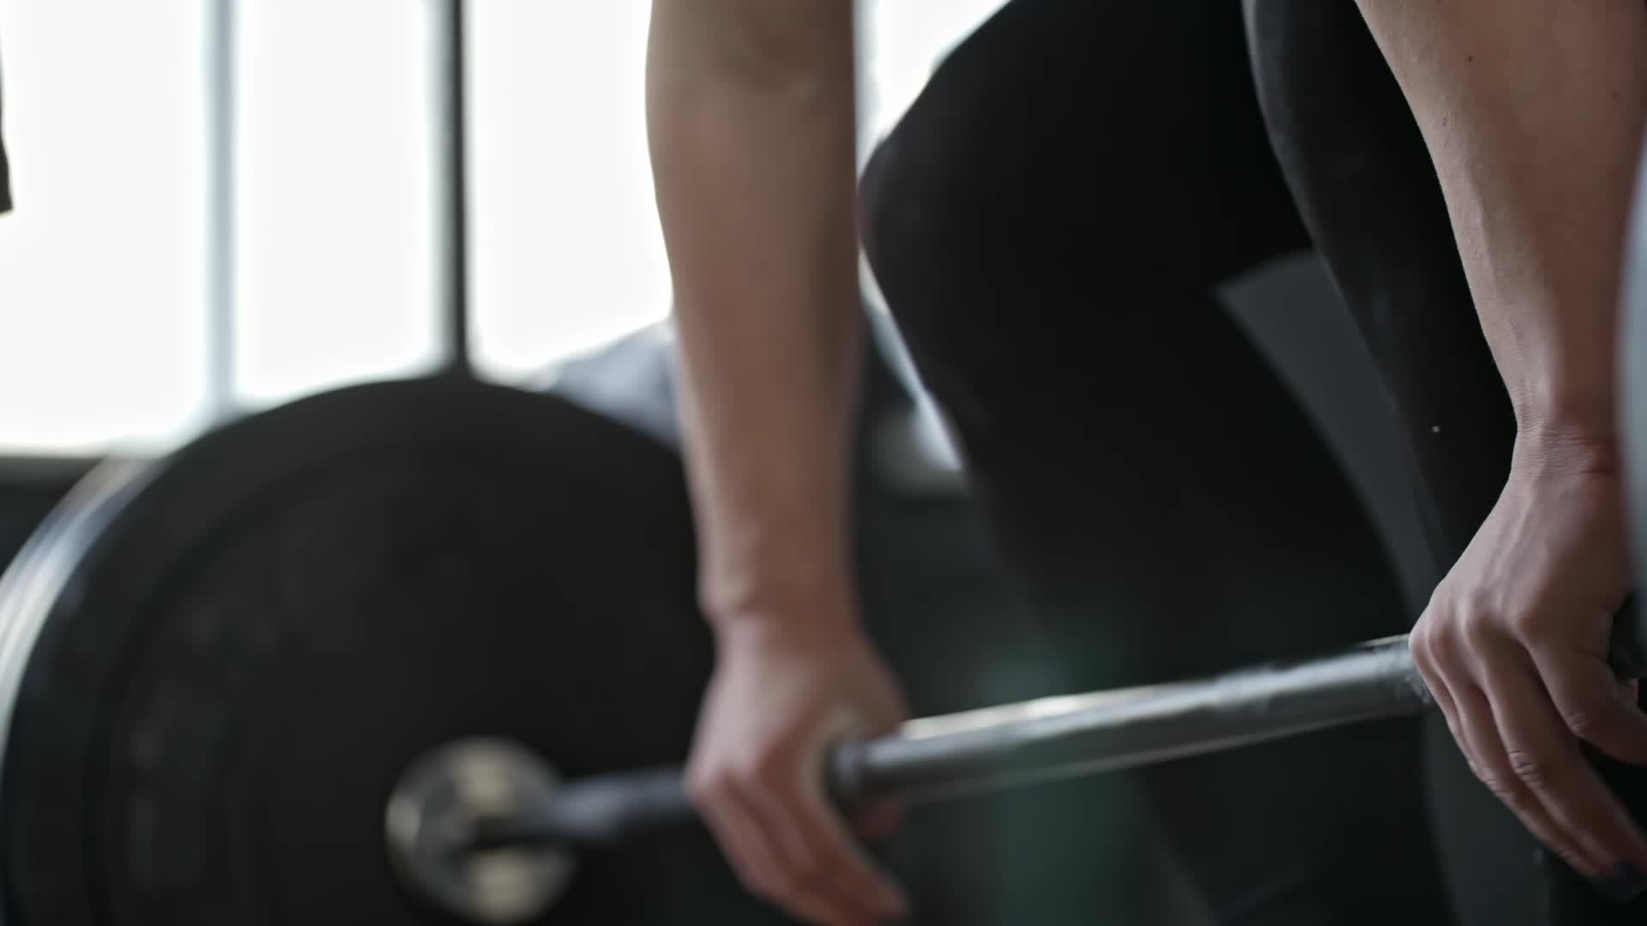
Target Market
Women's Age 25-45 living in Peterborough
Middle income professionals
Busy lifestyle with limited time
Interested in fitness, health and wellbeing (Sport England, 2022).

Slide 7

Customer Needs
Convenient services in one location
Personal attention and small classes
Comfortable and supportive environment
Combination of fitness and healthy lifestyle

Slide 8

Market Opportunity
Growing demand for fitness and wellness services in the UK
Increasing popularity of boutique fitness studios
More people focusing on healthy lifestyles and wellbeing
Opportunity to target women looking for personalised services (IBISworld,2024, UKActive, 2025).

Slide 9
Pestel Analysis
Social: increasing focus on health, fitness and wellbeing
Economical: customers are more price sensitive due cost of living
Technological: use of social media and online booking systems
Legal: health, safety and food hygiene regulations ( Johnson el al., 2017).

Slide 10

Swot Analysis
Strengths: Unique concept, clear target market
Weaknesses: New business, high start up coast
Opportunities: Growing wellness trend, social media marketing
Threats: Strong competition in the foulness industry (Kotler and Keller, 2016).

Slide 11
Marketing Strategy
Focus on women's only positioning
Strong and consistent brand identity
Social media marketing like Instagram and TikTok
Referral programmes and customer loyalty
(Armstrong and Kotler, 2020).

Slide 12
Marketing Mix 4Ps
Product: Pilates classes and healthy meals
Price: Affordable and flexible pricing
Place: Accessible location in Peterborough
Promotion: Digital marketing and influencer content

Slide 13
Operations & Teams
Qualified Pilates instructor
Staff member for food preparation (Longenecker, et al., 2017).
Ovner/Manager - Responsible for operations
Receptionist for customer service

Slide 14

Coast
Rent: Approximately £1,500 per month (Zoopla, 2026)
Reformer machines: Approximately £2,500 per machine (x6)
Total equipment cost: Approximately £15,000
Instructor wages: Approximately £20 per hour (HFE, 2026; Indeed, 2026)
Receptionist wages: Approximately £11 per hour ( PayScale, 2026).
Marketing costs: Approximately £300 per month
Food supplies: Approximately £800–£1,000 per month

Slide 15
Revenue
Average class price: approximately £12 per person
Around 8 clients per class = £96 per session
4–5 classes per day = £380–£480 daily income
Monthly memberships for stable revenue
Additional income from food and drinks (Burns, 2016).

Slide 16
Risks
High competition from gyms and fitness studios
High start-up and operating costs
Uncertainty in customer demand
Economic factors affecting customer spending

Slide 17
Conclusion
Strong and realistic business concept
Clear target audience and market demand
Unique combination of Pilates and nutrition
High potential for growth and long-term success

Slide 18
References
Armstrong, G. and Kotler, P. (2020) Principles of Marketing. 17th ed. Harlow: Pearson.
Baines, P., Fill, C. and Page, K. (2013) Essentials of Marketing. Oxford: Oxford University Press.
British Nutrition Foundation (2024). Sport and Exercise | British Nutritional Foundation. Available at: https://www.nutrition.org.uk/creating-a-healthy-diet/sport-and-exercise/ ( Accessed 12/04/2026).
Burns, P. (2016) Entrepreneurship and Small Business. 4th ed. London: Palgrave.
Food Standards Agency (2024). Food Standards Agency. Available at: https://www.food.gov.uk/ (Accessed 11/04/2025).
Glassdoor (2026). Reformer Pilates instructor salary in the UK. Available at: https://www.glassdoor.co.uk/Salaries/reformer-pilates-instructor-salary-SRCH_KO0,27.htm (Accessed 15/04/2026)
Gov.uk. (2022). How the population changed in Peterborough, Census 2021 - ONS. Available at: https://www.nhs.uk/live-well/exercise/exercise-health-benefits/ (Accessed 12/04/2026).
Health and Fitness Education (2023) Pay and Salary of Pilates teachers - How Much Pilates Teachers Get Paid? Available at: https://www.hfe.co.uk/pilates/articles/pay-salary-of-pilates-teachers/ (Accessed 11/09/2026).
IBISWorld (2026). Pilates & Yoga Studios in the UK - Market Research Report (2016-2031).Available at: https://www.ibisworld.com/united-kingdom/industry/pilates-yoga-studios/6091/#ProductsAndMarkets (Accessed 10/04/2026).

Slide 19
Indeed (2026)Pilates instructor Salary in the UK. Availible at:https://uk.indeed.com/career/pilates-instructor/salaries (Accessed 11/04/2026).
Johnson, G., Scholes, K. and Whittington, R. (2017) Exploring Strategy: Text and Cases. 11th ed. Harlow: Pearson.
Kotler, P. and Keller, K. (2016) Marketing Management. 15th ed. Harlow: Pearson.
Longenecker, J., Petty, J., Palich, L. and Hoy, F. (2017) Small Business Management. 18th ed. Boston: Cengage Learning.
Marcousé, I. (2014) Business Studies. 4th ed. London: Hodder Education.
NHS (2024). Benefits of Exercise. Available at: https://www.nhs.uk/live-well/exercise/exercise-health-benefits/# (Accessed 15/04/2026).
Sport England (2025). Record numbers playing sport and taking part in physical activity | Sport England. Available at: https://www.sportengland.org/news-and-inspiration/record-numbers-playing-sport-and-taking-part-physical-activity (Accessed 15/04/2026).
Sport England (2025). This Girl Can highlights barriers facing women on lower incomes | Sport England. Available at: https://www.sportengland.org/news-and-inspiration/this-girl-can-highlights-barriers-facing-women-lower-incomes (Accessed 15/04/2026).
ukactive (2025). The UK Health & Fitness Market Report 2025: a game-changer for thesector. Available at: https://ukactive.com/news/the-uk-health-fitness-market-report-2025-a-game-changer-for-the-sector/ (Accessed 12/04/2026).
Zoopla (2026). Commercial property to rent in Peterborough. Available at: https://www.zoopla.co.uk/to-rent/commercial/property/peterborough/ (Accessed 14/04/2026).

