Slide 1
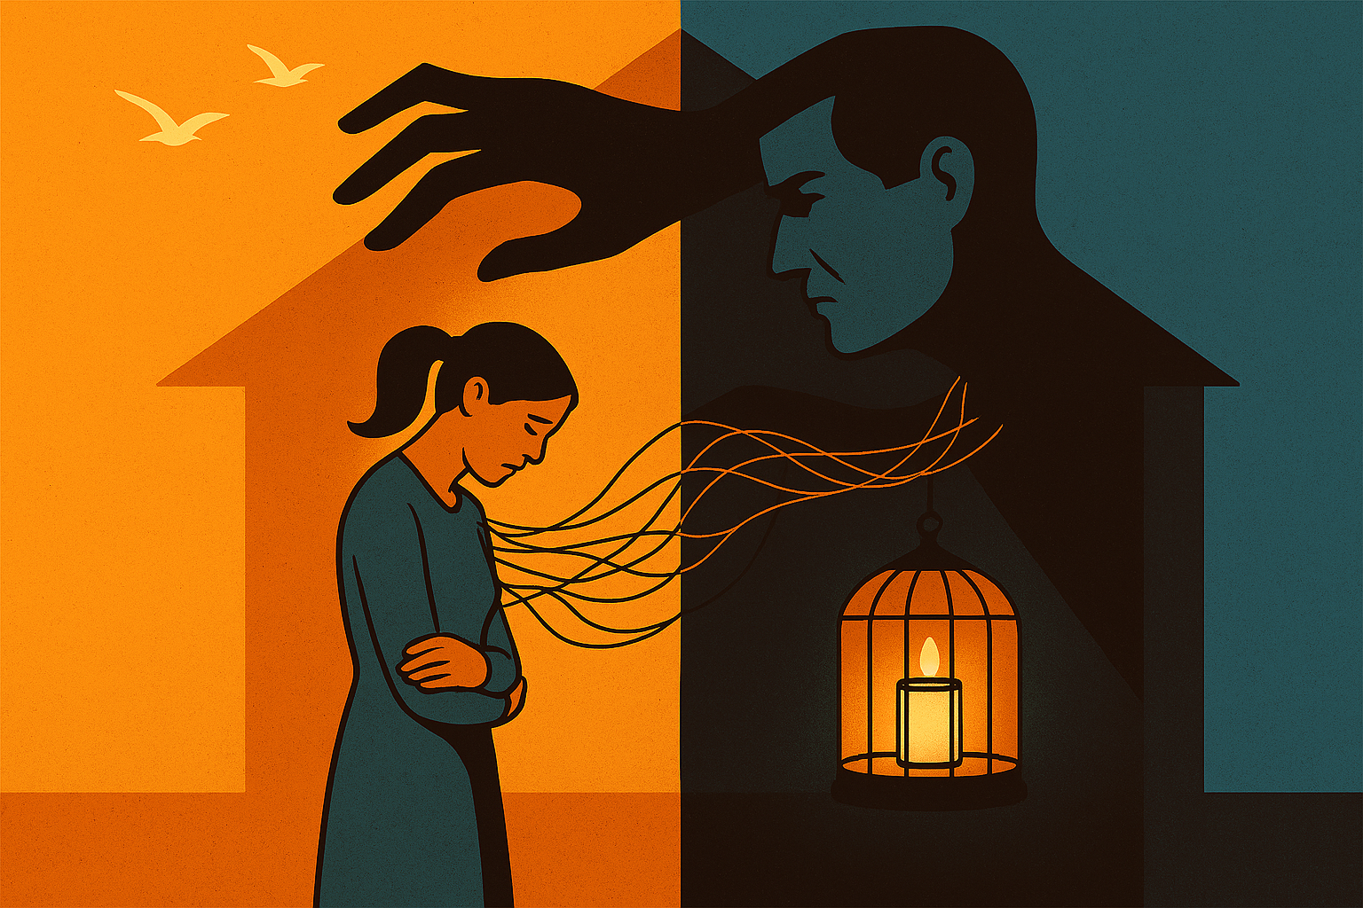
Domestic Abuse and Coercive control
By Zita Draper

Slide 2
Content
Aims and learning Objectives
What is domestic abuse?
What is coercive control?
Offences
Victims
Activity
Summary
Thank you, any questions?

Slide 3
Aims and Learning Objectives
The aim of today’s session is to discuss the offence of domestic abuse and the offence of coercive control.
By the end of today’s session students should be able to demonstrate their understanding of the offence of domestic abuse and coercive control and what they include.

Slide 4
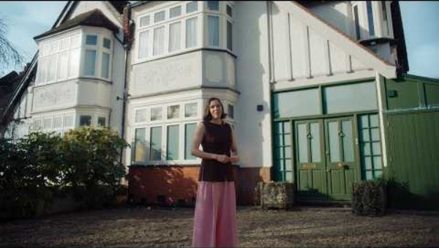
What is domestic abuse?
Notes:
Domestic Abuse: Caught on Camera - Alexander Street, a ProQuest Company

Slide 5

Domestic Abuse
Criminal offence
Also known as domestic violence
Can be physical or phycological or both
Can be on one occasion or constant

Slide 6

Continued
Anyone can be a victim of domestic abuse.
The victim is not to blame.
The Statistics?

Slide 7
The Statistics
1 Woman every 5 days is killed by an abusive partner or an ex-partner.
Every 30 seconds the police take a call regarding domestic abuse.
In 2025 – 27.9% of domestic abuse cases included male victims.

Slide 8
Types of domestic abuse
Psychological
Economic abuse
Technology abuse
Coercive control
Physical violence
Sexual Abuse

Slide 9
Activity
Each of you will be asked this question;
‘’ In relationships-friendships, family or romantic – what small behaviours could signal something isn’t quite right?’’
I would like you to share one behaviour.
I will then write these down on three pieces of paper.

Slide 10
Activity
Now I will place the three piece of paper on the table with three more blank pieces of paper.
As a group choose one of the cards to start your scenario.
Then, place the remaining cards in order that feels like a chain of moments leading to discomfort to increasing tension to a clear pattern of control.

Slide 11

Activity
I will ask you the following questions during the task:
1. Why did you choose that card first?
2. At what point would you say something feels unhealthy?
3. Could different people interpret these moments differently?

Slide 12
Now………
I would like you to choose a role:
Person A – The person in the relationship
Person B – A friend who is observing from the outside
Person C – A support professional

Slide 13
Continued
For each stage on the chain (you can focus on 2–3 key cards), ask:
Questions for each role
Person A:
“What might this person notice here? What might they tell themselves?”
Person B:
“What might a friend see from the outside? When would you check in?”
Person C:
“What advice or support might a professional offer at this stage?”

Slide 14
Finally……..
Final questions
“Which point on this chain feels like the earliest safe moment to reach out?”
“What kind of support options exist?”
“How can friends and community members safely help someone experiencing harm?”

Slide 15
The signs
Jealousy
Possessiveness
Constantly putting down their partner
Pressuring their partner
Uses anger or/and intimidation to control
Controls access to technology
Walking on eggshells

Slide 16
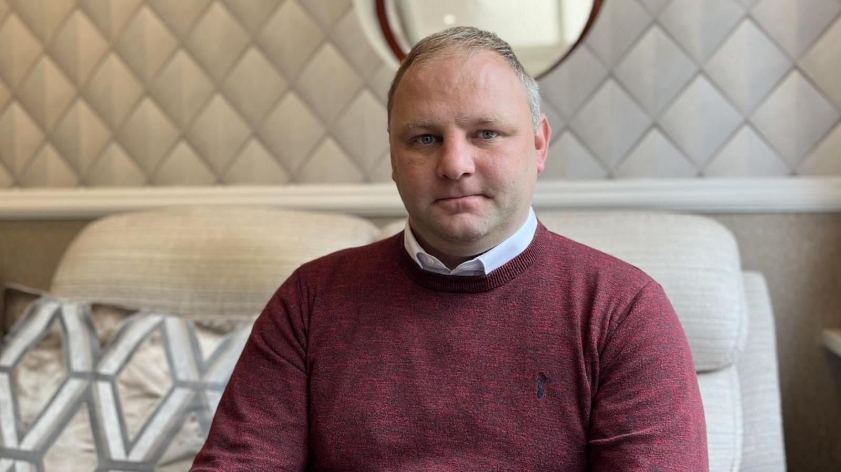
Case example: Survivor- Gareth Jones

Slide 17

Case example – Survivor - Katie

Slide 18


Slide 19
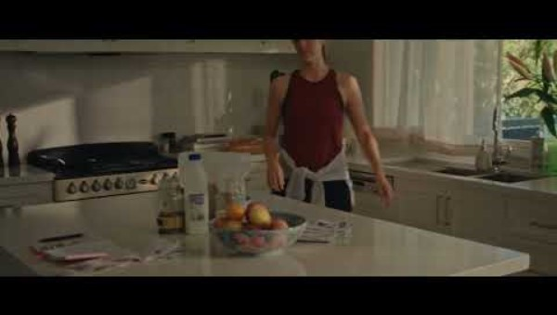
Finally……..

Slide 20
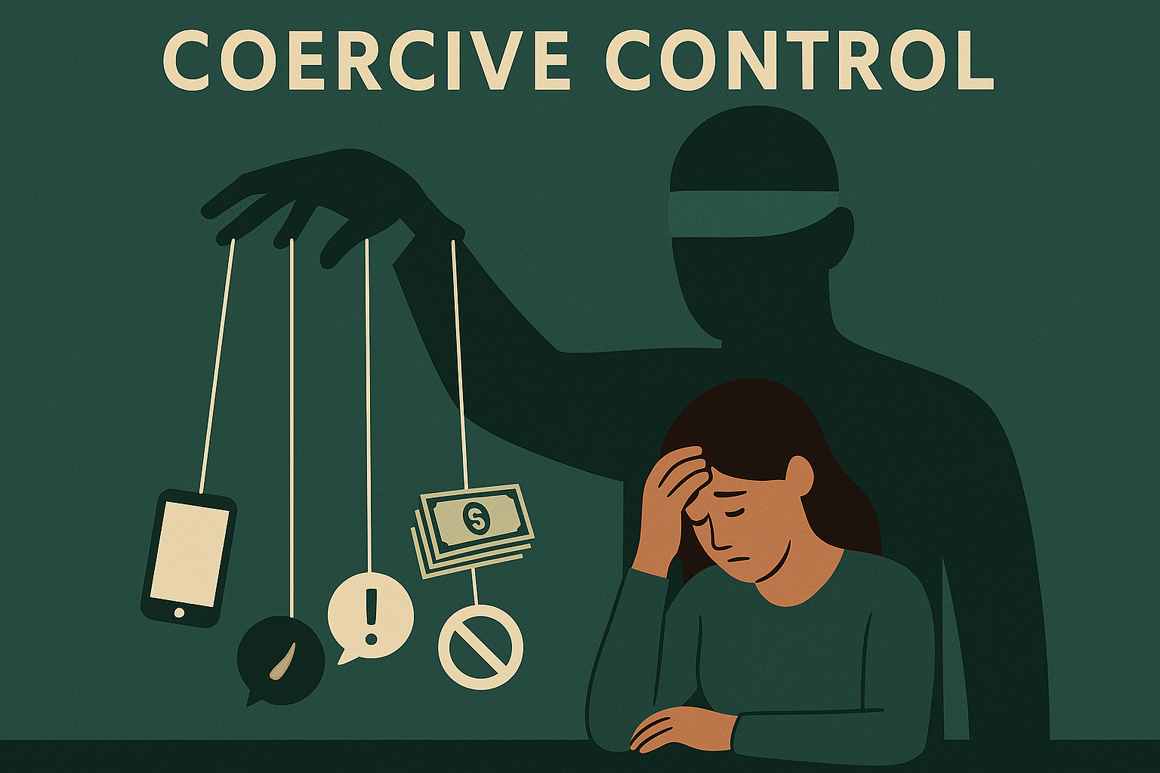

Slide 21
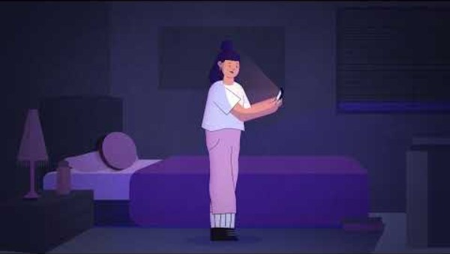
Coercive Control

Slide 22
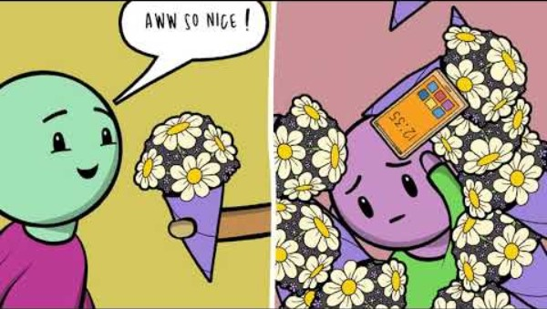
Continued

Slide 23


Slide 24
Domestic abuse
There is no single law that criminalises domestic abuse.
Domestic Abuse Act – gives a definition of domestic abuse – under S.1
Age does not matter

Slide 25
Continued
S.2 of the act is also key here as it deals with other people.
This encompasses people like ex partners or family members.
Definition of relative is included also – definition is the same as that found under S.63 of the Family Law Act 1996
Notes:
No need for cohabiting

Slide 26
Lastly,
S.3 – discusses children and domestic abuse

Slide 27
Other legislation
Coercive control – S.76 of the Serious Crime Act 2015.
Strangulation – S.75A of the Serious Crime Act 2015
Threat of disclosing sexual photographs or films

Slide 28
Strangulation
Introduced under S.70 of the Domestic Abuse Act 2021.
Schedule 2, paragraph 4 is also relevant here.
S.75 of the Domestic Abuse Act 2021.

Slide 29
Possible outcomes

Slide 30

Question?
Is domestic abuse a gendered crime? Justify your answer with evidence.

Slide 31
Activity
Create a 2-3 minute presentation – where you need to choose 2 words that represent a healthy relationship.
You need to discuss –
1. What those words are?
2. Why did you choose them?
3. How do these qualities show up in a healthy relationship?
4. How would someone feel in a relationship where these qualities are present?

Slide 32
Summary
Anyone can be a victim of domestic abuse.
It can include a number of types of abuse.
Is it a gender based crime?

Slide 33
Thank you
Any Questions?

