Slide 1

The Enquiring Mind: Creative Approaches
Y MEDDWL YMHOLGAR: DULLIAU CREADIGOL
Cyflwyniad i’r modiwl Introduction to the module
Notes:
Ground rules

Slide 2
Nodau ac amcanion y sesiwn
Session Aims and Objectives
Nodau:
Cyflwyno crynodeb o strwythur a chynnwys y modiwl
Cyflwyno'r cysyniad o greadigrwydd mewn addysg
Amcanion:
Diffinio ystyr creadigrwydd mewn perthynas ag addysg
Cydnabod pwrpas dulliau creadigol mewn addysg
Dechrau datblygu dealltwriaeth o gysyniadau ymholi gwyddonol a chreadigol mewn addysg
Aims:
To present a summary of module structure and content
To introduce the concept of creativity in education
Objectives:
To define the meaning of creativity in relation to education
To recognise the purpose of creative approaches in education
To begin to develop an understanding of the concepts of scientific and creative enquiry in education
Notes:
Slide one: Overview of aims and objectives.
Module structure will be covered along with an introduction to the concept of creativity in education.

Slide 3

Asesiad / Assessment – 100%
Portffolio digidol (cyfwerth â 4000 o eiriau)
Cynhyrchu portffolio digidol sy'n adlewyrchu ar 5 cysyniad allweddol a astudiwyd yn y modiwl a'u harwyddocâd ar gyfer addysg yr 21ain ganrif.
Dyddiad cyflwyno: 01/03/21 23:59
Digital portfolio (equivalent to 4000 words)
Produce a digital portfolio that reflects upon 5 key concepts studied in the module and their significance for 21st century education.
Submission Date: 01/03/21 23:59
Notes:
See Module Handbook
You are permitted to use I, if it is reflective this means that it should be in the past tense.
Make sure you consider your personal creativity and the work of others (these people will become clearer over the coming weeks).
Reflective blog should reflect upon the key areas covered in slide 3. You do not have to use these as the key concepts; if there is an area you want to focus on e.g ESGDC or Media studies you may (as long as you demonstrate the links between enquiry and learning) – may want to check with me first.
Seminar will cover assignment in more detail
1000 extra words – this can be recommended reading, links to video clips etc (avoid anything used in the lectures)
Any questions?

Slide 4

CYFLWYNIAD PORTFFOLIO DIGIDOL
DIGITAL PORTFOLIO PRESENTATION
Microsoft Sway
Gweler y canllawiau ar y daflen manyleb aseiniad
See guidance on assessment specification sheet

Slide 5

FEL RHAN O’R MODIWL HWN…
As part of this module…
Byddwch yn cael y cyfle i weithio tuag at achrediad fel ‘Microsoft Innovative Educator’.
Bydd hyn yn digwydd drwy
-Sesisynau anghydamserol/annibynnol
Mae gan bob myfyriwr gyfrif MEC am ddim
Bydd y cyrsiau yn cael eu ymgorffori yng nghynnwys y sesisynau
Mae angen 1000 o bwyntiau i ddod yn MIE
Byddwch yn derbyn tystysgrif DPP am bob cwrs i chi’n cwblhau
You will be given the opportunity to work towards an accreditation as a ‘Microsoft Innovative Educator’.
This will be done through:
Asynchronous sessions
All students have a free MEC account
The courses will be embedded into course content
You need 1000 points to become an MIE
You will receive a CPD certificate for every course you complete

Slide 6
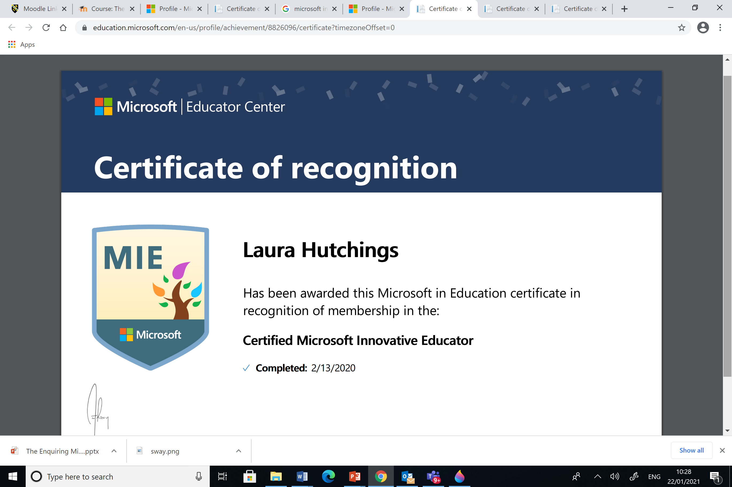
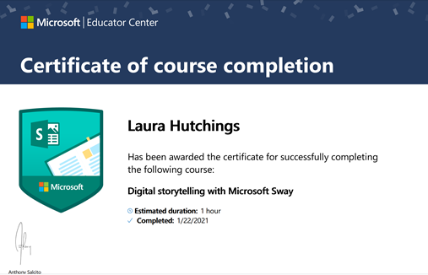
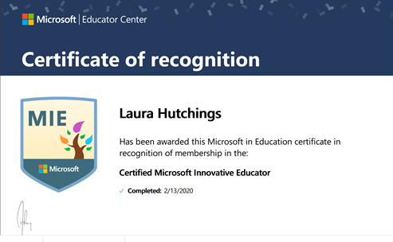
TYSTYSGRIF AM GWBLHAU CWRS
Certificate of course completion
Gellir lawrlwytho ac argraffu rhain
These can be downloaded and printed
Cyfle gwych i chi ddatblygu eich DPP
This is a fantastic opportunity for you to enhance your CPD

Slide 7

I GAEL MYNEDIAD I’CH CYFRIF
To access your account
Ewch i / Go to: https://education.microsoft.com/en-us
Ac arwyddwch i fewn gyda eich cyfeiriad e-bost myfyriwr
And sign in using your student email address.
Gallwch / You can:
Chwilio am gyrsiau o dan y tab ‘Training’
Search for courses under the training tab
Glicio ar y dolenni a rennir gyda chi ar Moodle/Teams i gael mynediad i’r cwrs
Click on the links provided to you on Moodle/Teams to access the course

Slide 8
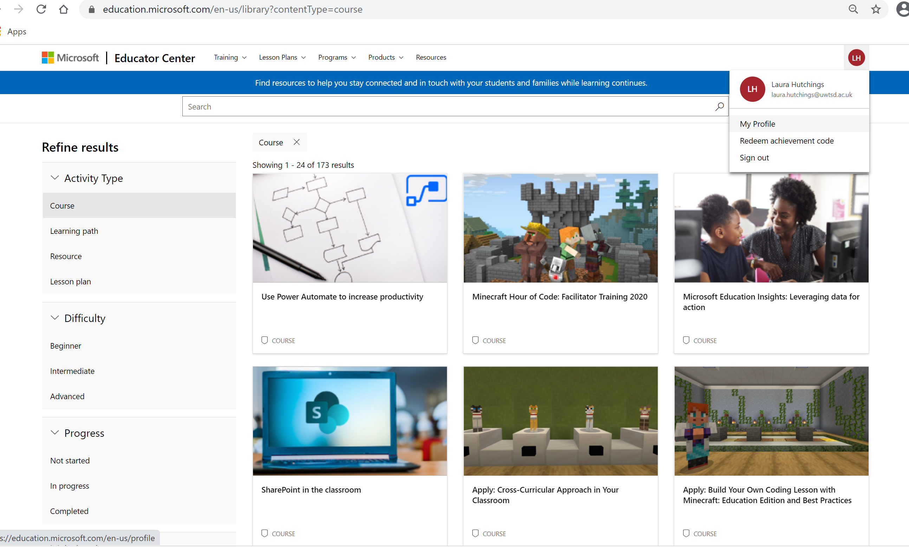
Sut i ddod o hyd i’ch tystysgrifau
How to find your certificates
Cliciwch ar eich proffil:
Click on your profile:
Bydd hwn yn mynd
â chi i’ch bathodynnau
This will take you
to your badges
O’r fan hyn gallwch lawrlwytho eich tystysgrifau
From here you can download your certificates

Slide 9
MEYSYDD ALLWEDDOL / Key Areas
Creadigrwydd yng nghwricwlwm heddiw (Ydi addysg yn lladd creadigrwydd?)
Y Drafodaeth Celf vs Gwyddoniaeth
Creadigrwydd a dylunio cwricwlwm (Effaith Leonardo a The Mantle of the Expert)
Cefnogi Chwarae Gwyddonol
Chwarae Creadigol
Cyfleoedd creadigol yn yr amgylchedd dysgu allanol
Gweler trosolwg o’r modiwl yn y llawlyfr
Creativity in today’s curriculum (Does education kill creativity?)
The Art vs Science Debate
Creativity and curriculum design (The Leonardo Effect and The Mantle of the Expert)
Supporting Scientific Play
Creative Play
Creative opportunities in the outdoor learning environment
See module overview in handbook
Notes:
It there room for creativity in today’s curriculum? – does education kill creativity:
Teachers and education staff are measured by lesson planning, data, targets etc – is there room to allow children to be creative? Unable to seize good opportunities for learning (Unlike Montessori).
Is there opportunity in the curriculum for children to follow their own interests?
Art vs Science – which one is more important? Can they be viewed as a separate subject or together? Which one promotes the most creativity?
Two creative approaches – The mantle of the expert – Created by Proffessor Dorothy Heathcore to allow pupils to take more of an ownership in education. The Leonardo Effect – combines art and science to improve children’s learning outcomes.
Supporting scientific play- how children investigate through play – scientific enquiry through exploration and by questioning children during experiences e.g why do toy cars role down a hill and not up? – increasing the likelihood of children asking questions themselves.
Creative play – the benefits of playing creatively for overall well being, development of learning to be creative through art.
Outdoor learning opportunities – learning through play outside, forest schools, encounters with plants and animals – increases children’s respect for the world they live in

Slide 10


Y meddwl ymholgar: beth mae’n ei olygu i chi?
The enquiring mind: what does it mean to you?

Slide 11
Y meddwl ymholgar ag addysg
The Enquiring Mind and Education
Plant a phobl ifanc yn cymryd cyfrifoldeb am eu dysgu eu hunain
Addysgu a dysgu yn ddisgybl-ganolog
Dysgu drwy brofiad
Datblygu cwestiynu, rhesymu a sgiliau datrys problemau
Children and young people take responsibility for their own learning
Teaching and learning is student centred
Experiential learning
Develops questioning, reasoning and problem solving
Notes:
Encouraging children and young people to follow their own interests
Learners are fully involved and child is put at the centre of learning
Experiential, hands on learning which will engage learners in education
Do children and young people explore anymore? – why not?

Slide 12

Cwblhewch y frawddeg:
Creadigrwydd yw …………………...
Complete the sentence:
Creativity is …………………

Slide 13

BETH YW CREADIGRWYDD
What is Creativity?
‘Creativity is a state of mind where in which all our intelligences work together’ – Lucas (2001)
‘Creativity is the ability to solve problems and fashion products and to raise new questions’ – Gardner (1997)
- Pa brosesau meddyliol sydd ynghlwm?
What mental processes are involved?
A yw creadigrwydd yn gynhenid?
Is creativity innate?
Beth yw’r gwahanol fathau o greadigrwydd?
What are the different types of creativity?
Notes:
What does creativity mean to you?
There are different definitions of creativity (like intelligence) – a vague term?
People are unsure what exact mental process are involved
Some people argue that you are either creative or not (show of hands)
Creative – good at drawing, can dance, can act, are scientifically minded. Good at telling stories etc.

Slide 14
Tonnau o greadigrwydd o fewn addsysg
The Waves of Creativity in Education
Adroddiad Plowden - CACE (1967)
Dysgu drwy ddarganfod
Mae gan blant ran weithredol yn y diffiniad o'r cwricwlwm a'i archwilio
Rôl graidd yn cael ei roi i chwarae
Y Cwricwlwm Cenedlaethol (cyflwynwyd yn 1988)
'Datblygiad creadigol' – yn y Cyfnod Sylfaen (2010)
'Meddwl creadigol' – a nodwyd fel sgil allweddol yn y Cwricwlwm Cenedlaethol (2008)
Plowden Report - CACE (1967)
Learning by discovery
Children have an active role in both the definition and exploration of the curriculum
A core role given to play
The National Curriculum (introduced in 1988)
‘Creative development’ – in Foundation Phase (2010)
‘Creative thinking’ – identified as a key skill in National Curriculum (2008)
Notes:
Plowden report – drew on a large body of so called liberal thinking
CACE – central advisory council in education
Learning goes beyond the classroom
Through Plowden creativity became associated with the integrated currilum, child-centred pedagogy and discovery learning
The National Curriculum
FP – 0-7 years old active and experiential learning, learning through play and creativity
Nat Cur – creativity does not apply to just the arts but arises in all domains of human endeavour (cross curricular)

Slide 15
Tonnau o greadigrwydd o fewn addsysg The Waves of Creativity in Education
Dysgu yn yr 21ain Ganrif
-symudiad i nodweddu 'creadigrwydd' i fewn i ddysgu bob dydd.
-Creadigrwydd yn cael ei ystyried yn rhan hanfodol o fywydau plant
Adolygiad Roberts (2006) – gwell ymgysylltu â dysgwyr a chynhwysiant
Mapio fframwaith ar gyfer creadigrwydd
Dull trawsgwricwlaidd ar gyfer creadigrwydd
21st Century Learning –
-a move into characterising ‘creativity’ into everyday learning.
-Creativity seen as essential part of children’s lives
The Roberts Review (2006) – enhanced learner engagement and inclusion
Mapped out a framework for creativity
Cross curricular approach for creativity
Notes:
Seen as a tidal wave or tsunami where creativity plays an everyday role in education - creativity would enhance learner engagement and inclusion

Slide 16
Cwricwlwm i gymru 2022 curriculum for wales 2022
Adroddiad Dyfodol Llwyddiannus Donaldson (2015):
Sawl gwaith dybiwch chi y mae’r geiriau ‘creadigol/creadigrwydd’ yn cael eu cyflwyno yn yr adroddiad hwn?
Pam bod creadigrwydd more bwysig yng nghwricwlwm heddiw?
Donalson’s Successful Futures report (2015):
How many times do you think the words ‘creative/creativity’ is mentioned in this report?
Why is creativity important in today’s curriculum?
Notes:
59 times

Slide 17
Cyfranwyr mentrus, creadigol’
‘enterprising, Creative Contributors’
cysylltu ac yn cymhwyso eu gwybodaeth a’u sgiliau i greu syniadau a chynnyrch
meddwl yn greadigol er mwyn ail-lunio a datrys problemau
adnabod cyfleoedd ac yn manteisio arnyn nhw
mentro’n bwyllog
arwain ac yn chwarae rolau gwahanol mewn timau’n effeithiol ac yn gyfrifol
mynegi syniadau ac emosiynau drwy wahanol gyfryngau
rhoi o’u hegni a’u sgiliau fel y bydd pobl eraill yn elwa
connect and apply their knowledge and skills to create ideas and products
think creatively to reframe and solve problems
identify and grasp opportunities
take measured risks
lead and play different roles in teams effectively and responsibly
express ideas and emotions through different media
give off their energy and skills so that other people will benefit and are ready to play a full part in life and work
Notes:
One of the 4 purposes of new curr for wales -
ambitious, capable learners, ready to learn throughout their lives
enterprising, creative contributors, ready to play a full part in life and work
ethical, informed citizens of Wales and the world
healthy, confident individuals, ready to lead fulfilling lives as valued members of society.

Slide 18
Meysydd dysgu cwricwlwm i gymru Curriculum for wales Areas of learning
Mae’r Celfyddydau Mynegiannol:
yn annog plant a phobl ifanc i ddatblygu eu gwerthfawrogiad creadigol
yn darparu cyfleoedd i archwilio meddwl, mireinio, a chyfleu syniadau, gan ennyn diddordeb meddwl, dychymyg a synhwyrau yn greadigol
yn darparu ysbrydoliaeth a chymhelliant wrth iddynt ddod â phlant a phobl ifanc i gysylltiad â phrosesau creadigol, perfformiadau a chynhyrchion eraill ac ysgogi eu harbrofi a'u creadigrwydd eu hunain.
The Expressive Arts:
encourage children and young people to develop their creative appreciation
The expressive arts provide opportunities to explore thinking, refine, and communicate ideas, engaging thinking, imagination and senses creatively
The expressive arts provide inspiration and motivation as they bring children and young people into contact with the creative processes, performances and products of others and stimulate their own experimentation and creativity.

Slide 19
Y CELFYDDYDDAU MYNEGIANNOL the Expressive Arts
Sut?
cerddoriaeth
drama
dawns
ffilm a chyfryngau digidol
y celfyddydau gweledol a dylunio
llythrennedd ac ysgrifennu creadigol.
How?
music
drama
dance
film and digital media
visual arts and design
literature and creative writing.

Slide 20
Gwyddoniaeth a thechnoleg
Science and technology
Caffael gwybodaeth trwy arsylwi ac arbrofi, a thechnoleg yn cymhwyso gwybodaeth wyddonol mewn ffyrdd ymarferol.
Yn manteisio ar chwilfrydedd plant a phobl ifanc am ein byd naturiol, corfforol a'n bydysawd wrth ymchwilio, deall ac egluro.
Plant yn cynhyrchu ac yn profi syniadau, yn casglu tystiolaeth, yn arsylwi, yn cynnal ymchwiliadau ymarferol, ac yn cyfathrebu ag eraill.
Acquiring knowledge through observation and experimentation, and technology applies scientific knowledge in practical ways.
Capitalises on children and young people’s curiosity about our natural, physical world and universe though investigating, understanding, and explaining.
Children generate and test ideas, gather evidence, make observations, carry out practical investigations, and communicate with others.

Slide 21

TASG/ Task
Darllen yr erthygl gan Caroline Sharp -‘Developing young children’s creativity: what can we learn from research?’
Tra’n darllen yr erthygl:
Gwnewch nodiadau o’r pwyntiau allweddol
Beth allwn ddysgu o’r erthygl?
Sut y gellir diffinio creadigrwydd?
Sut all yr hwylusydd gefnogi datblygiad creadigol?
http://www.nfer.ac.uk/publications/55502/55502.pdf
Read the article by Caroline Sharp -‘Developing young children’s creativity: what can we learn from research?’
Whilst reading the article:
Take note of the key points
What can we learn from the article?
How can creativity be defined?
How can the facilitator support creative development?
http://www.nfer.ac.uk/publications/55502/55502.pdf
Notes:
Seminar task – read article and discuss.
Research creative partnerships and LOCWS Swansea
In groups consider 10 questions you want to ask during the talk.

Slide 22
CYFEIRNODAU/ References
Gardner, H. (1997) Extraordinary minds. New York: Basic Books
Lucas, B. (2001). Creative Teaching, Teaching Creativity and Creative Learning. In A. Craft, B. Jeffrey & M. Leibling (Eds.), Creativity in Education. London: Continuum.

