Slide 1



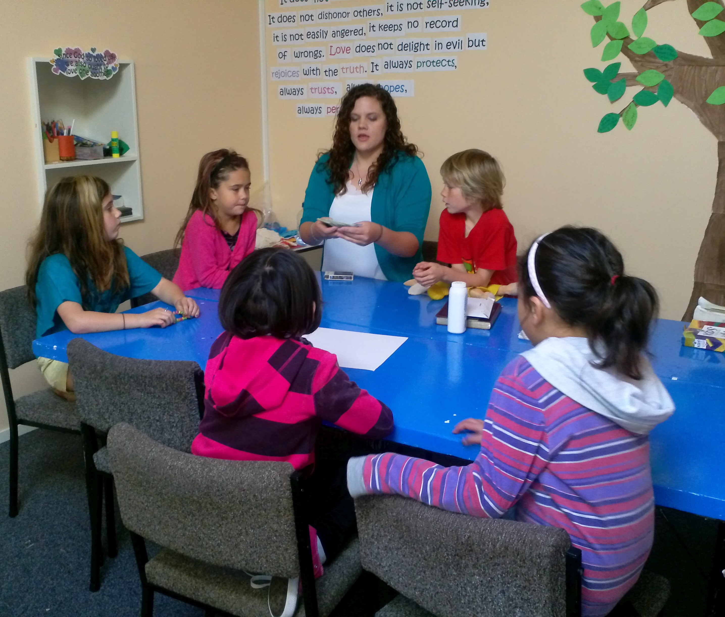

Working with children in a social care setting
Student Name: Anoshia Zaheer
Student Number:2128010
Module Code: LSHS4006
Module Name : Psycholgy in health and Social Care
Lecruer Name: Dr Kennedy Obohwemu

Slide 2


Introduction
From their appearance to their interests, youngsters change as they grow from grade school to preteens.
Between the ages of 7 and 11, a child's social development and interest in extracurricular activities (such as sports and art) will blossom (Meadows, 2019).
Children's skills and knowledge of the world expand when they approach the schooling years.
Children at this age require regular physical and emotional activities to establish a firm foundation for a lifetime of healthy habits and development (Erbil, 2020).
This presentation is going to propose activities for children between 7 to 11 years old while considering the Vygotsky theory of cognitive development.

Slide 3
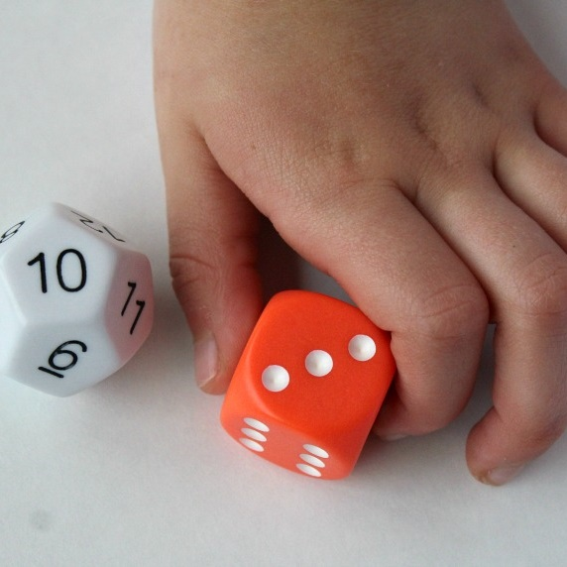
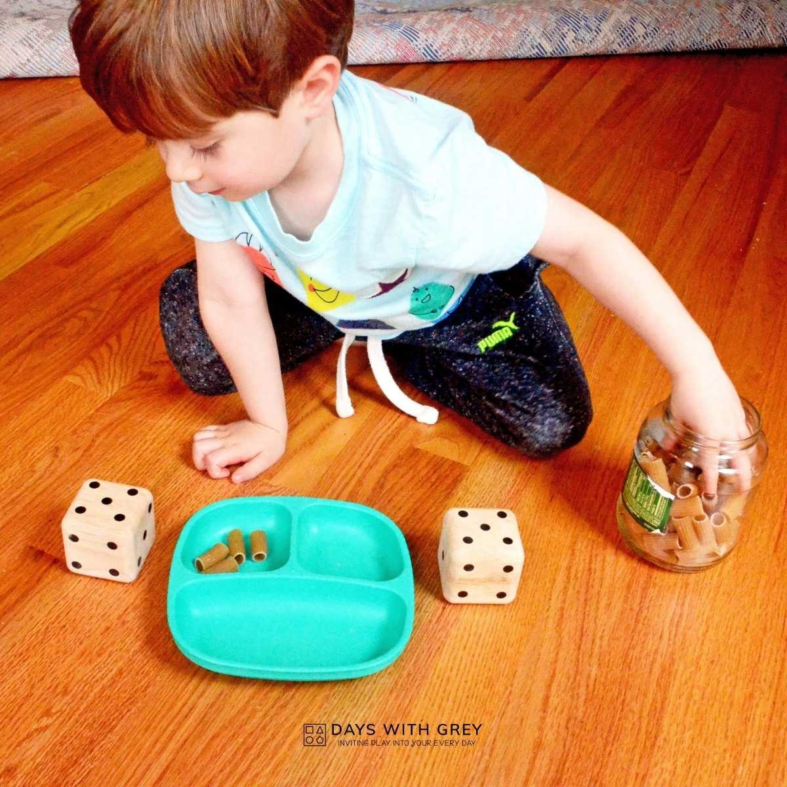
ACTIVITY 1: Dice Math
It's important to start working on your kid's arithmetic fundamentals as early as possible.
Playing this simple math game together at ages 7-11 will help your budding genius get more comfortable with mental arithmetic.
Dice are a fun and easy way to teach children how to take turns (Burte et al., 2019).
By simulating random number generators, they help kids understand the interplay of chance, probability, and tactic.
They prepare child for a lifetime of gaming success by teaching them to persevere in the face of setbacks and to embrace the thrill of victory (Vukovic and Juras, 2022).

Slide 4
ACTIVITY 2: Crossword Challenge
Your child's memory, observational skills, and processing power will all benefit from beginning to read horizontally and vertically with crossword puzzles (Purnant ET al., 2021).
Your child's problem-solving and pencil-control abilities will both benefit from this crossword puzzle.
Each animal must be recognised by the child before it can be written in the appropriate crossword grid.
This activity has significant impact on analytical reasoning skills of children.

Slide 5
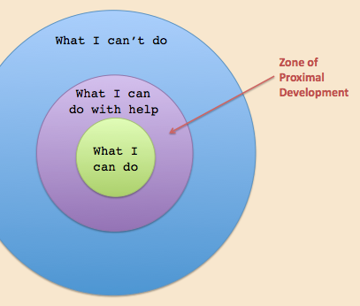
Vygotsky Theory of Cognitive Development
Culture influences a child's cognitive development, including reasoning and communication, according to Lev Vygotsky.
In Vygotsky's view, adults engage children in meaningful and demanding tasks to promote cognitive development (Darmayanti et al., 2023).
There are three stages of learning, in his view, and these are cognitive, motor, and social (Huang, 2021).
Cognitive, motoric, and sociocultural learning require thinking, doing, and interacting.
Adults, according to Vygotsky, might pick very useful insights by studying how youngsters develop.
He also held the view that play is an important means through which children acquire knowledge about their social and cultural environments.

Slide 6

Vygotsky Theory and Proposed Activities
Dice Math and Crossword Challenge exercises help youngsters overcome problems by asking them what to do next and about their psychological mechanisms.
Replicating the steps taken to solve a comparable problem or carry out a similar assignment (Erbil, 2020).
Putting students in groups to deliberate over problems and draw conclusions before taking action.
Putting students' problem-solving abilities to the test through the use of visual aids in mathematics.
Having students draw on their prior knowledge to better grasp more advanced concepts (Huang, 2021).
These are the core teachings of Vygotsky theory that can be accomplished by implementing the activities like Dice Math and Crossword Challenge.

Slide 7
Conclusion
Dice Math and Crossword Challenge activities are proposed for staff to implement.
These have potential to positively shape psychological abilities of children between 7 to 11 years old.
Vygotsky theory has proved to be productive in focusing on child’s cognitive and problem solving skills.
In essence, these proposed activities can fulfil the purpose of Vygotsky theory of child development.

Slide 8
References
Burte, H., Gardony, A.L., Hutton, A. and Taylor, H.A. (2019). Make-A-Dice Test: Assessing the intersection of mathematical and spatial thinking. Behavior Research Methods, 51, pp.602-638.
Darmayanti, R., Usmyatun, U., Setio, A., Sekaryanti, R. and Safitri, N.D. (2023). Application of Vygotsky Theory in High School Mathematics Learning Material Limit Functions. JEMS: Jurnal Edukasi Matematika Dan Sains, 11(1), pp.39-48.
Erbil, D.G. (2020). A review of flipped classroom and cooperative learning method within the context of Vygotsky theory. Frontiers in Psychology, 11, p.1157.
Huang, Y.C. (2021, May). Comparison and contrast of Piaget and Vygotsky’s Theories. In 7th International Conference on Humanities and Social Science Research (ICHSSR 2021) (pp. 28-32). Atlantis Press.

Slide 9
References
Meadows, S. (2019). Cognitive development. Companion encyclopedia of psychology, pp.699-715.
Purnanto, A.W., Nugroho, I., Shalikhah, N.D., Wardana, A.E., Ristiyani, M., Muttaqiin, H.N. and Rahmawati, L.E. (2021, September). Alphabetical Dice Row: Exploration and Evaluation Tool of Student’s Vocabulary Mastery. In Proceedings of the 2nd Borobudur International Symposium on Humanities and Social Sciences, BIS-HSS 2020, 18 November 2020, Magelang, Central Java, Indonesia.
Vuković, P. and Juras, A. (2022). APPLICATION OF DIDACTIC GAMES IN MATHEMATICS TEACHING. childhood, 17, p.18.

