Slide 1

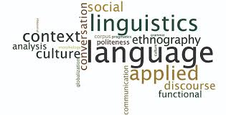
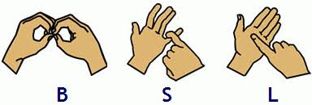
ECSS6001 Diversity of Language
Theme 5: Language Acquisition (Part 2)
Ken Dicks ken.dicks@uwtsd.ac.uk

Slide 2
Cognitive Constraints (Recap)
Whole object bias
When children encounter a new label, they prefer to attach the label to the entire object rather than to part of the object
E.g. dog (a label for the entire object rather than dog’s tail)
A taxonomic bias
Children will assume that the object label is a taxonomic category rather than a name for a individual dog
E.g. dog is a label for a group of animals not just Fido
Mutual exclusivity bias
It refers to the fact that a child who knows the name of a particular object will then generally reject applying a second name to that object
E.g. Show me the Truck – child picks up the truck, Show me the lorry - much more likely to select the novel object
Therefore Children have some clear biases or preferences in learning new words

Slide 3
Cognitive Processes
Operating Principles
Sensorimotor Schemata
Cognitive Constraints
Impairments of Language & Cognition

Slide 4
Impairments of Language and Cognition
We have discussed language and will continue to do so
We have also mentioned Cognitive Development but what exactly is it?

Slide 5
Impairments of Language and Cognition
Cognitive development is the study of childhood neurological and psychological development.
Specifically, cognitive development is assessed based on the level of conception, perception, information processing, and language as an indicator of brain development.
It is generally recognized that cognitive development progresses with age, as human awareness and understanding of the world increases from infancy to childhood, and then again into adolescence.

Slide 6
Impairments of Language and Cognition
The notion that a close relationship exists between language and cognition has generally been supported by studies of individuals with Down syndrome
These individuals tend to have language delays that are proportionate to the severity of their cognitive disability
However, other cases, there can be significant discrepancies between the level of cognitive functioning and the level of linguistic functioning
Examples if this type of study include;
Williams Syndrome
Chatterbox syndrome

Slide 7
Impairments of Language and Cognition
Williams Syndrome
Williams syndrome is a developmental disorder that affects many parts of the body.
This condition is characterized by mild to moderate intellectual disability or learning problems, unique personality characteristics, distinctive facial features, and heart and blood vessel (cardiovascular) problems.
Young children with Williams syndrome have distinctive facial features including a broad forehead, a short nose with a broad tip, full cheeks, and a wide mouth with full lips.
United States National Library of Medicine [NSNLM] (2019)

Slide 8
Impairments of Language and Cognition
Williams Syndrome
People with Williams syndrome typically have difficulty with visual-spatial tasks such as drawing and assembling puzzles, but they tend to do well on tasks that involve spoken language, music, and learning by repetition (rote memorization).
Affected individuals have outgoing, engaging personalities and tend to take an extreme interest in other people.
United States National Library of Medicine [NSNLM] (2019)

Slide 9
Impairments of Language and Cognition
Williams Syndrome
Although language is typically considered a relative strength for children with WS, there is still a clear pattern of relative strengths and weaknesses within that domain.
Briefly summarized, concrete vocabulary and phonological skills are relative strengths, grammatical abilities are at the level expected for overall intellectual abilities, and relational language and pragmatics are clear weaknesses.
Mervis & Velleman (2011)

Slide 10
More Jargon!
Concrete Vocabulary
The numbers of words that a person has and is able to use
Phonology
The ability to make sounds and the study of sound making in humans
Grammatical skills
The ability to put words in the correct order – also known as syntax
Relational Language
The way in which language used relates to that used by the other person in a conversation
Pragmatics
The linguistic and non-linguistic support for communication (e.g. pointing, nodding etc.)
Based on (Johnson and Johnson, 1998)

Slide 11
Impairments of Language and Cognition
Chatterbox Syndrome
A descriptor for the behaviour of children with arrested hydrocephalus, who may be sociable, talkative, pseudointelligent, and speaking in a seemingly erudite fashion on subjects about which they have no true understanding.
Developmental impairment where a person speaks fluently and grammatically, but shows poor performance in tasks testing general intelligence
Cases such as these seem to show that there is not such a clear link between cognitive development and language development

Slide 12
Innate Language Learning Mechanisms
Chomsky’s LAD/Universal grammar
The Language Bioprogram Hypothesis

Slide 13

Chomsky - LAD
A Brief Introduction to his theory
1.
Language Acquisition Device

Slide 14
Chomsky – Language Acquisition Device
The language acquisition device (LAD) was proposed by Noam Chomsky to explain how children, when exposed to any human language, are able to learn it within only a few years following birth.
Chomsky argued that all humans are born with the knowledge of what makes a human language. Included in this innate knowledge must be details of important characteristics of all the world’s languages.
The term universal grammar has been used to describe the knowledge contained in the LAD.
The process of language development is envisioned as one in which the child discovers which grammar rules contained within universal grammar apply to the language that the child is learning.

Slide 15
Chomsky – Language Acquisition Device
According to Chomsky, humans are born with the LAD, but other species are not.
Nonhuman primates and other species do not spontaneously learn human languages.
Furthermore, attempts to teach nonhuman species language have yielded mixed results.
Chimpanzees and gorillas have learned to use signed languages, such as American Sign Language (ASL). Washoe the chimpanzee and Koko the gorilla have each learned hundreds of signs and can use them to refer to concrete objects and concepts, such as hungry.
However, neither has been able to master the intricacies involved in construction of grammatically correct sentences.

Slide 16
Chomsky – Language Acquisition Device
Chomsky’s view of the LAD is consistent with there being specific structures in the brain involved in language learning and language processing.
Such brain structures are presumably present in human brains, but absent in nonhuman brains.
No specific claim was made regarding the specific location of the LAD in the brain.
Although there have been locations in the brain identified as language processing areas, such as Broca’s area and Wernicke’s area, a location corresponding to the LAD has not been found.

Slide 17


Critical Analysis
Read through the handout ‘A Summary of Chomsky’s Language Acquisition Device’.
Identify any areas where his theory could be questioned or challenged.
You do not need to find evidence to challenge but should try to identify where such opportunities might occur.
Handout: A Summary of Chomsky’s Language Acquisition Device’.
Guided Study: Critiquing the LAD Theory

Slide 18
Criticisms of Chomsky
Some researchers have rejected the notion that language acquisition is aided by innate knowledge.
In 1957, the behaviourist B. F. Skinner published the book Verbal Behaviour, in which he argued that all types of language behaviour were learned after birth through the same learning processes that are used for all human learning.
Some contemporary cognitive scientists, such as David Rumelhart and James McClelland, as well as others, view language learning as the result of general learning principles, rather than language-specific mechanisms.

Slide 19
Innate Language Learning Mechanisms
Chomsky’s LAD/Universal grammar
The Language Bioprogram Hypothesis

Slide 20
The Language Bioprogram Hypothesis
Language Bioprogram - Bickerton (1983, 1984)
Children have an innate grammar that, in the absence of proper environmental input, serves as the child’s language system forming a linguistic backup system
Evidence used for this hypothesis
Example 1: Pidgins and Creoles (Bickerton)
Example 2: Studies of language development in congenitally deaf children (Susan Goldin-Meadow)

Slide 21
The Language Bioprogram Hypothesis
Example 1: Pidgin
Pidgin: an auxiliary language that arises when speakers of several mutually unintelligible languages are in close contact (Bickerton, 1984)
E.g. Immigrant workers come to speak a simpler form of the dominant language of the area-just enough to get by
No recognizable syntax, often one word order, no complex sentences
2.
BBC Pidgin Service

Slide 22
The Language Bioprogram Hypothesis
Example 1: Creole
Creole: when the children of these immigrants acquire a pidgin as their native language
Relatively sophisticated, complex sentences
Unlike pidgins, the creoles resembled the structural rules of other languages
These rules often have a consistency no matter where the creole is created.
Based on : (Muysken, 2016)
3.
Creole Language

Slide 23
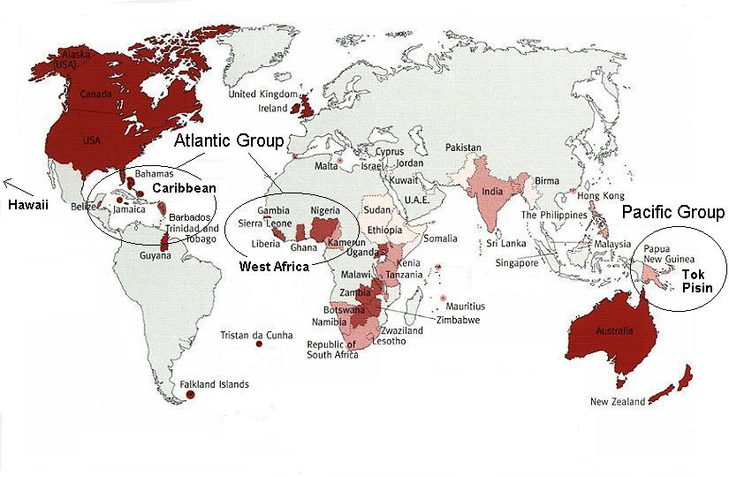

Slide 24
The Language Bioprogram Hypothesis
Case 2: Congenitally deaf children
Children (13 months to 4 years old ), studied every 2-4 months, for 1.5 years
None of these children were exposed to conventional sign language
Nevertheless, the children invented a form of gestural language (Homesign) similar to the language of children with normal hearing
One-sign utterances appeared (18 months), followed by 2-3 sign utterances
When linguistic input is minimal, deaf children may create a gestural language similar to normal children’s language
Goldin-Meadow (2010)

Slide 25
The Language Bioprogram Hypothesis
Bioprogram might operate in the absence of ordinary linguistic stimulation
What happens given appropriate linguistic input?
Bioprogram is suppressed and children learn the native language
Children use “Preemption Principle”; If you hear people using a form different from the one you are using, and do not hear anyone using your form, abandon yours and use theirs”
Cognitive processes associated with language use are not general purpose problem-solving processes but are instead restricted to language

Slide 26
Summary
Three classes of variables are needed for a complete account of language acquisition
Linguistic Environment
Gross environmental neglect (feral & isolated children) & Impaired language acquisition
Cognitive Processes
Cognitive process are correlated with language development
Innate Mechanisms
Children given poor linguistic input create communication systems similar to early child language*

Slide 27
Summary
*This last point is contested, although Chomsky and Bio programming are widely accepted there are those who feel that these views are simplistic
Genie for example is seen as showing that the brain needs to be stimulated in order to develop language
Researchers such as Jeff Siegel have argued that, for example ‘facts about Hawai‘i Creole, the language crucial to Bickerton’s Language Bioprogram Hypothesis, do not actually support the hypothesis’ (Siegel, 2007, p.81).
Pidgins and Goldin-Meadows research could also be seen as examples of the human ability to communicate rather than a ‘programmed’ ability to learn languages
We will look at Communication next

Slide 28
Summary
Pidgins and Goldin-Meadows research could also be seen as creative and spontaneous examples of the human need and ability to communicate rather than a ‘programmed’ ability to learn languages

Slide 29
A video recap
4. Theories of Language Development: Nativist, learning, interactionist

Slide 30
References
Goldin-Meadow, S (2010) Gesture’s role in creating and learning language Enfance Vol. (3): pp. 239–255. Available at: https://www.ncbi.nlm.nih.gov/pmc/articles/PMC3606027/ [Accessed 15/12/2020]
Johnson, H. & Johnson, K (1998) Encyclopaedic Dictionary of Applied Linguistics Blackwell Publishers Available at: https://web-b-ebscohost-com.ezproxy.uwtsd.ac.uk/ehost/ebookviewer/ebook/bmxlYmtfXzQ4NjQ4X19BTg2?sid=6e5ac38b-e732-4574-b2ce-ae49d8d46915%40pdc-v-sessmgr02&vid=0&format=EB&rid=1 [Accessed 15/20/2020]
Liu, S.; Volcic, Z.; Gallois, C.; (2015). Introducing Intercultural Communication - Global Cultures and Contexts, London: Sage
Mervis, C.B. and Velleman, S.L. (2011) Children with Williams Syndrome: Language, Cognitive, and Behavioral Characteristics and their Implications for Intervention Perspectives on Language Learning and Education Vol. 18 Iss. 3 pp. 98–107 Available at: https://www.ncbi.nlm.nih.gov/pmc/articles/PMC3383614/ [Accessed 15/12/2020]

Slide 31
References
Muysken, P. (2016, June 09). Creole Languages. Oxford Research Encyclopedia of Linguistics. Available at: https://oxfordre.com/linguistics/view/10.1093/acrefore/9780199384655.001.0001/acrefore-9780199384655-e-68. [Accessed 15/12/2020]
Saxton, M. (2010). Child Language: Acquisition and development. Thousand Oaks, (CA): SAGE Publications Ltd
Siegel, J. (2007) Recent evidence against the language bioprogram hypothesis: the pivotal case of hawai‘i creole Studies in Language Vol. 31 Issue 1, pp. 51–88
USNLM (2019) Williams Syndrome Available at: https://ghr.nlm.nih.gov/condition/williams-syndrome#resources [Accessed 15/12/2020]
Wardhaugh, R., Fuller, J. (2014). An Introduction to Sociolinguistics, Blackwell Available at: https://www-vlebooks-com.ezproxy.uwtsd.ac.uk/Vleweb/Product/Index/429953?page=0 [Accessed 15/12/2020]

Slide 32
Video References
BBC Radio 4 / Open University (2015) Noam Chomsky on Language Acquisition Available at: https://www.youtube.com/watch?app=desktop&v=7Cgpfw4z8cw [Accessed 15/12/2020]
BBC learning English (2017) A Guide to Pidgin Available at: https://www.facebook.com/watch/?v=10155749439255229 [Accessed 15/20/2020]
Audiopedia (2017) What is Creole Language? Available at https://www.youtube.com/watch?app=desktop&v=_JZcGQ1U8M4 [Accessed 15/12/2020]
Yue, C (No Date) Theories of Language Development: Nativist, learning, interactionist Khan Academy Available at https://www.khanacademy.org/test-prep/mcat/processing-the-environment/language/v/theories-of-language-development [Accessed 23/01/2021]

Slide 33
Further study:
Language Development: Theoretical Perspectives
by Esther Miller (2012) https://www.mindmeister.com/158556180/language-development-theoretical-perspectives
Child Language Acquisition Theory: Chomsky, Crystal, Aitchinson & Piaget
https://edupsychology.wikispaces.com/file/view/Child+Language+Acquisition+Theories.pdf

