Slide 1


Effective Communication Skills
University of Wales Trinity Saint David
Module name: Effective Teamworking and Communication BMSW4003
Student name: Alexandra Furcoiu – 2412154
Submission date: 26.03.2025
Listening, Coaching, Transactional Analytics, Drama Triangle

Slide 2
Summary
Communication – definition and styles
Listening – definition, examples, key points
Coaching - GROW model explained
Transactional Analysis Theory- Eric Berne
Reference list

Slide 3

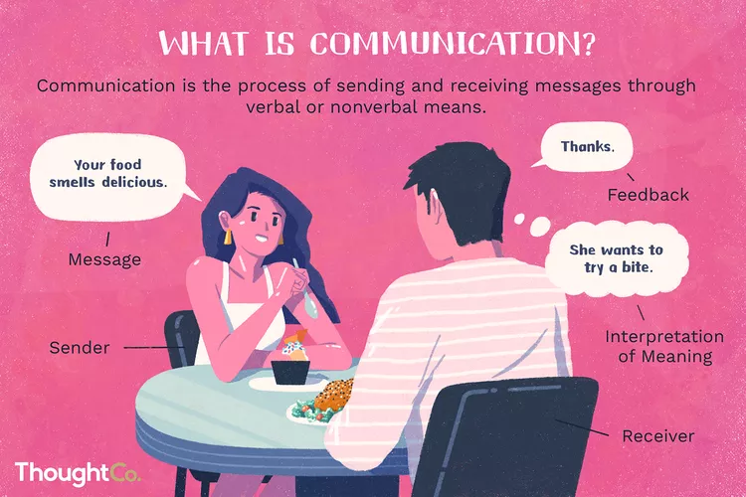
How would you describe communication?
“Communication is the transactional use of symbols, influenced guided, and understood in the context of relationships.” ( Duck & McMahan, 2015)

Slide 4
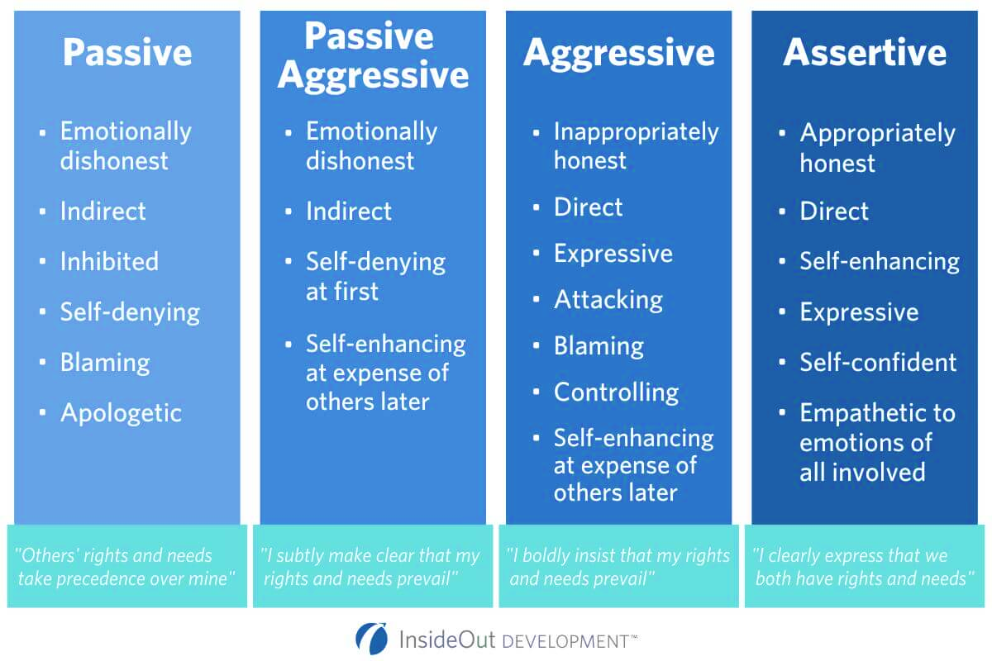
Do you know your style?

Slide 5

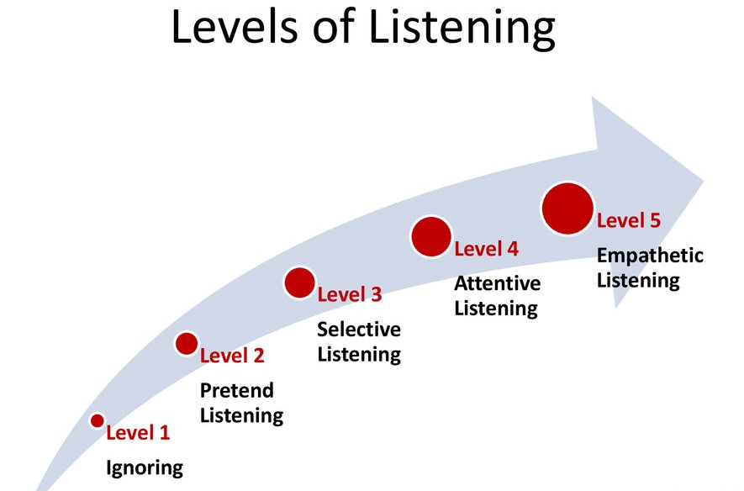
Listening
According to Cambridge Dictionary, to listen means “to GIVE ATTENTION to someone or something in order to HEAR him, her, or it”.
Source: slideplayer.com

Slide 6

Example:
Student ignores tutor and his/her colleagues – not paying attention to what is being said
Student can watch the tutor speaking, but not really listening ( occasionally nodding, pretending he/she understood)
Student listening to the tutor, but he/she gets distracted by someone else’s conversation and switches attention to them.
Student is focused on the lecturer and actively listening to the topic with no interruption and distractions.
Student is fully engaged with the lecture, and he/ she fully participates in activities and group discussions.
Revolutionlearning.co.uk

Slide 7
Key Points
Pause before responding
Concentrate
Clarify
Encourage
Avoid interrupting
Moodle: Effective Teamworking and Communication BMSW4009
Verywellmind.com

Slide 8

The GROW Model
A process for setting and achieving goals
(Aihr.com).
G- goals- the coach (lecturer) helps the coachee (students) to set up their schedule for their upcoming assignment – subject, guidance, materials, deadline.
R- reality- tutor asks questions to identify student’s challenges and offers advice
O- options- together they will be looking for the best approach for the assignment to avoid confusion and stress.
W- will- tutor makes sure that students have access to all materials and tools to complete their tasks and offers personal support to each student to receive feedback on their work

Slide 9
Transactional Analysis Theory: Eric Berne
Transactional Analysis is a method used to analyze the process of transactions in communication with others.
“It requires us to be aware of how we feel, think, and behave during interactions with others” Murray, H (2023).

Slide 10
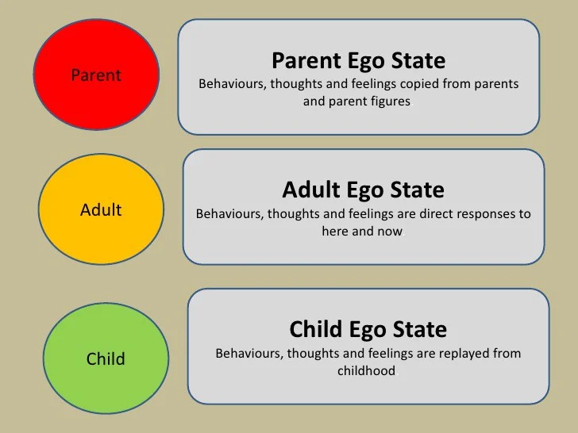
The Ego States

Slide 11
Reference list
Cambridge Dictionary; meaning of “listen” in English, available at https://dictionary.cambridge.org/dictionary/english/listen, accessed 25th March 2025.
Cuncic, A (2024), Verywellmind: Ways to improve active listening, available at https://www.verywellmind.com/what-is-active-listening-3024343#toc-ways-to-improve-active-listening, accessed 25th March 2025
Duck, S & McMahan, D.T (2015), Communication in everyday life: a survey of communication, Sage publications
Inside Out Development: What is My Communication Style? Understanding the 4 Types, available at https://insideoutdev.com/blog/understanding-4-communication-styles, accessed 25th March 2025
Moodle, Effective Teamworking and Communication, Active listening and Communication, available at https://moodle.uwtsd.ac.uk/course/view.php?id=10871&section=8, accessed 25th March 2025
Murray, H (2023), Transactional Analysis Theory & Therapy: Eric Berne, available at https://www.simplypsychology.org/transactional-analysis-eric-berne.html, accessed 25th March 2025
Nordquist, R (2024), Thought Co: What is Communication? The art of Communicating and How to Use It Effectively, available at https://www.thoughtco.com/what-is-communication-1689877, accessed 25th of March 2025
Siocom, G (2025), Academy to Innovate HR: GROW model, available at https://www.aihr.com/blog/coaching-models/, accessed 25th March 2025
Slide Player: Listening and Interpersonal Communication, available at https://slideplayer.com/slide/16845230/, accessed 25th March 2025

