Slide 1
CHILDREN, THE YOUTH AND FAMILIES
◆ PROGRAMME: BSc Health and Social Care
◆ MODULE: Children, Young People, and Families
◆ LECTURER: Rachael Rivers
◆ PRESENTERS: Tayba Habib (2026249)
Maryam Anwar (2015318)

Slide 2
CONTENTS
• SLIDE 2: CONTENTS
• SLIDE 3: INTRODUCTION
• SLIDE 4: DEFINITION OF WELL BEING
• SLIDE 5: DOMAINS OF WELL BEING
• SLIDE 6: ANALYSIS OF FAMILY RATIONALE
• SLIDE 7: PROFESSIONAL HELP WHICH CAN BE UTILISED BY FAMILY D
• SLIDE 8: MEETING THE FAMILY ISSUES THROUGH PROFESSIONAL INTERVENTIONS
• SLIDE 9: POLICIES IN PLACE FOR FAMILY D
• SLIDE 10: DOMESTIC ABUSE BILL
• SLIDE 11: BENEFITS AND FINANCIAL AID FROM THE GOVERNMENT
• SLIDE 12: THE STAYING PUT ACT
• SLIDE 13: CONCLUSION
• SLIDE 14: REFERENCES
SLIDE 15: REFERENCES

Slide 3
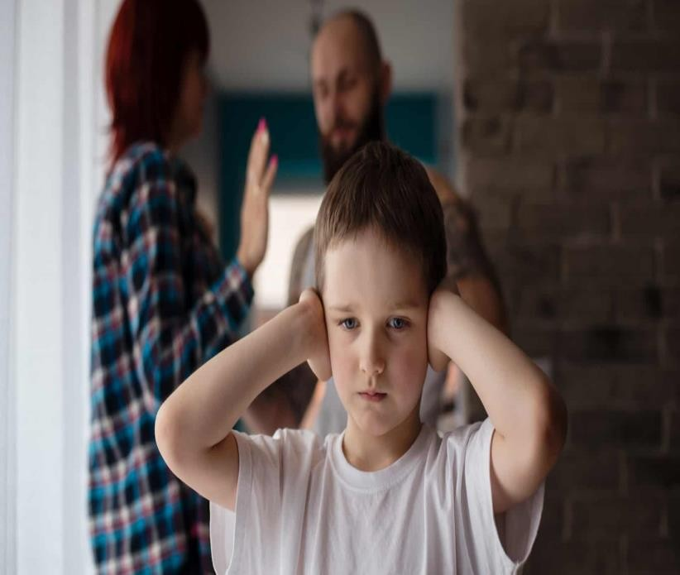
INTRODUCTION
Today we are going to discuss the predicament of family D. The case study of family D involves a mother and her 4 children, 2 of which are secondary aged daughters and the other two being boys, one of working age and one being of primary school age.
Domestic violence, concerns between the mother and her non- resident partner, re-housing needs, general finances, disabilities and the eldest son being in care are all tribulations which have significantly impacted this family

Slide 4
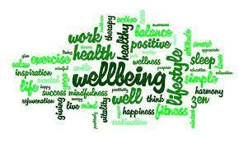
DEFINITION OF WELL-BEING
◆ The definition of well-being refers to what is intrinsically important and this is relative to the individual, well-being can also be both positive and negative. (Wikipedia contributor,2013)
◆ Positive well-being in regards to family D would be financial stability and being recipients of a new house. Smaller organizations like Refuge and Family Services Units offer groups and specialized counseling to women and children who are victims of domestic violence. (Humphreys and Mullender,n.d)
◆ Whereas negative well-being would be the opposite of this

Slide 5
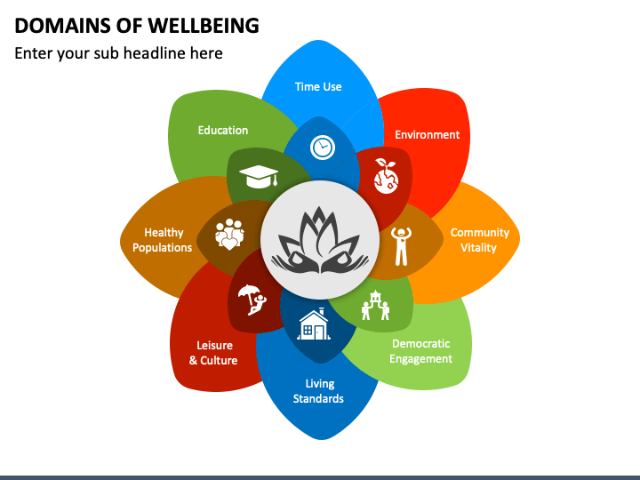
DOMAINS OF WELL BEING
With careful analysis of the case study of Family it seems that psychological well- being is a major component of the families issues
As stated earlier the problems which the family deals with are
• Poor psychological health is reflected in individuals' behaviour, for example signs of poor mental health may be talking less, avoiding social activities and struggling to make decisions (Bupa.co.uk,2019).
• We would advise Family D to receive treatment from a psychologist as what they have experienced may be traumatic for them, and this would give them the
chance to converse about their problems and receive advice from a professional.
• As mental health is a prodigious part of our health as a whole.
Domestic Violence
finances
disability
Poor psychological health is reflected in the behaviour of the family

Slide 6
ANALYSIS OF FAMILY RATIONALE
FINANCIAL
DIFFICULTIES
RELYING ON INCOME SUPPORT
DOMESTIC
VIOLENCE
CHILD IN
CARE
HOUSING
DISABILITIES
RELATIONSHIP
ISSUES
• This is an overview of the tribulations that the family face
• Making it easier to analyse these issues individually

Slide 7
PROFESSIONAL HELP WHICH CAN BE UTILISED BY FAMILY D
◆ CBT--> Cognitive behavioral therapy(American Psychiatric Association,2019) can be used for those who've experienced
domestic violence and reduces it's likelihood in the future.
◆ BENEFITS--> the family can research to see what financial support they are eligible for in order to ease their financial difficulties(GOV.UK)
◆ PUBLIC HEALTH ENGLAND(PHE)--> this can help the family to achieve a good mental health which could help to ameliorate their situation.(Public Health England,2018)
◆ DISABILITY LIVING ALLOWANCE--> this provides financial aid to those who are disabled and under 16, this can be spent on the youngest son in order to improve his quality of life.(GOV.UK)
This professional aid can be utilised by every member of family D and isn't subjective to one person, for example CBT can be used by all family members regardless of what their problems are

Slide 8
MEETING THE FAMILIES ISSUES THROUGH PROFESSIONAL INTERVENTIONS
◆ Domestic abuse--> Openforwards CBT and counselling Birmingham, Birmingham and Solihull Women’s Aid(Independent Domestic Violence Advisor)
◆ Financial difficulties--> benefits and financial aid from the government
◆ Mental health issues-->UK Health Security Agency( PHE), NHS Foundation Trust(Birmingham Healthy Minds)
◆ A disabled child--> Disability living allowance.
◆ These are all ways in which the complex issues of the family can be resolved, giving specific
treatments for specific issues,

Slide 9
POLICIES IN FORCE FOR FAMILY D
◆ Domestic Abuse Act (2021), this act ensures that survivors of domestic abuse are cared for as well as their
Children. Specialist Women Refuges (Women's aid, 2022).
◆ Housing needs assessment; This family requires rehousing needs as well.(Birmingham City Council)
◆ Safeguarding disabled children act (2009), this act ensures "that disabled children have the same right as non-disabled children to be protected from harm and Abuse", (Cambridgeshire and Peterborough
Safeguarding Partnership Board, 2022).
◆ Staying put (2013), this act was put in place so that those who have reached the age of 18 are able to remain with their foster carers for a longer period of time (GOV.UK, 2013)

Slide 10
DOMESTIC ABUSE ACT
This act was first imposed on the 30th April 2021, and it aims to protect those who are facing domestic abuse.
The act offers a range of things which can help aid Family D for example:
◆ Priority in need for housing this helps family D as they are in need of a house
◆ An official definition of domestic abuse which deems children to also be victims in their own right, this can provide protection for the children ensuring that their
experience with domestic abuse doesn’t become an obstacle in the future, and
obstructing them from success
These offers made by this relatively new act can help get the support that the family
needs during this calamitous time for them (Women's aid, 2022).

Slide 11
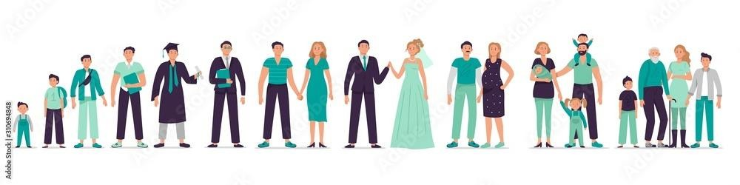
THE STAYING PUT ACT
◆ The staying put act was implemented to ensure that individuals can continue to receive care from their foster carers past the age of 18
◆ Local authorities in England must "facilitate, monitor and support staying put arrangements for fostered young people until they reach the age of 21" (The Fostering network, 2014)
◆ This act can ensure the eldest son can remain in care during a critical period of his life, allowing him to continue his life without being shifted to independence
◆ For example, he can continue employment, education, and training without being disrupted whilst at the same time being provided for by his foster family
◆ This is essential as it allows him to get his life together, as his being made to be independent at the tender age of 18 may be detrimental to his general well-being and quality of life
◆ Issues such as homelessness, unemployment and depression may afflict him due to having no knowledge of the real world, this act provide time for him to gain experience as an adult in order for him to be successful in the future

Slide 12
BENEFITS AND FINANCIAL AID FROM THE GOVERNEMENT
◆ The mother can try to research or gain financial advice from a financial advisor in order to see if they are eligible to financial aid from the government
◆ By doing so this could help reduce the families financial difficulties allowing them to have less anxiety when it comes to finances, and relieving the mother of stress as her children can be provided for
◆ For example the family may meet the eligibility criteria in order to claim and receive financial aid for their disabled son which can be used to buy him things to aid with his disability in day to day life
◆ The mother may also be able to claim single parent benefits in order for her to make sure her children receive everything they need
◆ By applying for financial aid the family can focus on their lives individually and this
could also be of benefit for their mental health

Slide 13

CONCLUSION
After viewing the case of family D, there are many issues for the family to consider when thinking about moving forward as a family, the factors that the family should take into consideration are:
◆ Gaining help from professionals and seeking advice from professionals as to how they can go about tackling their issues.
◆ The mother must consider her and her children's mental health as they have all been experiencing domestic abuse.
◆ Making sure that they stay together as a unit and ensure that each member is feeling good.
◆ Keeping a positive mindset as negativity will not contribute towards the betterment of the situation that they are in.
◆ These considerations being taken by the family will improve their situation and help them to reach a place where they are content.

Slide 14
REFERENCES
Adobe (n.d.). Different ages man with family. Mans life stages, person growth from kid, young boy, teenager, student to adult and old man. Male character vector illustration set. Boy growing up and starting family Stock Vector. [online] Adobe Stock. Available at: https://stock.adobe.com/uk/images/different-ages-man-with-family-mans-life-stages-person-growth-from-kid-young-boy-teenager-student-to-and-old-man-male-character-vector-illustration-set-boy-growing-up-and-starting-family/310694848 [Accessed 9 Oct. 2022].
American Psychiatric Association (2019). Treating Women Who Have Experienced Intimate Partner Violence. [online] www.psychiatry.org. Available at: https://www.psychiatry.org/File%20Library/Psychiatrists/Cultural-Competency/IPV-Guide/APA-Guide-to-IPV-Among-Women.pdf.
https://www.birmingham.gov.uk/info/50099/your_housing_needs_assessment.
Bupa UK (n.d.). Signs of poor mental health | Health Information | Bupa UK. [online] www.bupa.co.uk. Available at: https://www.bupa.co.uk/health-information/workplace-mental-health/signs-poor-mh.
Children and domestic violence: a research overview of the impact on children Catherine Humphreys and Audrey Mullender.
Cambridgeshire and Peterborough Safeguarding Partnership Board (2022). Safeguarding Disabled Children | Cambridgeshire and Peterborough
Safeguarding Partnership Board. [online] Safeguardingcambspeterborough.org.uk. Available at: https://www.safeguardingcambspeterborough.org.uk/children-board/professionals/procedures/safeguarding-disabled-children/.

Slide 15
REFERENCES
GOV.UK (n.d.). Check benefits and financial support you can get. [online] GOV.UK. Available at: https://www.gov.uk/check-benefits-financial- support.
GOV.UK (n.d.). Disability Living Allowance (DLA) for children. [online] GOV.UK. Available at: https://www.gov.uk/disability-living-allowance-children.
GOV.UK (2013). Staying put: arrangements for care leavers aged 18 years and above. [online] GOV.UK. Available at: https://www.gov.uk/government/publications/staying-put-arrangements-for-care-leavers-aged-18-years-and-above.
Public Health England (2018). Public mental health. [online] GOV.UK. Available at: https://www.gov.uk/government/collections/public-mental- health.
Sketch Bubble (2022). Domains of Wellbeing. [online] www.sketchbubble.com. Available at: https://www.sketchbubble.com/en/presentation-
domains-of-wellbeing.html [Accessed 5 Oct. 2022].
The Fostering network (2014). Staying Put | The Fostering Network. [online] Thefosteringnetwork.org.uk. Available at: https://www.thefosteringnetwork.org.uk/policy-practice/practice-information/staying-put.
Wikipedia Contributors (2019). Well-being. [online] Wikipedia. Available at: https://en.wikipedia.org/wiki/Well-being.
Women's aid (2022). Domestic Abuse Act. [online] Women’s Aid. Available at: https://www.womensaid.org.uk/get-involved/campaign/domestic- abuse-bill/.

