Slide 1

PAL Autos Ltd
Student Name: Samir Mhanna
Student Number: 2119514
Lecturer Name: Rajesh Kumar
Component 1 – Business plan presentation
(BMSW 4006)
Managing Enterprise in the 21st Century

Slide 2
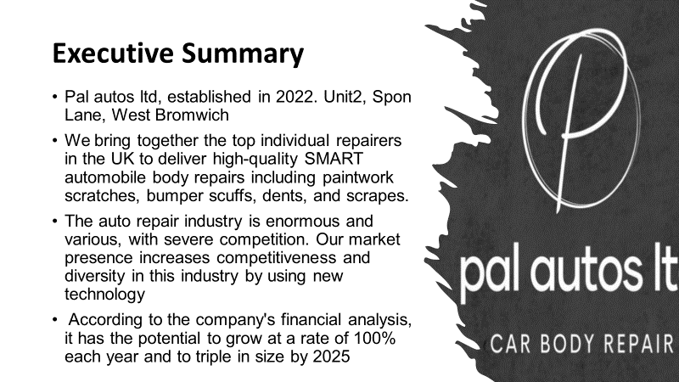

Slide 3

Our Business
Pal Autos Ltd specializes in automotive body and scratch repairs and spray.
We are a local, friends-run business that takes pleasure in providing courteous and competent services at reasonable costs.
Location: Unit2, Spon Lane, West Bromwich

Slide 4
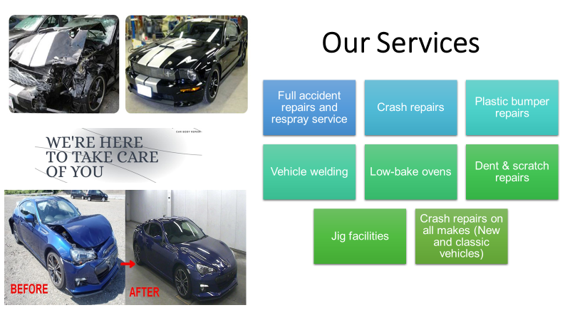

Slide 5

MARKET
The following section will examine the top competitors and determine the many variables that might affect our firm using PESETL Analysis (external factors) and SOWT Analysis (internal & external factors)

Slide 6
Competitor’s Analysis
 | Pal Autos ltd | AJM Autocraft Ltd | Sutton Auto Finish | TJR BodyworkX Ltd
Price | Good | High | High | Cheap
time ( booking, finishing) | Quick services Avoid waiting list | Long waiting list, 4 days work average | Waiting list, slow service | waiting list, quick services
Quality | Very good | High quality | good | Poor
Organizational Culture | Very good | Very good | Good | Good
Costumers target | Local taxi drivers Local car traders | Car insurance companies Classic cars | Car insurance companies Local privet car drivers | Privet costumers
Marketing | Website social media apps business meetings business advertising websites e.g. yell | Website Magazine | Website Social media apps | Do not have
Stability | New set up | 5 years | 7 years | 11 years

Slide 7
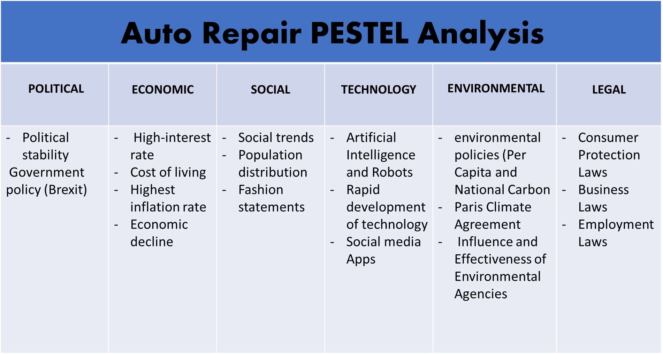

Slide 8
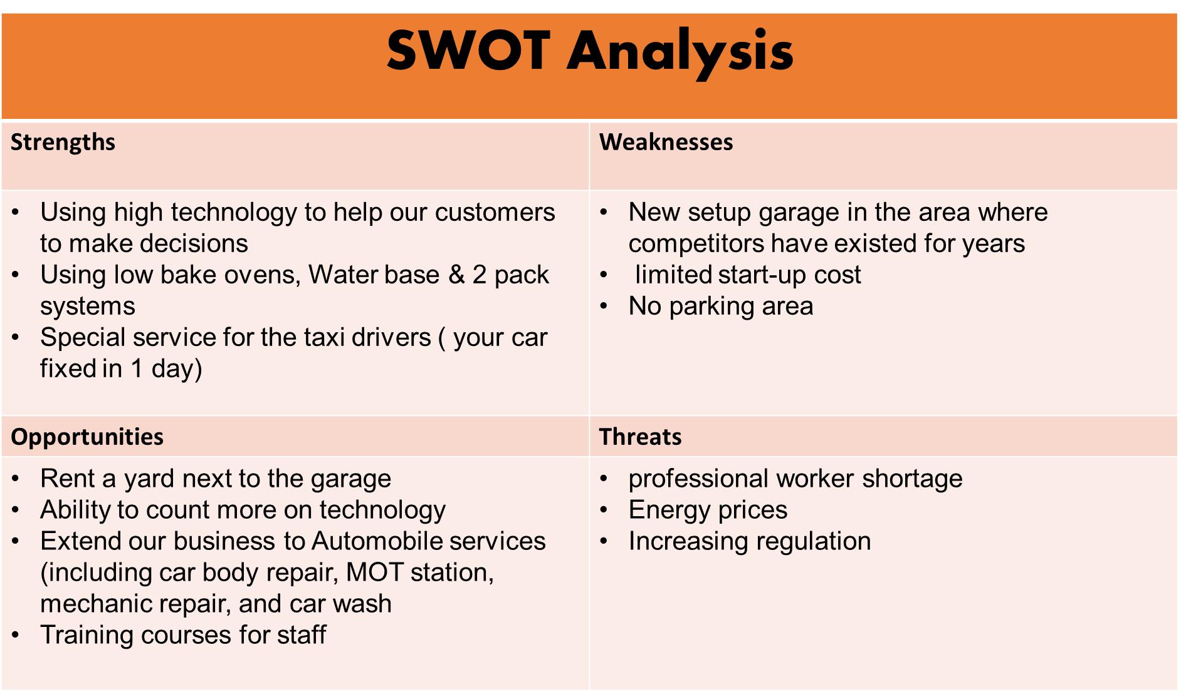

Slide 9
Target Market
A target market, also known as a serviceable obtainable market (SOM), is a definite segment of individuals who share common characteristics to whom a business proposals its products or services. (Sherlock, 2014)
Local auto traders
Taxi drivers' company
Local privet car drivers

Slide 10

“All marketing strategy is built on STP: Segmentation, Targeting, and Positioning”
(Kotler and Keller, 2008)
This Photo by Unknown Author is licensed under CC BY-NC

Slide 11
Segmentation
Segmentation | Description | Estimated size of segment
Geographic | The residents of West Midlands (in 2019 there was increasing of number of car about 7% comparing 2014) | - 5,961,929
Demographic | - Age/ 24 to 60 - Gander/ men - Work (%77.6 of men they are in employment) | 3,165,749 1,332,281 1,037,846
Psychographic | Social group ( Asian, Arab, immigrants, etc Life style/ active | 155,677 232,353
Behavioral | Responsiveness to price Friendly & Extroverted Abused | 185,883 127,794 34,854

Slide 12
Market Targeting
There are 989 car dealers in West Midland
445 taxi businesses operating in this region in 2018.
the West Midlands neighborhoods that have significantly more cars now than they did five years ago about 3,055,252 car (2019).

Slide 13

Market Positioning
Simply, building a brand identity or perception of the good or service in the minds of the target market is a strategic marketing positioning procedure.
Pal Autos position itself as a local:
Friendly and trusted place
Technology accompanies
Fast service
Based on our research, the next slide will show the market plan

Slide 14
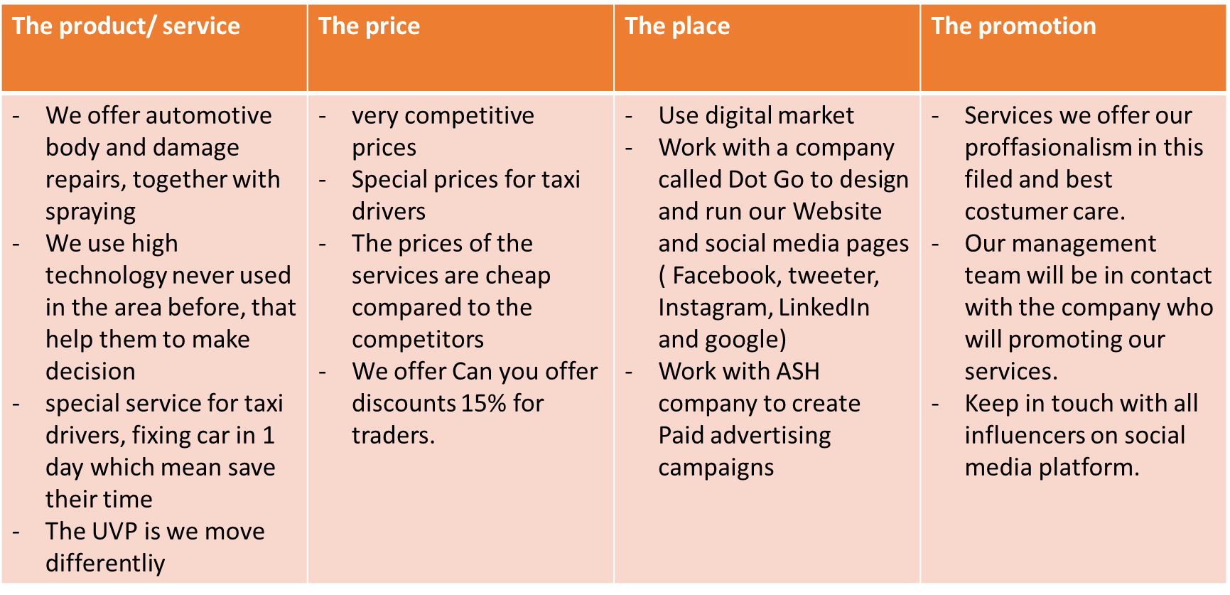
Marketing plan

Slide 15
Team management
Name / job Title | Role | Experience | Qualifications | Skills
Samir Mhanna/ Head manager | Leader Coordinator Team developer Administrator Motivator | 2 years managing a car body repair garages in the UK 3 years painting and preparing cars in the UK More than 9 years same experience in ( Palestine, Egypt, and Greece) | Skills for the workplace L4 Business administration L6 Vehicle Accident Repair (VRQs) Health and Safety | Delegation Emotional Intelligence Boundary Setting Organization Team Building Communication Decision Making

Slide 17
 | Dec-23 | Dec-24 | Dec-25
 |  |  |  | Totals
Sales Income | £313,000 | £400,000 | £450,000 | £1,163,000
Grants | £20,000 | £0.00 | £0.00 | £20,000
Bank Loan | £20,000 | £0.00 | £0.00 | £20,000
Investment by Owner | £18,000 | £0.00 | £0.00 | £18,000
Any Other Income | £0.00 | £0.00 | £0.00 | £0
Total Incoming | £371,000 | £400,000 | £450,000 | £1,221,000
Stock/ Materials | £74,000 | £15,000 | £30,000 | £119,000
Rent & Rates | £24,000 | £24,000 | £24,000 | £72,000
Wages | £108,000 | £120,000 | £160,000 | £388,000
Bills | £36,000 | £45,000 | £50,000 | £131,000
Insurances | £6,000 | £6,000 | £6,000 | £18,000
Repairs and Renewals | £16,000 | £5,000 | £15,000 | £36,000
Motor Expenses | £5,300 | £6,000 | £9,000 | £20,300
Phone/Internet | £1,200 | £1,200 | £1,200 | £3,600
Advertising | £9,800 | £6,000 | £8,000 | £23,800
Print/Stationery | £1,600 | £2,000 | £2,000 | £5,600
Miscellaneous | £6,500 | £5,000 | £3,500 | £15,000
Loan Repayments | £3,600 | £9,600 | £9,600 | £22,800
Bank Charges | £1,200 | £1,200 | £1,200 | £3,600
Accountancy Fees | £1,200 | £600 | £600 | £2,400
Investment in workplace | £0.00 | £100,000 | £40,000 | £140,000
TAX | £0.00 | £15,320 | £10,680 | £26,000
Total Outgoing | £294,400 | £346,600 | £370,780 | £1,011,780
Incoming less outgoing | £76,600 | £53,400 | £79,220 | £209,220
Opening Bank Balance | £0 | £76,600 | £130,000
Closing Bank Balance | £76,600 | £130,000 | £209,220

Slide 19
Break-even point 2023

Slide 20
References
Kotler, P. and Keller, K.L. (2008) Marketing strategy. In London: Business Forum.
Sherlock, Tracie. (2014). "3 Keys to Identifying Your Target Audience". Database: Business Source Complete. Retrieved 23 March 2016.
Wales State, Population estimates by local authority and age. Available at: Population estimates by local authority and age (gov.wales) Accessed on: 6th November 2022

