Slide 1
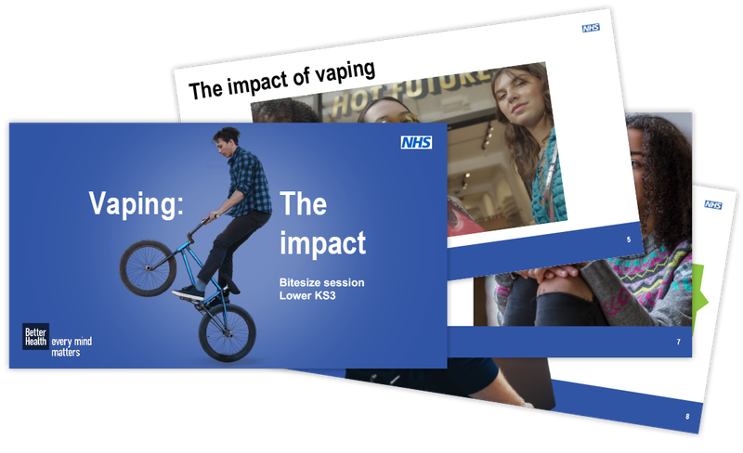

C1: Group Presentation
(Practice intervention)
Breathe Free: Choosing a Tobacco-Free Future
Task 1: The Campaign Breath Free
Module: Social Epidemiology and Public Health Development
Module Code : LCHS 7000
Lecturer: Dr Hamdi Hussain
Student ID:2311121
Student Name Asteria Joseph Nyamhanga Wilson

Slide 2
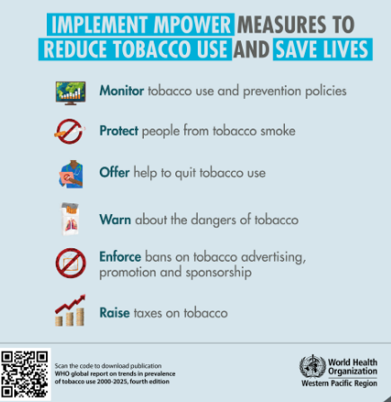
Introduction: Tobacco Control and Health Promotion
Campaign title: Breathe Free: Choosing a Tobacco-Free Future
Health promotion is the prevention of illness through improving behaviour, even before the onset of disease.
In tobacco control, preventing, educating, regulating or supporting activities to decrease exposure to vaping and smoking.
The campaign targets teenagers aged 13- 18 to prevent them from starting nicotine addiction.
Refusal skills, health literacy and decision-making are developed.
There are 8 sessions focused on behaviour aspects associated with environments of family, peers and school.
(Source WHO, 2026)
Notes:
Health promotion is about the prevention of illness through people's incentive to adopt healthier behaviours before illness occurs. This tobacco control campaign reaches young people aged 13 to 18, aims for “Nicotine Free” and builds refusal and decision-making skills to avoid nicotine dependence and maintenance.

Slide 3
6–8 Weekly Sessions: Campaign Activities and Aims
Week | Activity | Content | Aim
1 | Tobacco awareness quiz | Tobacco, nicotine, myths | Build knowledge
2 | Health impact workshop | Lungs, brain, addiction | Explain harms
3 | Peer-pressure role-play | Refusal and communication | Build confidence
4 | Vaping awareness | Nicotine products, marketing | Challenge misconceptions
5 | Trigger mapping | Stress, emotions, social situations | Identify risks
6 | Healthy alternatives | Sport, coping, relaxation | Develop safer strategies
7 | Pledge and goal-setting | Personal tobacco-free goals | Strengthen commitment
8 | Review and support | Quiz, feedback, action plans | Sustain tobacco-free behaviour through practical weekly activities
Notes:
Gradual acquisition of awareness, knowledge and skills takes place over the span of eight sessions. These learners will have the ability to understand the risk and resist peer pressure by engaging in activities like pledge cards, discussions, role play and quizzes.

Slide 4
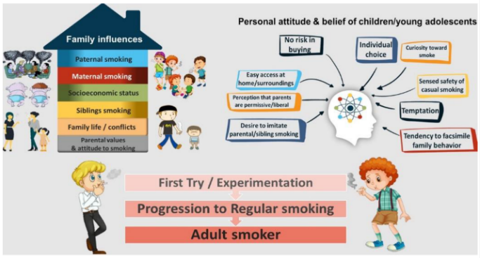
Campaign Rationale: Tobacco Control and Health Promotion
Health promotion takes place before diseases and conditions have a chance to occur, whereas tobacco control prevents tobacco initiation and nicotine dependence (Adams et al., 2023).
Peer influence (among ages 13–18), social norms, and exposure to tobacco smoke and emerging nicotine products are all factors that impact teens aged 13-18.
Knowledge, refusal skills and healthier decision-making can be developed through a campaign that is prevention-focused.
Smoke-Free Futures: Take Control then integrates the elements of education, hands-on program components and social support within these 8 Days.
(Source: Sharma et al., 2020)
(Source: Sharma et al., 2020)
Notes:
As with any health-caring environment, the goal of tobacco control is to prevent adoption of tobacco product use before dependency occurs. This campaign aims to reduce exposure to tobacco smoke and to promote healthier options for young children and young people, using the definable, practical and educational skills of young people to explain what and why.

Slide 5
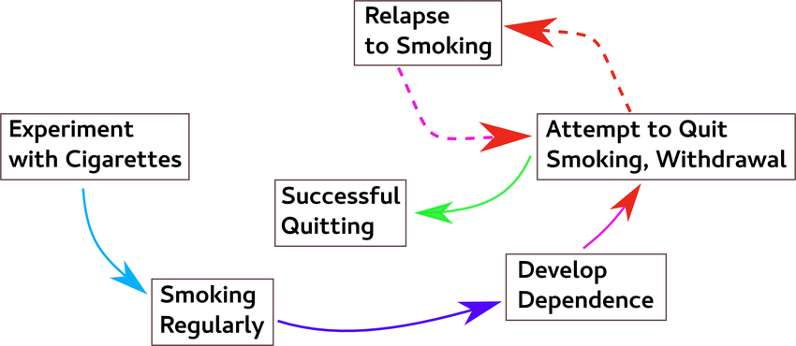
Justifying the Need for Tobacco Control
Early experimentation: It is a time when tobacco experimentation is likely to progress to nicotine addiction.
Protection from harm: Exposure to tobacco can harm the growing respiratory, cardiovascular, and nervous systems (NHS 2025).
Peer pressure: Acceptance and peer pressure may lead to experimentation among teens.
Emerging nicotine products: The use of vapes and other nicotine products makes prevention difficult.
Long-term prevention: Prevention at an early age saves in future diseases, dependency and health costs.
(Source: Sharma et al., 2020)
(Source: Khan, 2022)
Notes:
Tobacco control is important due to the fact that it determines one's lifetime habits. Initiation, peer pressure, and the emergence of new nicotine products are key prevention measures.

Slide 6
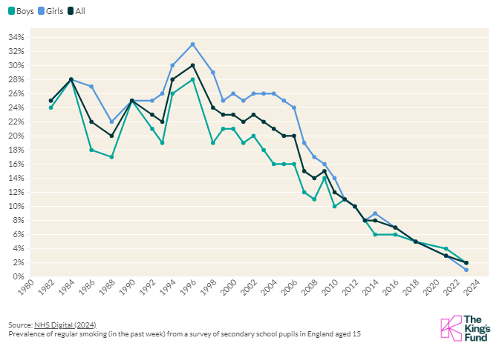
Social Determinants of Teenage Tobacco Use
Social determinants are factors that influence health behaviours, such as family environment, income, education, peers and neighbourhood environment.
Parental smoking, peer acceptance, stress and exposure to tobacco or vaping use could go into the equation with teenage tobacco use (Mays et al., 2024).
Such influences may render individual education somewhat ineffective.
The campaign therefore leverages the use of peer discussion, family awareness, and school support for resilience.
For instance, refusal role-play will assist the teen to cope with stress without harming friendships.
(Source: kingsfund.org.uk, 2025)
Notes:
Factors affecting family, peers, socioeconomic status, education, stress and neighbourhood environments are among the factors that influence teenage tobacco behaviour. Awareness of these determinants allows interventions that affect social influences and individual knowledge and choices.

Slide 7
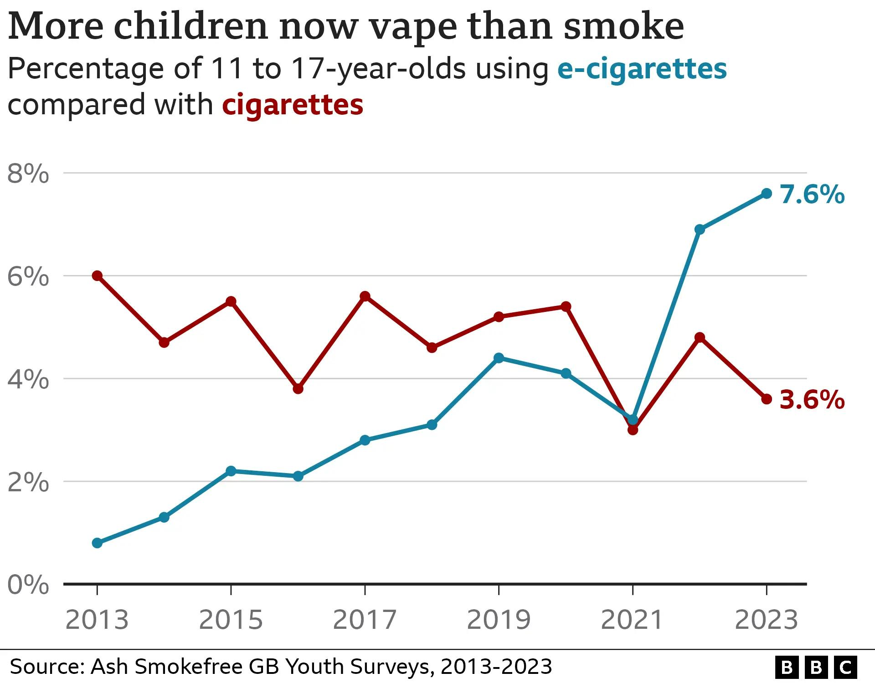
UK Tobacco-Control Guidelines and Youth Statistics
The campaign promotes predependence instead of dependence.
9% are currently using electronic cigarettes, and that is the reason why the approach taken in controlling tobacco should be modern.
1% of Year 8 and 11-15 children in England are currently smokers, and 1% are regular smokers (NHS England, 2025).
Improving prevention and protection through banning the sale of tobacco products to minors.
Tobacco control targets by the UK government are to ensure that young people stay clear of smoking and do not become dependent on nicotine (Khan, 2022).
(Source: Foster, 2024)
Notes:
UK tobacco control laws forbid the sale of tobacco to those under 18 years of age and focus on prevention. Youth statistics reflect ongoing exposure to tobacco and vaping – a sign of the importance of intervention early in the process before dependence is formed.

Slide 8
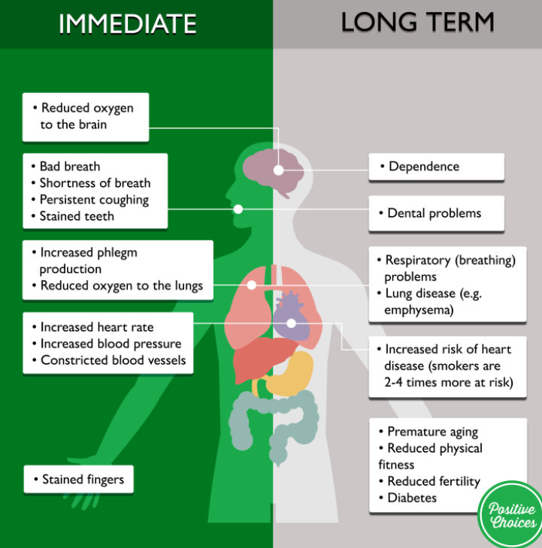
Short-Term and Long-Term Consequences of Tobacco Use
Short-term symptoms include coughing, irritation of the throat, inability to do exercises properly, craving for nicotine, and difficulty concentrating.
Nicotine dependency is easily formed in teenagers because of their frequent intake of nicotine (Karatayev et al., 2024).
These long-term effects include chronic respiratory disease, cardiovascular disease, and cancer.
Thus, the prevention of starting tobacco use from the ages of 13 to 18 years can have health benefits across the lifespan.
The consumption of tobacco leads to coughing, shortness of breath, addiction, irritation, difficulty exercising, and physical dysfunction throughout the day (NHS, 2024).
If one continues to be exposed to tobacco, it results in increased cardiovascular disease, respiratory diseases, and cancer.
(Source: Positivechoices, 2022)
Notes:
Immediate symptoms of tobacco exposure include respiratory irritation, cravings, and decreased performance. Ongoing exposure leads to a lifetime risk of cardiovascular diseases, respiratory illnesses and various cancers.

Slide 9
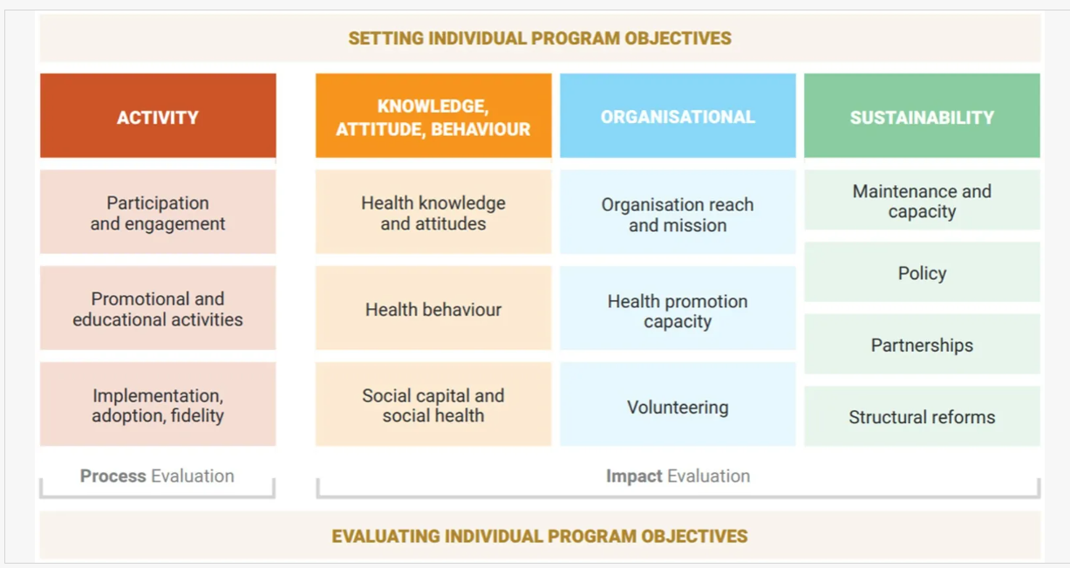
Behaviour-Change Activities and Individual Support
A change in behaviour requires skills rather than knowledge.
The skills can be acquired through various ways such as tests, debunking misconceptions, peer pressure refusals, lung volume tests, and triggers (Allen, 2024).
Teenagers learn to say no through refusals and adult identification.
Positive behaviours include sporting activities, creation, breathing and stress management (Bartos et al., 2022).
Individual plans motivate realistic and measurable objectives within 8 weeks.
(Source: Simpson et al., 2025)
Notes:
Interactive activities make learning practical. Through role play, quizzes, demonstrations, trigger mapping and action planning, teenagers are becoming aware of risks and how to avoid peer pressure, as well as learning healthier coping mechanisms.

Slide 10
Three Measurable Campaign Aims
Campaign aim | Measurement | Target | How it will be measured | Expected benefit | Timescale
1. Prevent tobacco initiation (35%) Reduce first-time use of cigarettes or e-cigarettes among participating teenagers. | Pre/post knowledge quiz | 15% improvement in tobacco non-initiation | Compare baseline and post-campaign responses on first-time tobacco use | Better informed health decisions | Week 8
2. Strengthen refusal skills (35%) Improve teenagers’ ability to resist peer pressure. | Structured role-play assessment | 20% improvement in refusal confidence | Score teenagers across 3 structured peer-pressure role-play scenarios | Greater confidence resisting peer pressure | Weeks 3–6
3. Increase tobacco knowledge (30%) Improve understanding of tobacco harms, nicotine addiction and product risks. | Anonymous baseline/follow-up questionnaire | 25% improvement in knowledge and reduced experimentation intentions | Compare pre/post questionnaire scores on health risks and intention to experiment | Lower intention to experiment with tobacco | Week 8
Notes:
These indicators measure awareness, confidence in refusal, behavioural intention, and protective behaviour. The pre-test and post-test will document improvement, whereas the follow-up will determine if this improvement is sustainable.

Slide 11
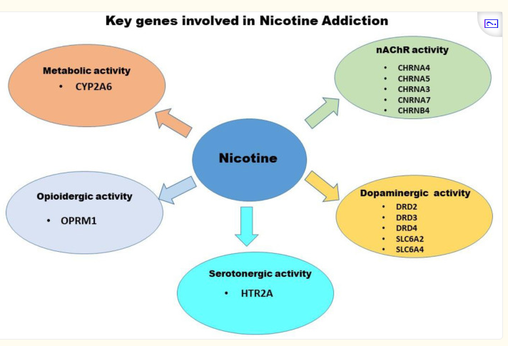
The Expected Benefits of Three AIMS
Nicotine awareness improved: Will improve the awareness of teenagers regarding nicotine addiction and the risks and dangers associated with experimentation with tobacco products.
Refusal skills enhanced: Enhances the self-confidence of teenagers to deal with peer pressure and make firm decisions to refrain from using tobacco products (Lockett et al., 2026).
Reduced intention to use tobacco: Reduces the likelihood of engaging in smoking and vaping activities.
Prevention maintenance: The combination of knowledge, confidence, and lower intentions helps in developing healthy behaviour and maintaining good health in the future.
(Source: Lockett et al., 2026)
Notes:
All in all, these objectives will aid in enhancing their knowledge, self-efficacy and decision-making abilities, thus enabling them to withstand social pressure from smoking.

Slide 12

Conclusion
The campaign employs health promotion, social epidemiology and behavioural change theory in the prevention of tobacco initiation.
Eight fidelity-enhancing sessions develop knowledge, refusal skills and supportive social norms.
Evaluation involves measuring knowledge, confidence and experimentation, which enables the prevention of smoking among teenagers.
Follow-up outcomes will investigate more successful, healthier life-course trajectories effectively and sustainably.
Notes:
The campaign involves health promotion, social epidemiology and behaviour change theories that aim at preventing smoking among young people under the age of 18 years. The campaign is well structured; it provides for measurable outcomes and has an effective evaluation process.

Slide 13

C1: Group Presentation
(Practice intervention)
Campaign Design For Teenage Smoking and Vaping Cessation
Task 2: The Campaign Breath Free
Module: Social Epidemiology and Public Health Development
Module Code : LCHS 7000
Lecturer: Dr Hamdi Hussain
Student ID: 2223485

Slide 14
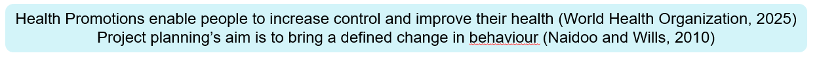
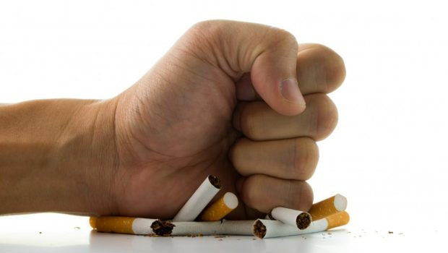
Campaign
Breath Free: Tobacco Free Future
Campaign Overview
A health Promotion Campaign to prevent the uptake of tobacco and vapes among teenagers(13-18).
Campaign is designed using Ottawa Charter for Health Promotion.
The Campaign aims to prevent smoking and vaping initiation by increasing knowledge and healthy behaviours.
Campaign is evaluated using the established evaluation frameworks.
This Photo by Unknown Author is licensed under CC BY-SA-NC

Slide 15
Needs Assessment Before Designing a Campaign
Breath Free combines a subjective view, professional judgement from teachers, school nurses and youth workers on where the tobacco experimentation is emerging.
With the objective view that freedom from preventable harm is the universal right for young people(Naidoo and Wills, 2010).
Target Population: Young People age 13-16, the identified age in which experimentation typically begins
Needs Assessment will :
Targets the schools and groups most at risk
Identifies which action should be given priority.
Ensure fair allocation of resources
Informs planning and appropriate commissioning of services

Slide 16
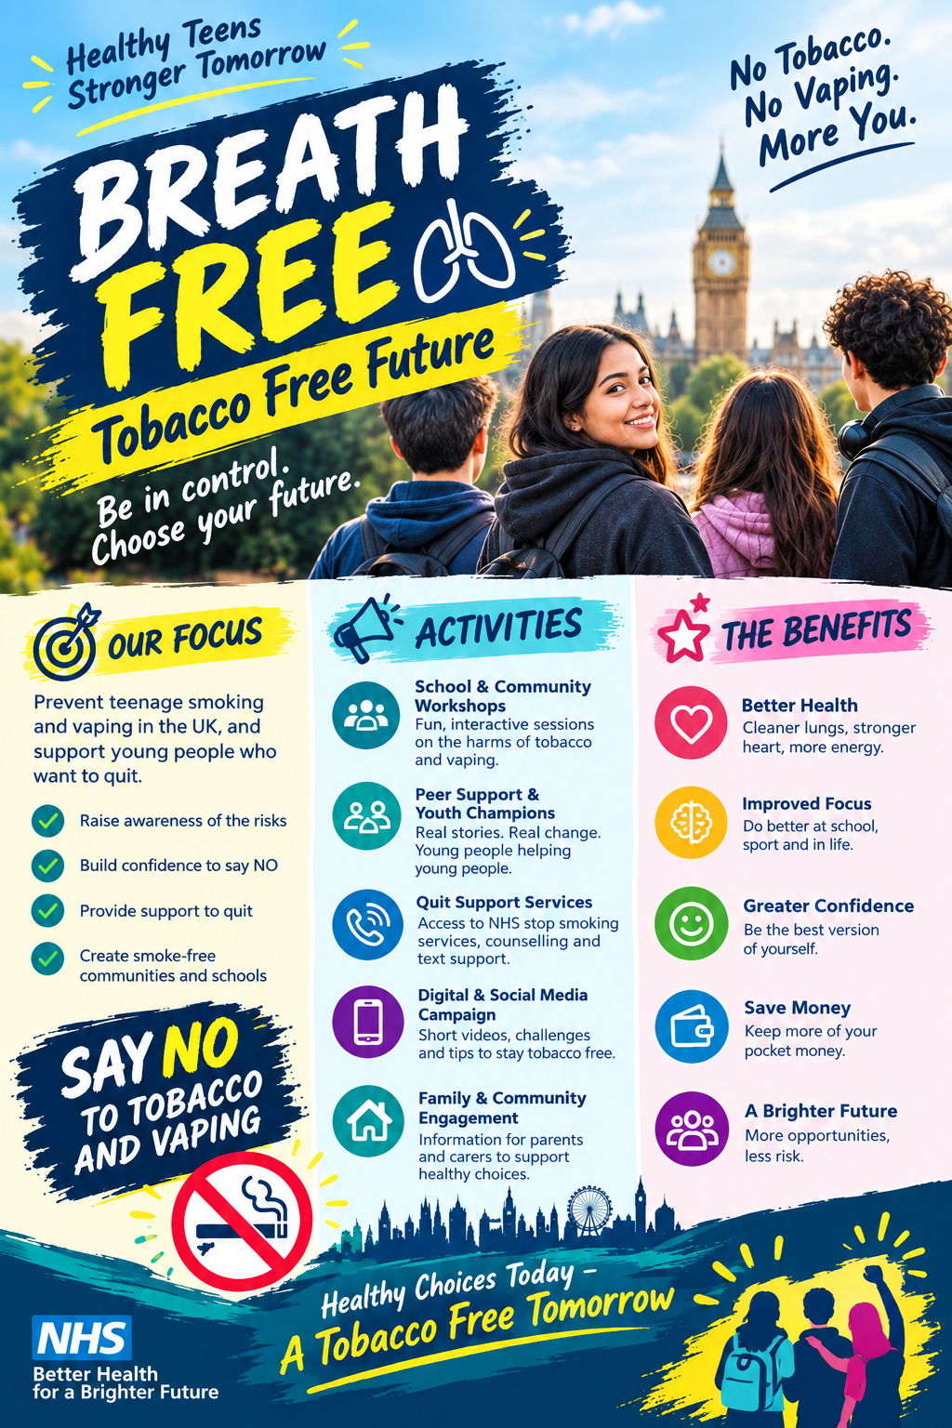
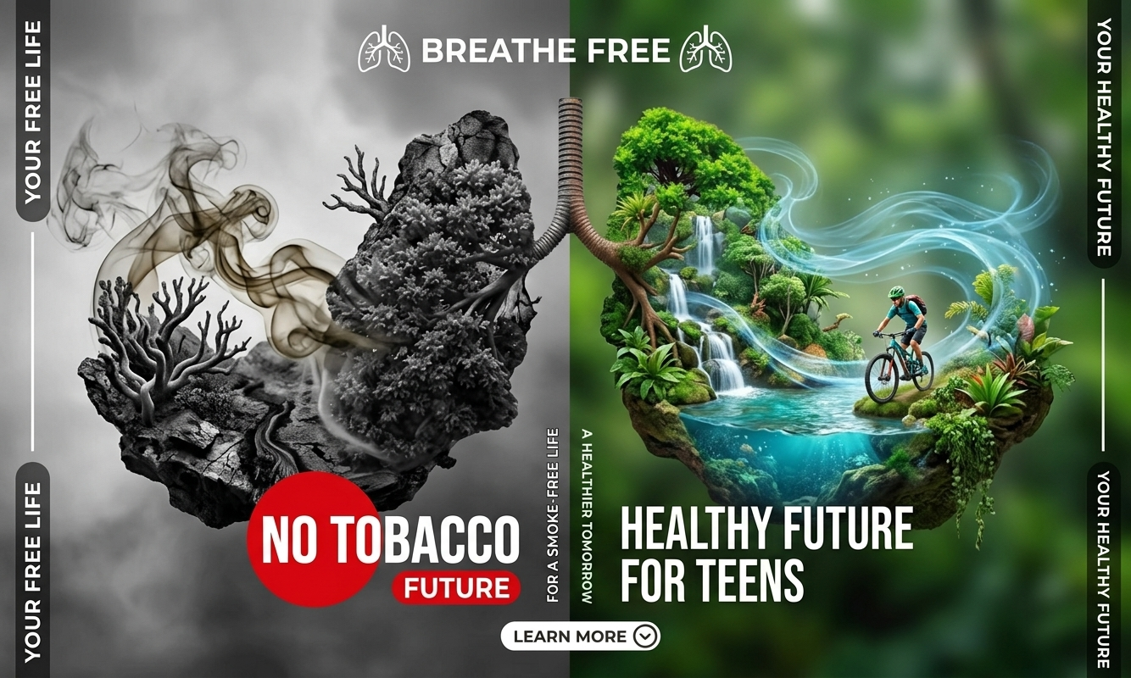
The Campaign: Slogan/Focus/Activities/Benefits
(Google, 2025; Canva, 2025)

Slide 17
Why a Tobacco Free Future Starts with Teenagers
Background and Rationale
Tobacco cause 7 Million deaths per year globally
Tobacco is the major cause of cardiovascular disease, respiratory conditions and cancer
Nicotine is highly addictive and damage brain development in young people
155 Million global smokers are between the age of 15 to 20 years (IHME, 2019).
Most adults first smoke when under the age of 18
In England, 4000,000 11-15 years old initiated smoking
NHS Long-Term Plan calls for a shift towards preventive approaches
The Marmot Review shows unhealthy behaviours like smoking are patterned by inequality so the target should be the teenagers in lower income disadvantaged communities
(World Health Organization, 2025b; Action on Smoking and Health, 2024; Marmot, 2010; NHS England, 2019).

Slide 18
Types of Evaluation
Evaluation is done before delivery so that the right data will be collected at the right time (Rootman.et.al. , 2001).
Evaluation provides feedback on the effectiveness of a programme.
Help to determine the appropriateness of intervention for the target population.
Target problems with its implementation.
Targets ongoing concerns that need to be resolved (O’Connor Fleming & Parker, 2001).
Process: Reach, acceptability, integrity, quality.
Impact: Immediate impact of intervention to measure shift in attitude.
Outcome: Ultimate goals of programme to measure long-term effect.
Summative: Conducted at the end of the programme and evaluate the whole cycle and take future decisions.
Cost-Effectiveness: To measure return and investment
(Hawe, Degeling and Hall,1990 ; Hawe, 1994)

Slide 19
Evaluation of Breath Free
Process
Were inputs delivered as planned/ Performance Indicators (PIs) set at the planning stage
Log workshops delivered, posters and material distributed, teacher and student feedback collected through questionnaires and observation, ambassadors trained.
Impact
How well objectives are met? Short-term change upto 6 months after deliver.
Pre/post questionnaire on tobacco harm, attitudes and confidence to refuse. Pop-up survey after the Personal No-Smoke Pledge, as in Stoptober Personal Quit Plan (Public Health England, 2018).
Outcome
Was the overall goal achieved? Long-term behaviour and policy change.
6- 12 months follow-up od student’s tobacco use against baseline, record new smoke-free school policies and retailer age of sale compliance.
Summative
Cost-Effectiveness
Whole cycle review
End of year review with schools, parents, students and partners (Ottawa Charter’s mediate activities), following recommendations (Saan and Wise, 2011)
Cost per unit of change.
Track resource spending throughout, report coat per student reached and per person who stays tobacco free.
(Rootman et al., 2001; Hawe, Degeling and Hall, 1990)

Slide 20
How to evaluate achieved Aims
Ottawa Charter Lense
Equity: compare school groups results to check the gap is not widening.
Community ownership: students and parents help design and interpret survey
Equal Partners: All stakeholders involved
Indicator | Target | Method
Campaign Recognition | 60% students | Tracking survey
Students recognizing harms of tobacco use | 70% | Questionnaire
Completion of personal no smoke pledge | 40% of year 9-11 | Pledge tool completion data
Self-efficacy, confidence to refuse | Increase vs baseline | Attitude scale
Past 30 days tobacco experimentation | 15% reduction | Baseline vs 6 months follow-up survey
Policy change: smoke free spaces, retailer compliance | All partner schools | Policy audit, trading data
When to measure:
Baseline before launch
During: monthly process log
Immediate after: Impact survey
6-12 months: Outcome follow-up
Public Health England (2018), Stoptober KPIs followed to set targets

Slide 21





Potential Partners: Local Area
It runs stop smoking support and public health work to improve health and reduce inequalities (Birmingham City Council, 2025)
PSHE association supports teachers with quality resources and guidance to improve health education in schools (PSHE Association, 2022).
School Nurses give advice and refer teenagers to local services.School Nurses(NHS , 2026)
Pharmacies supported by local council
offer quit smoking kits (Mentor, 2023)
LAs support councils to share good practice(LA, 2026)

Slide 22
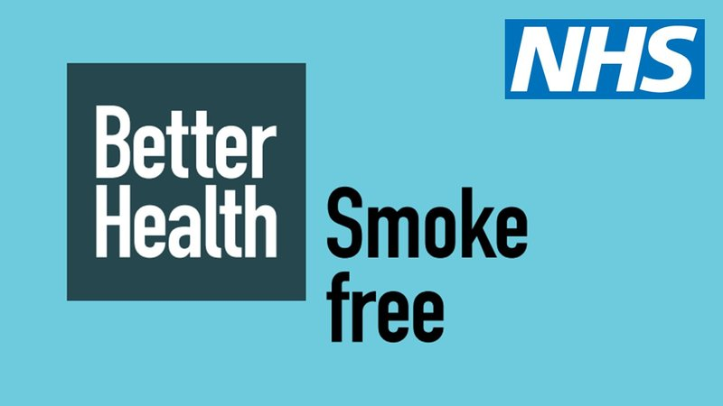
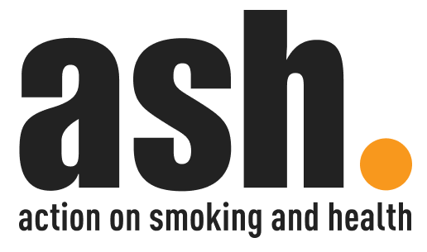

National Organisations
A charity working to reduce harm from tobacco (ASH, 2023)
Runs Stoptober to help people quit smoking
(Department of Health and Social Care, 2022)
A charity fighting heart and circulatory diseases and targeting preventable factors, smoking is one of the major cause(British heart foundation, 2024)

Slide 23
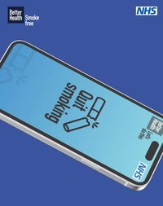
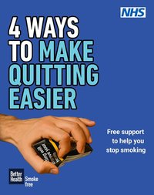
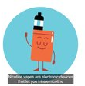
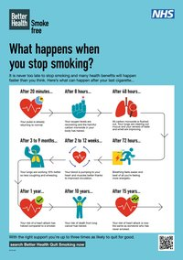
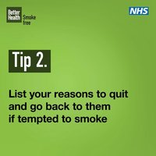
Replicated Resources
(Department of Health and Social Care, 2022)
Notes:
A selection of always-on animated social assets promoting the benefits of quitting smoking, the Personal Quit Plan and the NHS Quit Smoking App.
A set of six static frames promoting the range of quit smoking support available to enable you to create a carousel for Facebook. Editable version available via Partnerships@dhsc.gov.uk.
A video in 02:02 and 00:15 length formats explaining how nicotine vapes can be used to quit smoking. Longer form for websites and shorter form for social media.
A short animation promoting tips to help quit smoking for use on social media. MP4 format.
A3 poster outlining the benefits of quitting smoking. Available to download.

Slide 24


Module: Social Epidemiology and Public Health Development
Module Code: LCHS7000
Lecturer: Dr Hamdi Hussain
Student Name: Shabnam khan
Student ID: 2312156
Group Presentation
Task 3 Component 1
Benefits and Challenges
Breath Free:
Choosing A Tobacco Free Future
(Narongrit Doungmanee, 2025)

Slide 25
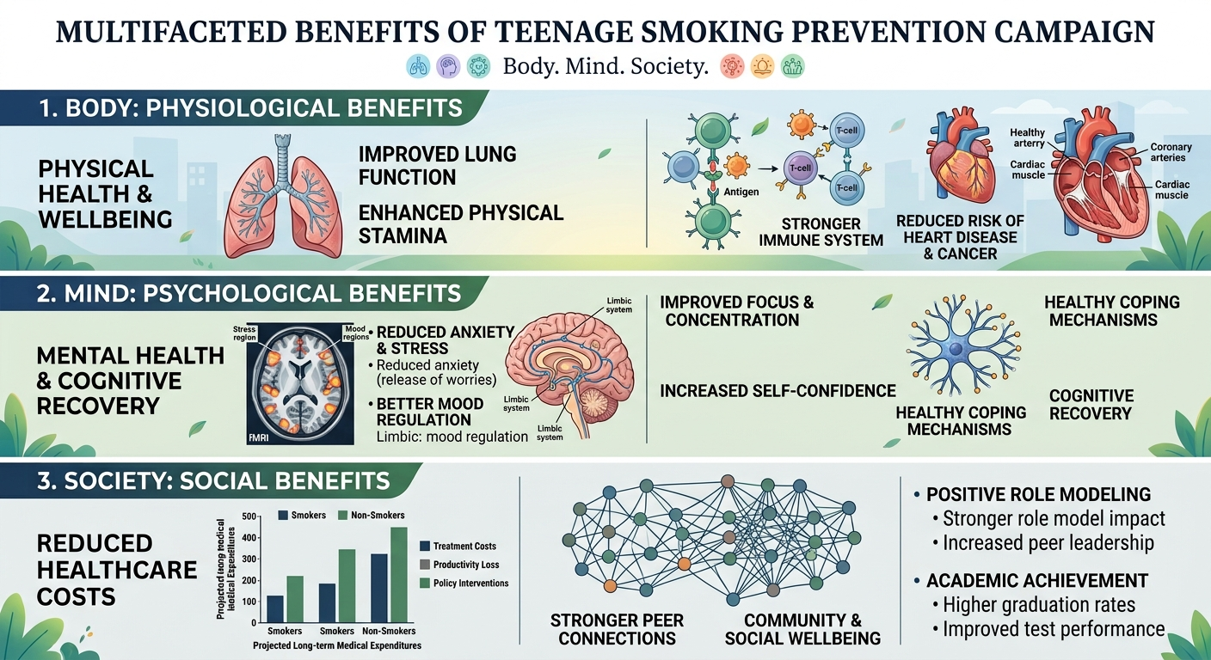
Campaign Aim:
To prevent teenagers from starting to smoke and vape by building knowledge and healthy behaviours and to support those who want to quit
What Teenagers gain by staying tobacco and vape free
What stands in their way, explained by theory.
How to overcome the barriers
Infographic Generated from Gemini, (2025)

Slide 26
Physiological Benefits
Behaviour is what people do. It is shaped by biology, psychology and social environment not by individual choice alone(Institute of Medicine, 2001).
Healthier Lungs
Good Heart Health
Brain Development
Improved Physical Fitness
The improvement in lungs start as early as 20 minutes after the final cigarette and breathing improves (British Lung Foundation, 2026).
Heart rate and blood pressure begins to normal after 20 minutes of quitting smoking and within a year risk of heart attack reduces to half (British Heart Foundation, 2023; Denscombe, 2007).
People who stopped smoking perform better in memory and thinking tests as compared to smokers (Alzheimer’s Research UK, 2024).
Smoking is directly associated with decreased fitness test due to high intake of chemicals in the body (NHS, 2023; World Health Organisation, 2020).

Slide 27
Sociological Benefits
According to Institute of Medicine (2001), behaviours are socially patterned. Health follows a social gradient, the lower the person’s social position, the worse their health(Marmot, 2010). UK Tobacco-free generation policy and UK Act, aimed a tobacco free future. (Matthes and Berrick, 2026).
Peer Influence
Smoke –Free Role Model
Financial stability
Educational Outcome
Equity
In UK, 99% of teen smokers started smoking with peers and family (NCSCT, 2021; Nicorette, 2026).
NHS Lanarkshire has launched its Positive Smoke-Free Role Models project help people to quit smoking for protecting passive smoking among children. This project helps preventing children and young people from becoming the next generation smokers (NHS, 2021; NHS, 2023).
A 20-a-day smoker could save £2,405 a year if they quit (Department of Health and Social Care, 2012).
Researcher found smokers aged 15 achieved lower grades in their GCSEs than their non-smoking counterparts (Bristol, 2026).
Nice guidelines suggest schools to take proactive approach to prevent smoking and reduce inequalities caused by smoking and low education in young people (Bristol, 2026).
Notes:
The UK is the third country to adopt a tobacco-free generation policy aimed not just at reducing or delaying smoking uptake, but at progressively making smoking obsolete for future generations. With the passage of the UK Act, attention has turned to implementation (Matthes and Berrick, 2026).

Slide 28
Psychological Benefits
According to Institute of Medicine (2001), psychological factors shape both health and smoking behaviour.
Confidence and control
Focus and wellbeing
Lower chances of anxiety and depression
According to ASH (2024), 1.1. million young people in UK between the age of 11-17 vape and 1000,000 smoke and they are at the higher risk of depression and anxiety (Whittaker, 2025; Mental Health Foundation, 2021).
Improved focus and productivity among teens who quit smoking (Mental Health Foundation, 2021; ASH, 2024).
Children through interventions and campaigns are trained to say NO if offered cigarettes. INTENT at University of Leeds is one such example to train young people how to handle peer pressure (Lewis , 2026).
Notes:
The UK is the third country to adopt a tobacco-free generation policy aimed not just at reducing or delaying smoking uptake, but at progressively making smoking obsolete for future generations. With the passage of the UK Act, attention has turned to implementation (Matthes and Berrick, 2026).

Slide 29
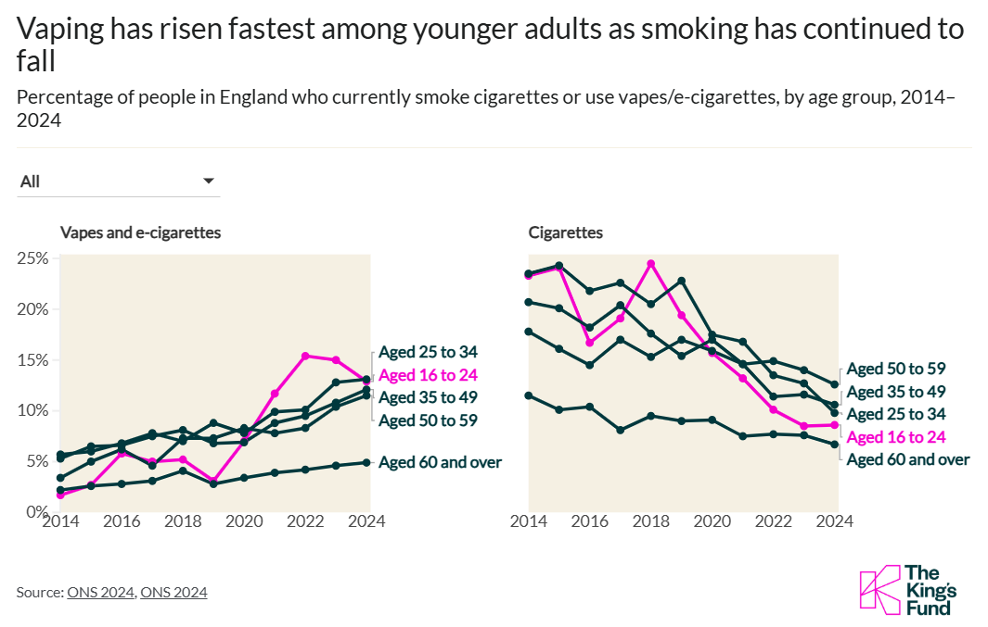
The Next Phase of Tobacco Control
(Asamoah, 2026)
Notes:
Youth smoking has dropped hugely in the last 20 years — from about a third of 16–24 year-olds smoking in 2000 to just 8.6% in 2024, the biggest fall of any age group. That's a real public health win. But as smoking fell, vaping rose. New polices now try to stop young people taking up vaping while still helping smokers switch away from cigarettes. Vaping isn't risk-free though — its long-term effects are dangerous, and despite the fruity flavours and branding, it shouldn't be seen as "healthy."

Slide 30
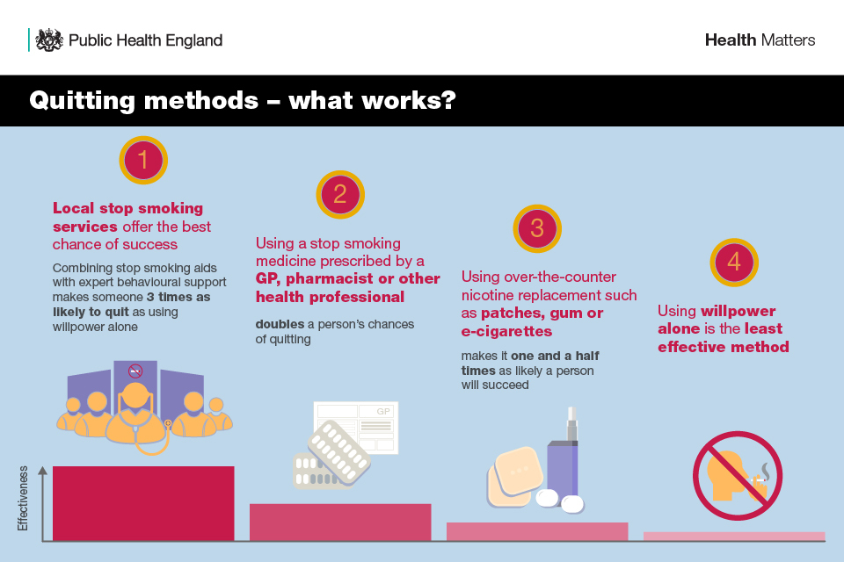
Smoking Cessation Support
Three main smoking aid offered in UK are prescription tablets, NRT(patches, gum , inhalers), E-Cigarettes
NICE recommends offering combination NRT for the smokers trying to quit.
Behavioural support and combination NRT (nicotine patch plus a faster-acting nicotine product) is the recommended treatment for young people who wish to stop smoking.
(Public Health England, 2019; NCSCT, 2026)

Slide 31
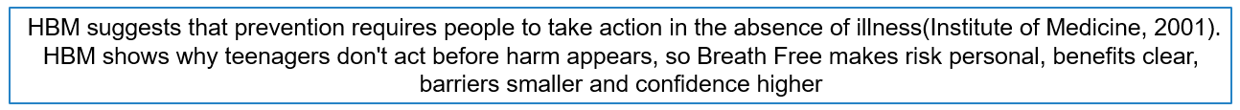
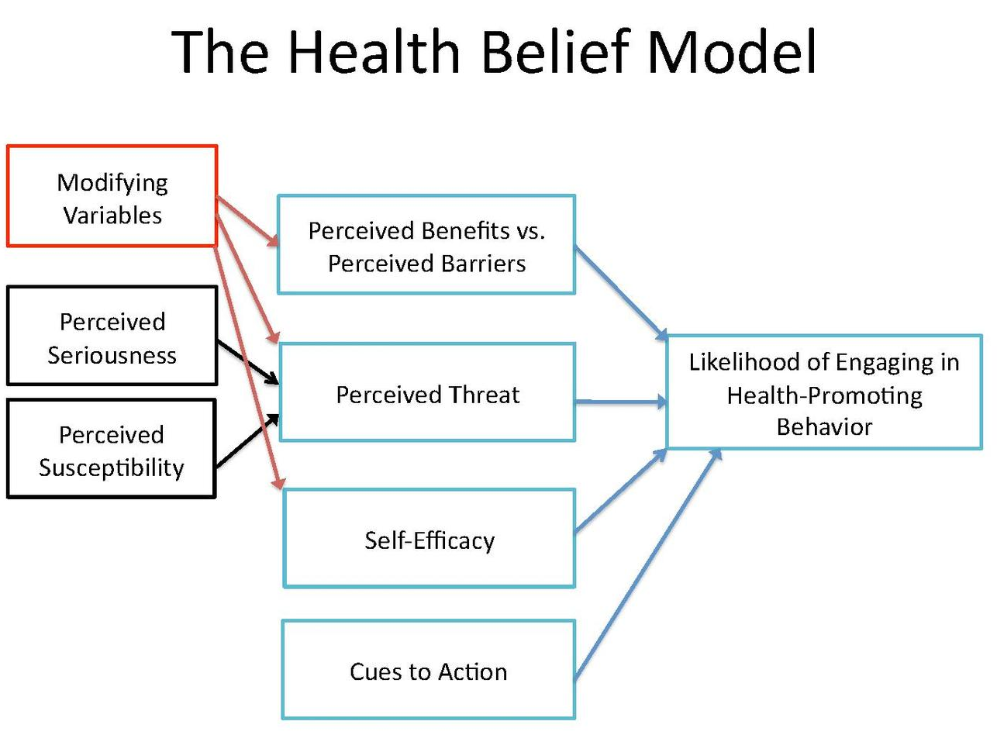
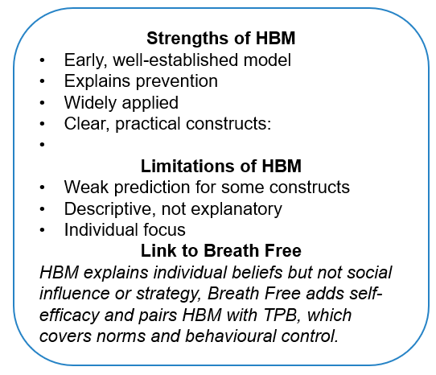
Barriers to Changing Behaviour from Theoretical Perspective
(Urich, 2020)
(Steckler, McLeroy and Hotzman, 2010; Rosenstock, Strecher and Becker, 1988: Institute of Medicine,2001),
Notes:
Because severity is a weak predictor and HBM offers no strategy for change, Breath Free pairs it with TPB to address social norms and behavioural control. This also justifies using two models.
Strengths of HBM Early, well-established model: one of the first theories built to explain health behaviour, so it is widely recognised (Hochbaum, 1958, cited in IOM, 2001). Explains prevention: it recognises that people must act before illness appears, which helps explain why they avoid screening or prevention (Rimer, 1990, cited in IOM, 2001). Widely applied: it has been used for vaccination, screening, exercise, nutrition and smoking cessation (Strecher and Rosenstock, 1997, cited in IOM, 2001). Clear, practical constructs: susceptibility, severity, benefits and barriers point to specific messages a campaign can target. Can be improved: adding variables such as self-efficacy, or combining it with other models, strengthens its predictive value (IOM, 2001). Limitations of HBM Weak prediction for some constructs: perceived severity does not reliably predict protective behaviour (Rimer, 1990, cited in IOM, 2001). Janz and Becker (1984, cited in IOM, 2001) review its limitations. Descriptive, not explanatory: it says what beliefs matter but not why they form, and it suggests no strategy for change (Rosenstock and Kirscht, 1974, cited in IOM, 2001). Individual focus: it centres on personal beliefs, not social norms, environment or access. This point is my own evaluation, not from the excerpt. Cite a source if you keep it. Link to Breath Free Because HBM explains individual beliefs but not social influence or strategy, Breath Free adds self-efficacy and pairs HBM with TPB, which covers norms and behavioural control.

Slide 32
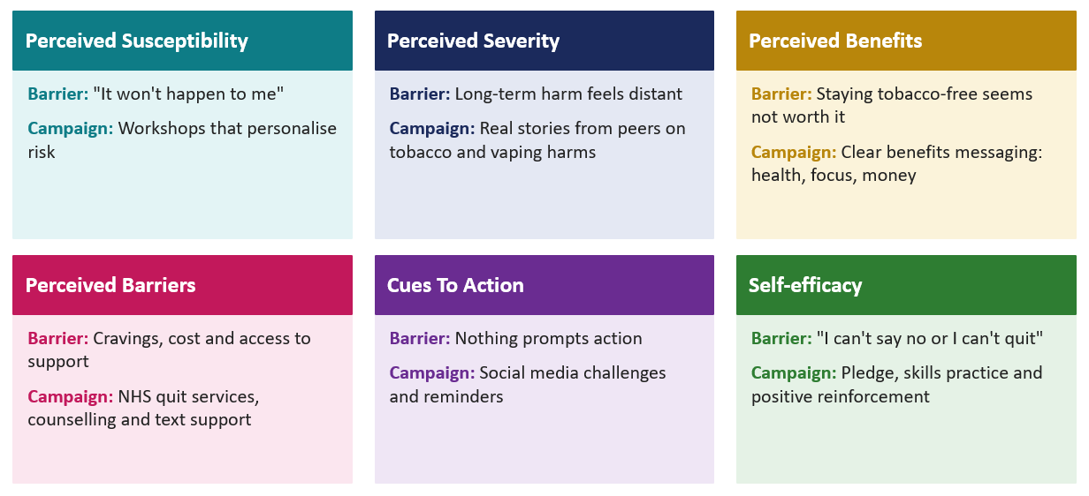
Health Belief Model: Teen Behaviour Barriers and Breath Free
(Rosenstock, Strecher and Becker, 1988)

Slide 33
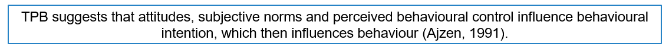
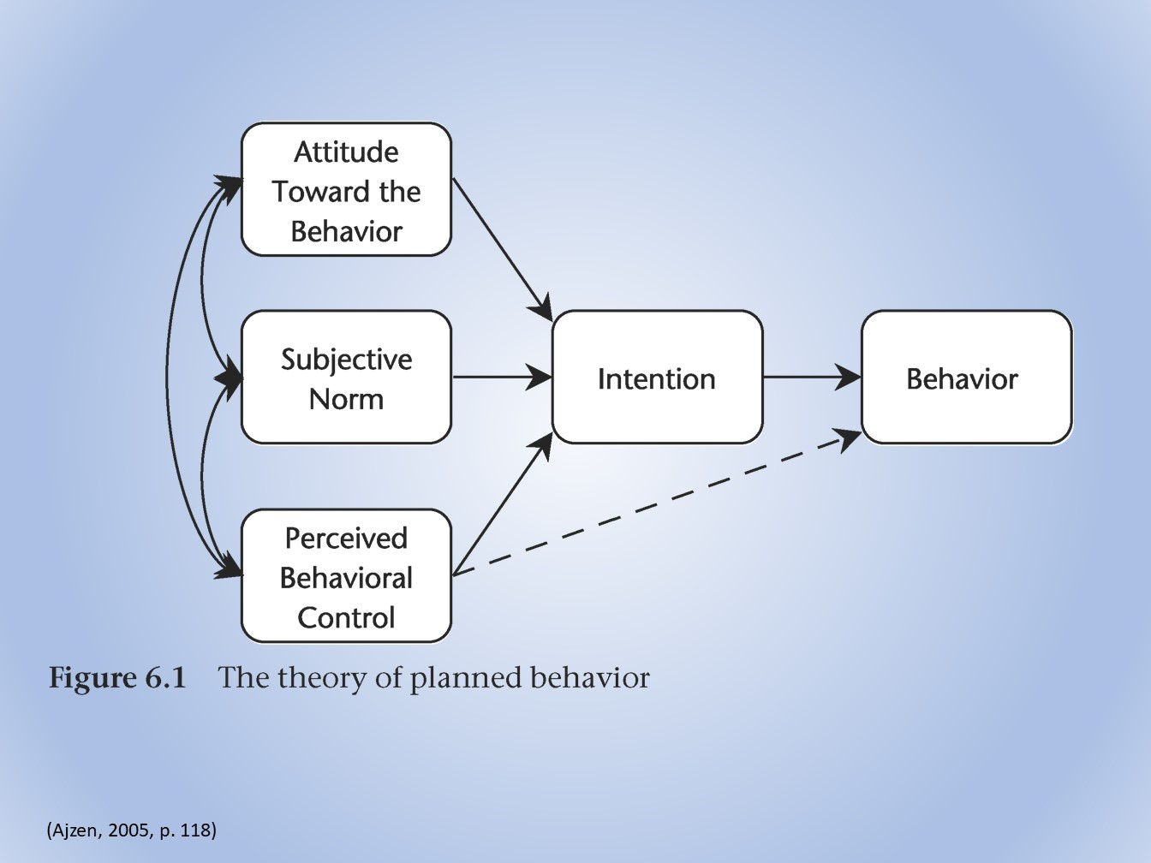
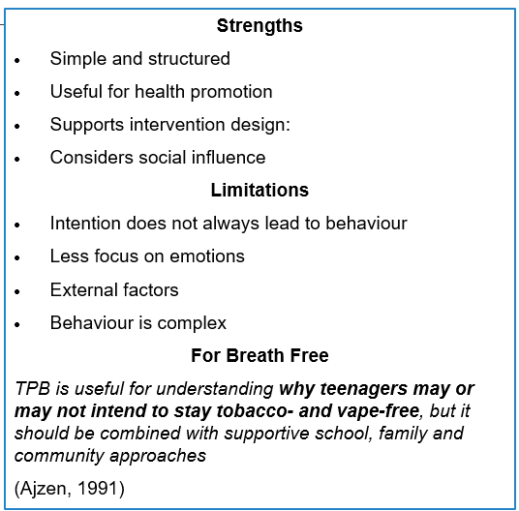
Theory Of Planned Behaviour
(Ajzen, 1991)
Notes:
Strengths
Simple and structured: Explains behaviour through attitudes, subjective norms and perceived behavioural control.
Useful for health promotion: Can identify barriers and factors influencing health behaviours.
Supports intervention design: Helps campaigns target beliefs, peer influence and confidence to change behaviour.
Considers social influence: Recognises that opinions and expectations of others can affect behaviour.
Limitations
Intention does not always lead to behaviour: Teenagers may intend to avoid vaping but still vape because of peer pressure or availability.
Less focus on emotions: Strong emotions, habits and impulsive decisions may not be fully captured.
External factors: Environment, family circumstances and access to tobacco/vapes can affect behaviour beyond individual control.
Behaviour is complex: The three main components may not explain every factor influencing teenage smoking or vaping.
For Breath Free: TPB is useful for understanding why teenagers may or may not intend to stay tobacco- and vape-free, but it should be combined with supportive school, family and community approaches.

Slide 34
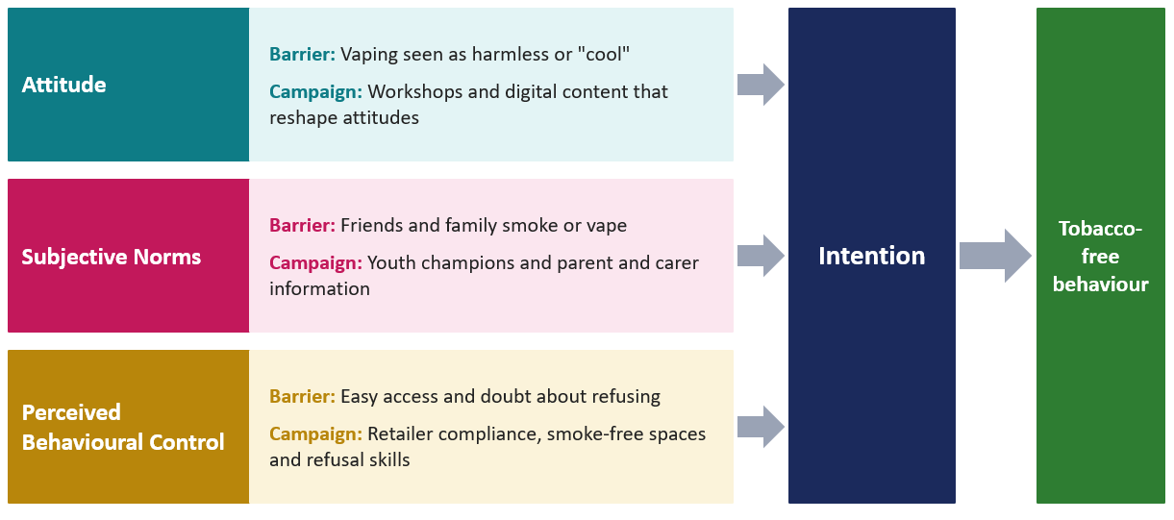
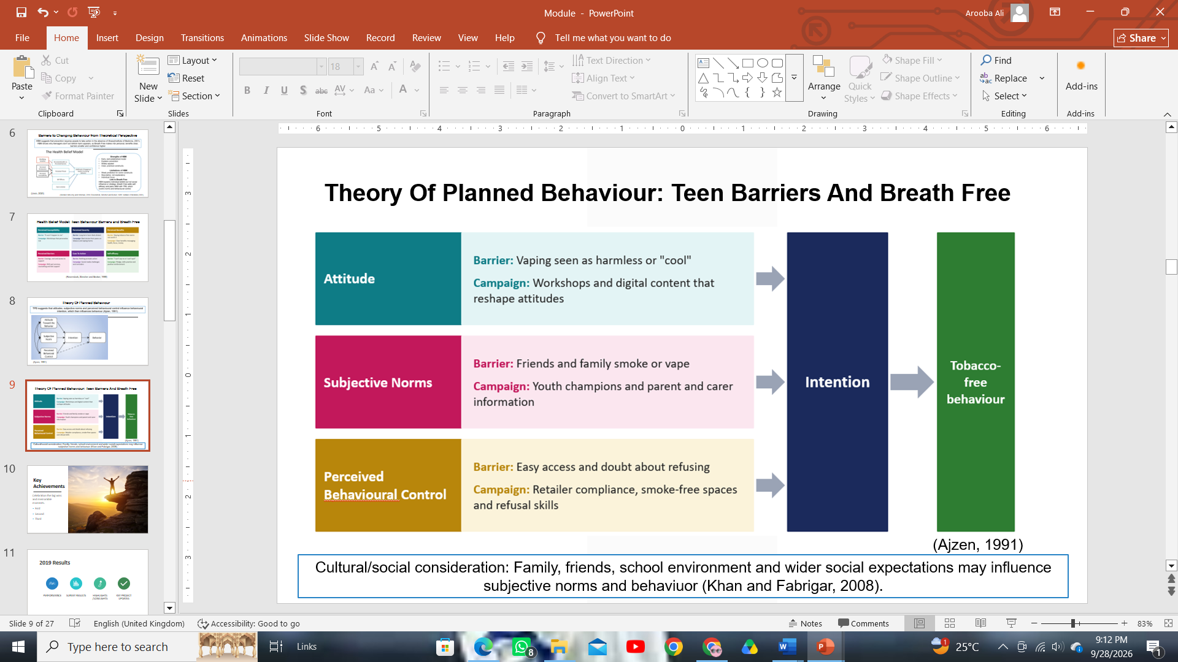
Theory Of Planned Behaviour: Teen Barriers And Breath Free
(Ajzen, 1991)
Notes:
Cultural/social consideration: Family, friends, school environment and wider social expectations may influence subjective norms and behaviour, so the campaign should use inclusive and culturally appropriate messages. health behaviour is shaped by more than knowledge and that context and culture should be considered (Khan and Fabrigar, 2008).

Slide 35
Proposed Solutions To Overcome Barriers And Challenges
Peer pressure : Role-play and refusal skill training through workshops to build confidence to say No (Lewis , 2026).
Lack of Knowledge: Deliver simple, and easy to understand health education on smoking/vaping risks (Denscombe, 2007).
Low confidence/Self Control: Quizzes , scenarios and pledges to increase self-efficacy(NHS, 2021).
Social Media Influence: Relatable social media messages promoting tobacco/vape free lifestyle (Matthes and Berrick, 2026).
Difficulty accessing support: Signpost to school staff, NHS Stop-Smoking services and trusted adults(Public Health England, 2019).
Nicotine dependence/Cravings : Spread knowledge about pharmacies and local services that offer combination NRT( Nicotine patches and gums), as statistics show quit success 25% over single use product (NICE, 2021).
Family/Social Influence: Involve parents and schools in awareness activities as most children likely to start smoking who have smokers in the family(Matthes and Berrick, 2026).
Cultural Acceptance: Tailor messages that are culturally appropriate and target cultural differences towards smoking and vaping within communities, using relevant role models(Khan and Fabrigar, 2008).
Deprivation: Target areas with higher deprivation, as smoking follows a social gradient(Marmot, 2010).

Slide 36
Reference List
Adams, T.N., Morris, J. and Bomgaars, D.L. (2023) Nicotine addiction and smoking: Health effects and interventions (nursing), PubMed. StatPearls Publishing. Available at: https://www.ncbi.nlm.nih.gov/books/NBK568714/ (Accessed: September 26, 2026).
Allen, J.P. (2024) “Rethinking peer influence and risk taking: A strengths-based approach to adolescence in a new era,” Development and psychopathology, 36(5), pp. 1–12. Available at: https://doi.org/10.1017/s0954579424000877.
Bartos, L.J., Funes, M.J., Ouellet, M., Posadas, M.P., Immink, M.A. and Krägeloh, C. (2022) “A feasibility study of a program integrating mindfulness, yoga, positive psychology, and emotional intelligence in tertiary-level student musicians,” Mindfulness, 13(10), pp. 2507–2528. Available at: https://doi.org/10.1007/s12671-022-01976-7.
Examquestionbank (2023) Health promotion theory review by experts, Examquestionbank.com. Available at: https://www.examquestionbank.com/questions/critically-review-health-promotion-theory (Accessed: September 26, 2026).
Foster, A. (2024) “What is the UK smoking ban, how will it work and when will it start?,” www.bbc.com, 16 April. Available at: https://www.bbc.com/news/health-68825322 (Accessed: September 26, 2026).
Karatayev, O., Collier, A. D, Targoff, S.R. and Leibowitz, S.F. (2024) “Neurological disorders induced by drug use: Effects of adolescent and embryonic drug exposure on behavioral neurodevelopment,” International Journal of Molecular Sciences, 25(15), pp. 8341–8341. Available at: https://doi.org/10.3390/ijms25158341.
Khan, J. (2022) The Khan Review making smoking obsolete independent review into smokefree 2030 policies. Available at: https://www.bda.org/media/p23fe2ai/khan-review-making-smoking-obsolete.pdf (Accessed: September 26, 2026).
kingsfund.org.uk (2025) What is the state of children’s health in England?, The King’s Fund. Available at: https://www.kingsfund.org.uk/insight-and-analysis/long-reads/state-childrens-health-england?utm_source=chatgpt.com (Accessed: September 23, 2026).
Lockett, C., Shah, S., Rizzo Liu, K., Stockings, E., Sunderland, M. and Mooney-Somers, J. (2026) “Study protocol for the breathe easy all together e-cigarette prevention program: A RE-AIM framework-based experimental process and impact evaluation,” BMC Public Health, 26(1). Available at: https://doi.org/10.1186/s12889-026-27623-7.
Lutmer, K.M., Wagner, H., Richdale, K., Zimmerman, A.B., Datta, A. and Dougherty, B.E. (2023) “Examining daily disposable soft contact lens wearers’ attitudes and beliefs using the health belief model: Ophthalmic & physiological optics,” Ophthalmic & Physiological Optics, 43(2), pp. 202–211. Available at: https://doi.org/10.1111/opo.13078. asteria Wilson

Slide 37
Reference List
Mays, D., Gilman, S.E., Rende, R., Luta, G., Tercyak, K.P. and Niaura, R.S. (2024) “Parental smoking exposure and adolescent smoking trajectories,” Pediatrics, 133(6), pp. 983–991. Available at: https://doi.org/10.1542/peds.2013-3003.
NHS (2020) Quit smoking - better health, NHS.UK. NHS. Available at: https://www.nhs.uk/better-health/quit-smoking/ (Accessed: September 26, 2026).
NHS (2024) Understanding the true impact of smoking - better health, nhs.uk. Available at: https://www.nhs.uk/better-health/quit-smoking/why-quit-smoking/understanding-the-true-impact-of-smoking/ (Accessed: September 29, 2026).
NHS (2025) Understanding the true impact of smoking - better health, nhs.uk. Available at: https://www.nhs.uk/better-health/quit-smoking/why-quit-smoking/understanding-the-true-impact-of-smoking/ (Accessed: September 26, 2026).
NHS England (2025) Smoking, drinking and drug use among young people in England, 2023, Digital.nhs.uk. Available at: https://digital.nhs.uk/data-and-information/publications/statistical/smoking-drinking-and-drug-use-among-young-people-in-england/2023 (Accessed: September 26, 2026).
Positivechoices (2022) Tobacco and Cigarettes: Factsheet, Positive Choices. Available at: https://positivechoices.org.au/teachers/tobacco-factsheet? (Accessed: September 26, 2026).
Sawyer, K., Hanafi, A., Freeman, T.P., Burke, C., Adams, S., Aveyard, P., Jacobsen, P. and Taylor, G. (2025) “What is the effect of presenting evidence of the mental vs physical health benefits of quitting smoking on motivation to stop smoking? An online randomised controlled experiment,” BMC Public Health, 25(1). Available at: https://doi.org/10.1186/s12889-025-22795-0.
Sharma, R., Martins, N., Tripathi, A., Caponnetto, P., Garg, N., Nepovimova, E., Kuča, K. and Prajapati, P.K. (2020) “Influence of family environment and tobacco addiction: A short report from a post-graduate teaching hospital, India,” International Journal of Environmental Research and Public Health, 17(8), p. 2868. Available at: https://doi.org/10.3390/ijerph17082868.
Simpson, A., Jackson, B., Rosenberg, M. and Willis, C. (2025) “Measuring delivery and impact in community-based health promotion initiatives: Development and overview of the healthway evaluation framework,” Frontiers in Public Health, 13. Available at: https://doi.org/10.3389/fpubh.2025.1676965. Asteria Wilson

Slide 38
Reference list
Action on Smoking and Health (2024) Young people and smoking, ASH. Available at: https://ash.org.uk/resources/view/young-people-and-smoking (Accessed: September 25, 2026).
ASH (2023) Action on smoking and health, Action on Smoking and Health. Available at: https://ash.org.uk/ (Accessed: September 28, 2026).
Birmingham City Council (2025) Get help to stop smoking | stop smoking | Birmingham City Council, Birmingham.gov.uk. Available at: https://www.birmingham.gov.uk/info/50405/addiction_and_substance_use_support/1364/stop_smoking (Accessed: September 28, 2026).
British heart foundation (2024) British Heart Foundation, British Heart foundation. Available at: https://www.bhf.org.uk/ (Accessed: September 28, 2026).
Canva (2025) Canva, Canva. Available at: https://www.canva.com/ (Accessed: September 28, 2026).
Cavanagh, S. and Chadwick, K. (2005) Health needs assessment: A practical guide. National Institute for Health and Clinical Excellence.
Department of Health and Social Care (2022) Better Health quit smoking, Campaign Resource Centre. Available at: https://campaignresources.dhsc.gov.uk/campaigns/better-health-quit-smoking/ (Accessed: September 28, 2026).
Google (2025) Gemini, gemini.google.com. Google. Available at: https://gemini.google.com/app (Accessed: September 28, 2026).
Hawe, P. (1994) “Capturing the meaning of ‘community’ in community intervention evaluation: Some contributions from community psychology,” Health Promotion International, 9(3), pp. 199–210. Available at: https://doi.org/10.1093/heapro/9.3.199.
Hawe, P., Degeling, D.E. and Hall, J. (1990) Evaluating health promotion : A health worker’s guide. Maclennan & Petty.
IHME (2019) Smoking and tobacco, Institute for Health Metrics and Evaluation. Available at: https://www.healthdata.org/research-analysis/health-topics/smoking-and-tobacco (Accessed: September 25, 2026).
LA (2026) Creative Health at Birmingham City Council Public Health: Public Health Researchers in Residence, LGAcomms. Local Government Association. Available at: https://www.local.gov.uk/case-studies/creative-health-birmingham-city-council-public-health-public-health-researchers (Accessed: September 28, 2026).
Marmot, M. (2010) Fair Society, healthy lives: The marmot review, Institute of Health Equity. The Marmot Review. Available at: https://www.instituteofhealthequity.org/resources-reports/fair-society-healthy-lives-the-marmot-review/fair-society-healthy-lives-full-report-pdf.pdf (Accessed: September 25, 2026).
Mentor, P. (2023) Quit smoking in Birmingham: Our best solution to kick the habit with ease, King’s Pharmacy. Available at: https://kingspharmacy.co.uk/quit-smoking-birmingham/ (Accessed: September 28, 2026).
Naidoo, J. and Wills, J. (2010) Developing practice for Public Health and Health Promotion e-book. Elsevier Health Sciences.
NHS (2026) Home, Website. Available at: https://www.bhamcommunity.nhs.uk/ (Accessed: September 28, 2026).
NHS England (2019) NHS long term plan will help problem drinkers and smokers, England.nhs.uk. Available at: https://www.england.nhs.uk/2019/01/nhs-long-term-plan-will-help-problem-drinkers-and-smokers / (Accessed: September 25, 2026).
O’Connor-Fleming, M., Parker, E., Higgins, H. and Gould, T. (2006) “A framework for evaluating health promotion programs,” Health Promotion Journal of Australia, 17(1), pp. 61–66. Available at: https://doi.org/10.1071/he06061.
PSHE Association (2022) Home | pshe-association.Org.UK, pshe-association.org.uk. Available at: https://pshe-association.org.uk/ (Accessed: September 28, 2026).
Public Health England (2018) Stoptober campaign evaluation, GOV.UK. Available at: https://www.gov.uk/government/publications/stoptober-campaign-evaluation (Accessed: September 28, 2026).
Rootman, I., Goodstadt, M., Hyndman, B., McQueen, D.V., Potvin, L., Springett, J. and Ziglio, E. (2001) “Evaluation in health promotion: Principles and perspectives,” Who.int [Preprint]. Available at: https://doi.org/9289013591 (‎print)‎.
Saan, H. and Wise, M. (2011) “Enable, mediate, advocate,” Health Promotion International, 26(suppl 2), pp. ii187-ii193. Available at: https://doi.org/10.1093/heapro/dar069.
Scriven, A. (2010) Promoting health: A practical guide - e-book. Elsevier Health Sciences.
World Health Organization (2025a) Health promotion, World Health Organization. WHO. Available at: https://www.who.int/health-topics/health-promotion#tab=tab_1 (Accessed: September 25, 2026).
World Health Organization (2025b) Tobacco, World Health Organization. World Health Organization. Available at: https://www.who.int/news-room/fact-sheets/detail/tobacco (Accessed: September 25, 2026).

Slide 39
Reference list
Action on Smoking and Health (2019) Smoking and mental health, ASH. Available at: https://ash.org.uk/resources/view/smoking-and-mental-health (Accessed: September 28, 2026).
Ajzen, I. (1991) The theory of planned behavior, ResearchGate. Available at: https://www.researchgate.net/publication/272790646_The_Theory_of_Planned_Behavior (Accessed: September 28, 2026).
Alzheimer’s Research UK (2024) How quitting smoking could be the next step you take for Better Brain Health - alzheimer’s research UK, Alzheimer’s Research UK. Available at: https://www.alzheimersresearchuk.org/news/how-quitting-smoking-could-be-the-next-step-you-take-for-better-brain-health/ (Accessed: September 29, 2026).
Asamoah, S. (2026) Securly - geolocation sharing, Kingsfund.org.uk. Available at: https://www.kingsfund.org.uk/insight-and-analysis/blogs/youth-vaping-next-phase-tobacco-control (Accessed: September 30, 2026).
ASH (2024) Young People, Mental Health and smoking - ASH Scotland, ASH Scotland. Available at: https://ashscotland.org.uk/briefing/young-people-mental-health-smoking/ (Accessed: September 28, 2026).
Bristol, U. (2026) Poor school grades and smoking: Is tobacco all to blame?, www.bristol.ac.uk. Available at: https://www.bristol.ac.uk/alspac/participants/discoveries/smoking-and-grades/ (Accessed: September 29, 2026).
British Heart Foundation (2023) Smoking, British heart foundation. Available at: https://www.bhf.org.uk/informationsupport/risk-factors/smoking (Accessed: September 29, 2026).
British Lung Foundation (2026) Asthma + lung UK, Asthma + Lung UK. Available at: https://www.asthmaandlung.org.uk/support-us/become-corporate-partner/our-partners (Accessed: September 29, 2026).
Denscombe, M. (2007) “UK health policy and ‘underage’ smokers: The case for smoking cessation services,” Health Policy, 80(1), pp. 69–76. Available at: https://doi.org/10.1016/j.healthpol.2006.02.015.
Department of Health and Social Care (2012) Half of all smokers underestimate the health and financial impacts of smoking, GOV.UK. Available at: https://www.gov.uk/government/news/half-of-all-smokers-underestimate-the-health-and-financial-impacts-of-smoking (Accessed: September 29, 2026).
Google (2025) Gemini, gemini.google.com. Google. Available at: https://gemini.google.com/app (Accessed: September 28, 2026).
Institute of Medicine (2001) Health and behavior the interplay of biological, behavioral, and societal influences. National Academies Press. Available at: http://www.nap.edu/catalog/9838.htm.
Khan, M. and Fabrigar, L. (2008) “Planned behavior theory,” Encyclopedia of Public Health, pp. 1110–1111. Available at: https://doi.org/10.1007/978-1-4020-5614-7_2652.
Lewis , D. (2026) Welcome to zscaler directory authentication, Leeds.ac.uk. Available at: https://www.leeds.ac.uk/news-society-politics/news/article/5082/building-teenagers-resilience-to-say-no-to-smoking (Accessed: September 29, 2026).

Slide 40
Reference list
Marmot, M. (2010) Fair Society, healthy lives: The marmot review, Institute of Health Equity. The Marmot Review. Available at: https://www.instituteofhealthequity.org/resources-reports/fair-society-healthy-lives-the-marmot-review/fair-society-healthy-lives-full-report-pdf.pdf (Accessed: September 28, 2026).
Matthes, B.K. and Berrick, J. (2026) “Reshaping the social meaning of smoking: The UK’s tobacco-free generation policy,” European Journal of Public Health, 36(4). Available at: https://doi.org/10.1093/eurpub/ckag107.
Mental Health Foundation (2021) Smoking and mental health, Mental Health Foundation. Available at: https://www.mentalhealth.org.uk/explore-mental-health/a-z-topics/smoking-and-mental-health (Accessed: September 28, 2026).
Narongrit Doungmanee (2025) Digital health illustrations, royalty-free vector graphics & clip art - iStock, Istockphoto.com. Available at: https://www.istockphoto.com/illustrations/digital-health (Accessed: September 28, 2026).
NCSCT (2021) Young people and stopping smoking, Ncsct.co.uk. Available at: https://www.ncsct.co.uk/publications/category/young-people-smoking (Accessed: September 29, 2026).
NCSCT (2026) Nicotine replacement therapy (NRT) for young people 12-17 years of age. Available at: https://www.ncsct.co.uk/library/view/pdf/NRT-and-young-people.pdf (Accessed: September 29, 2026).
NHS (2021) Become a positive smoke-free role model | NHS Lanarkshire, Scot.nhs.uk. Available at: https://www.nhslanarkshire.scot.nhs.uk/become-a-positive-smoke-free-role-model/ (Accessed: September 29, 2026).
NHS (2023) Benefits of quitting smoking, nhs.uk. Available at: https://www.nhs.uk/better-health/quit-smoking/why-quit-smoking/benefits-of-quitting-smoking/ (Accessed: September 28, 2026).
Nicorette (2026) Social benefits of quitting smoking, Nicorette.co.uk. Available at: https://www.nicorette.co.uk/getting-ready-to-quit/social-benefits (Accessed: September 28, 2026).
NICE (2021) Overview | tobacco: Preventing uptake, promoting quitting and treating dependence | guidance | NICE, www.nice.org.uk. Available at: https://www.nice.org.uk/guidance/ng209 (Accessed: September 30, 2026).
Public Health England (2019) Health matters: Stopping smoking - what works?, GOV.UK. Public Health England. Available at: https://www.gov.uk/government/publications/health-matters-stopping-smoking-what-works/health-matters-stopping-smoking-what-works (Accessed: September 29, 2026).
Rosenstock, I.M., Strecher, V.J. and Becker, M.H. (1988) “Social learning theory and the health belief model,” Health Education Quarterly, 15(2), pp. 175–183. Available at: https://doi.org/10.1177/109019818801500203.
Steckler, A., McLeroy, K.R. and Hotzman, D. (2010) “Godfrey H. Hochbaum (1916-1999): From Social psychology to Health Behavior and Health Education,” American journal of public health, 100(10), p. 1864. Available at: https://doi.org/10.2105/AJPH.2009.189118.
Urich, A. (2020) The health belief model, PennState. Pressbooks. Available at: https://psu.pb.unizin.org/kines082/chapter/the-health-belief-model/ (Accessed: September 28, 2026).
Whittaker, R. (2025) Teen vapers and smokers have a higher rates of depression and anxiety, study finds, The Independent. Available at: https://www.independent.co.uk/news/health/vaping-smoking-mental-health-depression-anxiety-cigarettes-b2795168.html (Accessed: September 29, 2026).
World Health Organisation (2020) Tobacco: Health benefits of smoking cessation, www.who.int. Available at: https://www.who.int/news-room/questions-and-answers/item/tobacco-health-benefits-of-smoking-cessation (Accessed: September 28, 2026).

