Slide 1
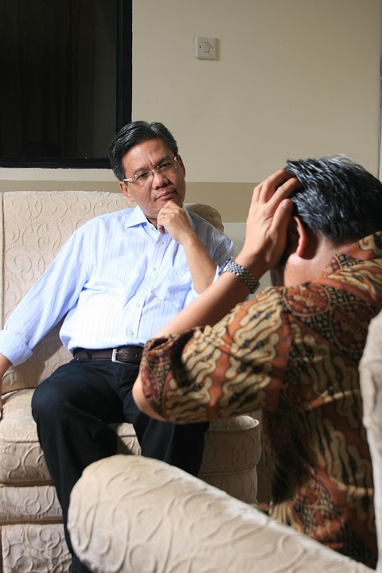
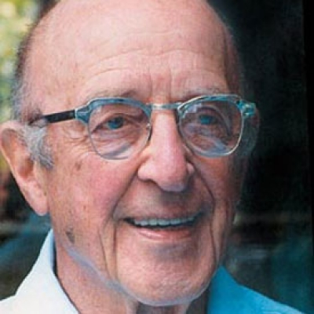
Carl Rogers and the Person-Centred Approach
Gemma Lewis, Health and Social Care, Level 4
Theory and Key Concepts
Carl Rogers developed the Person-Centred Approach to help people achieve personal growth and self-understanding.
Self-concept – the way a person sees and values themselves
Real self and ideal self – the real self is who a person actually is, while the ideal self is who they wish to be.
Empathy – understanding another person’s feelings and perspective from their point of view.
Genuineness – being honest, open and authentic in communication.
Congruence – being true to yourself.
(Rogers, 1980)
Impact and Application in Health and Social Care
Carl Rogers’ Person Centred Approach has shaped modern health and social care practice
Encourages professionals to treat individuals with empathy, respect, and unconditional positive regard.
Builds trust, understanding, and positive relationships between staff and service users.
Promotes equality, self-esteem, and empowerment by valuing each person’s unique experiences.
Supports effective communication and a person-centred approach that improves wellbeing.
Guides health and social care workers to deliver compassionate, individualised support.
(Joseph, 2025).
Introduction/Background
Carl Rogers (1902-1987) was an American psychologist who helped to develop the humanistic approach.
He developed the person-centred approach, focusing on understanding people through empathy, genuineness, and unconditional positive regard.
Rogers believed that everyone has a natural desire to grow and reach their full potential when they feel accepted and valued.
His ideas changed how people think about therapy and have strongly influenced person-centred care in modern health and social care.
(Ralls and Riggs, 2019).
D
When the Concepts Don’t Match – Incongruence
When the real self and ideal self don’t match, a person experiences incongruence. This can make a person feel unhappy, unsure, or low in confidence.
(Banyard et al., 2024)
References
Banyard, P., Dillon, G., Norman, C. and Winder, B. (2024). Essential Psychology. 4th edn. London: SAGE Publications.
Joseph, S.A. (2025). The Humanistic Psychology of Carl Rogers: Understanding the Person- Centred Approach. 1st ed. Oxford: University Press, Incorporated.
Rall, E and Riggs, C. (2019). The little Book of Psychology. Chichester: Summersdale Publishers Ltd.
Rogers, C. (1980). A way of Being. Boston: Houghton Mifflin.

