Slide 1
PRACTICUM: LAST LESSON
Skills Audit
Ending

Slide 2

OPENING ROUND….

Slide 3

SKILLS AUDIT
What have we learnt about counselling?
This Photo by Unknown Author is licensed under CC BY-SA

Slide 4

SKILLS AUDIT What did we learn?
THE LEARNING, THE LEARNING….THE REFLECTION
This Photo by Unknown Author is licensed under CC BY-SA

Slide 5

What did we learn?
This Photo by Unknown Author is licensed under CC BY-SA

Slide 6

ENDINGS, CLOSE OF COURSE AND REVIEW OF MODULE
This Photo by Unknown Author is licensed under CC BY-NC-SA

Slide 7
COUNSELLING SKILLS
ENDINGS

Slide 8

Exercise:
Groupwork -

Slide 9
TWO TYPES OF ENDINGS TO LOOK AT:
Endings in Helping Relationships
Ending of the module

Slide 10
REVIEW ON ENDING A COUNSELLING SESSION
Pacing, add time limits into contract?
Give warning of ending
Ending on an even note?
Summarise
End
Door knob moments
The danger of over running sessions

Slide 11
ENDINGS IN HELPING CAN BE:
Fixed
Sudden and or premature
Fading
Definitive or with scheduled follow up

Slide 12
So, endings can be….
Planned
Unplanned

Slide 13
ENDINGS….
Contract at the start
Short Term
Long Term

Slide 14
TALK ABOUT ENDING …..
Include ‘ending’ talk from the start
Short term………….
Long term

Slide 15
Short Term
Discuss the most important things to work on in the time you’ve got
Work to your time limits - Psychodynamic or CBT?

Slide 16
Long Term
Have a review session every six weeks
What have we done and where do we need
to go?
CORE?

Slide 17
WHAT ARE THE SIGNS THAT WE ARE APPROACHING AN ENDING
CLIENT
HELPER

Slide 18
CLIENT
Controlling what was the presenting issue, e.g. anxiety or depression
Has hope for the future
“Perhaps I’m not so bad after all”
“I guess I did the best I could”

Slide 19
CLIENT
Client self report
Sessions become a review of what has happened since the last session, take a ‘conversational’ turn
Starts to turn up late

Slide 20
CLIENT
DNA’s [last session]
Client is not controlling what was the presenting issue, e.g. anxiety or depression NEEDS SIGNPOSTING/ REFERRAL – HOW?

Slide 21
Helper
Wondering what to work on
Noticing improvement in the client
Sessions become more ‘chatty’ and less intense

Slide 22
HELPER
Client misses/delays sessions
Need to be sensitively managed
LACK OF THERAPEUTIC MOVEMENT

Slide 23
HOW TO WORK TOWARDS ENDING
From the start
Dependency
If possible, work out an ending strategy
Beware of attachment issues
Don’t ignore feeling about endings [theirs and yours}

Slide 24
Working towards endings…
Work with feelings about endings
End ethically – still part of the helping process
Consolidate learning
The ending of helping is a new beginning for the client
They are their own most valuable resource

Slide 25
How to deal with unexpected endings
Look at the bigger picture
Understand that some people will avoid endings and will not turn up for the last appointment
Hope for the future

Slide 26
Remember….
Refer often during the helping process to ‘when counselling ends’
Give plenty of warning that an ending is approaching if and when this is possible

Slide 27
Some ending possibilities…
What is the main thing you are taking away from our work together?
What aspect of our sessions have you found most helpful, unhelpful?
Identify any further work the client may be interested in, e.g., an onward referral, relevant self help books, support groups, etc

Slide 28
EVALUATION AND REVIEW
So, how did it go?
Evaluation
Self reflection

Slide 29

EXERCISE:
This Photo by Unknown Author is licensed under CC BY-NC-SA

Slide 30

Exercise:

Slide 31
Final stages
Work towards the last session
Last session is a review – Core, drawing, time line, discussion of your work together and achievements

Slide 32
ENDINGS IN HELPING
Any personal disclosure is likely to bring with it a degree of dependence
When dependence occurs without either party realising it, problems occur
Take some time to discuss the relationship itself
Review and reflection helps work towards an ending
Managing expectations
Ending a helping relationship can tap into other life events

Slide 33
Signs….
Client will indicate readiness
Feedback from significant others to helpee
Helper observation and reflection
The reaching and consolidation of goals
What are they taking away with them?

Slide 34
Final stages
Further support
Bibliotherapy
Groups
Continuing support or return

Slide 35
To recap: Ways of ending a helping relationship:
Review of work every six sessions of helping
Work towards this from the start, plan ahead
Use of language
Consolidation and maintenance of work undertaken – into new situations
Relapse prevention
Review meeting – say goodbye
Have to pay special attention to ending helping

Slide 36
Final stages…..
Review or booster sessions in three months
Ending is part of the counselling process
By ending weakly you may undo some of the work you have done, end clearly, so say “Goodbye”
Different/difficult work contact thereafter?

Slide 37
COUNSELLING
WHAT MAKES IT WORK?

Slide 38
Based on firstly…………..
Relationship
Core conditions

Slide 39
How is change determined?
ROGERS - Job of helper is to move the block to our natural changing process
EGAN - Change happens through problem solving the difficulty and setting up strategies in which to manage ones life more successfully

Slide 40
ALL COUNSELLING IS ABOUT CHANGE…………
What small thing could you do today which could make things better?

Slide 41
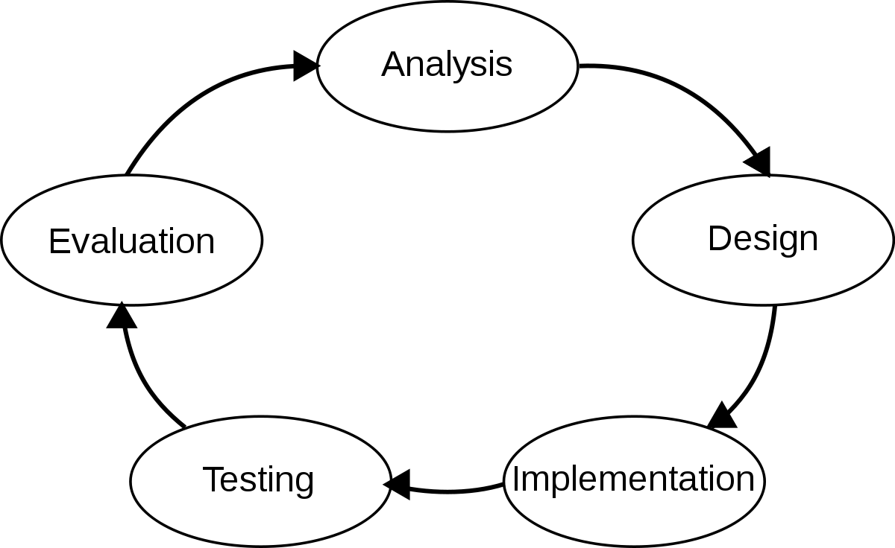
THE ENDING OF YOUR PRACTICUM 1 MODULE…
The beginning, the ending, and the beginning
This Photo by Unknown Author is licensed under CC BY-SA

Slide 42

REFLECTION
Remember self care !

