Slide 1
Living Well A life –Course to Health and Wellbeing
Wendy Davies

Slide 2
Introduction
A person’s life can change over time and how their health and well-being needs also change across the life course.

Slide 3
History of how life courses have changed over time
In a contemporary society where people are living longer there are different challenges for an aging society which affect their long-term outcomes (Larkin,2023)
There are chronic diseases - but people live with them helped by modern treatments (Paschos, 2020).
Low mortality from injuries, infection (antibiotics) (Rickard et al., 2020)
Improving outcomes globally for babies and mothers agreed at 2014 World Health Assembly (WHO, 2023)
Greater knowledge of nutrition and its impact on health (Fanzo et al.,2021).
Greater knowledge of lifestyle related illness - smoking, alcohol, lack of exercise, social isolation and loneliness (Proctor et al.,2023).
Notes:
History of it.

Slide 4
People in older age face unique challenges which must be addressed to support their wellbeing. Age is a risk factor for many illnesses (Guo et al.,2022) and changing relationships can lead to loneliness which impacts wellbeing (Dahlberg et al.,2022). It is important to understand these issues because the UK has an aging population (Witham et al.,2022)
Notes:
To toked about the life Couse ovary time and say what I am going to toked about which it is Old people where I got the ref from.

Slide 5
Aging Society (Older age)
There is no strict definition as to what age might be considered old age (NHS England,no date).
According to Public Health Wales 65 years and over is defined as old age (National Public Health Service for Wales, 2004).
Aging is a risk factor of various diseases, neurodegenerative diseases, cardiovascular diseases, cancer, immune system disorders, and musculoskeletal disorders (Li et al., 2021).
Understanding the risk factor that age brings identifies how people can work towards improving their health and wellbeing (Steptoe et al.,2015).
Risk factors specific to older age includes retirement, living arrangements and ageism (Larkin, 2013; Fernández-Puerta et al., 2024).

Slide 6
Factors impacting health in old age
A change in environment for example bereavement can lead to someone living alone which can cause loneliness which can lead to poor lifestyle choices(Larkin,2013)
Increase in alcohol consumption particularly in older woman (Larkin, 2013)
This is concerning because excessive drinking increases the risk of heart disease, stroke, cancer and liver cirrhosis, anaemia, cognitive deficits, sleep problems, peripheral neuropathy, gastrointestinal problems, decreased bone density and blood cell production (Larkin, 2013)
Drinking in older age also increases the likelihood of falls (Larkin, 2013).
The importance of health expectancy on old age is linked to creating a positive environment (Lak et al., 2020)

Slide 7
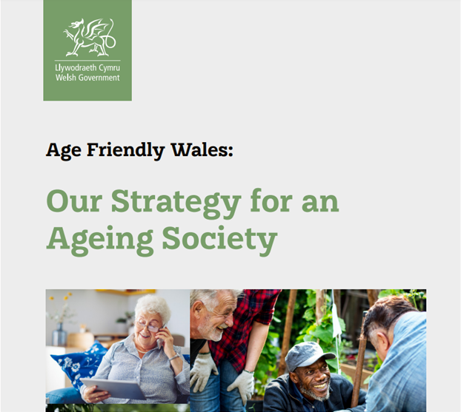
INTERVENTION:Age Friendly Wales:
Government Strategy for an
Ageing Society
Using figures from ONS (2019) the Welsh Government state that in Wales, it is estimated that in 20 years (by 2038) 1-in-4 of the population will be over 65 (Welsh Government, 2021).
The population aged over 75 in Wales is set to increase from 9.3% of the population in 2018 to 13.7% in 2038 (Welsh Government, 2021).
The Government’s Vision is an age friendly Wales that supports people of all ages to live and age well (Welsh Government, 2021).
Criticism has come from Age Cymru who state that ‘The current levels of investment in older people’s mental health and wellbeing in Wales are not meeting needs’ (Age Cymru, 2024).
(Welsh Government, 2021)

Slide 8
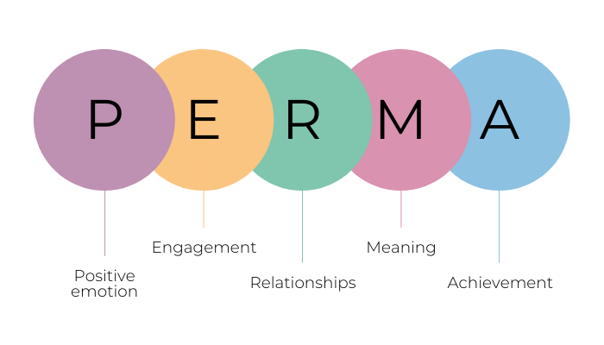
PERMA Model
The Perma Model (Brewerton, 2021).

Slide 9
PERMA Model and how it relates to Living well
The ‘PERMA’ model helps understand how to improve wellbeing by considering 5 aspects which contribute to wellbeing - positive feelings, engagement, relationships, meaning and achievement (Australian Public Service, 2023).
Understanding the link with wellbeing Perma can help identify the importance of people in older age being more positive in their relationships to help with living well in this stage of life(Australian Public Service, 2203).

Slide 10

PERMA –how it relates to older people
Positive emotion -resilience and wellbeing need to be encouraged with positive emotions.
Engagement – important for involvement in activities which they can lose themselves in.
Relationship - at risk of loneliness if their partner dies or if their children do not visit or if their pet dies.
Meaning – older people can give up and cannot see the point of living anymore – they need to have a purpose.
Achievement – important that people are encouraged to feel a sense of achievement for example learn a new hobby dancing, painting, knitting, sewing (Nurse Next Door, n.d.; Alamdari and Targhvaeinia, 2024).
(Nurse Next Door, n.d.)

Slide 11
Conclusion
The UK including Wales has an aging population this is of concern because age is a risk factor for many illnesses.
A good start in life is important in terms of health and nutrition.
Throughout their lifespan people need to protect against illness through exercise and nutrition, maintain mental wellbeing by avoiding loneliness and by not smoking and drinking alcohol to excess.
In Wales the Government wants to create an age friendly Wales.
Age Cymru say more money is needed to support mental health and wellbeing in older people in Wales.
Notes:
My conclusion on it.

Slide 12
Any Questions

Slide 13
References
Alamdari, N. and Taghvaeinia, A., (2024) The Effectiveness of Positive Education Program Based on PERMA Model on Positive Thinking and Life Expectance in Older Adults. Aging Psychology, 10(2), pp.198-183.doi: 10.22126/jap.2024.10628.1778
Age Concern (2024) Investment in older people’s mental health in Wales not matching demand. Available at: https://www.agecymru.wales/latest-news/investment-in-older-peoples-mental-health-in-wales-not-matching-demand/ (Accessed 18 February 2025)
Australian public service(2023)The Perma Model for Flourishing Available at: https://www.apsacademy.gov.au/resources/perma-model-flourishing#:~:text=Martin%20Seligman%20presents%20the%20'PERMA,can%20improve%20their%20own%20wellbeing( Accessed 11.02.25)
Brewerton P., (2021) What is the PERMA model of positive psychology? Strenghtscope. (Available at: https://www.strengthscope.com/podcasts/what-is-the-perma-model-of-positive-psychology (Accessed 11.02.24)
Dahlberg, L., McKee, K.J., Frank, A. and Naseer, M., (2022) A systematic review of longitudinal risk factors for loneliness in older adults. Aging & mental health, 26(2), pp.225-249. https://doi.org/10.1080/13607863.2021.1876638
Fanzo, J., Bellows, A.L., Spiker, M.L., Thorne-Lyman, A.L. and Bloem, M.W., (2021) The importance of food systems and the environment for nutrition. The American Journal of Clinical Nutrition, 113(1), pp.7-16. https://doi.org/10.1093/ajcn/nqaa313
Fernández-Puerta, L., Caballero-Bonafé, A., de-Moya-Romero, J.R., Martínez-Sabater, A. and Valera-Lloris, R., (2024) Ageism and Associated Factors in Healthcare Workers: A Systematic Review. Nursing Reports, 14(4), pp.4039-4059. https://doi.org/10.3390/nursrep14040295
Guo, J., Huang, X., Dou, L. et al.(2022) Aging and aging-related diseases: from molecular mechanisms to interventions and treatments. Sig Transduct Target Ther 7, 391 https://doi.org/10.1038/s41392-022-01251-0

Slide 14
References
Lak, A., Rashidghalam, P., Myint, P. K., & Baradaran, H. R. (2020) Comprehensive 5P framework for active aging using the ecological approach: an iterative systematic review. BMC public health, 20(1), 33. https://doi.org/10.1186/s12889-019-8136-8
Larkin M.,(2013) Health and Well-Being across the Life Course. Sage Publications, London.
Li, Z., Zhang, Z., Ren, Y. et al.,(2021) Aging and age‐related diseases: from mechanisms to therapeutic strategies. Biogerontology 22, 165–187 https://doi.org/10.1007/s10522-021-09910-5
National Public Health Service for Wales (2004) A Profile of the Health of Older People in Wales. Available at:Microsoft Word - Chapter1 Introduction.doc (Accessed 11.02.25)
NHS ( no date) Improving care for older people. Available at: https://www.england.nhs.uk/ourwork/clinical-policy/older-people/improving-care-for-older-people/#:~:text=How%20old%20is%20an%20older,healthier%20than%20someone%20aged%2060.(Accessed 4 March 2025).
Nurse Next Door (no date) 5 Ways Positive Psychology Leads To Happier Ageing. Available at :https://www.nursenextdoor.com.au/blog/5-ways-positive-psychology-leads-to-happier-ageing/ (Accessed 11 March 2025)
Office of National Statistics(2018) Living longer Available at:https://www.ons.gov.uk/peoplepopulationandcommunity/birthsdeathsandmarriages/ageing/articles/livinglongerhowourpopulationischangingandwhyitmatters/2018-08-13 (Accessed 13.02.25)
Paschos, K., (2020) The management of chronic diseases is a major challenge for modern health systems: an integration of concepts and strategies concerning patients, doctors and health care. Sci Chron, 25(1), pp.38-53. Available at: http://www.tzaneio.gr/wp-content/uploads/epistimonika_xronika/p20-1-3.pdf (Accessed 4 March 2025)
Proctor, A.S., Barth, A. and Holt‐Lunstad, J., (2023) A healthy lifestyle is a social lifestyle: The vital link between social connection and health outcomes. Lifestyle Medicine, 4(4), p.e91. https://doi.org/10.1002/lim2.91

Slide 15
References
Pronk, Nico PhD, MA, FASCM, FAWHP; Kleinman, Dushanka V. DDS, MScD; Goekler, Susan F. PhD, MCHES; Ochiai, Emmeline MPH; Blakey, Carter BS; Brewer, Karen H. MPH. (2021) Promoting Health and Well-being in Healthy People 2030. Journal of Public Health Management and Practice 27(Supplement 6):p S242-S248, November/December 2021. | DOI: 10.1097/PHH.0000000000001254
Rickard, J., Beilman, G., Forrester, J., Sawyer, R., Stephen, A., Weiser, T.G. and Valenzuela, J., (2020) Surgical infections in low-and middle-income countries: a global assessment of the burden and management needs. Surgical infections, 21(6), pp.478-494. https://doi.org/10.1089/sur.2019.142
Steptoe, A., Deaton, A. and Stone, A.A.,(2015) Subjective wellbeing, health, and ageing. The lancet, 385(9968), pp.640-648. Available at: https://www.thelancet.com/journals/lancet/article/PIIS0140-6736(13)61489-0/fulltext (Accessed 4 March 2025).
Weldrick, R. and Canham, S.L.(2024) Intersections of ageism and homelessness among older adults: Implications for policy, practice, and research. The Gerontologist, 64(5), p.gnad088. DOI: 10.1093/geront/gnad088
Welsh Government (2021) Age Friendly Wales: Our Strategy for an Ageing Society Available at:https://www.gov.wales/sites/default/files/publications/2021-10/our-strategy-for-an-ageing-society.pdf (Accessed 18 February 2025)
Witham, M.D., Cooper, R., Bowden Davies, K.A. et al. (2022) Ageing Research Translation: a new era for UK geroscience. Nat Aging 2, 867–868 https://doi.org/10.1038/s43587-022-00288-8
World Health Organization, (2023) Improving maternal and newborn health and survival and reducing stillbirth: progress report 2023. World Health Organization. Available at:https://books.google.co.uk/books?hl=en&lr=&id=Kdq-EAAAQBAJ&oi=fnd&pg=PR5&dq=improved+mortality+rates+of+childbirth+in+western+countries&ots=275U256KhR&sig=ErciG7lQLkj8Ogj-xGXKqGrqgjA&redir_esc=y#v=onepage&q=improved%20mortality%20rates%20of%20childbirth%20in%20western%20countries&f=false (Accessed 4 March 2025)

