Slide 1
Why is Psychology Important when working as a Health Visitor
Task 1 Presentation
Student name: Shahanara Bibi
Student ID no: 2116667
Programme: Certificate of Higher Education Skills for Workplace ( Health and Social Care)
Module : Psychology for Health and Social Care
Module code: BMHP4003
Lecturer: Joanne Davies

Slide 2
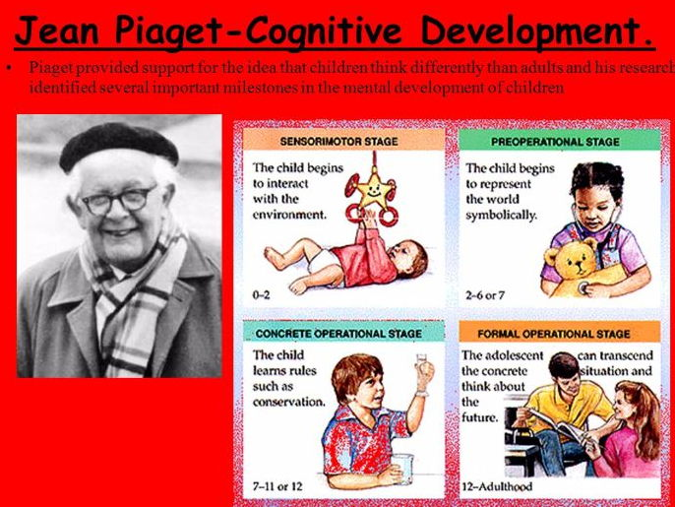
Introduction
Psychological theory of a life span development (0-2years).
Jean Piaget (1896-1980)
Health Visitor
Pinterest

Slide 3

JOB ROLE
Health Visitor:
Health visitors are specialist community nurses who are NHS registered . They specialize in working with families to identify health issues and needs, as early as possible so they can improve health and wellbeing of families and infants, , preventing ill health and reduce inequalities. If there is any problem with the childs development and other professional help is needed they can refer to other specialists.
Ref: NHS https://www.health careers.nhs.uk
Adams C. J Fam Health Care . (2007).
cpdonline.co.uk

Slide 4
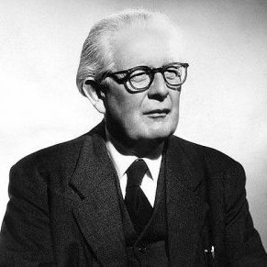
psychological
Theory of life span development
Jean Piaget
According to Jean Piaget (1896-1980) children developed in four stages. Piaget is a stage theorist who studied child development, instead of looking at psychoanalytical or psychosocial position he looked and focused on the cognitive side of childhood development. His theory of cognitive development suggests that intelligence changes as children grow. (Miller, 2011)
Piaget spent 50 years of his life researching and studying children and how their minds work.
We will view six major theoretical perspective (Structural Functionalism, Symbolic Interactionism , and conflict perspective)
Psychodynamic
Behavioral
Cognitive
Humanistic
Contextual
Evolutionary perspective
m
Modern Therapy

Slide 5
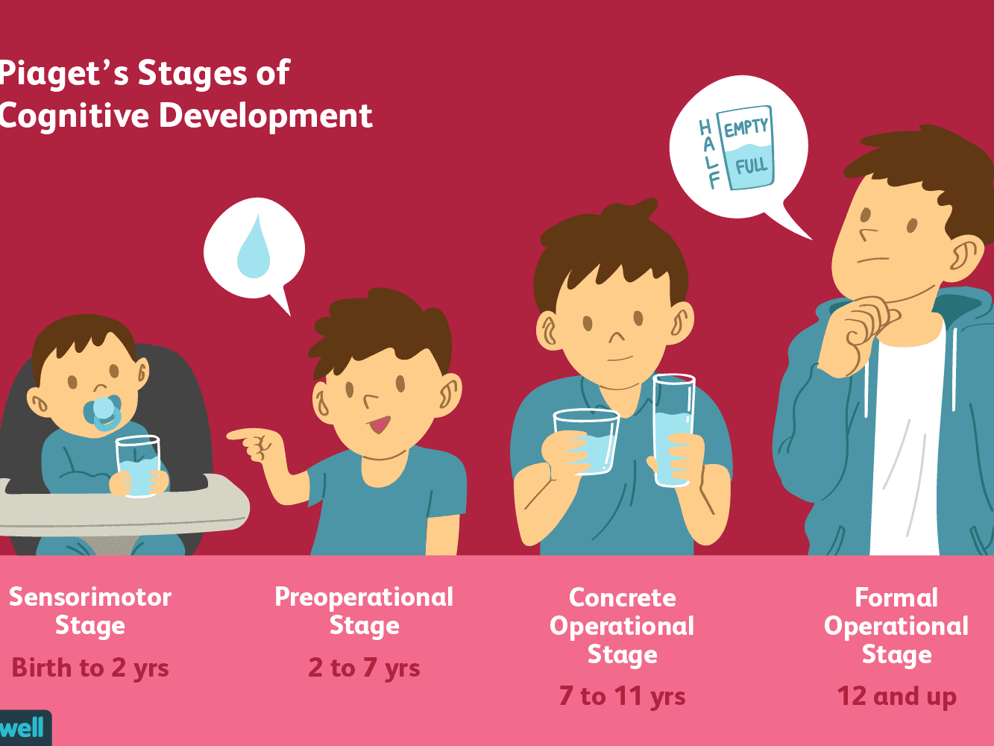
Piaget proposed four major stages of cognitive development are:
Sensorimotor intelligence (0 to 2 years)
Preoperational thinking ( 2 to 7 years )
Concrete operational thinking (7 to 11 years)
Formal operational thinking ( 12 years and up)
We will be exploring Piaget’s theory of child development : (0-2years).
Sensorimotor stage is the first of the four stages of Piaget’s theory of cognitive development. From birth babies use their senses to explore the world around them.
eg: Primary Circular Reactions (1-4 months) . This substage involves coordinating sensation and new schemas.
www.verywellmind.com

Slide 6
Why is Psychology important when working as a Health Visitor
Conclusion
Psychology is important as a Health Visitor. As a professional they can evaluate the development of a child from the age of at least 0-2years old.
We also have looked at Swiss Psychologist Jean Piaget on his theory of lifespan development.

Slide 7
Ref:
“ Assimilation”, The Gale Encyclopedia of Psychology. 30 Nov 2000.
Callaghan, T.C. (30 Nov 2004). “Cognitive Development Beyond Infancy” The Cambridge Encyclopedia of Child Development.
Lowry, R. J. (1979). The Journals of A.H. Maslow Vol. 1. Monterey, CA: Brooks/Cole Publishing Co. pp.231,388.
Magali , B. (1976), "Piaget's Theory of Cognitive Development and Individual Differences", Piaget and His School, Berlin, Heidelberg: Springer Berlin Heidelberg, pp. 269–279, doi: 10.1007/978-3-642-46323-5_20, ISBN 978-3-540-07248-5, accessed 07/09/2022.
Mcleod, S. A. “Piaget/ Cognitive Theory “. Simple Psychology. accessed 07/09/2022.
Muller et al,. (2009). Scholnick et al,. (1999). Cited in Lourenco, (2002). Pp.281-295.
Pollack, R H , (1971). “Binet on perceptual-cognitive development or Piaget-come- lately”, Journey of the History of the Behavioural Sciences (published Oct 1971,). Vol.7 no. 4, pp.370-4.
Suggate , S. Martzog ,P. (2022). Early Child Development and Care 192:10, pages 1659-1672.
Hoffman, E. (2008). “Abraham Maslow: a biographer’s reflections” Journal of Humanistic Psychology. 48 (4): 439-443.

