Slide 1

Byw a Gweithio yma yng Nghymru.
Living and Working here in Wales.
Heddwen Davies
Ionawr / January 2020
This workshop has been prepared with support from :
Bethan : Coleg Cymraeg Cenedlaethol,
Nia : Rhagoriaeth and the Urdd and
Natalie : The Institution of Education.

Slide 2
Taith Personol Personal Journey / a Diddordeb Engagement
Beth mae’n golygu i chi eich bod chi’n medru astudio yng Nghymru?
Pam wnaethoch chi dewis PCYDDS a dod yma i astudio yng Nghaerfyrddin?
Oeddech chi’n gwybod bod gan Cymru iaith unigryw?
Ysgrifennwch eich sylwadau personol ar post it’s a rhowch ar wal.
What does it mean to you to be able to study in Wales?
Why did you choose to come to UWTSD & study at Carmarthen?
Were you aware before you started this course that Wales had it’s own language?
Write what these mean to you on post its and place on a wall.
Notes:
Ask the students to complete the task writing three answers on different post its and then getting them to place the post its on the flip charts accordingly i.e. one flip chart to have all the comments for “what does it mean to you to be able to study in Wales?” etc
Reasons could be linked with cultural aspects or economical – too expensive to move away from home, environmental – OAE especially, linguistic – some may have wanted to stay in Wales in order to be able to study through the medium of Welsh
What’s important to recognise & to appreciate and to value is that we will all be on a different journey to each other in terms of our awareness of the language and the use of it.
5 activity & 5mins discussing post its

Slide 3
Bwriad … It is hoped that …
Hoffwn feddwl tra eich bod chi’n teithio trwy eich graddau byddwch yn profi, deall a dathlu yr ansawdd arbennig sydd o fyw a dysgu yng Ngymru ac wrth wneud hyn, eich bod chi’n datblygu eich hymdeimlad o Gymreictod.
Bod ganddoch wir deimlad o berthyn i’r Prifysgol ac i’r gymuned leol rydych yn byw ynddi. Ein bod ni’n balch o’n ymrwymiad i Gymru ar holl brofiadau mae hyn yn rhoi i ni.
Eich bod chi’n hyrwyddo Cymru fel gwlad sy’n edrych allan i’r byd. Hybu dinasyddiaeth fyd eang a datblygiadu cynaliadwy.
We hope that as you progress through your degrees you will experience, understand and celebrate the distinctive quality of living and learning in Wales & in doing so that you enjoy finding your own identity & your own sense of Welshness.
That you have a heightened sense of belonging to here – your University and in the local community that you live. That we’re proud of the whole Welsh experience.
That you also promote an out-ward looking and international Wales in your work and lives. Promoting global citizenships and concern for sustainable development.
Notes:
Even if you don’t engage with the Welsh Language beyond what has been shared today in the reminder of your course I sincerely hope that you will use a little bit of it and that you consider what role could welsh have in your future?
Hopefully by being a part of this workshop you have new ideas or wishes for what it means to you to be able to study in Wales.
Gobeithiaf bod bod yn rhan o’r gweithdy yma wedi’ch ysbrydoli I ddechrau pob sgwrs yn y gymraeg ac eich bod gennych re-newed angerdd I fedru astudio a siarad a byw a gweithio yng nghymru trwy ddefnyddio’r iaith Gymraeg!!

Slide 4
Pam? Why?
Gallai sgiliau dwyieithrwydd fod yn ddefnyddiol mewn unrhyw swydd ond yn enwedig mewn swyddi sy'n cynnwys cyfathrebu â phobl.
Bilingual skills could be useful for any job but especially those involving communicating with people.

Slide 5
Yn sgil polisïau a deddfwriaeth newydd yng Nghymru, mae mwy a mwy o alw am bobl sy’n gallu gweithio’n ddwyieithog. Mae cyflogwyr yn gwybod bod angen iddynt gyflogi gweithwyr sy’n hyderus yn y Gymraeg a’r Saesneg er mwyn iddynt allu cynnig y gwasanaethau gorau posibl i’w cwsmeriaid. Mae pobl sy’n gallu siarad ac ysgrifennu Cymraeg yn ennill bron i 11% yn uwch ar gyfartaledd* | Due to new policies and legislation in Wales, there is a growing demand for people who can work bilingually. Employers know they need to employ workers who are confident in Welsh and English so that they can offer the best possible services to their customers. People able to speak and write Welsh, can earn on average nearly 11% more* *Gyrfa Cymru

Slide 6
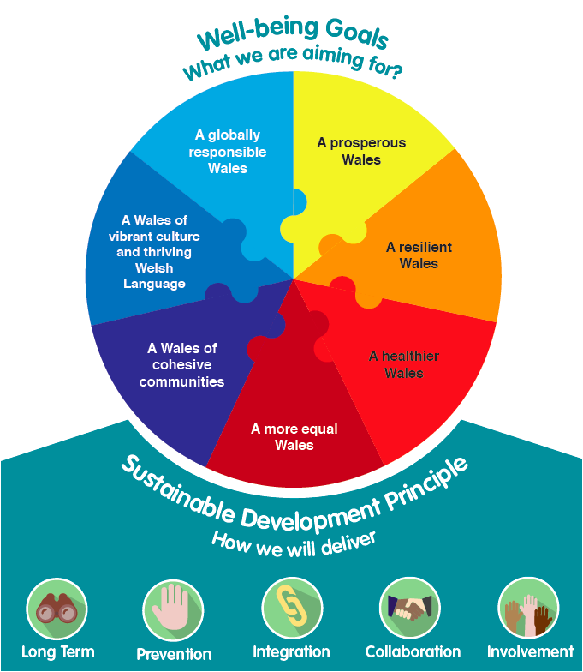
Deddf Lleisiant Cenedlaethau’r Dyfodol (2015)
Well-being of Future Generations Act (2015)

Slide 7

Ydi’r Gymraeg yn bwysig yn y byd gwaith?
Is the Welsh language important in the world of work?
Tasg: Trefn Pwysigrwydd
Notes:
Disgyblion i ymateb trwy symud i’r con sydd yn cyfateb i barn yr unigolyn.

Slide 8
https://www.youtube.com/watch?v=mCjLWzRUZik
Dwy iaith, dwywaith y sgiliau. Mae ymchwil diweddar yn dangos bod y gallu i siarad ac ysgrifennu yn y Gymraeg a'r Saesneg yn rhoi mantais bwysig i chi os ydych yn chwilio am swydd neu eisiau datblygu'ch gyrfa.
Two languages, twice the skills. Recent research shows that being able to speak and write in both Welsh and English can give you an important advantage whether you’re looking for a job or wanting to further your career.

Slide 9
Cyflogaeth / Employment
“I ni, mae’r iaith Gymraeg yn rhan o’r pecyn cyfan sydd ar gael yma i’r cwsmer. Mae’r ffaith bod angen staff sy’n gallu rhoi croeso i westeion yn Gymraeg yn golygu bod y Gymraeg yn sgil ychwanegol sy’n gallu agor drysau i’r bobl ifanc sy’n dod i weithio yma hefyd.”
Gwesty’r Harbwr – Aberaeron
“For us, the Welsh language is a part of the complete package available to the customer. The fact that we need staff that can welcome our guests in Welsh means that the Welsh language is an additional skill which can also open many doors for the young people that come to work here with us.”
The Harbourmaster – Aberaeron

Slide 10
Cyflogaeth / Employment
“Pan fo BT yn recriwtio staff yng Nghymru, mae’r gallu i siarad Cymraeg yn bendant yn cael ei ystyried yn sgil ychwanegol. Mae llawer o’n swyddi yn ymwneud â delio â’r cyhoedd, felly mae gallu siarad y ddwy iaith yn ased enfawr. Pe bai dau ymgeisydd yn meddu ar yr un lefel o sgiliau, ond dim ond un ohonynt yn gallu siarad Cymraeg, byddai’r unigolyn hwnnw yn fwy tebygol o gael cynnig y swydd. Nid wrth recriwtio yn unig y mae hyn yn bwysig; rydym yn chwilio yn barhaus am siaradwyr Cymraeg sydd eisiau datblygu gyrfa hirdymor gyda BT.”
“When BT recruits employees in Wales, having the ability to speak Welsh is most definitely considered as an added skill. Many of our jobs involve dealing with the public, thus being able to speak both languages is a huge asset. If two applicants had the same skill levels, but only one of them was Welsh speaking, the latter would be considered as having an extra skill and more likely to be offered employment. Not only is this important at the recruitment stage; we continually seek Welsh speakers who want to develop a long term career within BT.”
Geraint Strello, Rheolwr Polisi Iaith Gymraeg, BT

Slide 11
Cyflogaeth / Employment
“Yn TESCO, rydym yn llwyr ymwybodol o’r ffaith bod pobl yn hoffi siopa yn lleol, a dyna pam ein bod yn sicrhau bod teimlad ‘lleol’ i’n holl siopau. Yng Nghymru, mae hyn yn naturiol yn golygu ein bod yn cynnig gwasanaethau Cymraeg, yn brandio ein hunain yn unol â hynny ac mae gennym arwyddion a thiliau hunanwasanaeth dwyieithog. Pan fo hynny’n bosibl, mae hefyd gennym staff sy’n siarad Cymraeg.”
_{Enfys Fox, TESCO}
“We in TESCO fully realise that people like to shop locally and that is why we ensure that there is a ‘local’ feel to all our shops. In Wales, this naturally means that we offer services in Welsh, brand ourselves accordingly and have bilingual signage and self scan tills. Where possible, we also have Welsh speaking staff.”
_{Enfys Fox, TESCO}

Slide 12
Cyflogaeth / Employment
“Gall iaith ychwanegol fod yn fantais bersonol a phroffesiynol enfawr. Rydym yn ddyfal yn chwilio am staff sy’n siarad Cymraeg ac yn annog ein staff i ddysgu’r iaith. Yn fy mhrofiad i fel cyflogwr, mae iaith ychwanegol yn rhoi’r elfen ychwanegol honno i rai sy’n ymgeisio am swydd.”
Alison Inker, Rheolwraig Vidal Sassoon, Caerdydd
"An additional language can be an enormous personal and professional benefit. We actively seek Welsh speaking staff and encourage our staff to learn the language. In my experience as an employer, having another language gives an extra aspect when applying for posts"
Alison Inker, Manager at Vidal Sassoon, Cardiff

Slide 13
Pam bod y Gymraeg yn bwysig yn y byd gwaith ac i fusnesau ?
Why is the Welsh language important in the Workplace and to businesses?

Slide 14
Gofal Plant
Gofal Cymdeithasol ac Iechyd
Busnes a Thechnoleg Gwybodaeth
Twristiaeth a Hamdden
Y Cyfryngau a'r Celfyddydau Perfformio
Amaethyddiaeth
Child Care
Social Care and Health
Business and Information Technology
Tourism and Leisure
Media and Performing Arts
Agriculture
Notes:
The Welsh Assembly Government has identified six priority areas where demand for people with bilingual skills is most likely to increase.
Mae Llywodraeth Cymru wedi cydnabod chwe maes blaenoriaeth lle mae galw am bobl sydd â sgiliau dwyieithrwydd fwyaf tebygol o godi.

Slide 15
Tasg Grŵp / Group Task
meithrinfa / gofal plant
Dietegydd
gweithiwr gofal iechyd
gwesty
gampfa / clwb cadw’n heini
athro
nyrs gofal dementia
contractiwr amaethyddol
canolfan awyr agored
gofalwraig cartref gofal
hyfforddwr personol
siop
Gwasanaethau cyhoeddus: nyrsio
gwasanaethau tân, ambiwlans a heddlu
nursery / child care
dietician
health support worker
hotel
gym/health club
teacher
dementia nurse carer
agricultural contractor
outdoor adventure centre
nursing home care worker
personal trainer
Shop
Public services : nursing, fire brigade, ambulance service and police
Notes:
Mewn Grwpiau dychmygwch eich bod yn rhedeg un o’r busnesau yma:
Pam mae’n bwysig cynnig gwasanaeth Cymraeg? Why is it important to provide a Welsh Lanuage service?
Pa fudd bydd I’r busnesau yma trwy gynnig gwasanaeth cymraeg?
What benefits will your business gain from providing a Welsh language service?

Slide 16
Ail ymweld : Taith Personol / Re-visit : Personal a Diddordeb Journey / Engagement
Beth mae’n golygu i chi eich bod chi’n medru astudio yng Nghymru?
Pam wnaethoch chi dewis PCYDDS a dod yma i astudio yng Nghaerfyrddin?
Oeddech chi’n gwybod bod gan Cymru iaith unigryw?
Ysgrifennwch eich sylwadau personol ar post it’s a rhowch ar wal.
What does it mean to you to be able to study in Wales?
Why did you choose to come to UWTSD & study at Carmarthen?
Were you aware before you started this course that Wales had it’s own language?
Write what these mean to you on post its and place on a wall.
Notes:
Ask the students to complete the task writing three answers on different post its and then getting them to place the post its on the flip charts accordingly i.e. one flip chart to have all the comments for “what does it mean to you to be able to study in Wales?” etc
Reasons could be linked with cultural aspects or economical – too expensive to move away from home, environmental – OAE especially, linguistic – some may have wanted to stay in Wales in order to be able to study through the medium of Welsh
What’s important to recognise & to appreciate and to value is that we will all be on a different journey to each other in terms of our awareness of the language and the use of it.
5 activity & 5mins discussing post its

Slide 17










Beth am rannu o’ch profiadau personol?
What about sharing some of your experiences?
Notes:
A oes profiad gyda chi o ddathlu eich diwylliant/ traddodiadau / crefydd ac ati? Cymdeithasau aml ddiwylliannol? Mynychu digwyddiad o ddathlu a oedd yn wahanol I’r hyn I chi’n gyfarwydd gyda wrth dyfu I fynny? – fel gwnaeth dysgu’r agweddau yma effeithio arno chi?
Rhannwch eich profiadau o fewn eich grwpiau
10mun
Have you any experiences of other traditions on this planet / other cultures on this earth / being in a multi cultural community ? Attending a celbreation that is differernt to that what you have been brought up with knowing? & how did it make you feel learning about those things ?
share your experiences with others within your group
10mins

Slide 18
Beth allwch chi wneud i gynnig gwasanaeth Cymreig a iaith Cymraeg?
What can you do to provide some Welshness in our service & some Welsh?

Slide 19
Llefydd yng Nghymru / Places in Wales
Caerdydd
Ynys Môn
Aberystwyth
Abergwaun
Abertawe
Aberhonddu
Wrecsam
Cardiff
Anglesey
Aberystwyth
Fishguard
Swansea
Brecon
Wrexham
Notes:
Place place names on the map correctly & What do we know about the location?
5 to 10mins tops

Slide 20
Notes:
Adolygu’r ymateb 5mins

Slide 21
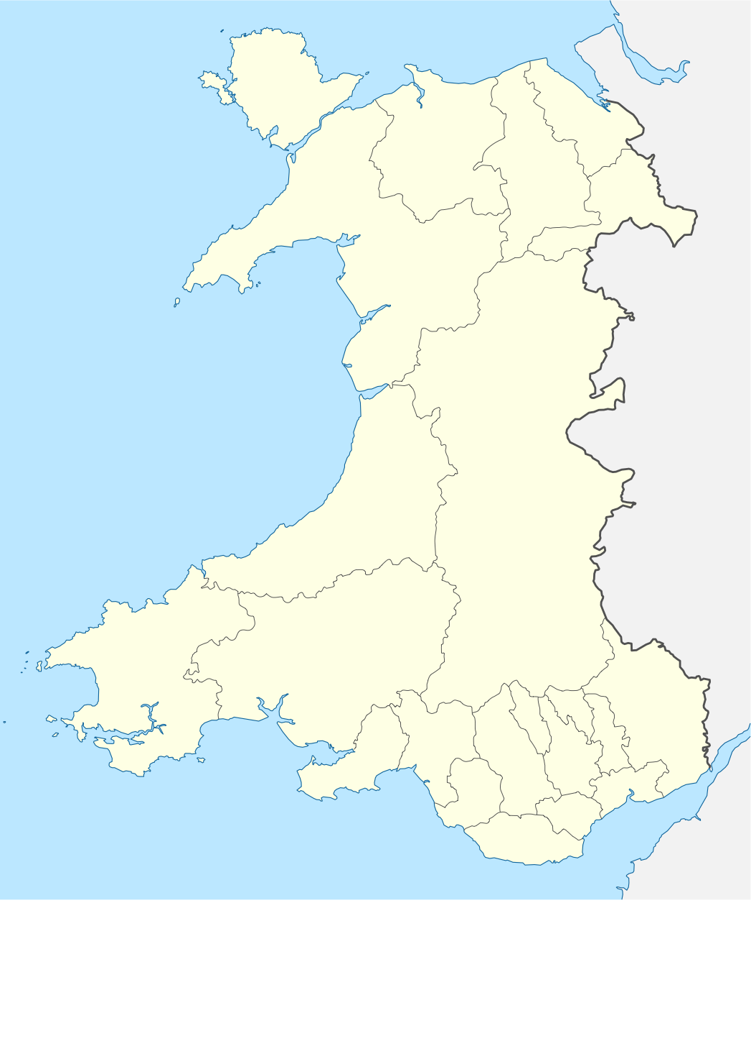
Ynys Môn - Anglesey
Wrecsam – Wrexham
Aberystwyth
Llanfair ym Muallt - Builth Wells

Slide 22
Lleoliad / Locations
Abergwaun - Fishguard
Abertawe – Swansea
Caerdydd -Prif Ddinas Caerdydd
Cardiff - Captial City of Wales

Slide 23

Dathliadau blynyddol sy’n unigryw i Gymru
Annual celebrations that are unique to Wales
Dydd Calan – casglu calennig
Diwrnod Santes Dwynwen
Dydd Gŵyl Dewi
Eisteddfod yr Urdd
Eisteddfod Genedlaethol
New Years Day
St Dwynwen’s Day (25th January)
St David’s Day (March 1st )
Urdd Eisteddfod (May half term)
National Eisteddfod (1st Week in August)

Slide 24
Arfer dda o greu ethos Gymreig
Good practice of creating a Welsh ethos
Cyfarch :
(i)Bore da.
(ii)Sut wyt ti?
Dwyeithog :
(i)Posteri, (ii)Cynnwys darlithoedd
Digwyddiadau cymdeithasol :
(i)Gwasanaethau Eglwysig, (ii)Cyngherddau, (iii)Cynadleddau
Greeting :
(i)Good morning.
(ii)How are you?
Bilingual :
(i)Posters, (ii)Lecture content,
Social Events :
(i)Services in the Chapel, (ii)Concerts, (iii)Conferences
Notes:
Whole school approach – dev school ethos – see page 20 YCC Dimensiwn Cymreig y Cwricwlwm yng Nghymru : arfer dda mewn addysgu a dysgu YCC.
Need to plan the Cwricwlwm Cymreig effectively
Identify & promote YCC across all areas of learning – meaningful inclusion
e.g. History / Art / Music
Mathematics – using local business- bicycle shops or farmers markets
Mwy na bore da – brechdanau yn y bore etc – creu ethos cymraeg yn bwysig.

Slide 25
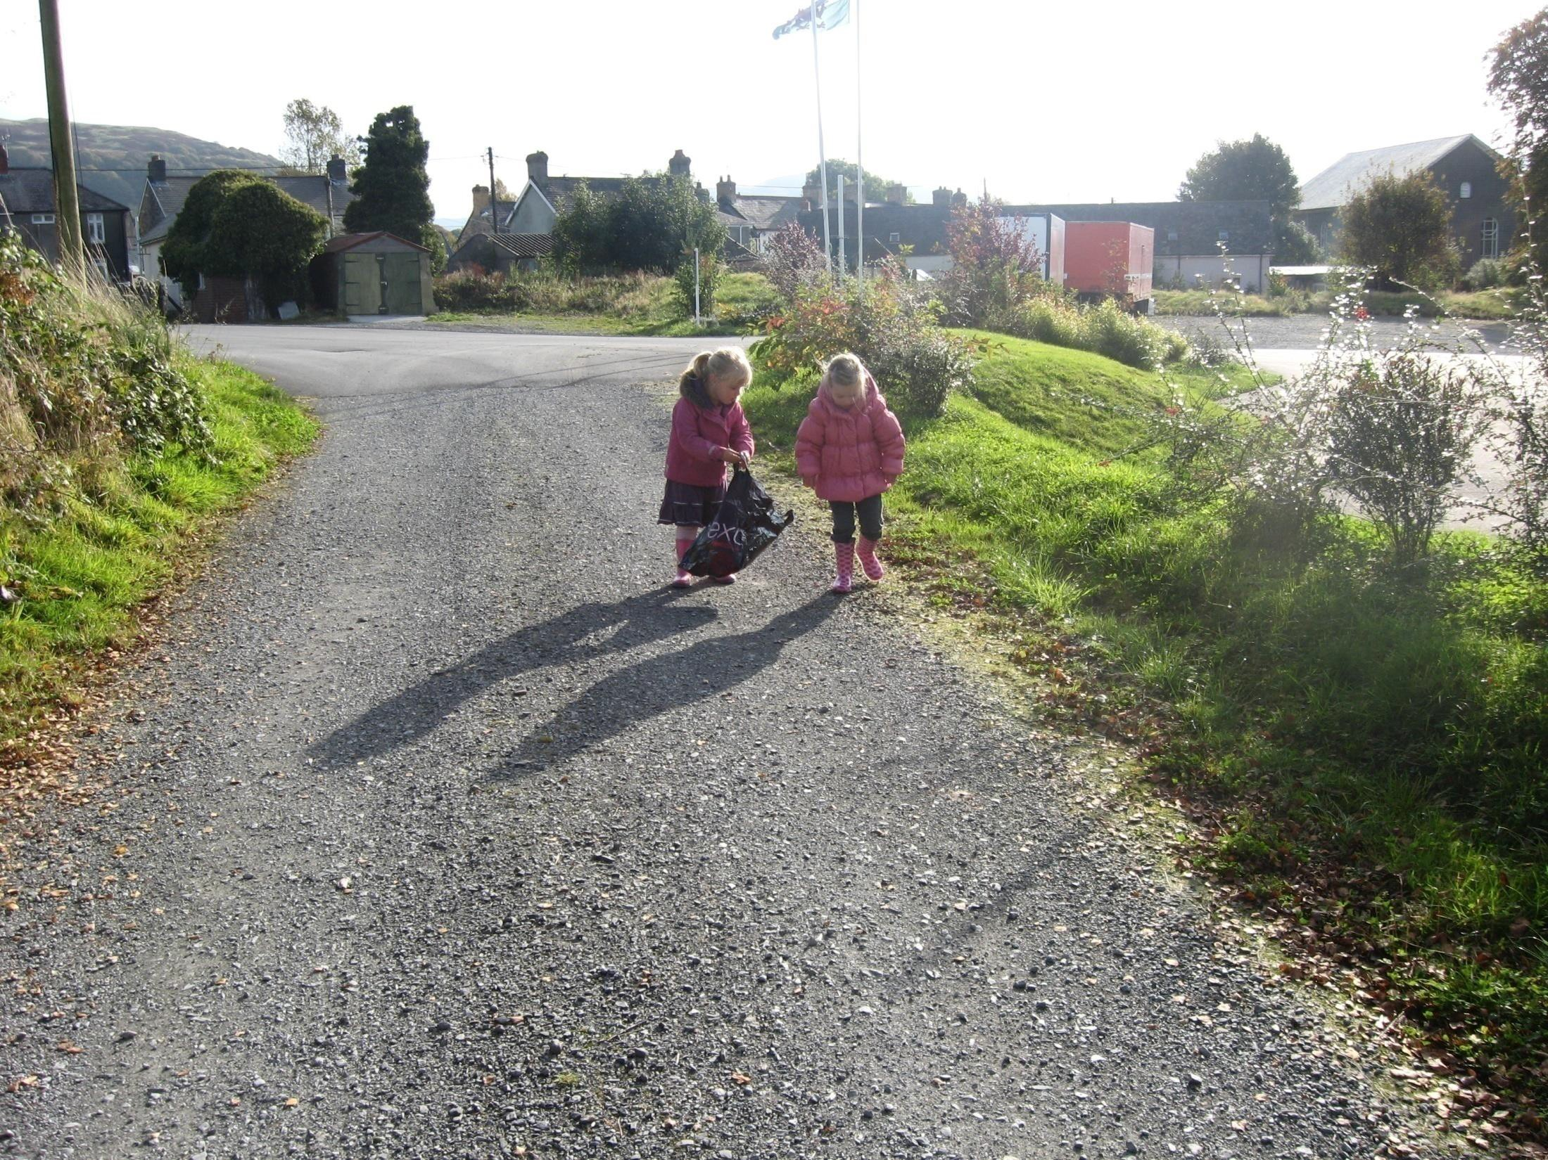
My daddy’s reado’r papur.
It was my granny. She knito fe i fi.
It’s a little dog and he’s jumpo.

Slide 26

Dull Trochi : Defnydd o homophonus Immersion Strategy: the use of homophones
Notes:
What are Homophones?
A homophone is a word that is pronounced the same as another word but which has a different meaning and which may also differ in spelling. For example, 'red' and 'read' are homophones, as they are pronounced the same way but do not share the same meaning e.g.
Know – no
Son – sun
Flea – flee
Hear – here
Ate – eight

Slide 27


Slide 28





Bore da
P’nawn da
Noswaith dda
Nos da
Cwrs Mynediad: Uned 1

Slide 29
Geirfa Cymraeg defnyddiol Useful Welsh vocabulary
Bore da
Prynhawn da
Nos da
Da iawn
Gallai helpu?
Rydw i’n dysgu Cymraeg
Diolch yn Fawr
Hwyl fawr
Good morning
Good afternoon
Good night
Very good
Can I help?
I’m learning Welsh
Thank you very much
Goodbye

Slide 30


Pwy ydych chi? neu / or Pwy wyt ti?
Tom Jones ydw i.
Hilary Clinton ydw i.
Cwrs Mynediad: Uned 1

Slide 31

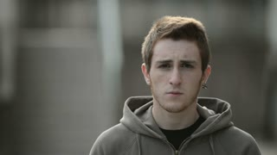


Sut ydych chi? neu / or Sut wyt ti?
da iawn, diolch!
iawn
wedi blino
ofnadwy
Cwrs Mynediad: Uned 1

Slide 32
A. Good morning, who are you?
B. Hello, I’m Ceri. Who are you?
A. I’m Eryl. How are you Ceri?
B. Very well, thank you. How are you?
A. Ok, thanks.
B. Bye!
Sgwrs
Bore da, pwy ydych chi?
Helo, Ceri ydw i. Pwy ydych chi?
Eryl ydw i. Sut wyt ti Ceri?
Da iawn, diolch. Sut wyt ti?
Iawn, diolch.
Hwyl!
Cwrs Mynediad: Uned 1

Slide 33
A. Good morning, who are you?
B. Hello, I’m Ceri. Who are you?
A. I’m Eryl. How are you Ceri?
B. Very well, thank you. How are you?
A. Ok, thanks.
B. Bye!
Sgwrs
Bore da, pwy wyt ti?
Helo, Ceri ydw i. Pwy wyt ti?
Eryl ydw i. Sut wyt ti Ceri?
Da iawn, diolch. Sut wyt ti?
Iawn, diolch.
Hwyl!
Cwrs Mynediad: Uned 1

Slide 34
BWYD / FOOD

Slide 35

Patrymau brawddegau / Sentence patterns
Wyt ti eisiau llaeth?
Geirfa cyson mewn brawddegau Consistent vocabulary in sentences
Ti moyn lla’th?

Slide 36
Ffrwythau / Fruit Prydiau Bwyd
Meal Times
afal apple
oren orange
banana banana
grawnwin grapes
peren pear
pîn afal pineapple
lemwn lemon
Amser brecwast - Breakfast
Amser cinio - Lunch
Amser te - Tea Time
Amser swper - Supper
Notes:
Hand out the word mats after this activity

Slide 37
I want ... Dw i ise …
I want ... Dw i ise …
I want ... Dw i ise …
I want … Dw i ise …
I want … Dw i ise …
paned o goffi
paned o de
siwgr
un arall
bwyd
Notes:
Can they look at the word mats and choos a different food type – Dw i ise …bara

Slide 38
I don’t want ... Dw i ddim ise …
I don’t want ... Dw i ddim ise …
I don’t want ... Dw i ddim ise …
I don’t want… Dw i ddim ise …
I don’t want … Dw i ddim ise …
paned o goffi
paned o de
siwgr
un arall
bwyd
Notes:
As before can they choose a food type that they don’t want / or don’t like

Slide 39
Cofiwch, mae'r gallu i ddefnyddio Cymraeg a bod gennych gwybodaeth am Gymru yn ddefnyddiol iawn beth bynnag rydych yn ei ddewis o ran gyrfa yn y dyfodol.
Remember, the ability to use Welsh & your general knowledge about Wales can be very useful no matter what area of work you choose in the future.

Slide 40








Cefnogaeth ymhobman! Support is everywhere!
Notes:
Cyfle I chwilota ar eu dyfeisiadau ac edrych ar yr adnoddau amrywiol craidd. 20 – 30 mun / mins
Opportunities to use their devices to search for activities and look at the resources
Adborth cyflym – Pethau diddorol. Dyfeiswyr cymru – bwysig ein bod ni’n sicrhau hyder bobl I feddwl yn greadigol er mwyn medru creu I’r dyfodol.
Feedback – interesting finds. 5 – 10 mun / mins

Slide 41
Diweddglo In conclusion
Hoffwn feddwl tra eich bod chi’n teithio trwy eich graddau byddwch yn profi, deall a dathlu yr ansawdd arbennig sydd o fyw a dysgu yng Ngymru ac wrth wneud hyn, eich bod chi’n datblygu eich hymdeimlad o Gymreictod.
Bod ganddoch wir deimlad o berthyn i’r Prifysgol ac i’r gymuned leol rydych yn byw ynddi. Ein bod ni’n balch o’n ymrwymiad i Gymru ar holl brofiadau mae hyn yn rhoi i ni.
Eich bod chi’n hyrwyddo Cymru fel gwlad sy’n edrych allan i’r byd. Hybu dinasyddiaeth fyd eang a datblygiadu cynaliadwy.
We hope that as you progress through your degrees you will experience, understand and celebrate the distinctive quality of living and learning in Wales & in doing so that you enjoy finding your own identity & your own sense of Welshness.
That you have a heightened sense of belonging to here – your University and in the local community that you live. That we’re proud of the whole Welsh experience.
That you also promote an out-ward looking and international Wales in your work and lives. Promoting global citizenships and concern for sustainable development.
Notes:
Even if you don’t engage with the Welsh Language beyond what has been shared today in the reminder of your course I sincerely hope that you will use a little bit of it and that you consider what role could welsh have in your future?
Hopefully by being a part of this workshop you have new ideas or wishes for what it means to you to be able to study in Wales.
Gobeithiaf bod bod yn rhan o’r gweithdy yma wedi’ch ysbrydoli I ddechrau pob sgwrs yn y gymraeg ac eich bod gennych re-newed angerdd I fedru astudio a siarad a byw a gweithio yng nghymru trwy ddefnyddio’r iaith Gymraeg!!

Slide 42
Canlyniad y cwis Result of the quiz
Da iawn
Very good
Hwyl fawr! Goodbye!
Bendigedig
Excellent

