Slide 1
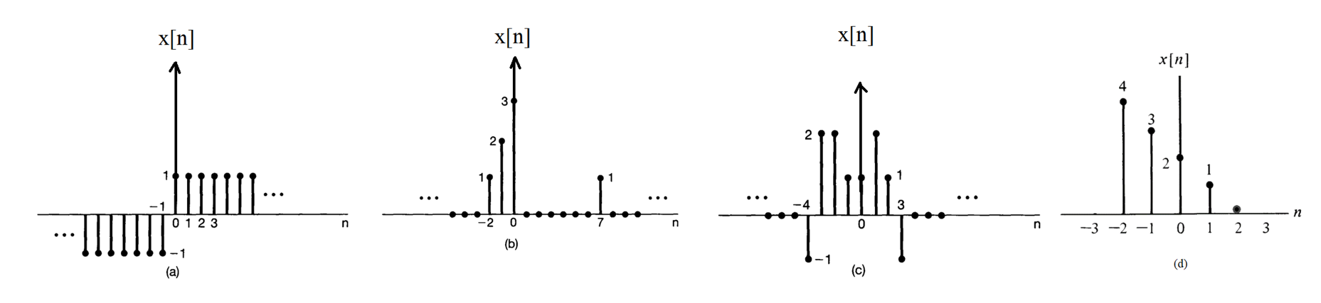
Revision 1
Exercise 1
ACDA4009 – Signals and System

Slide 2
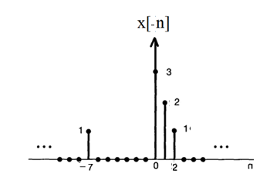
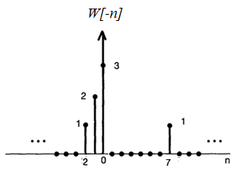
Revision 1
Exercise 2
b.
ACDA4009 – Signals and System

Slide 3

Exercise 3

