Slide 1
Leadership and Management Skills for the Workplace Developing Relationships
Student Name: Yahya Abdalla
Student ID: 1919523
Name of the Lecturer: Gregory Cowan

Slide 2

Introduction
Knowledge, skills, and behaviour
Add strategic and innovative ideas
Analyze the pros and cons
Eliminate the risks
(Source: Singh, 2018)
Notes:
This paper has been executed from the viewpoint of a graduate trainee Human Resource Officer of the Human Resource Department of an organization (Singh, 2018). Being a trainee, the first thing that needs to be taken into account is training in knowledge, skills, and behaviour so that the organization can significantly benefit from it. To add strategic and innovative ideas to the organization, the HRM team must ensure that they get to analyze the pros and cons that come along with it so that they can eliminate the risks that they are likely to face. The HRM team needs to understand their role and act according to the needs of the organization so that they can help the organization grow effectively.

Slide 3
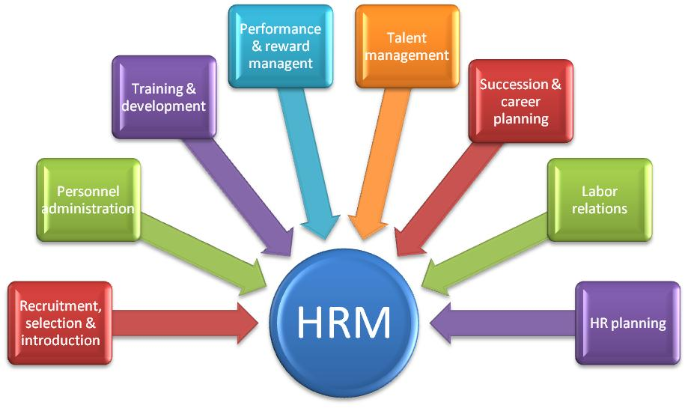
Determine appropriate knowledge required by HR professionals
Conversational therapy
Detect the flaws
Managing the accounts
Issues related to the organization
Organization's finances
Safeguard the documents
(Source: Naz et al., 2019)
Notes:
As an HR professional, one must have detailed knowledge about computers and electronic devices to deal with any technical fault that occurs within the department. Their expertise in processors, electronic equipment, chips, circuit boards, and software will help them to act as an asset to the company (Hao, Yang and Shi, 2019). As an HR professional, a person must be able to provide conversational therapy to the employees working under them to help them to come out of their interpersonal issues and the issues related to the organization. The HR managers must be aware of the policies and procedures they must follow to maintain the safety of the documents that are kept with them (Naz et al., 2019). They should also know about the data protection laws and rules that are required to be followed by the organizations, as this will enable the organization to use this knowledge to safeguard their documents and institutional data.
As an HR professional, a person must have the idea about managing the accounts of the organization as, at times, they are made to take care of the accounts and detect the flaws in case of any misunderstanding taking place in the detection of the accounts. The HR managers are required to be highly knowledgeable as they are expected to take care of the overall aspects of the organization (Raza and Awang, 2020). The employees working under them seek help in case of any issue they face in their respective fields. The HR officer should also be able to execute an effective financial data report by having done a detailed analysis of the organization's finances. The audit sessions that take place within the organization are also taken care of by the Hr offers of the organization.

Slide 4
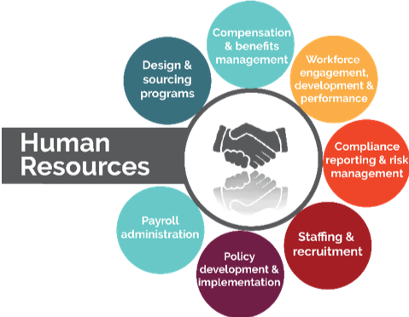
Determine appropriate Skills required by HR professionals
Listening power
Detect the issues
Coordinator between the employees and the organizational head
Speaking skills
Judging the situation
Management skills
Ability to deal with complex problems
(Source: Abbasi et al., 2021)
Notes:
As an HR professional, one must have the ability to be an active listener as with this approach, and the HR professionals are able to gain the full attention of the employees and make them feel welcomed (Afsar, 2016). The HR officer is responsible for making the organization's employees feel comfortable to work with. The listening power of the HR officers helps them to detect the issues that are unsaid and goes unnoticed at the time (Abbasi et al., 2021). Speaking skills are among the most important skills that an HR officer must have. The HR officers act as a coordinator between the employees and the organizational head; thus, they need to have great speaking skills so that they can convey the right message to each other, having helped them to understand the base of the organization.
The HR professionals must be skilled in making effective decisions and judging the situation appropriately so that they can plan effective strategies based on their analysis. They must be able to negotiate with the employees in the difficult times when they get to face any major issue at work. This will enable the organization to make the employees stay longer. Another essential skill that HR professionals must have is managing any situation effectively (Saling and Do, 2020). Management skills are a must-have in the profession of Human Resource Management, as without them, the existence of the HR team would be in question. A complex situation in an organization is very common; thus, the HR officer must have the ability to deal with complex problems and solve them efficiently by addressing the issues in an adequate manner. The HR managers must also have the skill to understand social perspectives as this will enable them to be aware of the reactions that they might face on having applied new strategies.

Slide 5

Determine appropriate Behaviour required by HR professionals
Human psychology
Conduct psychological research
Influence the behaviour of the employees
Preferences of the employees
Analyze the factors
Monotonous environment
Reduce the employee turnover rate
(Source: Amin and Rubel, 2020)
Notes:
Having gathered detailed knowledge about the subject matter, the managers must have the ability to understand the situation based on human psychology. Knowledge of human psychology helps HR officers to understand human behavior and mold the situation accordingly (Ngenzi, Scott and Mars, 2021). As the leading of a particular team, the HR officers get to deal with a wide range of individuals; thus, having understood human psychology will facilitate the HR officers to determine the behavioral changes within the employees. The HR managers often conduct psychological research to conduct a detailed analysis of the situation and working environment. The organizational behavior also depends on the changes made by the HR team that further influence the behavior of the employees working under him. The HR managers of the organization try to motivate the team by making small changes within the organization that can further act in compliance with the needs and preferences of the employees.
The HR officers should also have knowledge about anthropology and sociology as that helps them gather knowledge about the group behavior and various dynamics prevalent in the organization. The HR officers analyze the factors that are based on the societal trends and influences by having applied the same, and the organization can easily handle the changes that take place in it (Amin and Rubel, 2020). The HR officers make sure that they get to be ineffective changes within the organization so that the monotonous environment of the organization can be hanged from time to time. This helps the organization adopt necessary changes, thus making the employees stay long. The HR officers work strategically to reduce the employee turnover rate and make the employees stay within the organization with effective growth and development opportunities.

Slide 6
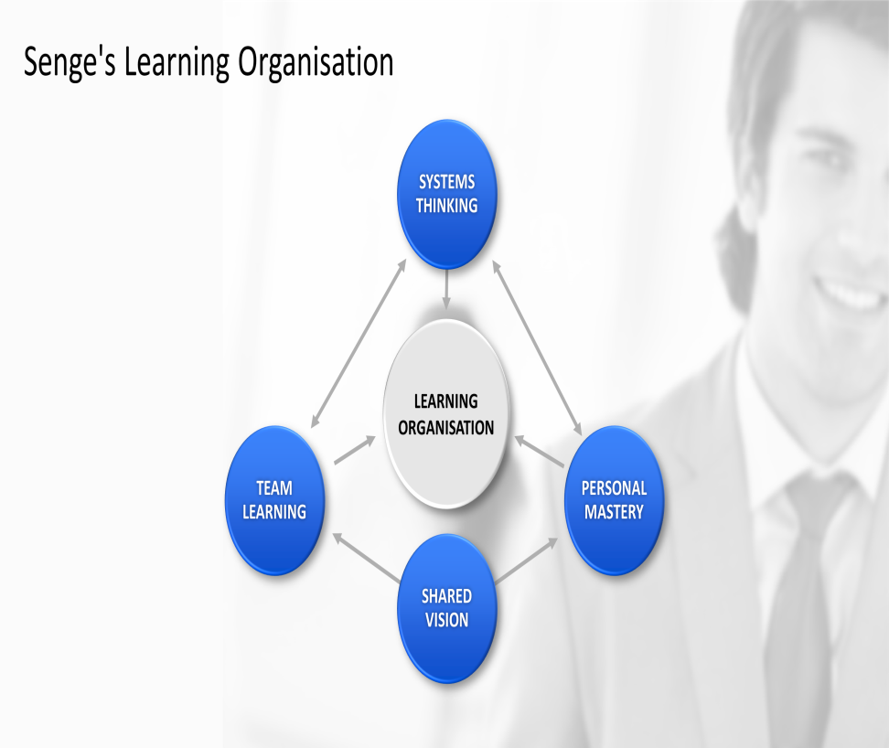
Personal Skills Audit on Knowledge
Determine my knowledge
Knowledge of administration and management
Customer needs
Quality of the products and services
Lack in having much knowledge about technical skills
(Source: Shahzadi and Waqas Raja, 2021)
Notes:
To become a skilled and knowledgeable HR professional, one must have core knowledge about certain fields; thus, to determine my knowledge about the given field, this audit program has been executed (Kozhakhmet et al., 2019). My personal skills and knowledge encompass various fields that I have gathered from my degrees and preliminary learning. To start with my strengths, I would like to state that I have detailed knowledge of administration and management. This knowledge of mine will help me to look after the administration department of the organization effectively. It will also enable me to manage the team efficiently. As an HR professional, I believe that my knowledge and ability to manage the team will be of great help to the organization as I will be able to take on the responsibility that will be assigned to me with utmost efficiency (Javaid, Jaaron and Abdullah, 2022). I also have detailed knowledge about the customer and personal service that will make me check on the customer needs and assess the quality of the products and services.
I also have a strong base in the statistical calculation which also helps in understanding the flaws that will lay in the calculations done by the employees in any given field. Apart from the strengths that I have mentioned in the above paragraph, I also have many flaws in terms of having detailed knowledge about the given field. One of my major weaknesses is that I lack in having much knowledge about technical skills (Shahzadi and Waqas Raja, 2021). I might not be able to handle the issues that are related to core programming knowledge as I have enough training to handle the issues related to software malfunctioning and handle high-tech technical glitches. Thus I aim to work on this flaw of mine and make sure that I get to convert it into my strength shortly.

Slide 7
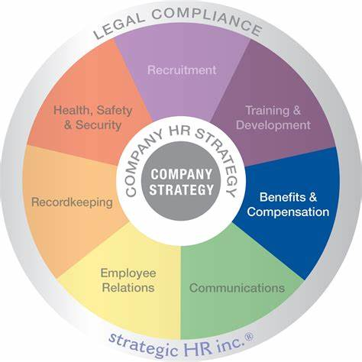
Personal Skills Audit on Skills
System evaluation
Key indicators of performance
Analyzed the issue
Effective strategies
Work proactively
Acquire greater knowledge
Effective solutions to the problems
(Source: Shaikh, Diwan and Kumar, 2021)
Notes:
To evaluate my personal skills as an HR officer, I would like to address the key factors that are likely to help me in my profession. I have great skills in system evaluation that I aim to use in my career since it will help me to identify and measure the performance level of the employees by having used key indicators of performance (Reslan, Garanti, and Emeagwali, 2021). My analytical skills will help the team to get benefited in the time of need. This will also enable us to analyze the situation, having observed the core factors that have led to the issue. Having analyzed the issue, I will be able to plan effective strategies for the organization and the teammates to get them to work productively. My time management skills will also be of great help to the organization. This will help the team to get the work done beforehand as I will make the team learn time management skills.
I believe that my persuasion skill will facilitate the company to have greater scope in managing the employees. It will help me to make necessary negotiations with the employees and help them adjust to the work environment of the organization (Shaikh, Diwan and Kumar, 2021). I will also use this skill for the training and development of the employees so that they can be ready to work proactively and contribute effectively to the team. I have made use of learning strategies to push my limits and get myself ready to acquire greater knowledge about a subject matter. Thus as an efficient HR officer, I will try to foster those strategies within the team and make them efficient enough to perform the task.
I also have great skills in managing organizational conflicts and solving issues. I will use the same to maintain peace within the workplace. It will enable me to identify business problems and devise effective solutions to the problems (Wu, Lee and Pham, 2019). I will try to incorporate teamwork and build a strong team that has diverse knowledge in every field so that the organization can handle any given situation with the skills of the experts. However, I lack some technical abilities that I need to work on so that I can manage the technical fault that falls in my duty as an HR officer.

Slide 8
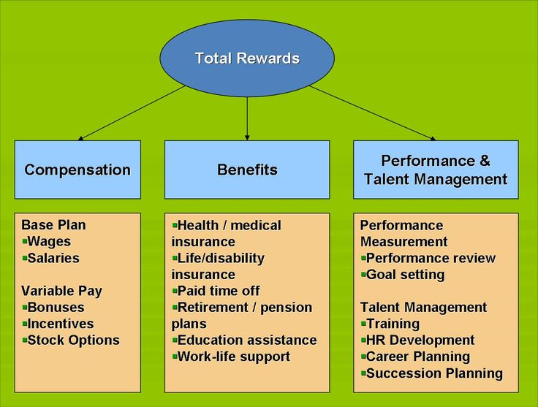
Personal Skills Audit on Behaviour
Gain positive confidence
Past experiences and studies
Acquire knowledge
Engaged with the organization
Understanding transcriptions and statistics
(Source: Jayasingam, Chong and Bakar, 2021)
Notes:
As I have always been open to expressing my thoughts and ideas in school and college, I have been able to gain positive confidence in myself, which has been reflected in my behavior. I believe that I can be an efficient HR officer since my positive approach toward the tea will be highlighted in my behavior (Afsar, Cheema and Saeed, 2017). My personal skills are based on my past experiences and studies that I have got to work on ever since my childhood. I have also been through various books and attended workshops to acquire knowledge about human behavior and the changes that are required by every human to get out of the monotony. Having understood human nature, I will be able to help the organization to make the employees stay within the organization since I will add effective strategies and plans to get the employees engaged with the organization and feel excited to work on the tasks.
My ability to analyze things minutely and identify small to big details about a particular situation will make me determine the issues that I might get to face when dealing with the team members (Jayasingam, Chong and Bakar, 2021). I will make sure that I get to communicate with the employees of the organization frequently so that they do not get to feel detached from the team members. There are also things that I lack, which I believe to be my inefficiency in understanding transcriptions and statistics; thus, I aim to work in it in the near future by having taken an active part in the organizational workshops.

Slide 9
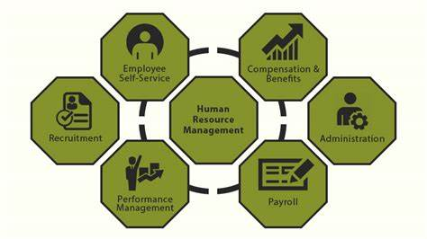
Potential benefits to the organization
Potential benefit
Unique perception
Handling issues
Organizational policy
Achieve the target
(Source: Balozi, Othman and Isa, 2018)
Notes:
The potential benefit that the organization is getting to derive from my knowledge, skills, and behavior is that I have been a positive influence on the company. My unique perception of the people and handling issues enables me to greatly benefit the organization (Balozi, Othman and Isa, 2018). I have a tendency to get the task done before the stipulated time; thus, this always gets me to achieve the target and makes the employees those having been working under me follow the same. I ensure that I get to follow up with the organizational policy and get the task done on time.

Slide 10
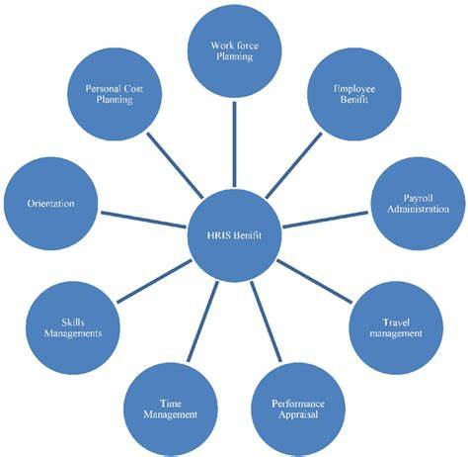
Potential benefits to the organization
Communicational skills
Recreational activities
Analytical skills
Achieve the milestone
Recruitment and training
Provide continuous growth
Hard work and performance
(Source: Almadana, Suharnomo and Perdhana, 2021)
Notes:
Having trained as an HR professional of the organization, I have got to gain various skills as an individual that will benefit both the organization and my personal life. I was trained to have great communicational skills so that I could have an approachable outlook toward the employees. This will help them to communicate with me and discuss the issues that they get to face within the organization (van Berkel, Penning de Vries and Knies, 2022). I was trained to stay professional yet have the ability to maintain a friendly relationship with the team members by having connected to them on a personal level through various organizational programs and recreational activities. As I already have great analytical skills, I was trained to make adequate use of them in the professional field and help the organization gain greater productivity from the end of the employees. I was also taught to develop a performance management system by having made the employees feel motivated to perform better and achieve the milestone that had been set for them.
By way of the effective training and development process, I have been able to be an active member of the team. Through the recruitment and training sessions, I will be able to add efficient employees to the team. I will also be able to build a strong relationship with my teammates by showing empathy toward them when they are in need (Almadana, Suharnomo and Perdhana, 2021). It will also ensure that I get to provide continuous growth and development opportunities to the employees and make them ready to push their limits so that they can excel in their careers. I will check on the performance of the team closely so that I can provide them recognition for their hard work and performance within the organization. Thus I believe that these qualities of mine will be of great help to me and will enable me to be productive for the organization.

Slide 11
Conclusion
Conduct a detailed audit
Expert in the HRM department
Potential benefits that the organization
Skills and knowledge
Notes:
To conclude the above description, it can be stated that this paper is solely based on the knowledge, skills, and behavior that needs to be followed by the HR professionals of an organization. This paper has also stated about my personal skills, knowledge, and behavior to conduct a detailed audit on my ability to become an expert in the HRM department. The potential benefits that the organization is likely to have for having hired me as an HR manager have also been elaborated on so that my skills and knowledge can be heightened in an effective manner.

Slide 12
References
Abbasi, S.G., Shabbir, M.S., Abbas, M. and Tahir, M.S., 2021. HPWS and knowledge sharing behavior: The role of psychological empowerment and organizational identification in public sector banks. Journal of Public Affairs, 21(3), p.e2512.
Afsar, B., 2016. The impact of person-organization fit on innovative work behavior: the mediating effect of knowledge sharing behavior. International journal of health care quality assurance.
Afsar, B., Cheema, S. and Saeed, B.B., 2017. Do nurses display innovative work behavior when their values match with hospitals' values? European Journal of innovation management.
Almadana, A.V., Suharnomo, S. and Perdhana, M.S., 2021. Can generational differences and feeling trusted improve knowledge-sharing behavior? Consequences of high-performance work systems. Journal of Workplace Learning.
Amin, M.B. and Rubel, M.R.B., 2020. Human resource management practices and employee knowledge sharing behavior: Mediating role of knowledge sharing intention. Asian Journal of Empirical Research, 10(5), pp.150-164.
Balozi, M.A., Othman, S.Z. and Isa, M.F.M., 2018. Mediating effects of subjective norms on the relationship between career advancement and job characteristics and knowledge sharing behavior among Tanzanian healthcare professionals. Gadjah Mada International Journal of Business, 20(2), pp.187-203.
Hao, Q., Yang, W. and Shi, Y., 2019. Characterizing the relationship between conscientiousness and knowledge sharing behavior in virtual teams: an interactionist approach. Computers in Human Behavior, 91, pp.42-51.
Javaid, M., Jaaron, A.A. and Abdullah, N.H.B., 2022. Relationship between Big Five personality traits and knowledge sharing behaviour: moderating role of Islamic work ethics. Cross Cultural & Strategic Management, (ahead-of-print).
Jayasingam, S., Chong, M.M.K. and Bakar, R.A., 2021. Knowledge sharing behaviour of overqualified repatriates. Journal of Global Mobility: The Home of Expatriate Management Research.
Kozhakhmet, S., Jayasingam, S., Majeed, N. and Jamshed, S., 2019. When investment in employee development promotes knowledge sharing behavior in an uncertain post-Soviet context. Personnel Review.
Naz, S., Li, C., Nisar, Q.A. and Rafiq, M., 2019. Linking emotional intelligence to knowledge sharing behaviour: mediating role of job satisfaction and organisational commitment. Middle East Journal of Management, 6(3), pp.318-340.
Ngenzi, J.L., Scott, R.E. and Mars, M., 2021. Information and communication technology to enhance continuing professional development (CPD) and continuing medical education (CME) for Rwanda: a scoping review of reviews. BMC Medical Education, 21(1), pp.1-8.
Raza, I. and Awang, Z., 2020. Knowledge sharing in multicultural organizations: evidence from Pakistan. Higher Education, Skills and Work-Based Learning.
Reslan, F.Y.B., Garanti, Z. and Emeagwali, O.L., 2021. The effect of servant leadership on innovative work behavior and employee knowledge sharing in the Latvian ICT sector. Baltic Journal of Management.
Saling, K.C. and Do, M.D., 2020. Leveraging people analytics for an adaptive complex talent management system. Procedia Computer Science, 168, pp.105-111.
Shahzadi, I. and Waqas Raja, M., 2021. Knowledge Management Based HR Practices and Three-Dimensional Knowledge Sharing Behavior: Evidence From South Asian Higher Education Institutes. International Journal of Management (IJM) Volume, 12, pp.335-350.
Shaikh, M., Diwan, M. and Kumar, R., 2021. Role of HRIS and Knowledge Sharing Behaviour towards Innovation Capability: Moderating role of Organizational Citizenship Behaviour. Journal of Entrepreneurship, Management, and Innovation, 3(2), pp.237-261.
Singh, P.K., 2018. Knowledge strategy, sharing behavior and performance: Reviewing a knowledge-oriented approach. Management Research Review.
van Berkel, R., Penning de Vries, J. and Knies, E., 2022. Managing Street-Level Bureaucrats’ Performance by Promoting Professional Behavior Through HRM. Public Personnel Management, 51(2), pp.189-212.
Wu, W.Y., Lee, L.Y. and Pham, T.T., 2019. Examining the influence of expatriates’ social capital and knowledge-sharing behavior on financial performance. International Journal of Organizational Analysis.
Notes:
References
Abbasi, S.G., Shabbir, M.S., Abbas, M. and Tahir, M.S., 2021. HPWS and knowledge sharing behavior: The role of psychological empowerment and organizational identification in public sector banks. Journal of Public Affairs, 21(3), p.e2512.
Afsar, B., 2016. The impact of person-organization fit on innovative work behavior: the mediating effect of knowledge sharing behavior. International journal of health care quality assurance.
Afsar, B., Cheema, S. and Saeed, B.B., 2017. Do nurses display innovative work behavior when their values match with hospitals' values? European Journal of innovation management.
Almadana, A.V., Suharnomo, S. and Perdhana, M.S., 2021. Can generational differences and feeling trusted improve knowledge-sharing behavior? Consequences of high-performance work systems. Journal of Workplace Learning.
Amin, M.B. and Rubel, M.R.B., 2020. Human resource management practices and employee knowledge sharing behavior: Mediating role of knowledge sharing intention. Asian Journal of Empirical Research, 10(5), pp.150-164.
Balozi, M.A., Othman, S.Z. and Isa, M.F.M., 2018. Mediating effects of subjective norms on the relationship between career advancement and job characteristics and knowledge sharing behavior among Tanzanian healthcare professionals. Gadjah Mada International Journal of Business, 20(2), pp.187-203.
Hao, Q., Yang, W. and Shi, Y., 2019. Characterizing the relationship between conscientiousness and knowledge sharing behavior in virtual teams: an interactionist approach. Computers in Human Behavior, 91, pp.42-51.
Javaid, M., Jaaron, A.A. and Abdullah, N.H.B., 2022. Relationship between Big Five personality traits and knowledge sharing behaviour: moderating role of Islamic work ethics. Cross Cultural & Strategic Management, (ahead-of-print).
Jayasingam, S., Chong, M.M.K. and Bakar, R.A., 2021. Knowledge sharing behaviour of overqualified repatriates. Journal of Global Mobility: The Home of Expatriate Management Research.
Kozhakhmet, S., Jayasingam, S., Majeed, N. and Jamshed, S., 2019. When investment in employee development promotes knowledge sharing behavior in an uncertain post-Soviet context. Personnel Review.
Naz, S., Li, C., Nisar, Q.A. and Rafiq, M., 2019. Linking emotional intelligence to knowledge sharing behaviour: mediating role of job satisfaction and organisational commitment. Middle East Journal of Management, 6(3), pp.318-340.
Ngenzi, J.L., Scott, R.E. and Mars, M., 2021. Information and communication technology to enhance continuing professional development (CPD) and continuing medical education (CME) for Rwanda: a scoping review of reviews. BMC Medical Education, 21(1), pp.1-8.
Raza, I. and Awang, Z., 2020. Knowledge sharing in multicultural organizations: evidence from Pakistan. Higher Education, Skills and Work-Based Learning.
Reslan, F.Y.B., Garanti, Z. and Emeagwali, O.L., 2021. The effect of servant leadership on innovative work behavior and employee knowledge sharing in the Latvian ICT sector. Baltic Journal of Management.
Saling, K.C. and Do, M.D., 2020. Leveraging people analytics for an adaptive complex talent management system. Procedia Computer Science, 168, pp.105-111.
Shahzadi, I. and Waqas Raja, M., 2021. Knowledge Management Based HR Practices and Three-Dimensional Knowledge Sharing Behavior: Evidence From South Asian Higher Education Institutes. International Journal of Management (IJM) Volume, 12, pp.335-350.
Shaikh, M., Diwan, M. and Kumar, R., 2021. Role of HRIS and Knowledge Sharing Behaviour towards Innovation Capability: Moderating role of Organizational Citizenship Behaviour. Journal of Entrepreneurship, Management, and Innovation, 3(2), pp.237-261.
Singh, P.K., 2018. Knowledge strategy, sharing behavior and performance: Reviewing a knowledge-oriented approach. Management Research Review.
van Berkel, R., Penning de Vries, J. and Knies, E., 2022. Managing Street-Level Bureaucrats’ Performance by Promoting Professional Behavior Through HRM. Public Personnel Management, 51(2), pp.189-212.
Wu, W.Y., Lee, L.Y. and Pham, T.T., 2019. Examining the influence of expatriates’ social capital and knowledge-sharing behavior on financial performance. International Journal of Organizational Analysis.

Slide 13


