Slide 1
Testing your Solution
Lecture 5: Problems- Solving Techniques (PST)
Dr Redhwan Al-amri

Slide 2
Today’s Lecture
Testing and Errors
Trace Tables
Truth Tables???

Slide 3
Problem Solving
1
Identify the Problem
Understand it and all the details
What? Why? When? Where? Who? …
Yes ☺
Done - hooray!
No ☹
5
Test Solution
Did it work?
2
Develop Possible Solution(s)
Solution
1
Solution
2
Solution
3
4
Implement it
3
Select Best Solution
Carry out the chosen solution
Solution
2

Slide 4
Testing your Solution
Is my solution correct?
  You have to test it!
  It is very important you do this and not just one test.
    You need to conduct multiple tests!
You test your solution to discover errors.
In computing, there are two main types of errors:
  Syntax Errors
  Logical Errors

Slide 5
Syntax Errors
Misusing a language’s grammar rules.
In English, for example:
  Misspelling a word
  Using words that do not exist
  Using bad grammar.
In computing, writing a programming language (in our case pseudocode or flowchart) statement incorrectly.
  Some of you would have heard me say you are not using variable names or input/output statements correctly ☺.

Slide 6
Syntax Error Example in English
Correct English syntax for telling someone where you have place an item is:
  “I have put it on the table.”
Incorrect English syntax
  “I have it on the table put.”
All the right words are there, but:
  The syntax is wrong!
  It is grammatically incorrect making the sentence sound like gibberish.
I read, however, that translated word for word, the second sentence is correct syntax in German¹.
¹Source: Prelude to Programming, 6th edition by Elizabeth Drake

Slide 7
Syntax Errors in Computing
In computing, it is easy to identify syntax errors.
Your solution will not work if it contains syntax errors.
  The computer program will catch all syntax errors in your solution and display an error message.
    Unfortunately, sometimes these messages can be a bit cryptic! ☺
  You will not be able to execute your solution until you fix all the syntax errors.

Slide 8
Logical Errors
The syntax of your solution is correct, but:
  It contains a mistake, resulting in:
    Unexpected Behaviour
    Incorrect Behaviour
A logical error may:
  Produce the wrong output
  Produce an incorrect calculation result
  Cause a program to crash while running
They are commonly referred to as bugs.
They are not always easy to recognise.

Slide 9
Source of Logical Errors
Typo errors, for example:
  Mistakenly typing the wrong symbol
  Mistakenly typing the wrong variable name
Incorrect logic by the programmer. For example:
  Using the wrong formula
  Incorrect interpretation of the requirements

Slide 10
Logical Error Examples
For example, a simple solution to check if a person is legally old enough to drive.
Can you spot the error?

Slide 11
Finding Logical Errors
Test your solution, using different types of data:
  Good data: data you know should work.
  Bad data: data you know should not work.
  Data you know the answers for.
  Data you do not know the answer for.
  Etc.
To help us, we are going to be using trace tables.

Slide 12
Trace Tables
A technique used to check algorithms, e.g. flowcharts and pseudocode, for logical errors.
Also known as dry running or desk-checking.
You:
  Identify each of the variables in your solution, and
  Trace their values as each line/process in your solution is executed.
As the name suggests, you use a table:
  Columns represent the different variables and their values.
  Rows represent each solution step and process

Slide 13
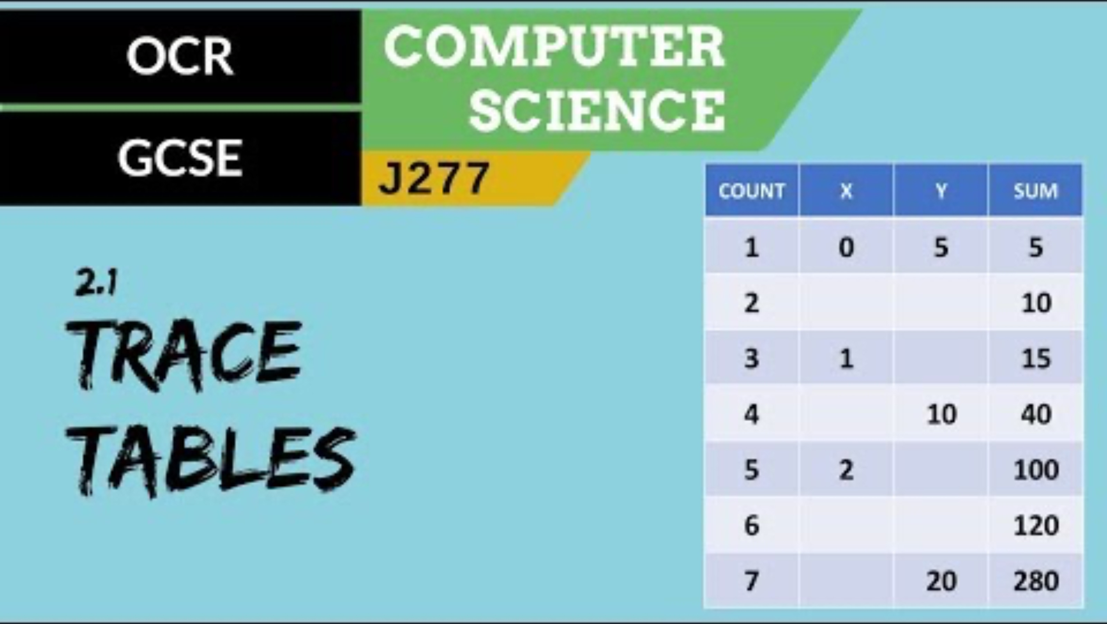
Example

Slide 14
Lab Exercise
Examples and Exercises
Download instructions from Moodle

