Slide 1
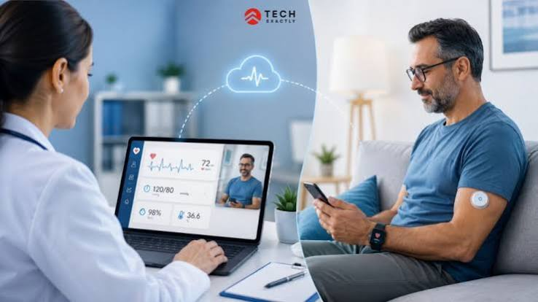
Evaluating Remote Patient Monitoring (RPM) in the NHS
BMH6026: Digital Transformation in Health and Care
Student Name:Pavlin Enchev
Student Number:2327272
Digital Transformation in Health and Care Professions
August 2026
Notes:
Hello and Welcome. Today I'm going to talk about Remote Patient Monitoring, or RPM. It is an innovative digital healthcare solution that allows healthcare professionals to monitor patients in their own homes with connected digital devices. Over the past few years, the NHS has been increasingly using Remote Patient Monitoring to enhance patient care, decrease unnecessary hospital visits and help those with long-term health conditions.
During this presentation, I will explain what Remote Patient Monitoring is, how it works, its impact on healthcare professionals, patients and communities, and the challenges associated with its implementation. Lastly, I will make recommendations and draw conclusions on whether Remote Patient Monitoring is a successful digital transformation in UK health and social care.

Slide 2
Introduction & Aim
What is Digital Transformation?
Digital transformation is the use of technology to improve healthcare services, patient outcomes and organisational efficiency.
Patient
Digital Device
NHS Monitoring Team
Clinical Action
Presentation Aim
To assess the impact of Remote Patient Monitoring on health and social care in the UK.
Objectives:
Explain Remote Patient Monitoring.
Describe how RPM operates in the NHS.
Evaluate benefits for professionals and patients.
Critically analyse limitations.
Recommend future improvements.
(CQC, 2024; Health Innovation Network UK, 2023)
Notes:
Digital transformation is transforming the way health and social care organisations provide services. Healthcare providers are increasingly leveraging digital technologies to enhance access, efficiency and quality of care, rather than just face-to-face appointments.
One such example is Remote Patient Monitoring. Patients measure their health at home with connected devices, like blood pressure monitors, pulse oximeters or glucose sensors. The information is safely sent to health care providers who analyze the results and determine if additional action is required.
This presentation assesses the effect of Remote Patient Monitoring in the NHS. It delves into the role of the technology in assisting healthcare professionals, enhancing patient experiences, and advancing community healthcare. The presentation also reflects on the risks, such as digital exclusion, cyber security and workforce issues, and offers recommendations for future practice.

Slide 3
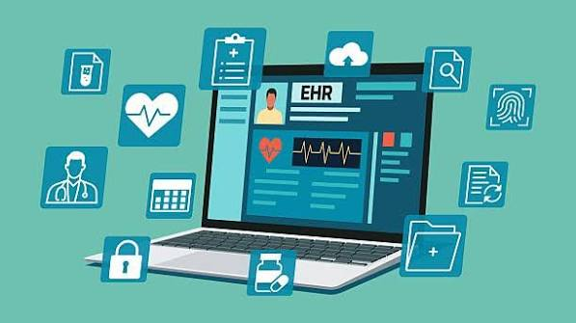
What is Remote Patient Monitoring (RPM)?
RPM: Remote Patient Monitoring (RPM) is a digital technology that enables healthcare providers to monitor patients outside of the healthcare environment
Some RP Devices Include:
Blood pressure monitors
Pulse oximeters
Continuous glucose monitors
Smart weight scales
Heart rhythm monitors
Wearable fitness and activity trackers
Used For:
Diabetes
Hypertension
Heart failure
COPD
Post-operative recovery
Notes:
Remote Patient Monitoring is the process of gathering health data from a distance, from home. The devices automatically record health measurements and securely send the information to healthcare teams.
The data is reviewed regularly by healthcare professionals, who can easily detect changes in a patient's condition. This enables earlier intervention before issues become critical. Remote Patient Monitoring is especially beneficial for individuals with chronic diseases like diabetes, hypertension, chronic obstructive pulmonary disease (COPD), and heart failure. It is also becoming more popular for use after surgery or discharge from the hospital. Unlike traditional healthcare, where appointments are required, Remote Patient Monitoring offers ongoing data on a patient's condition. This enables clinicians to make informed decisions and minimises unnecessary hospital visits.

Slide 4

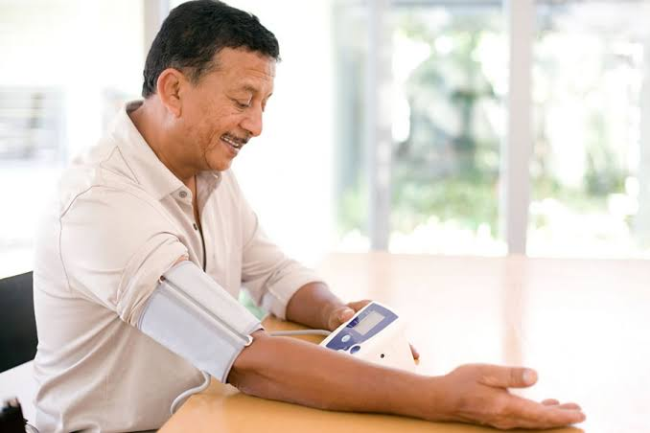
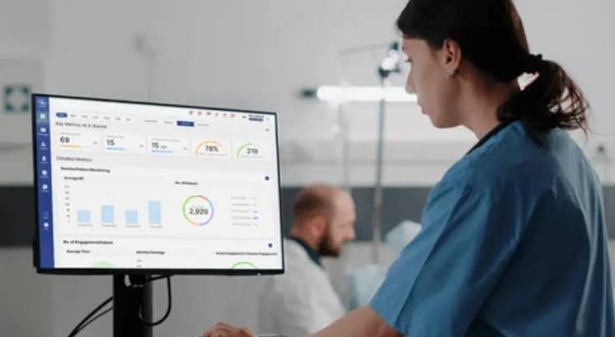
How Remote Monitoring Works
How the System Operates:
Patient measures health data at home.
Device securely sends information.
NHS digital platform receives results.
Healthcare professionals review alerts.
Appropriate action is taken if needed.
Patient Measures Health Data
Device Sends Info
NHS Digital Platform
Professional Review of Alerts
Action is Taken
Possible Clinical Actions
Telephone consultation
Video appointment
Medication review
GP referral
Hospital assessment
Emergency intervention
Notes:
It begins with a patient using a digital monitoring device at home. The device can measure data like blood pressure, oxygen saturation, blood glucose or heart rate, depending on the condition being tracked.
The findings are securely sent to an NHS digital platform where health care professionals can access them. Some systems automatically alert when readings are out of safe limits. Clinicians evaluate the information and decide on the best response. This could include contacting the patient, changing medication, further investigations or hospital assessment if needed.
One of the best things about Remote Patient Monitoring is that it enables healthcare teams to detect issues earlier than they would be able to during a standard appointment. Early intervention can lead to better outcomes for patients, fewer avoidable hospital admissions and better patient confidence in managing their condition at home.

Slide 5

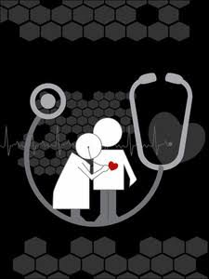

Benefits for the Health and Care Workforce
Key Benefits
Enables early identification of patient deterioration.
Reduces unnecessary face-to-face appointments.
Supports proactive rather than reactive care.
Improves multidisciplinary communication.
Prioritises patients according to clinical need.
Reduces pressure on hospital beds.
Supports NHS Virtual Ward programmes.
Overall Impact: Healthcare professionals can intervene earlier, improving efficiency while maintaining patient safety.
Notes:
The use of Remote Patient Monitoring has revolutionized the way healthcare providers care for patients with chronic conditions.
Clinicians get regular health information, rather than waiting until a patient is seriously unwell, to detect deterioration much earlier. This helps to facilitate proactive care, which is care that takes place prior to admission to hospital.
The technology also enables professionals to prioritise workloads. Clinicians can review each patient in a different manner, instead of reviewing all patients, they can concentrate on patients with readings that suggest a higher clinical risk.
One of the other key advantages is better multidisciplinary cooperation. The same digital information can be used to help manage patients by community nurses, GPs, hospital specialists and pharmacists.
Remote Patient Monitoring can also be used to help NHS Virtual Wards, where appropriate, to monitor patients at home safely, rather than in hospital. This helps to alleviate pressure on hospital capacity and enhances patient flow.
However, the technology does not reduce the need for healthcare professionals. Instead, it changes how care is delivered by supporting faster decision-making and better use of clinical resources.

Slide 6
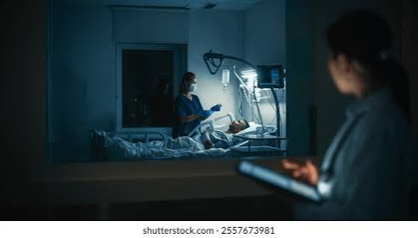

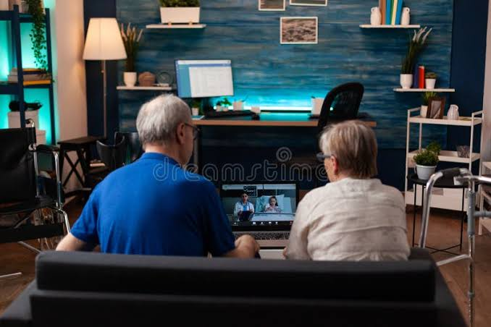



Impact on Patients and Communities
Patient Benefits | Community Benefits
Greater independence at home. Earlier treatment when health worsens. Fewer emergency hospital admissions. Improved management of long-term conditions. Increased patient confidence. Better quality of life. Reduced travel to healthcare facilities. | Improves access in rural communities. Supports ageing populations. Reduces demand on NHS services.
Notes:
Remote Patient Monitoring puts patients in the centre of their care. People with chronic conditions often prefer to stay at home instead of making regular visits to the hospital. This can be done remotely, and still with ongoing clinical supervision. Patients are more engaged in their own health management as they frequently monitor key health parameters and are aware of the impact lifestyle changes have on their health.
This also helps communities as healthcare resources are utilized more efficiently. Minimising unnecessary attendance at hospital frees up capacity for those who need urgent treatment. RPM is especially beneficial for rural communities, where accessing hospitals can be challenging. It also contributes to the UK's ageing population by enabling older people to stay independent for longer.
However, the success of implementation will rely on the ability to ensure that patients are able to use the equipment properly and know when to seek medical advice on their own if symptoms worsen.

Slide 7
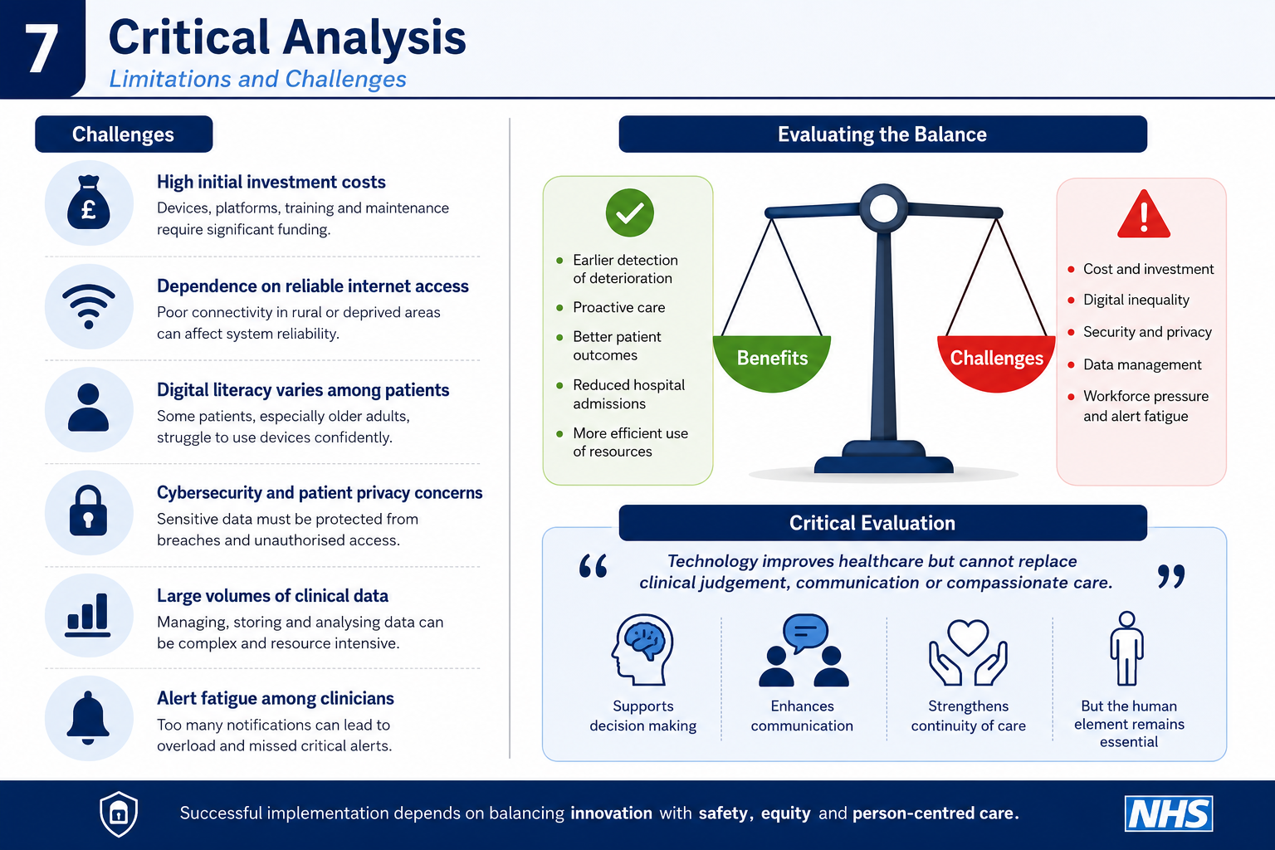
Critical Analysis
Limitations & Challenges
Recommendations
High initial investment costs.
Dependence on reliable internet access.
Digital literacy varies among patients.
Cybersecurity and patient privacy concerns.
Large volumes of clinical data.
Alert fatigue among clinicians.
Critical Evaluation:
Technology improves healthcare but cannot replace clinical judgement, communication or compassionate care.
Notes:
While Remote Patient Monitoring has many benefits, it also presents some key challenges that healthcare organisations need to tackle. The technology demands significant capital expenditure, such as digital devices, software platforms, technical support and staff training.
Digital exclusion is another challenge. Monitoring equipment may be difficult to use for some patients, especially older adults or those who are not used to using digital technology. In some locations, poor internet connectivity can also impact system reliability. Healthcare professionals are also presented with new challenges. With continuous monitoring, there is a lot of patient information generated and it is hard to determine which alerts need to be acted on immediately. Too many notifications can lead to alert fatigue, which is when important alerts are missed. Another major concern is cybersecurity, as patient data needs to be securely transferred and stored.
Consequently, Remote Patient Monitoring should be considered a decision support technology, not a substitute for health care professionals. Safe, high-quality care is still dependent on human assessment, clinical reasoning and compassionate communication.

Slide 8
Recommendations
Expand NHS Virtual Ward programmes.
Improve digital infrastructure nationwide.
Strengthen cybersecurity systems.
Increase staff training.
Improve patient digital education.
Design inclusive technologies for older adults (Health Innovation Network, 2023).
Monitor outcomes through continuous evaluation.
Promote collaboration between healthcare providers and technology developers.
Deliver equitable, sustainable and patient-centred digital healthcare.
Goal
Notes:
There are several enhancements that could support the future use of Remote Patient Monitoring in the NHS.
First, ongoing investment is required to increase the capacity of Virtual Ward services to provide safe care at home to more patients who have appropriate conditions. Digital infrastructure should also be enhanced to ensure reliable internet connectivity in all areas, especially in rural areas where internet connectivity is not reliable.
Training is also crucial. Healthcare professionals must be continually educated to confidently use monitoring systems, and patients must be provided with instructions on how to use devices properly and understand their own health information.
It is also crucial for organisations to enhance their cybersecurity protocols to safeguard sensitive patient data and restore trust in digital healthcare. Last but not least, healthcare providers should continuously assess patient outcomes, staff experiences, and service efficiency to pinpoint areas for improvement. If invested and managed properly, Remote Patient Monitoring can be a fundamental part of the future health and social care provision in the UK.

Slide 9
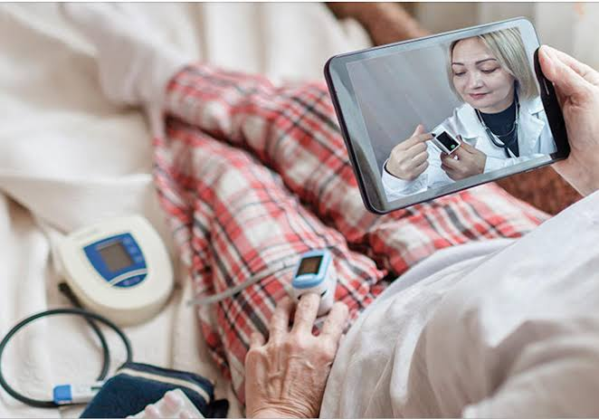
Conclusion
Remote Patient Monitoring is transforming healthcare delivery across the NHS.
It supports earlier intervention and proactive management of long-term conditions.
Healthcare professionals can deliver more efficient, coordinated services.
Challenges such as digital inequality, cybersecurity and workforce readiness remain
Remote Patient Monitoring demonstrates how digital innovation can improve healthcare quality when combined with effective governance, skilled professionals and patient-centred implementation.
Take-Away
Notes:
In conclusion, Remote Patient Monitoring is a key digital innovation that is reshaping health and social care in the UK.
The evidence indicates that it can help identify patient deterioration earlier, help to manage long-term conditions proactively and enhance communication between healthcare professionals. These enhancements help to improve patient outcomes and lower unnecessary hospital admissions and alleviate the strain on NHS services. Patients also gain independence at home and increased involvement in their own health care. This helps to promote person-centred care and is in line with the NHS goal to provide more care in the community. While these benefits exist, they must be sustained through ongoing investment, staff training and strong cybersecurity protocols. Digital inclusion should also be a priority to ensure that vulnerable groups are not left behind in accessing digital healthcare services.
In general, Remote Patient Monitoring is not just a technological advancement. It is a new way of delivering healthcare that brings together technology and professional skills to enhance the quality, safety and sustainability of health and social care.

Slide 10

Critical Reflection and Future Outlook
Opportunities
Priorities
Wider use of Artificial Intelligence to identify early clinical deterioration.
Expansion of NHS Virtual Wards (NHS England, 2024).
Integration with wearable health technologies.
Greater use of predictive analytics.
Increased personalised healthcare.
Protect patient privacy.
Improve digital inclusion.
Strengthen staff digital competence.
Maintain person-centred care.
Future digital healthcare should enhance—not replace—the human relationship between professionals and patients.
Notes:
In the future, Remote Patient Monitoring is likely to play a more prominent role in the delivery of routine care. Artificial Intelligence can assist doctors in interpreting vast amounts of patient information more efficiently, and detect early warning signs before patients become seriously ill. This may further enhance early intervention and minimise unnecessary hospital admissions.
The NHS will also be rolling out more Virtual Ward services, enabling more patients to be monitored at hospital level safely at home. Wearable technology will keep improving to deliver more precise and real-time health data. But technology should not be the end goal of healthcare. Ensuring patient privacy, minimizing digital disparities and preserving public confidence will continue to be key priorities. Healthcare organisations will also need to invest in workforce development to ensure that professionals are confident in their ability to use emerging technologies safely and effectively.
As digital healthcare continues to evolve, it is essential to strike a balance between innovation and compassion, ensuring that technology enhances, not detracts from, the patient-provider dynamic.

Slide 11
Reference List
Care Quality Commission (2024) The state of health care and adult social care in England 2023/24. London: CQC.
Health Innovation Network (2023) Remote Monitoring in Long-Term Conditions. London: Health Innovation Network.
National Institute for Health and Care Excellence (2023) Early Value Assessment: Remote Monitoring Technologies. London: NICE.
NHS England (2024) Virtual Wards Operational Framework. London: NHS England.
Nuffield Trust (2024) The Future of Digital Health in the NHS. London: Nuffield Trust.
The King's Fund (2023) Digital Change in Health and Social Care. London: The King's Fund.
World Health Organization (2021) Global Strategy on Digital Health 2020–2025. Geneva: WHO.
.

Slide 12


Questions
Thank You!
Notes:
Thank you for your attention. Feel free to ask any questions about Remote Patient Monitoring and its contribution to digital transformation in health and social care.

