Slide 1

LCHS4010
Psychology in Health and Social Care
Student name: Walde B. Barreras
Student number: 2508291
Lecturer’s name: Peace
I use Artificial Intelligence (AI) to check my grammar, conduct research for my assignments, and make sure my Harvard citations and references are formatted appropriately.

Slide 2
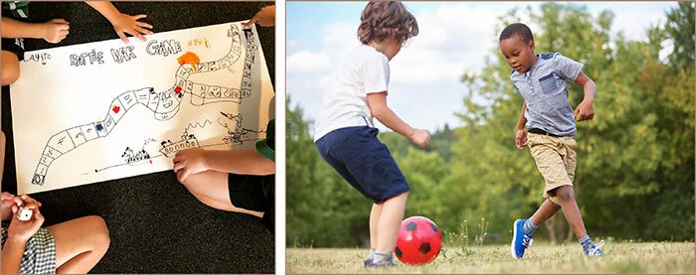
Examining Isaac's Development Using Piaget's Cognitive Development Theory
Learning through play.

Slide 3

Introduction:
Isaac’s Background
Four years old
Mother experiences postnatal depression
Disrupted childcare
Language delay
Withdrawn and clinging
(Piaget, 1952)
Image: Shy child at a nursery.

Slide 4
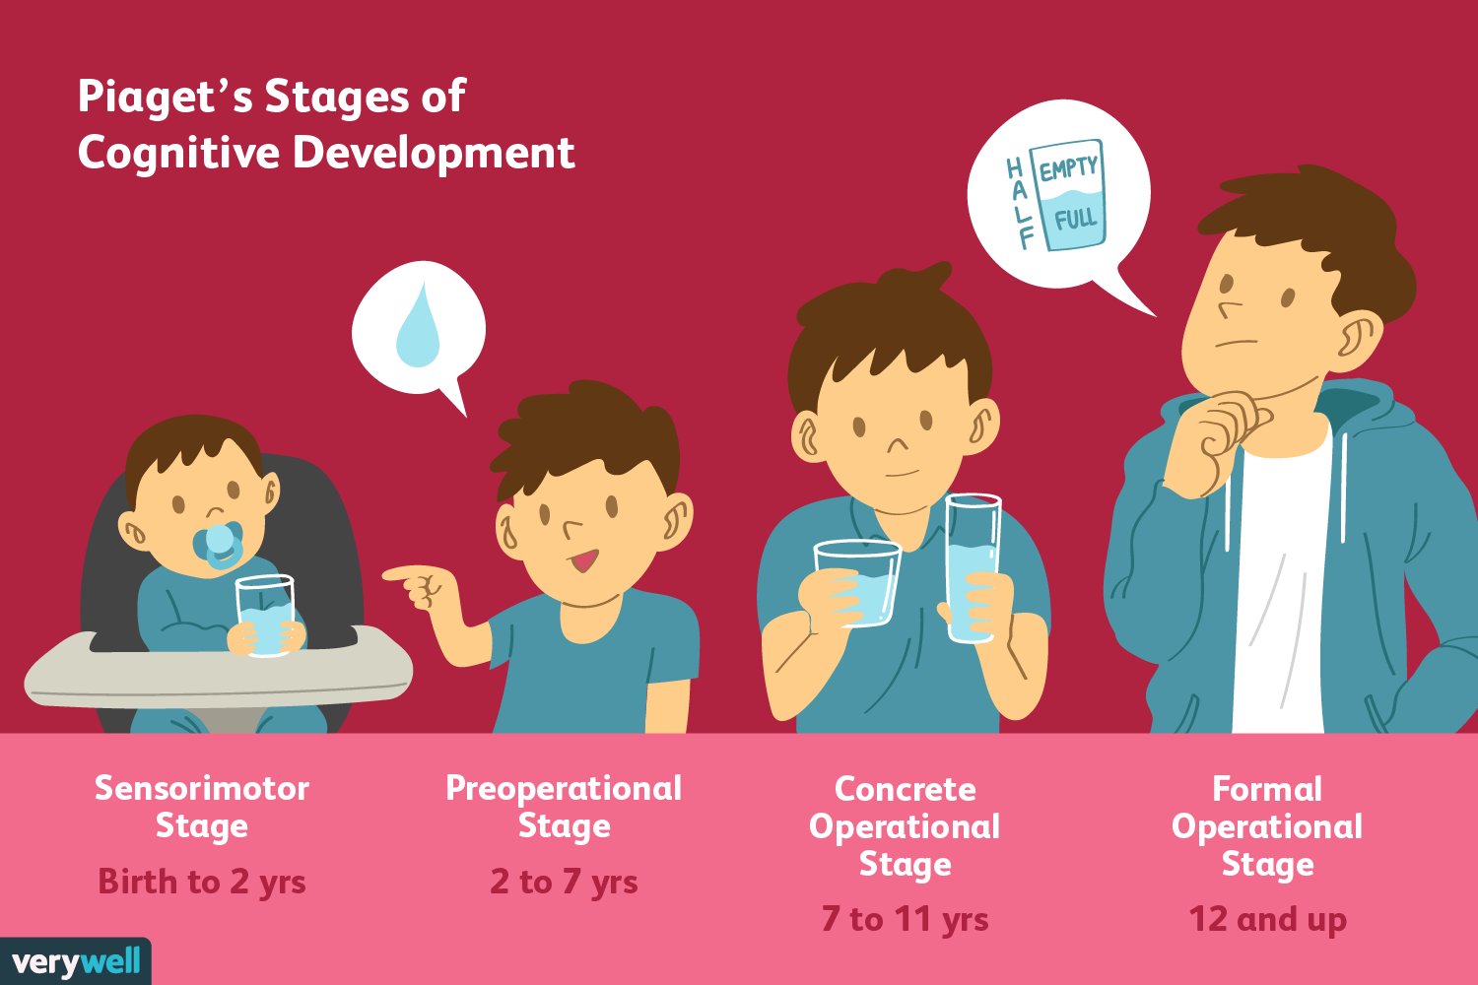
Piaget’s Theory
Important Ideas:
Children learn via play.
Learning happens in stages.
Isaac is in the Preoperational Stage (2–7 years).
Symbolic play develops thinking and language.
(Piaget, 1952)
Image: Piaget’s phases diagram.

Slide 5
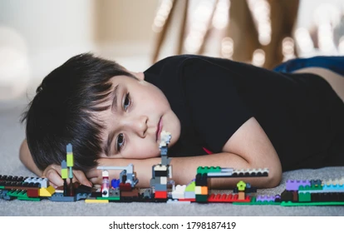
Applying the Theory
Isaac's encounters could have impacted:
The formation of language
Interaction with others
Play-based learning
Self-assurance
(Piaget, 1952)
Picture: A child playing by themselves.

Slide 6
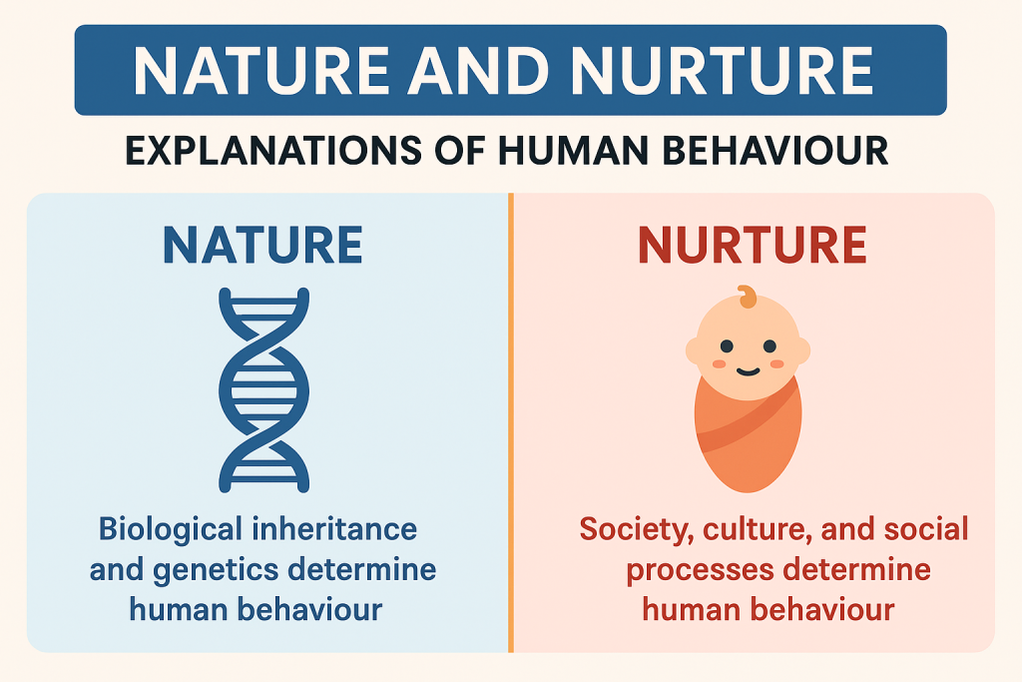
Nature versus Nurture
The natural world:
Development of the brain
Temperament
Nurturing:
The family setting
Childcare
Interaction with others
Reference: Bronfenbrenner (1979)
Image: Nature vs nurture illustration

Slide 7
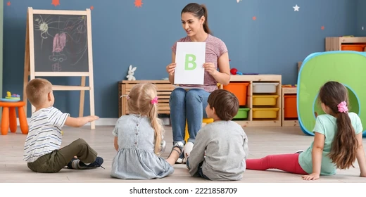
Support Plan:
Learning through play
Play in small groups
Language & Speech Therapy
Support from parents
Department of Education, 2024
Picture: A teacher reading aloud to kids.

Slide 8
Strengths & Limitations
Advantages:
Play-based learning: Children learn through play and exploration (Piaget, 1952)
Child-focused: Learning develops at the child’s own pace.
Supports Early Years Foundation Stage (EYFS): Encourages active, hands-on learning (Department for Education 2024)
Limitations:
Limited focus on Emotions: Piaget focuses more on thinking than feelings.
Disregards attachment: It cannot fully explain Isaac’s clinginess and separation anxiety (Bowlby, 1969/1982).
(Vygotsky, 1978)

Slide 9

Conclusion:
Piaget describes Isaac's cognitive growth.
Learning is aided by play and exploration.
Language and confidence can be enhanced by early intervention.
(Piaget, 1952)
Image: Happy children learning together.

Slide 10
References:
Berk, L.E (2023). Development Through the Lifespan. 8th edn. Pearson.
Bronfenbrenner, U. (1979). The Ecology of Human Development. Harvard University Press.
Department for Education (2024). Statutory Framework for the Early Years Foundation Stage.
Piaget’s, J. (1952). The origins of Intelligence in children.
Piaget, J. (1962). Play, Dreams and Imitation in Childhood. W.W. Norton.
Vygotsky, L.S. (1978). Mind in Society. Harvard University Press.

