Slide 1

The function of Human Resource Management
Operations management
Session 2 week 4

Slide 2
Workforce
planning
Recruitment and selection
Operational issues.
Notes:
The HR function …..

Slide 3

Session Objectives
Types of organisations
Human resource planning process
Retaining personnel in event organisations
Recruitment and selection
HR Function
HRM theories

Slide 4

Managing organisations and the people within them is a difficult task and there are not often easy answers to the problems that managers face.
There is not often one solution to a problem but several alternatives that to choose from.
Complex

Slide 5
The management of people involves some degree of uncertainty.
Managers should attempt to limit that uncertainty in order to reduce the risk involved in making decisions.
To do this, we need to understand:
  individual motivation (people)
  the structural components of organisations and how they influence individual behaviour.

Slide 6
Understanding organisations
All organisations, regardless of size, age or purpose, have two broad components that significantly influence their operation, development and ability to function effectively.
These components are structure and culture.
It can also be said that the structure is a framework for the culture to be implemented, while the culture dictates how the company should be structured.
Knowing the relationship between culture and structure will enable any transition be managed more effectively. This makes leadership and management training so important as you will develop the skills to analyse a business and determine the culture within it in order to improve both performance and productivity.

Slide 7
Structure
Organisational structure is often thought of as the ‘hierarchy’ of an organisation, ideally providing a clear chain of command from the top of the organisation, such as a director, owner or CEO (Chief Executive Officer), down to front-line staff, who deal directly with customers.
‘the sum total of the ways in which it (the organisation) divides its labour into distinct tasks and then achieves coordination between them’.
Minzberg 1971

Slide 8
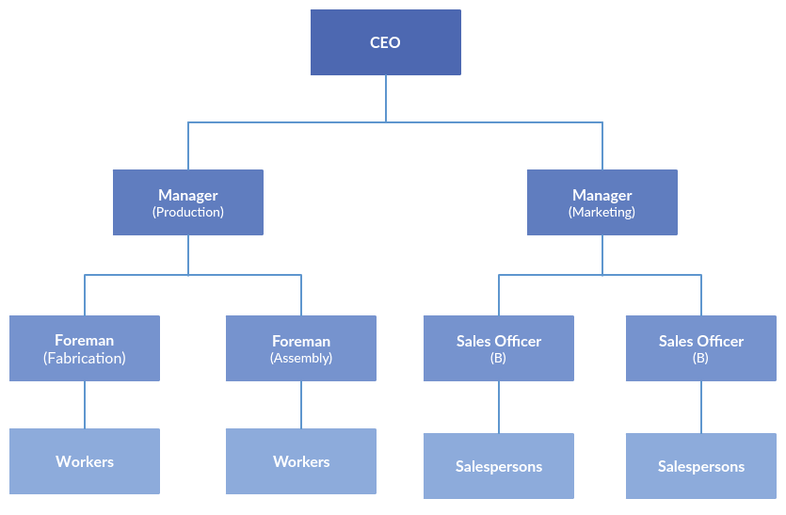
Structure
‘Hierarchy’ is only one of the three components of structure, which are:
  Complexity – the number of ‘levels’ in an organisation
  Formalisation – the extent to which there are formal rules, policies and procedures
  Centralisation – the extent to which decisions are made at the ‘top’ of the organisation.

Slide 9
Structure (Continued)
Sherratt et al. (2009:5) states that organisational structures
‘describe and determine the way work is arranged, how authority is exercised and the channels of communication that prevail, up, down and across the various divisions’.
An events/festival planner who may not have a formal organisational structure will be affected by the way work is arranged, managed and channels of communication.

Slide 10
Complexity
Organisations can be seen as tall, flat, wide or thin in structure or even adopt a matrix-like design.
This structure depicts the complexity of management within that organisation.
A small event company is likely to be less complex in structure, and thus less differentiated, than a large organisation employing many people.

Slide 11
Human resource management
Organisations, event planners will all need to consider the management of people, also know as Human research management.
HRM is defined as -
“The policies and practices one needs to carry out the people or human resources aspects of a management position, including recruiting, screening, training, rewarding and appraising” (Dessler 2000)
The planning process for HR needs to be carried out carefully in order to fulfil the needs of the different types of events
Notes:
REFER BACK TO Ffos

Slide 12
Types of Organisations
As well as the structure of an organisation within the events industry there is a need for flexibility.
Flexible Organisations
The Flexible-Firm Model was proposed in 1984 by John Atkinson of the Institute of Manpower Studies. He suggested that organisational structures require increased plasticity in a fluctuating market and unpredictable and competitive business environment.
  Functional Flexibility - Functional flexibility is advantageous because it provides workers with the opportunity to learn new skills and enables the firm to utilise them more efficiently. If the workers are equipped with a greater range of skills, then they can be used to respond quickly to market fluctuations.
  Numerical Flexibility - Numerical flexibility is adjusting the number of employees based on the needs of the employer. A good example of this is seasonal work and fixed-term contracts, flexible employment methods such as short-term contracts, outsourcing, temporary workers. employers can match labour demands with the number of employees under contract at the company.
  Why?
  Workforce planning
  Different events
  Size of event
Notes:
Different events
Size of event
=Equals careful workforce planning

Slide 13
Internal need for change
As a company grows (or shrinks), the structure must change to accommodate the increase (or decrease) in the number of employees and/or volunteers and to decide how the work of the organisation will be divided between people, commonly known as division of labour.
The Events industry is very flexible and change is the norm, therefore the workforce will need to adapt to that.

Slide 14

HR Planning Process
Careful workforce planning requires –
  Human Resource Strategy
  Policies and procedures
  Recruitment
  Legal Rights of employees
  Skills Audit (skills gaps)
  Training and Professional Development
  Supervision and appraisals
  Operational planning and management

Slide 15
The event recruitment and selection process
State specific event need.
Use appropriate recruitment and selection methods.
Match suitable applicant to job.
Review recruitment and selection processes and modify as required.

Slide 16
Event recruitment activities
Determining the vacancies.
Sourcing strategy.
Preparing and publishing information.
Processing and measuring applications.
Notifying applicants.
(Tyson and York 2000: 106–107)

Slide 17
Event job descriptions
Job/role title.
The event-related tasks and activities included in the job. These will be linked to the objectives of the role. Performance indicators can also be stipulated here.
Levels of responsibility and any departmental affiliations within the event organisation, as well as the name of the line manager for the position.
Pay scale.

Slide 18
Training programme for Event Managers
Training programme
Work Shadowing
Mentoring
Leadership
Team Development
Education Courses
Notes:
Here is an example of the structure of a Training programme for events managers

Slide 19
Retaining Personnel in Event Organisations
Retention of staff is a fundamental issue
High turnover of staff places specific demands on event managers
Termination, outplacement/redeployment and re-enlistment
Evaluation of Process
Motivation and retention ( next slide)

Slide 20
Categories of motivation theory
Needs - MASLOW 1949
Goals - Drucker (1954) popularised the term ‘management by objectives’ (MBO), a process of participative goal setting and decision making that assumes by involving employees in setting their own goals (in line with strategic direction of the organisation) they will be more motivated to achieve those goals
Expectancies - VROOM Expectancy theory suggests individuals are motivated by considering the perceived consequences of their actions
Self-efficacy - simply how you are interacting with and relating to others in the organization, has a direct impact on the organization’s goals.
Job design - autonomy over task/ extrinsic. intrinsic feedback – Hertzberg 1970
Notes:
NEEDS – MASLOW 1949
GOALS - Drucker (1954) popularised the term ‘management by objectives’ (MBO), a process of participative
goal setting and decision making that assumes by involving employees in setting their own goals
(in line with strategic direction of the organisation) they will be more motivated to achieve those goals
EXPECTAMCY THEORY – VROOM Expectancy theory suggests individuals are motivated by considering the perceived consequences of their actions
SELF EFFICY - r simply how you are interacting with and relating to others in the organization, has a direct impact on the organization’s goals.
JOB DESIGN – autonomy over task/ extrinsic.intrinsic feedback – Hertzberg 1970
DISPOSITIONAL FACTORS -

Slide 21

Employment law
Why is it important to consider the legal rights of employees in the events industry?​
What do you need to consider and why?
  Equality Act 2010 - legally protects people from discrimination in the workplace and in wider society
  Recruitment and selection
  Equal opportunities - The term “equal opportunities” upholds the idea that all workers within an organisation should be entitled to and have access to all of the organisations facilities at every stage of employment, including the pre-employment phase.
  Health and safety ( Covid )
  Work time directive - You cannot work more than 48 hours a week on average - normally averaged over 17 weeks. This law is sometimes called the 'working time directive' or 'working time regulations'. You can choose to work more by opting out of the 48-hour week.

Slide 22

Reflection..
What steps would you consider in making sure that your staff is from more diverse background?
Importance of upskilling staff?
What are the benefits ?

Slide 23
References
Information adapted from -
Beech, Kaiser & Kaspar. The Business of Events Management. Pearson
Bladen Kennell, Abson & Wilde. Events Management. An Introduction. Routledge
Raj, Walters &Rashid Events Management: Principles & Practice

