Slide 1

BMBM4005 Marketing Fundamentals
Week 9
Gwyneth Jones

Slide 2
Today
Marketing Research

Slide 3
What is Marketing Research?
Marketing research is the process of systematically gathering analysing and interpreting data and information about a market, including its consumers, competitors, industry trends and various factors that impact it.
The main purpose of marketing research is to gain insights and knowledge that help organisations make informed decisions, develop effective strategies and identify opportunities or challenges within a specific market or industry.

Slide 4
Marketing Research and the Marketing Planning Process.
Marketing research is the function that links the consumer, customer and public to the marketer through information - information used to identify and define marketing opportunities and problems; generate, refine, and evaluate marketing actions; monitor marketing performance; and improve understanding of marketing as a process.
Marketing research specifies the information required to address these issues, designs the methods for collecting information, manages and implements the data collection process, analyses, and communicates the findings and their implications.
American Marketing Association (AMA) - Official Definition of Marketing Research

Slide 5
Key Functions of Market Research
Understand consumers
  Target audience needs, preferences, behaviours and demographics
Competitor analysis
  Key competitors, market share, strategies used (7Ps)
Market trends
  Market size, forecasts, market demand, PESTEL factors
Product development
  Product research and market testing
Marketing and advertising
  Marketing mix decisions, advertising media use and effectiveness.

Slide 6
Exercise
You work for a company planning to enter the ‘subscription meal kit’ market in the UK.
What market research information will help you make key marketing decisions?

Slide 7

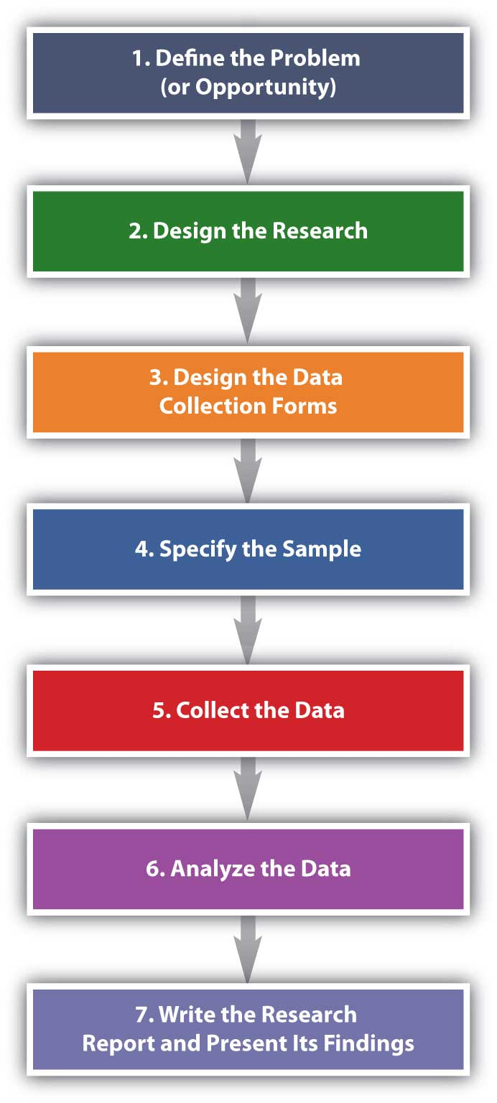
The research process

Slide 8
Sampling
It is not usually possible to survey everyone in a research target group (the population):
  Too costly
  Too time consuming
Researchers select samples of representative respondents to base their research on
Two main sampling methods:
  Random sampling (probability sampling)
  Non random sampling (non probability sampling)

Slide 9
Two Types of Market Research
Primary (field) data sources
  Data collected by an organisation or its agent
  Primary marketing research activities include:
        Surveys, interviews, focus groups etc…
Secondary (desk) data sources
  Data that has already been collected by another organisation or for another purpose
  Secondary data sources include: journals, industry reports, government statistics, internal reports such as sales figures or financial data, websites etc….

Slide 10
Key Facts About Secondary Data
Secondary research should be carried out before primary research
Secondary research is usually cheaper and quicker
Secondary data can be less relevant (if not collected for a specific purpose) or less current

Slide 11
COMPARISON OF PRIMARY AND SECONDARY RESEARCH
TYPE OF DATA | STRENGTHS | WEAKNESSES
Primary Data | Tailored to specific needs Current – latest data | Expensive to collect Longer collection and analysis process
Secondary Data | Cheaper to collect Quicker to collect Usually already analysed | May not precisely address research question as collected for a different purpose May be out of date May be less reliable depending on the source

Slide 12
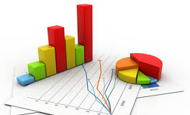

Types of Research Data
  Quantitative
  Qualitative

Slide 13
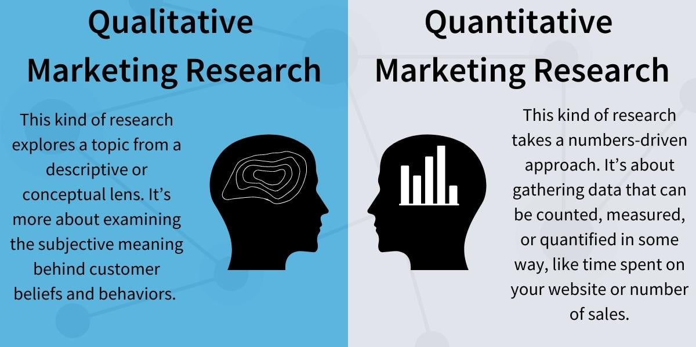
Brand Identity

Slide 14
Sources on External Secondary Data
Government – Census, trade surveys, social surveys etc. https://data.gov.uk/
Media – Trade magazines, TV, newspapers etc.
Commercial data – Mintel, Statista, Keynotes, Euromonitor, trade magazines etc.
Academic – University and research institute reports etc.
Economic Organisations – Banks, EU, UN, IMF etc.
The Internet – Search engines, price comparisons, customer feedback etc.
Media Sources –
Competitor Data -

Slide 15
Sources on Internal Secondary Data
Customer data
Product data
Financial statements
Human Resource data
Sales data
Internal reports

Slide 16
Exercise
Conduct a search of online secondary research that would help you develop your ‘subscription meal kit’ product
What did you find?
How will you use this data?

Slide 17
Quantitative Research Methods
Quantitative research methods collect factual data that is analysed statistically and expressed numerically.
Quantitative research is structured and systematic to ensure accurate and consistent data is collected.
Large sample sizes are used.

Slide 18
Quantitative Research Methods
Surveys (questionnaires) Face-to-face, online, postal, telephone.
Omnibus surveys
Observation – analysis of behaviour often in a retail environment.
Mystery Shopping & scanner data – used to research service standards
Experimentation – manipulating variables in a small test area
Web analytics – analyse web and mobile traffic

Slide 19
Qualitative Research Methods
Qualitative research methods collect data on feelings and opinions that must be analysed subjectively using descriptive techniques. Qualitative data can not be analysed statistically or expressed numerically.
More time consuming with smaller sample sizes.
Uses probing open questions to understand respondents’ behave and opinions.

Slide 20
Qualitative Research Methods
Qualitative data can be collected using the following methods:
  Individual depth interviews
  Focus Groups (Group discussions)
  Internet – chat rooms, group discussions, social media

Slide 21
Exercise
What primary research methods would you use to help you launch your ‘subscription meal kit’ product?
Which are qualitative and quantitative?
How will the data you collect help you develop an effective marketing strategy?

Slide 22
Reliability of Data
The following factors can impact on the reliability of data:
  Secondary data collected for a different purpose may not be as complete and reliable as primary data.
  Data from a secondary source may have bias or less rigorous collection and analysis methodology.
  Most research is based on sampling techniques. Unrepresentative samples will produce unreliable data.

Slide 23
RELIABILITY OF DATA
  Timeliness – Older data may not be accurate, especially in a dynamic environment.
  Bias - Researchers may introduce bias in surveys by influencing responses with their attitudes, body language etc.. Or ignoring data that doesn’t fit with their needs.
  Accuracy - Internet sources are often inaccurate.
  Validity – the data collection methods must accurately address the research question.

Slide 24
VIDEO LINKS
  The following YouTube videos explain the concept of marketing research with some useful examples.
  Remember market research is an important aspect of the marketing function that helps businesses make informed business decisions on which markets to enter and how to develop effective marketing strategies in competitive markets.
  Conducting market research is a key way the marketing department contributes towards achieving overall business goals.
  YOU CAN USE THIS IN ASSIGNMENT 2 – SECTION 1- How does marketing contribute towards overall business goals.

Slide 25


Slide 26


Slide 27


