Slide 1

UNICEF
AND EDUCATION
Phillippa Townley
P151886

Slide 2
Who is unicef??
Works in 190 different countries – not just the UK.
Helping to save children’s lives, defend their rights and reach their full potential.
UNICEF never give up on helping others.

Slide 3
‘Education offers a ladder out of poverty and a path to a promising future’
Education is extremely important for a child, helps them to gain a happy and healthier life.
Provides children with the skills and tools they need.
Not only that, helps children to recognise themselves and build friendships. Oak (2018).

Slide 4
The education system..
The education system is extremely poor.
Over 264 million children and adolescents around the world do not have the opportunity to enter or to even complete school.
Barriers such as poverty, discrimination, armed conflict, emergencies and effects of climate change.
UNICEF are working in 155 countries to provide learning opportunities.

Slide 5
Barriers to education
Parents not being able to afford the direct and indirect cost of schooling.
Schools located miles away making it not a safe place for children.
Increase the risk of sexual abuse.
Supporting the Ministry of Education.

Slide 6
Stats..
End of 2015 school year – 61 million children were out of education.
250 million children in the world cannot read, write or do basic math.
130 million of the total number attended school.
Children excluded were the most venerable and hard to reach children in the world.

Slide 7
‘We need to change attitude towards it. We need to set our girls free’
How can education help a girls life for the better?
98 million girls who should be in secondary school are not.
12 million girls are married before their 18th birthday.
1 in 5 becomes a mother before that age.
UNICEF increase quality maternal care. They empower the role of women in the design and delivery of water, sanitation and hygiene ecosystems.
Its essential in a girls life to receive this care, 70,000 adolescent girls ages 15-24 are infected with HIV every week.

Slide 8
Education for girls..
Education is extremely important to young girls.
Young girls witnessing gender inequality on a daily basis.
Unequal responsibilities for work.
Girls having to think that their ‘duties’ are more important than education.

Slide 9
How can unicef help??
The solution to the problem is Education.
UNICEF collaborate with partners to develop educational opportunities.
In the past decade, millions of children have gained access to educational opportunities.

Slide 10
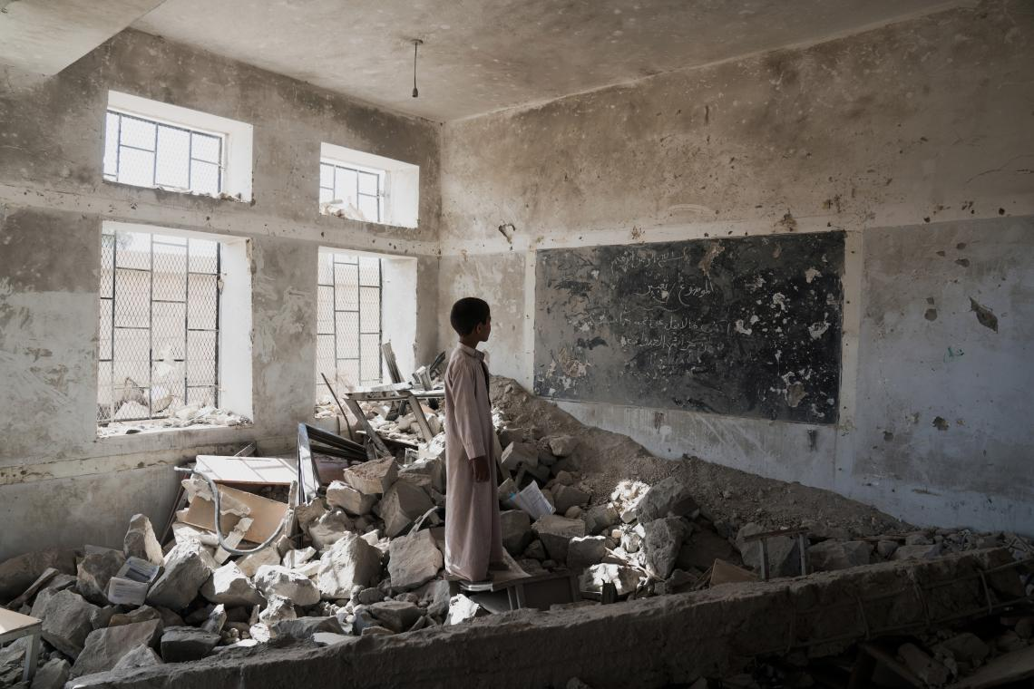
. Every year, UNICEF help millions of children get an education.
. Providing them with the essentials they need for an education.
UNICEF (2019)

Slide 11
Funding..
UNICEF are working really hard to provide support to these children from all over the world, is it enough?
UNICEF are a registered charity who rely a lot of funding.
Without the funding, they will not be able to make any of their aims possible.

Slide 12
Thank you for listening.

Slide 13
Reference list:
Claridge, J. (2019). Children Act 2004. [online] Workingwithkids.co.uk. Available at: http://www.workingwithkids.co.uk/childrens-act.html [Accessed 13 Mar. 2019].
Oak, M. (2019). Why is Education So Important? Something We Don't Think of But Should. [online] EduZenith. Available at: https://eduzenith.com/why-is-education-so-important [Accessed 10 Mar. 2019].
Unicef.org. (2019). Education. [online] Available at: https://www.unicef.org/education [Accessed 7 Mar. 2019].
Unicef.org. (2019). Gender equality. [online] Available at: https://www.unicef.org/gender-equality [Accessed 10 Mar. 2019].
Unicef.org. (2019). Research and reports. [online] Available at: https://www.unicef.org/research-and-reports [Accessed 14 Mar. 2019].
Unicef UK. (2019). Why donate to Unicef? - Unicef UK. [online] Available at: https://www.unicef.org.uk/why-donate-to-unicef/ [Accessed 12 Mar. 2019].

