Slide 1
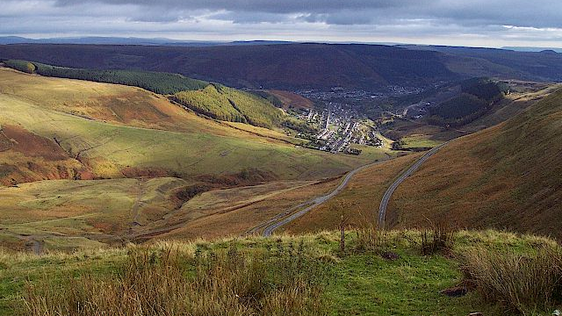

Rhondda Valley
Leonard Betton 1910735 BMSP4014
This is a presentation to explain what made the Rhondda Valley distinctly prosperous during the Industrial Revolution
Notes:
Leonard Betton 1910735 BMSP4014
This is a presentation to explain what made the Rhondda Valley distinctly prosperous during the Industrial Revolution

Slide 2
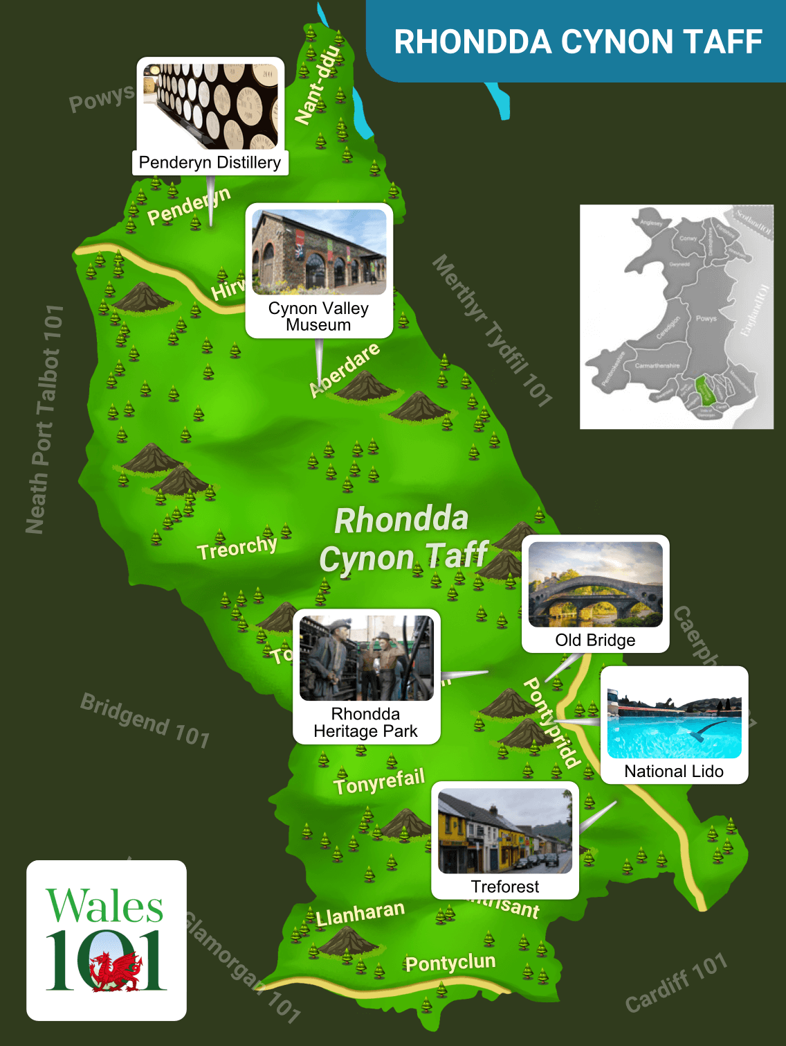
Introduction
Before the Industrial Revolution the Rhondda Valley was mainly farmland The introduction of crop rotation and Government policy forced the farmers to sell their produce to the markets rather than feed the villages this led to the Agricultural revolution. This forced the farmers to look for other work to feed their families.(Foundations of Western Culture, 2016)
Notes:
The Rhondda is a county in the South East of Wales.

Slide 3
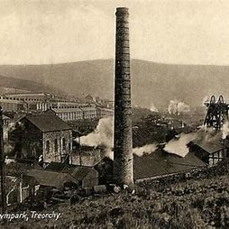
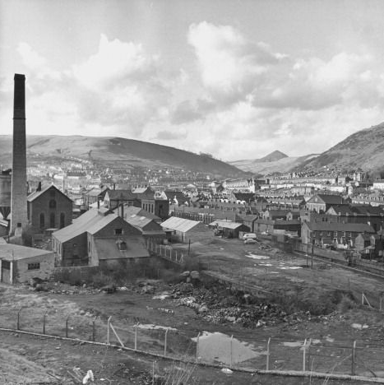
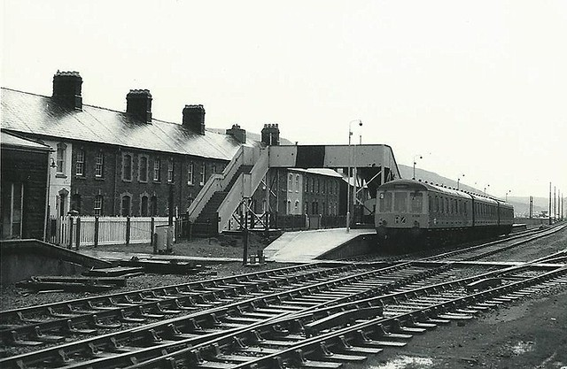
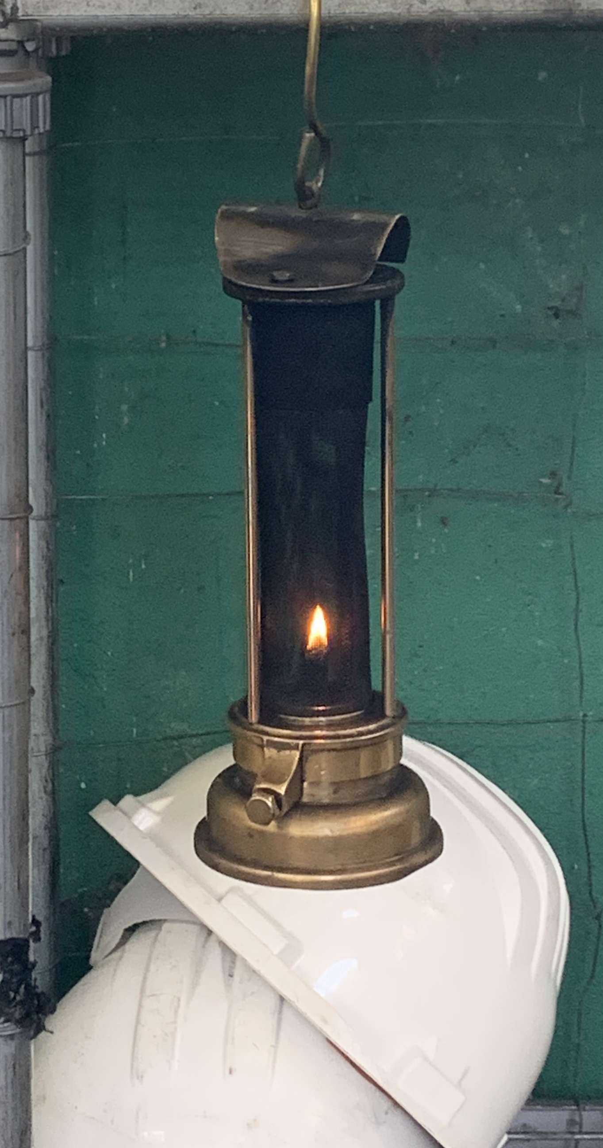
The Workers
Coal is a black sedimentary rock and is used as a fossil fuel to generate heat or electricity.
Iron-ore is a rock which metallic iron can be extracted.
The Rhondda Valley became the main place for work . People came from England, Scotland and Ireland looking for work. The area became overcrowded.
Notes:
The Industrial revolution changed the landscape of the Rhondda with the opening of the ironworks in 1787. (Easymalc, 2023)
The population rose from one thousand people in 1850 to an enormous 150 thousand by 1910.(Carradice, 2011)

Slide 4
Abraham Darby(1677-1717)
Henry Bessemer (1813 -1898)
Thomas Newcome (1664-1729)
James Watt (1736-1819)
Who were the main players?
Notes:
These men were the innovators of the time. Inventing the technology to increase output in the Rhondda coal and iron works.

Slide 5
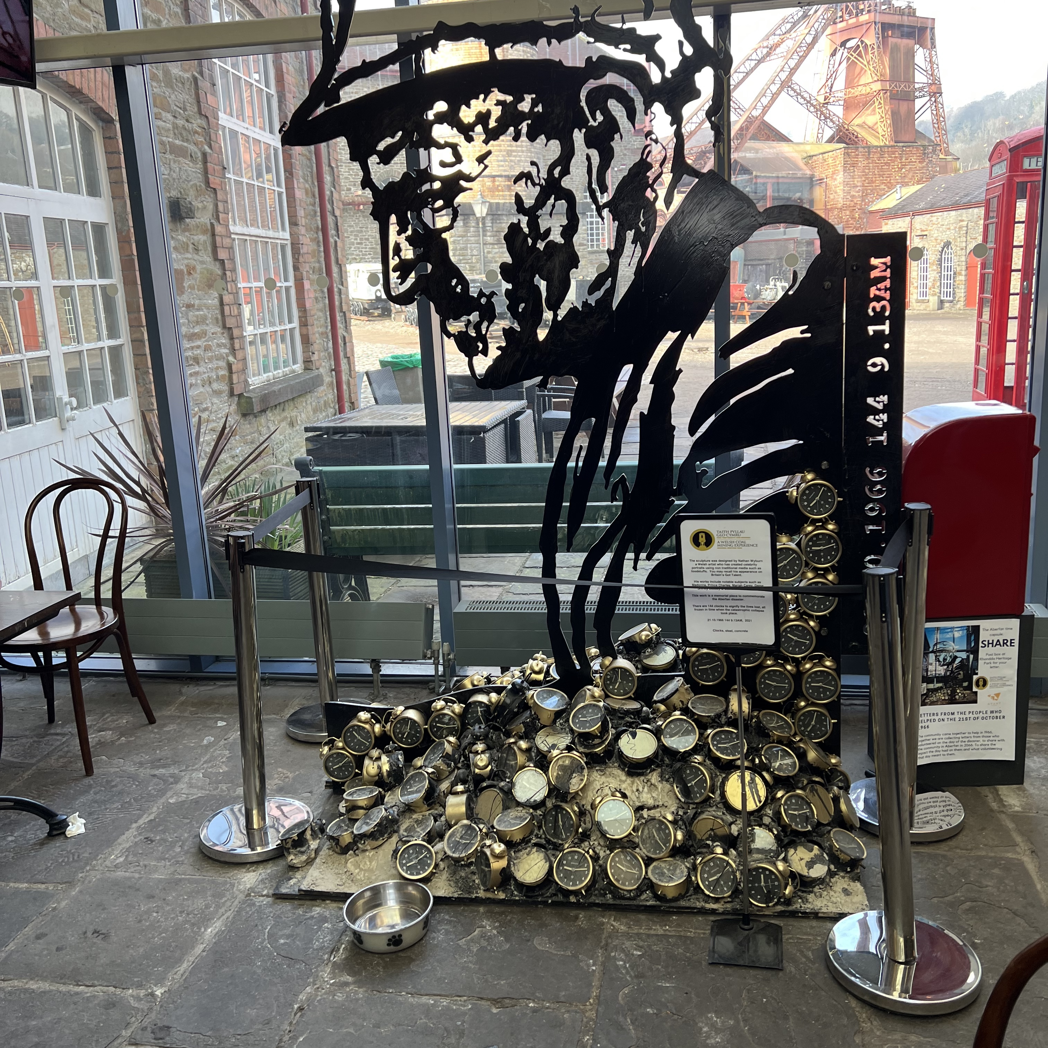
The Environment
South Wales was the biggest producer of iron during the Industrial Revolution.
There was great wealth however this wasn’t true for the workers.
There was overcrowding, poverty and disease.
Introduction of schools, chapels and workingmen's clubs.
Decline of the welsh language.
The landscape was now an industrial area with villages replaced by towns.
Notes:
With the increase of population there was poverty, overcrowding and disease. (Carradice, 2011)..

Slide 6
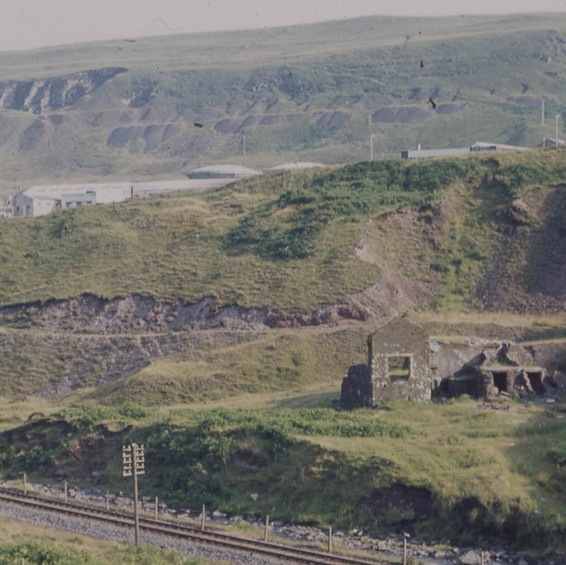
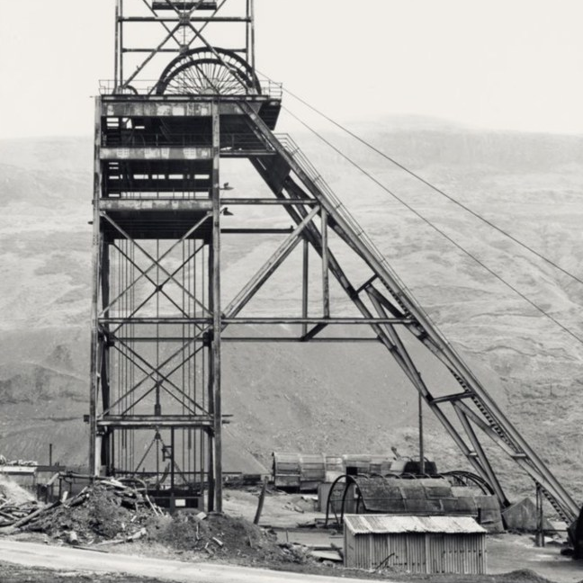
The Economy
The economy in Britain was in a good position at this time as the change from agriculture to mines and ironworks were bringing work and wealth to the country.
The rest of the world were behind in innovation, however soon the other countries of the world began copying the ideas used in the valleys of the Rhondda and would eventually overtake Britain as leaders of this Industry.
(Broadberry, 2021)
Notes:
Through the use of technology the output from the mines and ironworks increased. This led to the valley becoming a leader in producing coal and iron.

Slide 7
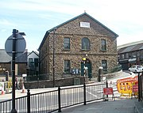
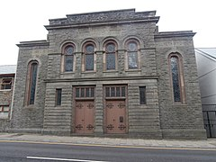
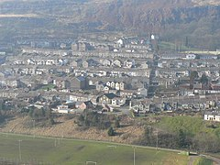
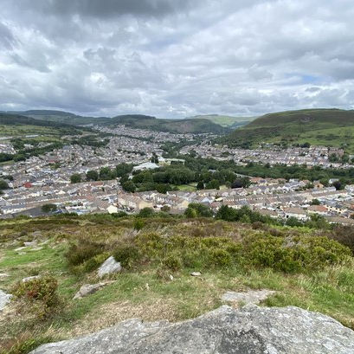
Conclusion
The Rhondda Valley went from a rural farming area to be the main area for the Industrial Revolution.
The landscape changed dramatically and with it the population increased.
There were good outcomes such as the introduction of churches, schools and workingmen clubs.
However the welsh language speakers fell as workers flocked from English speaking countries
This period was good for the economy of the valley but it paid the price in the destruction of the landscape.
Notes:
This presentation has shown how the Welsh Rhondda Valley changed during the industrial revolution. The period was good for the economy and innovation but the people of the valley paid the price many with their lives and others with the legacy of destroyed landscape after they closed.

Slide 8
References
Easymalc. (2023, February 8). The Changing Face of the South Wales Valleys Pt 1 - The Demand for Iron and Coal. Easymalc’s Wanderings. https://www.easymalc.co.uk/the-changing-face-of-the-south-wales-valleys-pt-1/
‌
Foundations of Western Culture. (2016b). Effects of Agriculture on the Industrial Revolution – Foundations of Western Culture: Uwgb.org. http://foundations.uwgb.org/agriculture/
‌
Broadberry, S. (2021). Britain, the Industrial Revolution, and Modern Economic Growth (K. Fukao & S. Broadberry, Eds.). Cambridge University Press; Cambridge University Press. https://www.cambridge.org/core/books/abs/cambridge-economic-history-of-the-modern-world/britain-the-industrial-revolution-and-modern-economic-growth/114BB88442A2A685B1A9C3ED65ED1D29
‌
Carradice, P. (2011, March 17). BBC - Wales History: The blackening of Wales. Www.bbc.co.uk. https://www.bbc.co.uk/blogs/waleshistory/2011/03/wales_and_industrialisation.html
Notes:
This is my presentation Thank you for listening.

