Slide 1
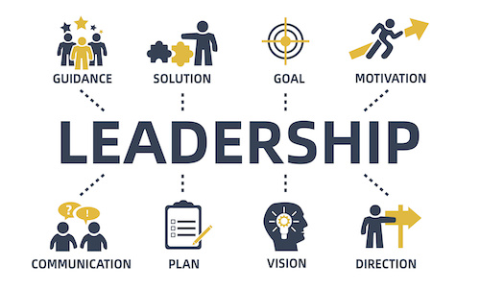
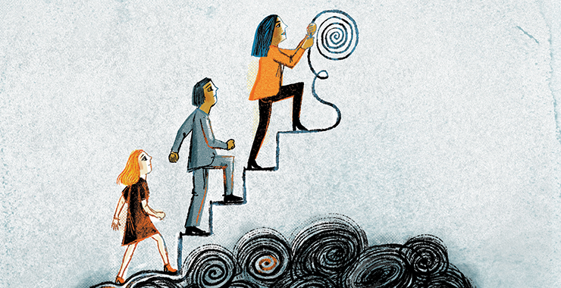

HPGC7002 Empowerment & Leadership
Theme 6: Community Profiling / Community Empowerment
Ken Dicks ken.dicks@uwtsd.ac.uk

Slide 2

What is a Community Profile?
A community profile can be defined as follows:
  A comprehensive description of the needs of a population that is defined, or defines itself, as a community, and the resources that exist within that community, carried out with the active involvement of the community itself, for the purpose of developing an action plan or other means of improving the quality of life of the community.
  (Hawtin, M. & Percy-Smith, J. 2007).
What is this quote saying? Take a little time to read through it and then Paraphrase it the Chat facility in Teams.

Slide 3

Community Profiles and Assessing Needs
Assessing local need and profiling the local community is the first step towards developing a local plan to identify:
needs,
gaps in provision e.g. health, environment, economic, facilities for young / old…….
Can you think of areas that it may identify?

Slide 4
Community Profiles and Assessing Needs
A tool used by a number of professions to help plan or address issues within an area….
Not just for professionals…increasingly community needs assessment are community member led and instigated so as to ensure any strategy for that community is informed from the “lived reality of that community or groups within that community”.

Slide 5
Community Profiles and Assessing Needs
Communities are not simply homogeneous, but consist of a range of social and cultural groups. People’s thoughts, ideas, perceptions and needs may therefore differ.

Slide 6
Community ?
We could define a community in the following ways:
a group of people who live or work in the same geographical location, for example a housing estate, village or neighborhood.
an administrative area or district
a group of people with a shared or common interest or set of characteristics (e.g. we talk of the LGBT community).
But these are not the only definitions

Slide 7

‘Our’ Community
This video gives some examples of Community profiling in action.
Community Profiles (Jamaican Information Service, 2012)

Slide 8
‘Our’ Community
This video gives some examples of Community profiling in action.
Community Mapping (Community Architects Network, 2013)

Slide 9
‘Our’ Community
This is an exercise to explore a ‘virtual’ community
Over the course of this exercise I will ask you as a group to plan a community that meets the needs of different groups.
In turn plan a community that meet the needs of the following:
People over 65
Young people under 18
People with a physical disability
Parents with young children

Slide 10

‘Our’ Community
Together we will create a basic map of the community you would like to live in, identifying significant places that have specific meaning to you or which meet your specific needs
Why do we represent it visually?
When instructed to do so, move on to the next group’s map, look at what resources they have included and decide what you would like to add and if there are any resources that you would like to remove
Continue to do this until you have visited every ‘community’ or you are instructed to stop

Slide 11

‘Our’ Community
Take a look at all of the ‘communities’ that you have created
Are they all the same?
Did you change anything in the communities that you ‘visited’
If so what?
Do you object to any of the changes that have been made to your ‘original’ community?

Slide 12
Social Research
Community profiling uses social research in a community primarily in order to listen to the voice of (often) marginalised people and then to feed that voice into an assessment of their collective needs,
with a view to creating what Moran and Butler (2001, p. 60) refer to as a ‘living health profile’. (this could be translated in to a living sustainability profile”….

Slide 13

The Whole picture
A community profile should be comprehensive in coverage. Rather than look at individual aspects of a community in isolation…how different aspects of the life of the community are interrelated.
This is also the principle behind the Wales Index of Multiple Deprivation (WIMD) that we looked at in a previous session

Slide 14
The Whole picture
1. the area as a place to live – including;
the quality of the physical environment and people’s attitudes to living there;
the extent to which needs are matched with resources; and,
the extent to which local facilities meet people’s goals and aspirations;

Slide 15
The Whole picture
2. the area as a social community –
residents’ involvement in the social life of the community;
the extent to which the community is supportive;
formal and informal networks within the community;

Slide 16
The Whole picture
3. the area as an economic community –
  income levels and employment prospects of local residents;
  travel to work data (both inwards and outwards)
  prosperity and viability of local shops;
  prosperity and viability of major employers

Slide 17
The Whole picture
4. the area as a political community –
systems and structures of political representation and local area management;
the extent to which local people can influence decisions that affect them;
the degree of involvement in local decision making;
participation in community organizations;

Slide 18
The Whole picture
5. the area as a personal space -
  the degree of attachment that people have to the local area;
  memories and life experiences of local people;
  the amount of leisure time that people spend in their local area

Slide 19
The Whole picture
6. the area as part of its city/town/region –
infrastructural, economic and social linkages between the local area and the city or district of which it is a part;
The specific local identity that differentiates the community from the rest of the area/district.

Slide 20
Neighbourhood appraisal
Neighbourhood appraisal is another term akin to a community profile :
Is a systematic review of the attributes, problems and potential of an area…
Detailed information on every issue is not so important as awareness of the sustainability agenda…

Slide 21
Community Profile
The aim of the community profile must be to act as a catalyst for the improvement of the quality of life of members of that community.
It should recognize strengths, needs and areas for conflict or tension

Slide 22



How to
Essentially a community profile is a piece of social research….
The Welsh Government document ‘Community Profiling and Tension Mapping’ outlines three elements of the process.
Community mapping and profiling
Tracking cohesion
Monitoring tensions
Discuss what you understand each of these to mean.

Slide 23
How to
Look at each in turn and, using the handout provided identify how you would collect the data and any issues that you would need to consider.

Slide 24
References
Community Architects Network (2013) Community Mapping Available at http://communityarchitectsnetwork.info/opensources-media.php [Accessed 22/09/2022]
Hawtin, M. & Percy-Smith, J. (2007) Community Profiling: A Practical Guide to Auditing Social Needs Open University Press https://www-vlebooks-com.ezproxy.uwtsd.ac.uk/Product/Index/155210?page=0 [Accessed 09/11/2022]
Jamaican Information Service (2012) Community Profiles Available at: https://www.youtube.com/watch?v=z-rDTEnOIu8 [Accessed 22/09/2022]
Moran, R.A. and Butler, D.S. (2001) ‘Whose health profile?’, Critical Public Health, vol. 11, no. 1, pp 59–74. Available at: https://web-s-ebscohost-com.ezproxy.uwtsd.ac.uk/ehost/pdfviewer/pdfviewer?vid=0&sid=d4604556-4a50-4d75-8734-083074bb20d3%40redis [Accessed 22/09/2022]
Welsh Government (2011) Community Mapping and Tension Monitoring: A practical guide and sourcebook of information and ideas for Welsh local authorities and their partners Cardiff: Welsh Government Available at https://www.shu.ac.uk/centre-regional-economic-social-research/publications/community-mapping-and-tension-monitoring [[Accessed 22/09/2022]

