Slide 1
Adventure & Challenge in the Curriculum
Dylan Blain

Slide 2

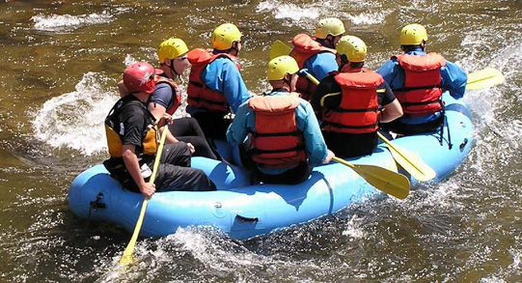
from theory to practice

Slide 3
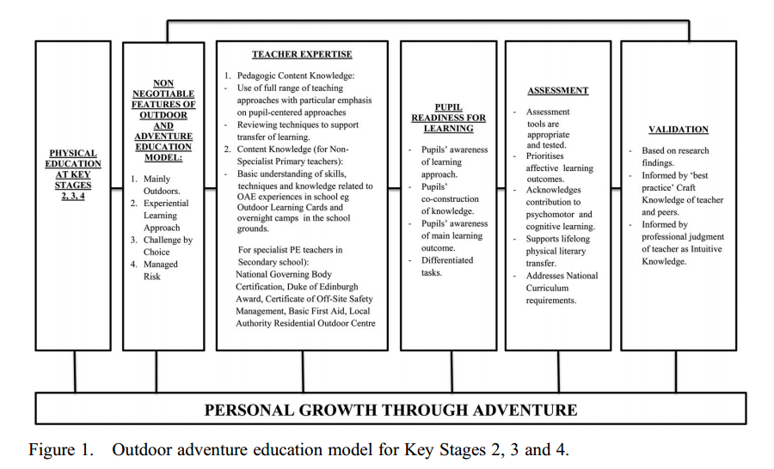
(Williams & Wainwright, 2016)

Slide 4
Pedagogical Model for Adventure (Williams & Wainwright, 2016)
Mainly outdoors
Experiential Learning
Challenge by Choice
Managed Risk

Slide 5
Outdoor Learning Cards

