Slide 1

Lecturer Name: Afzal Munna
Student Name: Varzari Cristina
Student ID: 2110951
Module code : LCBB6001
Module Title : International Business Communications (assessment 2)

Slide 2
Table of Contents
Introduction 3
What is a cultural difference 4
Cultural differences in Germany and the UK 5-6
Intercultural theories 7-8
Cultural Similarities in Germany and the UK 9-10
Recommendation 11
Conclusion 12
Reference List 13
Thank You 14

Slide 3
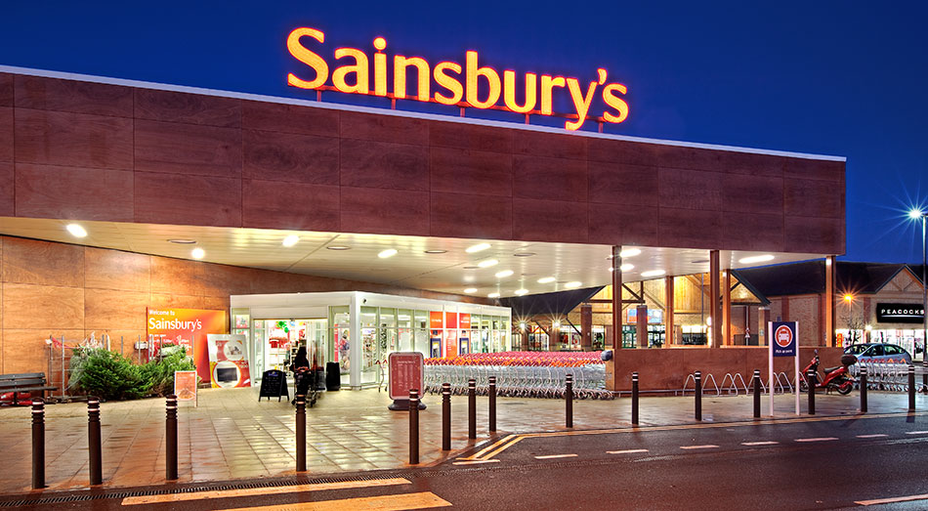
Introduction
International business communication can be referred to as a field of study which includes business-to-business and global interactions (Bolten, 2020).
The purpose of international business communication is to maintain global teams and plan different types of marketing activities.
There are different processes for enhancing international business communication.
Notes:
Some of those are concerned about different cultures, concise language and others (Fraccastoro et al., 2021). The chosen organisation is Sainsbury's which is considered to be one of the most uprising supermarket chains currently operating in the United Kingdom and Netherlands. Moreover, this presentation has the aim of defining the concept of cultural differences, analysing differences and similarities between the cultures of the United Kingdom and Germany and also providing recommendations.

Slide 4

What is a cultural difference
Cultural differences can be explained as different types of languages, behaviours, race, national origins and other aspects among different groups of people.
It can also include the differences between different cultural traits such as different music, cultural morals and others.
The overall study of cultural differences involves both the aspects of anthropological and psychological perspectives.
Notes:
Some examples of cultural differences may include Practices, Expressions, Religion, Music, Cultural Mores, Rituals and many more of that. In this presentation, the cultural differences will be personified based on Germany and the United Kingdom (Jiang et al., 2019). The main purpose of this analysis is to identify the strength factors which have progressed Sainsbury's in the United Kingdom. Moreover, those strengths will be adopted based on Germany for proposing a business-friendly environment. Analysis of cultural differences will eventually help the company to identify the customer base or the respective consumer base who will have more interest in the company's products or services.

Slide 5

Cultural differences in Germany and the UK
The cultural differences between Germany and the United Kingdom are based on different factors or measuring pointers (Barreto et al., 2021).
Those measuring pointers can be explained as Language, social structure in those countries, religious values, business activities and others.
In terms of language, the UK has one official language English and there are also other minority languages such as Welsh and Gaelic languages.
Notes:
Moreover, it has been found that UK children are taught English at a very young age as 86% of UK People have English as a first language. However, in the case of Germany, the official language is German where 95% of people in the country speak German (Britishcouncil, 2023). Regarding social structure, Germany's social studies is categorised into four segments The exalted, The established, The Fighters, and The Marginalised. On the contrary, the UK structure is divided into seven social classes which are the Elite, Established middleman, Technical Middle class, New affluent workers and three others.

Slide 6

Cultural differences in Germany and the UK(cultural sensibility)
In terms of religious values, British society is considered to be the most scrutinised in the overall world.
There are different types of religious beliefs based on agnosticism, atheism, secularism, humanism and others.
Cultural sensibility in the UK is considered to be the formal society where UK people are likely to dress appropriately based on the cultural occasion.
Notes:
46% of the total population can be identified as Christian which is considered to be the highest in the overall United Kingdom. In terms of Germany, more than 50% of the population has been identified as Christian. However, 20% to 30% of people are considered to be non-religious (Johnson and Zurlo, 2020). There are also different religious affiliations in Germany such as Catholicism, Orthodoxy, Protestantism and others. In terms of business activities, Germany is mainly known for small as well as medium-scale organisations. Regarding business activities in the UK, this country specialises in sectors like Retail, Hospitality, Finance, Entertainment and others.

Slide 7
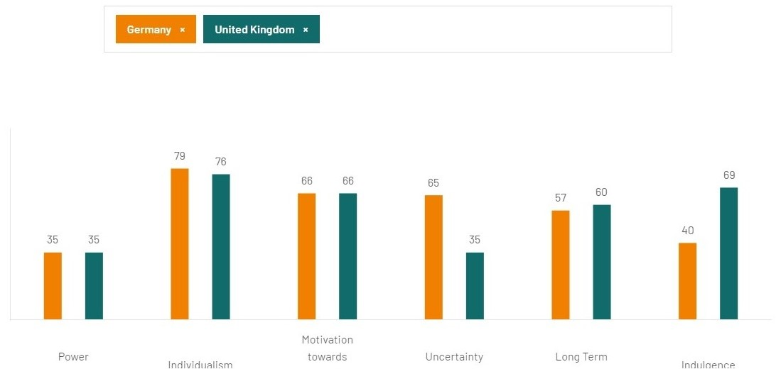
Intercultural theories
Intercultural theories are more concerned with the individual-level factors regarding communication or miscommunication (Wikberg, 2021).
Majority of the intercultural communications are theorised to operate as a business function.
There are different types of intercultural theories based on the situational analysis perspective.
Notes:
Some examples of those theories can be mentioned as Hofstede cultural dimension theory, social identity theory and many more of others. As per the opinion of Deresky (2013), Hofstede's cultural dimension theory provides the idea of how the respective culture of an individual society affects the members who are residing in the existing society. This theory also explains how those values are related to each other in terms of efficiency, effectiveness and the transparency perspective. While aligning with the company profile of Sainsbury's, this theory will help analyse the different cultural beliefs in Germany as the company is planning to expand in the corresponding country. It is essential to develop information about cultural beliefs to identify their overall needs or requirements.

Slide 8

Intercultural theories
Another intercultural theory can be explained as social identity theory which mainly helps to differentiate between multiple cultures.
As per the opinion of Dignen and McMaster (2013), this theory is primarily used to understand the respective communication behaviours
It is relying on the perspective of any individual membership status within a culture or in a group of different cultures.
Notes:
As per the guidelines mentioned in the social identity theory, social behaviour is mainly contemplated by the respective characters or the personal motivations depicted by the human being or any particular individual. People tend to maintain a positive image in the existing society by contributing to different types of social gatherings or social events. As a result, sometimes backtracked from life and adopted dishonest paths or their respective ways. Similarly, Sainsbury's can also adopt this particular theory to adopt different perspectives of individuals while accessing both the positive as well as the negative perspective. This will be beneficial for the company while Sainsbury's can easily identify the behaviour of multiple people and develop a product which will be more useful for them in fulfilling their basic needs.

Slide 9

Cultural Similarities in Germany(culture sensibility) and the UK
From a report, it has been found that not only historical background but various cultural perspectives.
Both countries such as the United Kingdom as well as Germany have the same perspective.
Regarding cultural sensibility in Germany, German people have sensibility aspects such as Intellectual Conversations, Manners with punctuality, and Privacy and also they like to be efficient.
Notes:
It is in terms of different aspects such as Social, Economic as well environmental perspectives. In terms of languages, in both of the countries, English has been an important language based on the overall contingency of different cultural barriers. It has been observed that English is the first and official language for more than 60% of the United Kingdom considering many of the towns or villages. Similarly, in the case of Germany, it can be observed that German is the first language consideration in the country. However, it has been found that more than 30% of German children learn the English language from a very young age while enhancing their internal skills as well as external skills.

Slide 10

Cultural Similarities in Germany and the UK
Another similarity can be outlined as democracy where both countries like Germany as well as the United Kingdom belong to the same European Region.
As a result, for all of the aspects like political, economic as well environmental perspectives.
The German people as well as the UK people are quite similar to each other.
Notes:
The workplace timing is also similar in terms of both the countries such as Germany as well as the United Kingdom. It has been found in the majority of organisations, that workplace activities start from 8:30 or 9 pm and it is scheduled for more than 8 to 9 hours. Those respective timings are almost the same as the overall country perspective of Germany as well as the United Kingdom. So, workplace activities or the respective timings can be considered as another cultural similarity between the overall country profile of Germany and the United Kingdom. So, it will be helpful for Sainsbury's while expanding the overall business to Germany from the United Kingdom.

Slide 11
Recommendation
For expanding in a new market, it is very important to know about the available resources.
It is based on the external resources as well as the internal resources.
Other recommendations can be provided as having more of an adaptability perspective
Notes:
There are different perspectives or recommendations provided as Sainsbury's is aiming to expand the overall business operation to a completely new market in Germany. Without the proper resources, any of the companies may not be able to operate the overall business with the proper efficiency, effectiveness as well and transparency factors. So, it is highly recommended that the company better manage all the resources while fulfilling all of them. It is based on the internal environment as well as the external environment analysis. It is very crucial to have a brief idea about the existing environment as there are different types of enabling as well as restraining factors which can be proved as beneficial factors or non-beneficial factors for the overall company or organisations such as Sainsbury's. So, those two recommendations can be provided for the sake of Sainsbury's.

Slide 12
Conclusion
The chosen organisation is Sainsbury's.
It is considered to be one of the uprising supermarket chains in the United Kingdom.
International Business Communication becomes very crucial when a specific company or organisation is trying to expand in other countries where the respective business environments are new for the company or the organisation. The company is planning to expand in Germany. There are different types of cultural differences between the countries which have been identified based on language, social structure, religious beliefs and many more. Moreover, cultural similarities have been also identified.
Notes:
International Business Communication becomes very crucial when a specific company or organisation is trying to expand in other countries where the respective business environments are new for the company or the organisation. The company is planning to expand in Germany. There are different types of cultural differences between the countries which have been identified based on language, social structure, religious beliefs and many more. Moreover, cultural similarities have been also identified.

Slide 13
Reference List
Reference List
Barreto, M., Victor, C., Hammond, C., Eccles, A., Richins, M.T. and Qualter, P., 2021. Loneliness around the world: Age, gender, and cultural differences in loneliness. Personality and Individual Differences, 169, p.110066.
Bolten, J., 2020. Intercultural business communication: An interactive approach. In Exploring the rhetoric of international professional communication (pp. 139-155). Routledge.
Britishcouncil, 2023. Language. [Online] Available at: <https://study-uk.britishcouncil.org/why-study/about-uk/language > [Accessed on 08 November 2023]
Deresky, H., 2013. International management: Managing across borders and cultures. Pearson Education
Dignen, B. and McMaster, I., 2013. Effective international business communication. (No Title).
Fraccastoro, S., Gabrielsson, M. and Pullins, E.B., 2021. The integrated use of social media, digital, and traditional communication tools in the B2B sales process of international SMEs. International Business Review, 30(4), p.101776.
Jiang, T., Li, H. and Hou, Y., 2019. Cultural differences in humor perception, usage, and implications. Frontiers in psychology, 10, p.123.
Johnson, T.M. and Zurlo, G.A., 2020. World Christian Encyclopedia. Edinburgh: Edinburgh University Press.
Wikberg, A.M., 2021. A theory on intercultural caring in maternity care. Scandinavian Journal of Caring Sciences, 35(2), pp.442-456.
Notes:
Deresky, H., 2013. International management: Managing across borders and cultures. Pearson Education
Dignen, B. and McMaster, I., 2013. Effective international business communication. (No Title).
Fraccastoro, S., Gabrielsson, M. and Pullins, E.B., 2021. The integrated use of social media, digital, and traditional communication tools in the B2B sales process of international SMEs. International Business Review, 30(4), p.101776.
Jiang, T., Li, H. and Hou, Y., 2019. Cultural differences in humor perception, usage, and implications. Frontiers in psychology, 10, p.123.
Johnson, T.M. and Zurlo, G.A., 2020. World Christian Encyclopedia. Edinburgh: Edinburgh University Press.
Wikberg, A.M., 2021. A theory on intercultural caring in maternity care. Scandinavian Journal of Caring Sciences, 35(2), pp.442-456.

Slide 14
THANK YOU

