Slide 1
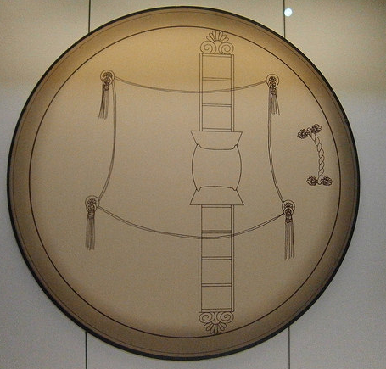
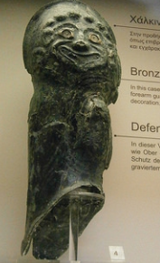
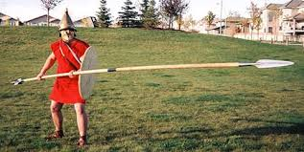
What types of archaeological evidence can help you with studying warfare?
Votive offerings (Arms and Armour from Olympia)
Examples of High Quality armour
Actual weapons and Armour
Understanding construction of ancient weapons and shields
Belief about Protection (gorgoneion)
Grave Finds
Battle Flied/Burail Graves
Experimental Archaeology:
Useful in the study of weapon tactics

Slide 2
What are the problems?
Votive offerings (Arms and Armour from Olympia)
Sacrificial nature.
Non-battle use. (Ceremonial uses)
Generally represents the elite class of society.
Grave Finds
Partial surviving evidence because of damage
Also be votive in nature.

