Slide 1
Digital Skills and Research Methods
Improving Workplace Efficiency at Mayfair Home Care Agency
Module:
Certificate of Higher Education Skills for the Workplace
Health & Social Care
Presented by:
[Group Members’ Names]
Case Study:
Mayfair Home Care Agency

Slide 2
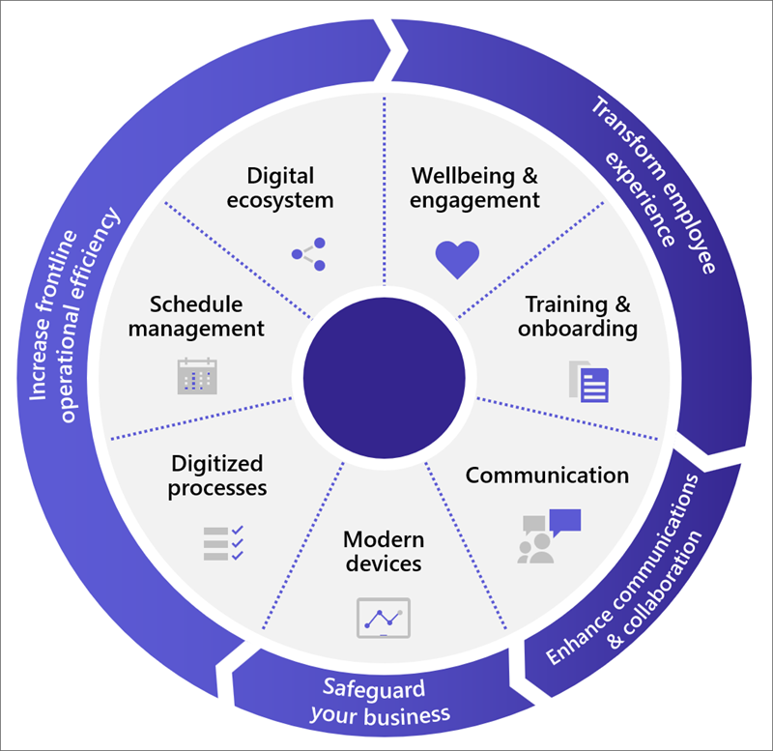
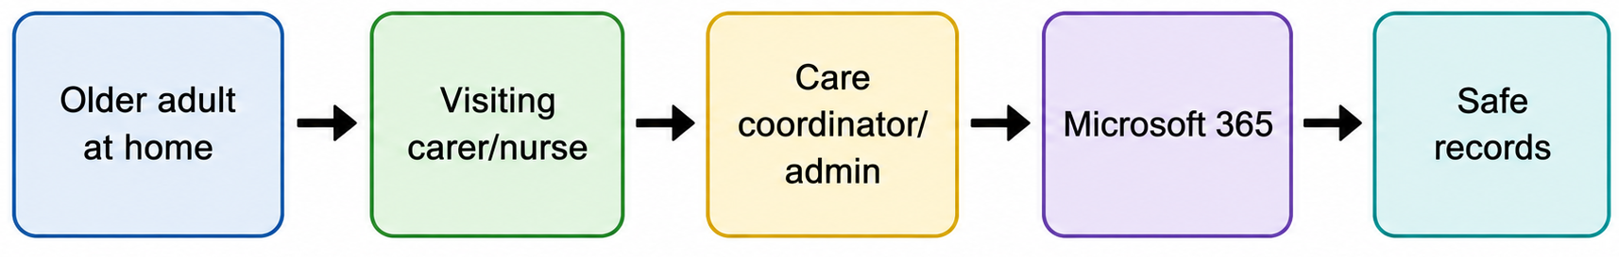
Introduction to Mayfair Home Care Agency
• Mayfair Home Care Agency provides person-centred support to older adults living independently, requiring effective coordination between carers, nurses, care coordinators and administrative staff (DHSC, 2022).
• The organisation has introduced Microsoft 365 to improve communication, scheduling and documentation, reflecting wider digital transformation across adult social care services (DHSC, 2023).
• However, technology implementation alone does not guarantee success because workforce engagement and digital capability significantly influence adoption outcomes (Stoumpos, Kitsios and Talias, 2023).
• Research indicates that organisations with stronger digital skills are better positioned to improve service quality, workforce productivity and care outcomes (Skills for Care, 2024).

Slide 3
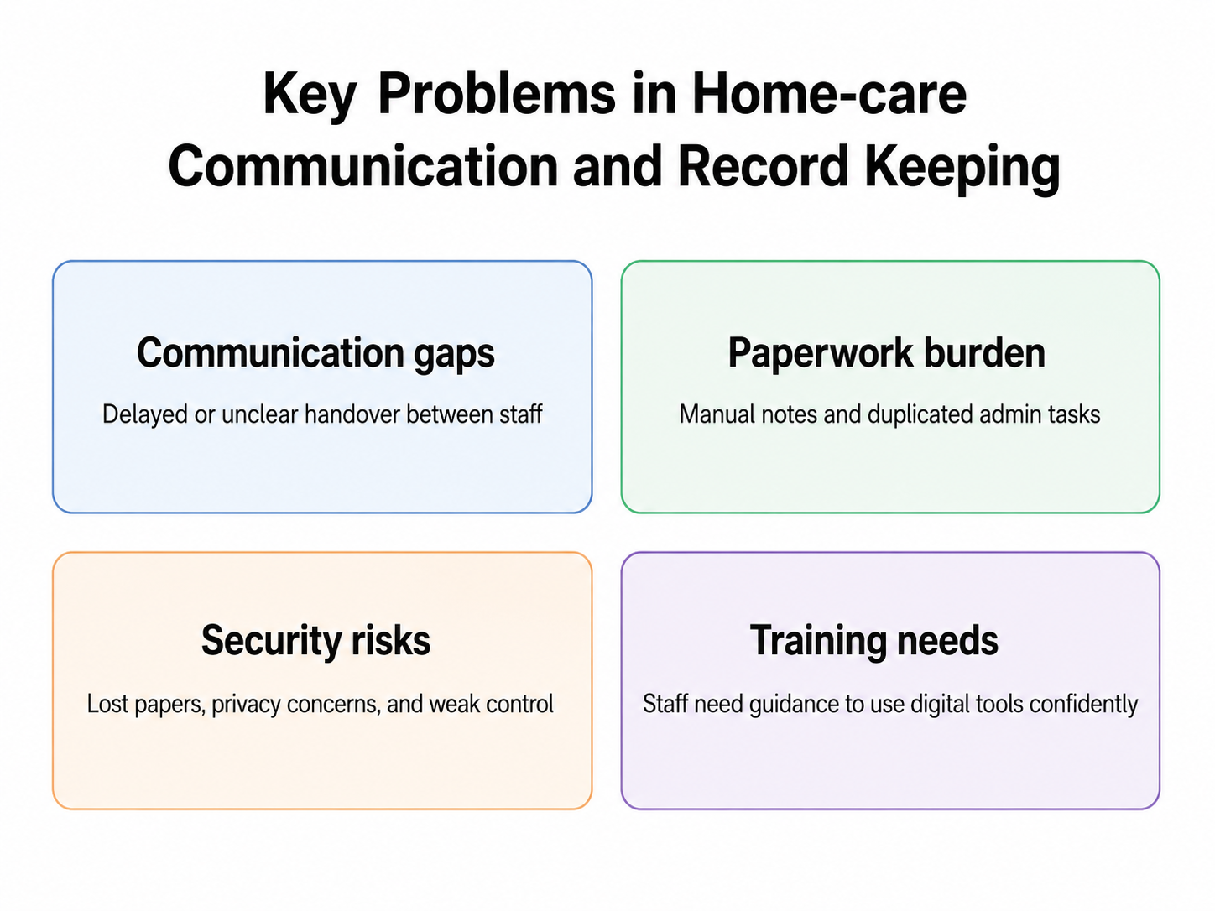
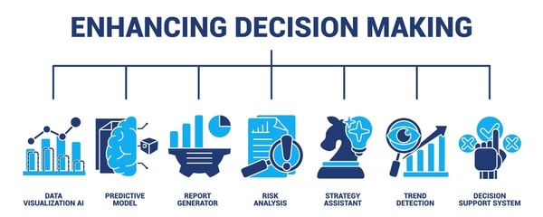
Current Digital Challenges at Mayfair
• Communication between field-based carers and office staff can be delayed, reducing the speed of decision-making and service coordination (Microsoft, 2025).
• Inconsistent documentation processes may create duplication, inefficiencies and difficulties in maintaining accurate care information (CQC, 2024).
• Variations in staff digital confidence may limit effective use of digital technologies and reduce the benefits of Microsoft 365 implementation (WHO, 2023).
• Evidence suggests that low levels of eHealth literacy remain a significant barrier to digital transformation within healthcare environments (Brørs et al., 2023).
• These challenges highlight the need for integrated systems that improve efficiency while supporting workforce development and information governance (DHSC, 2023).

Slide 4
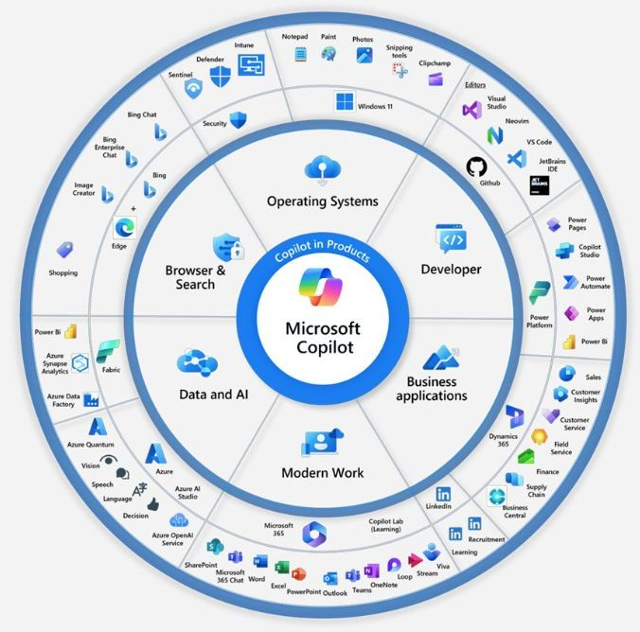
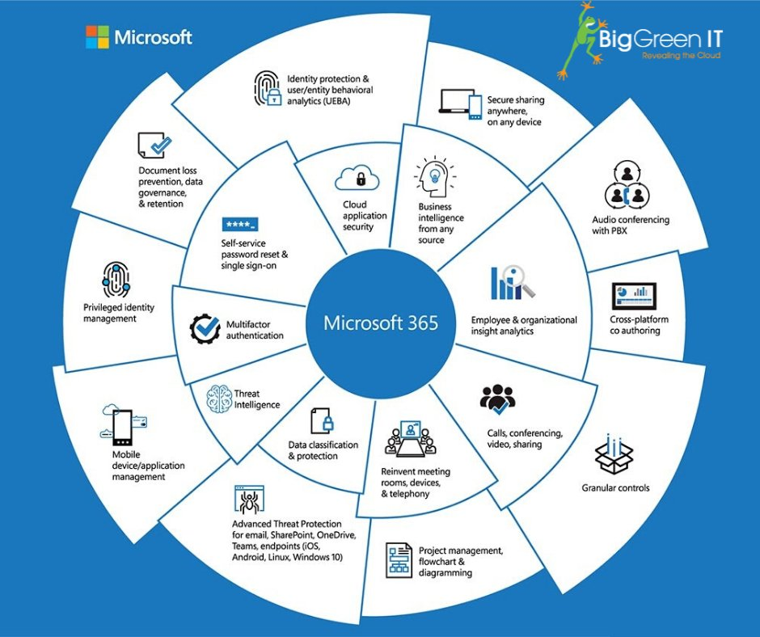
Why Microsoft 365 is relevant
• Microsoft 365 integrates communication, collaboration and productivity tools within a single platform, reducing fragmented working practices (Microsoft, 2025).
• Integrated digital systems can improve workforce efficiency by enabling real-time access to information and reducing administrative burden (DHSC and NHS England, 2022).
• Digital transformation supports better coordination of care activities, contributing to improved service-user outcomes and operational effectiveness (Stoumpos, Kitsios and Talias, 2023).
• Effective use of Microsoft 365 aligns with national priorities promoting digitally enabled adult social care services (DHSC, 2023).
• Therefore, Microsoft 365 should be viewed as a strategic organisational solution rather than simply a collection of software applications (Local Government Association, 2024).

Slide 5
Task 1: Chosen productivity app — Excel
• Excel is suitable for Mayfair because it can centralise rotas, visit schedules, medication logs and absence records within a structured system, improving operational oversight (Microsoft Excel, 2026).
• Compared with fragmented record-keeping, Excel enables managers to monitor workforce deployment more efficiently and allocate resources according to service demand (DHSC and NHS England, 2022).
• Structured spreadsheets support greater consistency in documentation, which is essential for maintaining safe and effective care delivery (CQC, 2024).
• Digital tools such as Excel contribute to wider organisational transformation by reducing administrative burden and supporting evidence-based decision-making (Stoumpos, Kitsios and Talias, 2023).
• Therefore, Excel offers practical value for Mayfair because it combines accessibility, flexibility and data management functions within a familiar platform (Microsoft Excel, 2026).
Staff ID | Staff Role | Visit Time | Service User | Location | Task Type | Status
Staff A | Visiting Carer | 08:00–09:00 | Service User 01 | Home Visit Area A | Morning care support | Completed
Staff B | Nurse | 09:15–10:00 | Service User 02 | Home Visit Area B | Medication check | In Progress
Staff C | Visiting Carer | 10:15–11:00 | Service User 03 | Home Visit Area C | Personal care support | Scheduled
Staff D | Care Coordinator | 11:00–11:30 | Service User 04 | Main Office | Care plan update | Pending
Staff E | Visiting Carer | 12:00–13:00 | Service User 05 | Home Visit Area D | Lunch visit | Scheduled
Staff F | Nurse | 13:30–14:15 | Service User 06 | Home Visit Area E | Health observation | Completed
Staff G | Visiting Carer | 15:00–16:00 | Service User 07 | Home Visit Area F | Afternoon support | Delayed
Staff H | Admin Staff | 16:15–17:00 | Service User 08 | Main Office | Documentation review | Pending
Sample Excel rota showing how Mayfair could organise visits, staff roles, service-user support and task status in one structured schedule.

Slide 6
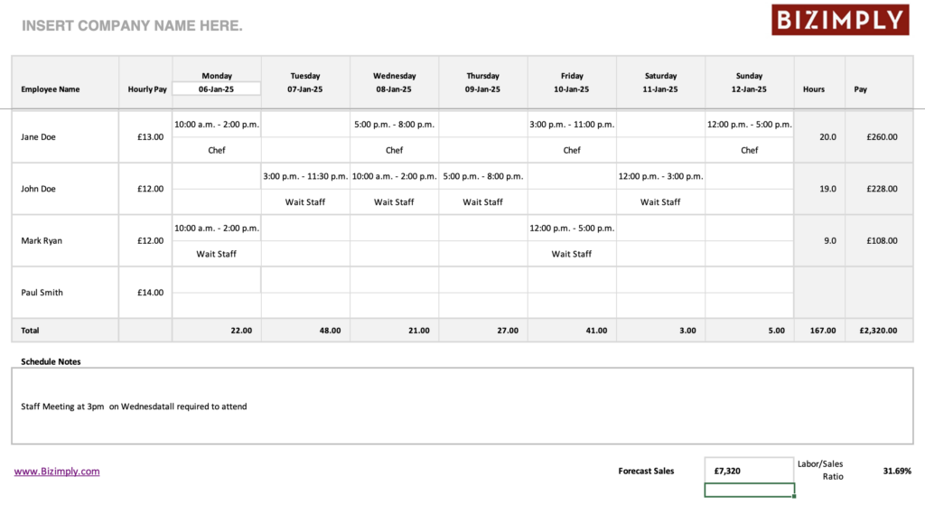
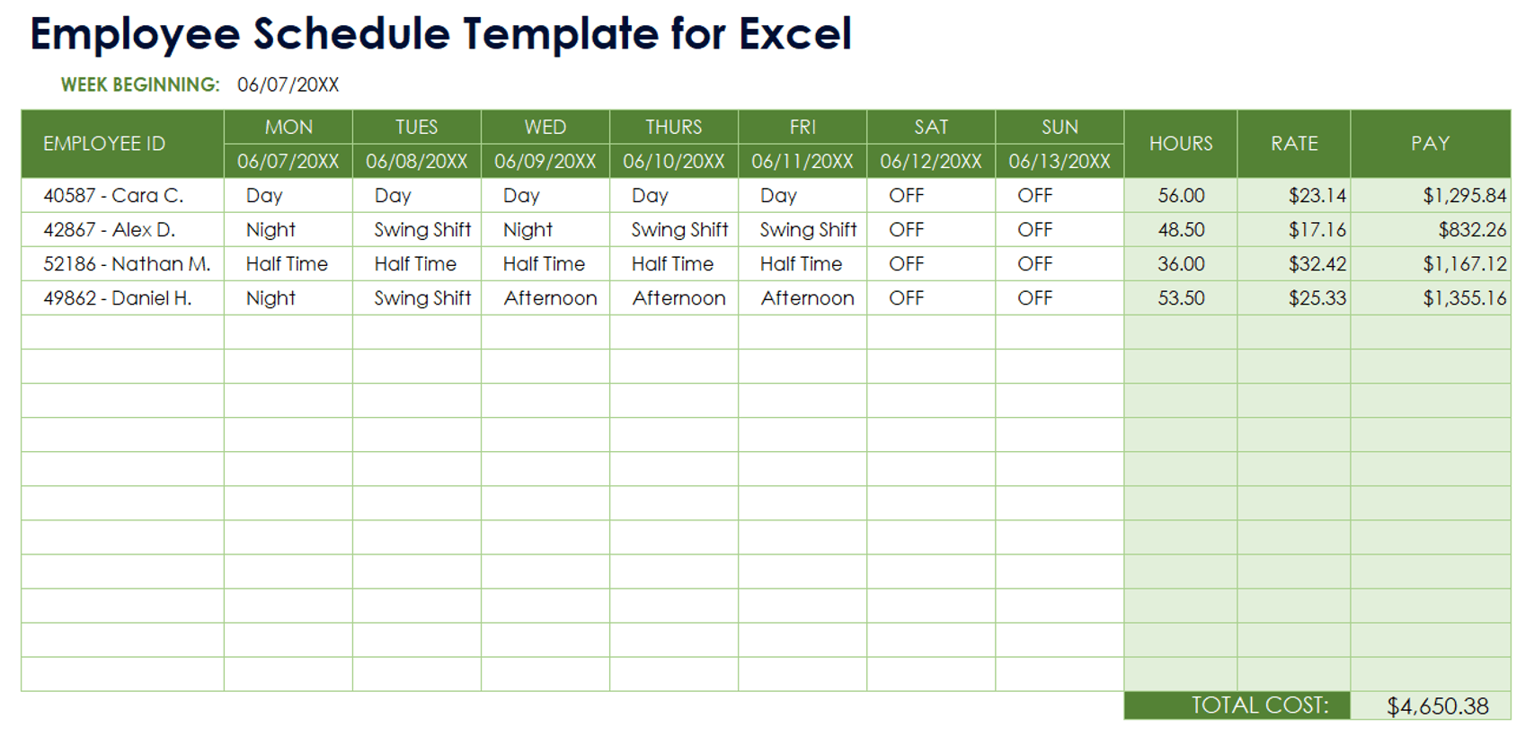
Current method vs Excel method
Traditional paper-based schedules increase the risk of duplicated information, delayed updates and communication errors across multiple care locations (CQC, 2024).
• Excel tables, filters and conditional formatting enable managers to identify staffing shortages and workload imbalances more rapidly than manual systems (Microsoft Excel, 2026).
• Dropdown menus and standardised templates improve data consistency, reducing the likelihood of recording inaccuracies that may affect care delivery (Local Government Association, 2024).
• Shared digital records provide greater visibility of workforce information, supporting faster operational decision-making and service coordination (DHSC, 2023).
• However, efficiency gains depend on staff digital competence, demonstrating that successful implementation requires training alongside technology adoption (WHO, 2023).

Slide 7
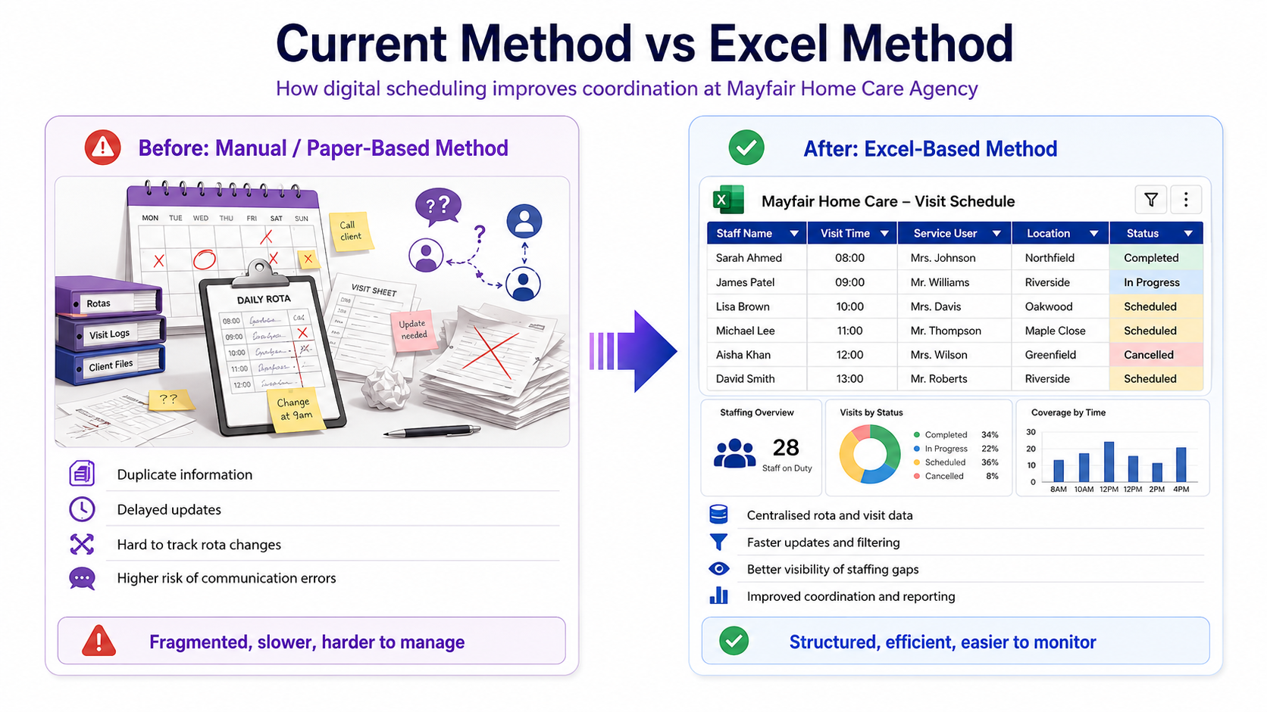

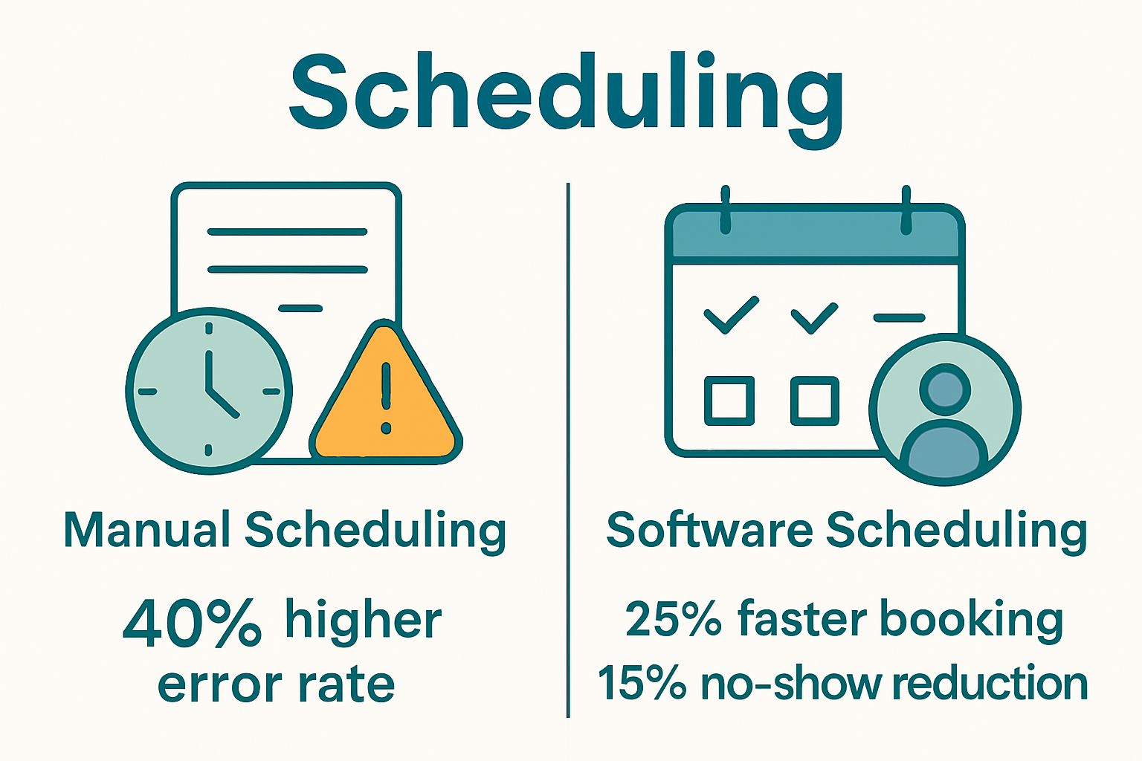
Benefits of Excel for Mayfair
Excel can improve scheduling efficiency by automating calculations and reducing time spent manually updating staff rotas (Microsoft Excel, 2026).
• Better organised records support accurate monitoring of care activities and contribute to improved service quality and accountability (CQC, 2024).
• Centralised workforce data enables managers to identify trends, monitor absences and make evidence-based staffing decisions (DHSC and NHS England, 2022).
• Reduced duplication of information supports productivity improvements and decreases administrative workload across the organisation (DHSC, 2023).
• The ability to generate reports quickly strengthens managerial oversight and supports continuous service improvement within Mayfair (Stoumpos, Kitsios and Talias, 2023).

Slide 8
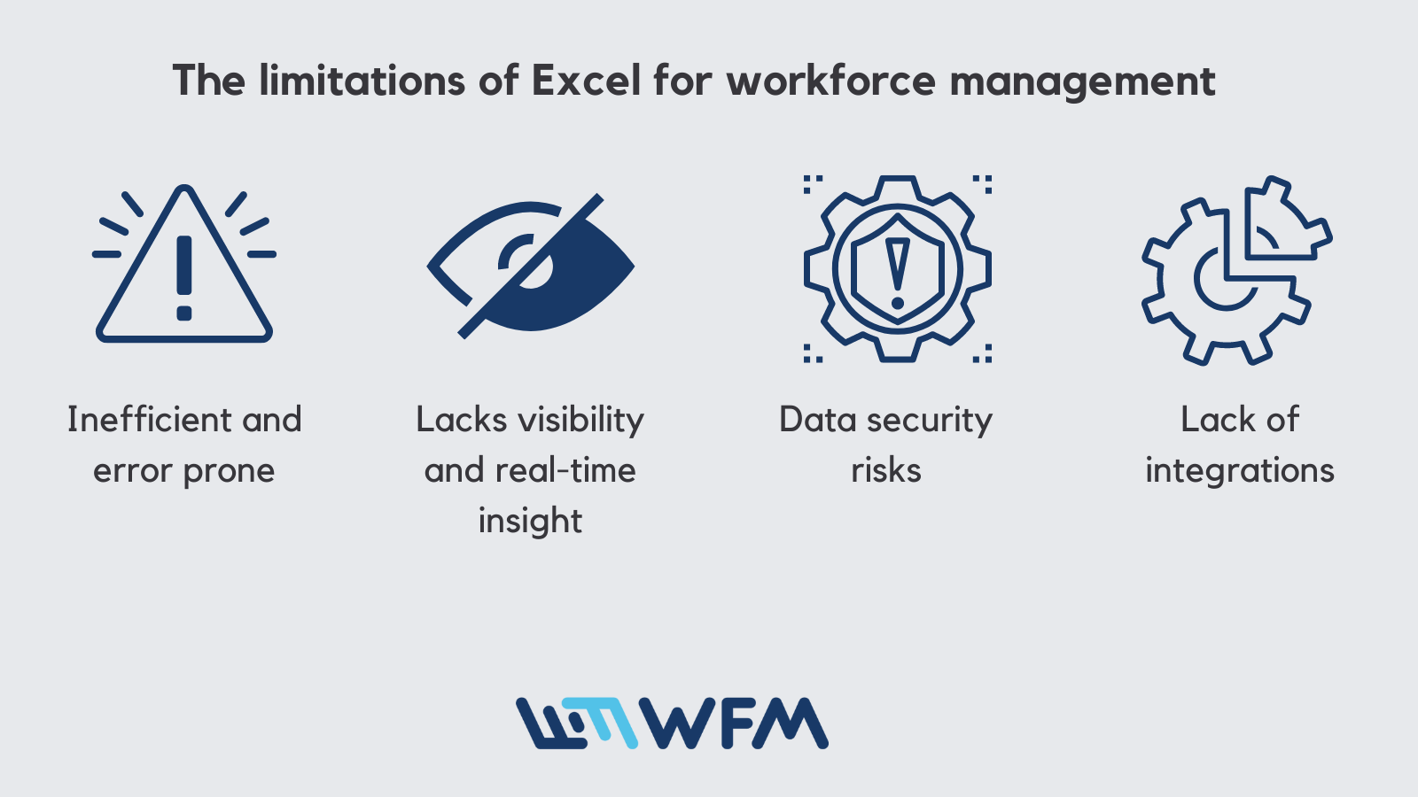
Limitations of Excel
• Excel remains vulnerable to human error because inaccurate data entry can affect schedules, records and management decisions (CQC, 2024).
• Staff with limited digital confidence may struggle to utilise advanced spreadsheet functions effectively, reducing potential benefits (Brørs et al., 2023).
• Version-control problems may occur when multiple employees edit files simultaneously without appropriate governance procedures (Local Government Association, 2024).
• Sensitive care information stored within spreadsheets requires robust access controls to minimise confidentiality and security risks (NHS England Digital, 2026).
• Although Excel improves administration, it cannot fully replace dedicated electronic care-record systems designed specifically for clinical and social care environments (CQC, 2024).

Slide 9
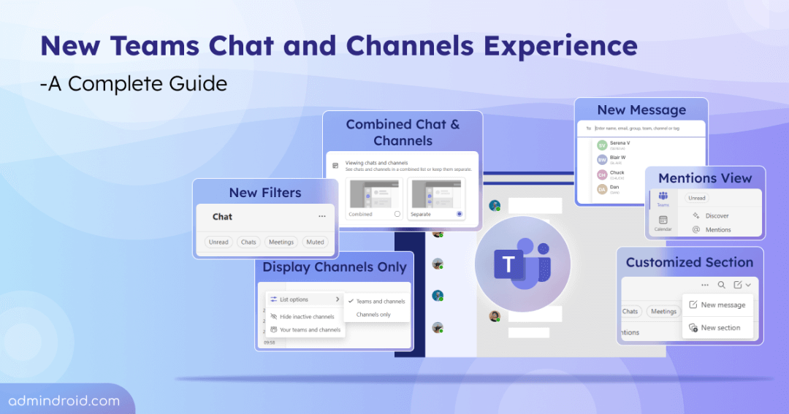
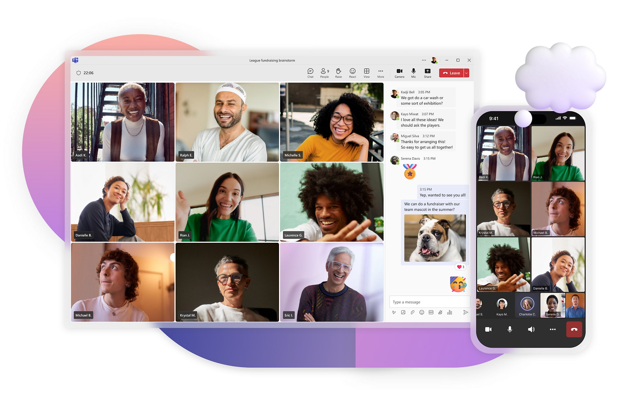
Task 2: Chosen collaboration tool — Microsoft Teams
• Microsoft Teams is designed to support communication and collaboration between carers, nurses, care coordinators and administrative staff regardless of location (Microsoft, 2025).
• Within Mayfair, Teams can create a central communication platform that reduces reliance on fragmented communication methods such as phone calls and separate email chains (DHSC, 2023).
• Real-time messaging and file-sharing capabilities enable faster information exchange, supporting responsive decision-making in care delivery (Microsoft, 2025).
• Integrated collaboration tools align with national digital transformation objectives that encourage connected and efficient care services (DHSC and NHS England, 2022).
• Therefore, Teams offers strategic value by improving workforce coordination while supporting continuity of care across multiple service settings (Stoumpos, Kitsios and Talias, 2023).

Slide 10
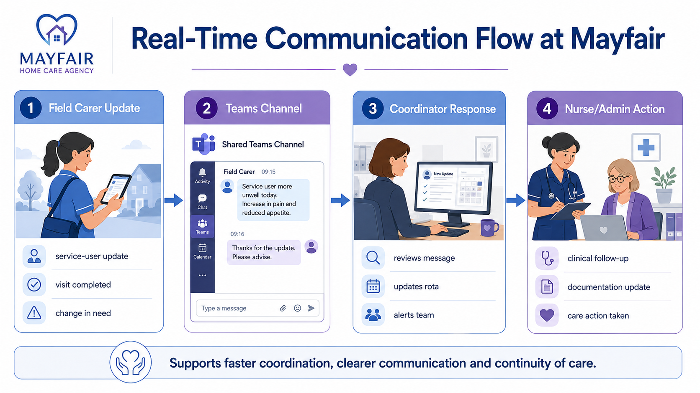
How Teams improves communication
• Field-based carers can provide immediate updates regarding service-user needs, enabling faster responses from office-based staff (Microsoft, 2025).
• Care coordinators can use Teams to communicate rota changes instantly, reducing delays associated with traditional communication methods (DHSC, 2023).
• Nurses can participate in virtual meetings and multidisciplinary discussions without requiring physical attendance, improving collaboration efficiency (Microsoft, 2025).
• Secure file-sharing features enable care documentation to be accessed and updated more effectively by authorised personnel (CQC, 2024).
• Organised channels create structured communication pathways, reducing information loss and improving accountability across teams (DHSC and NHS England, 2022).

Slide 11
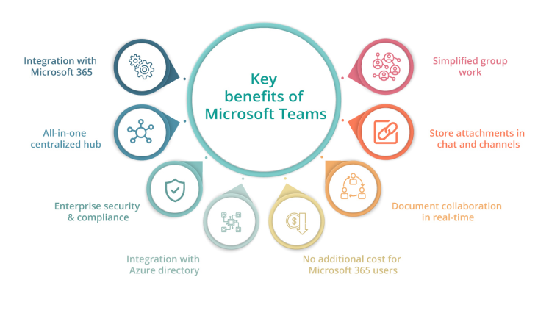
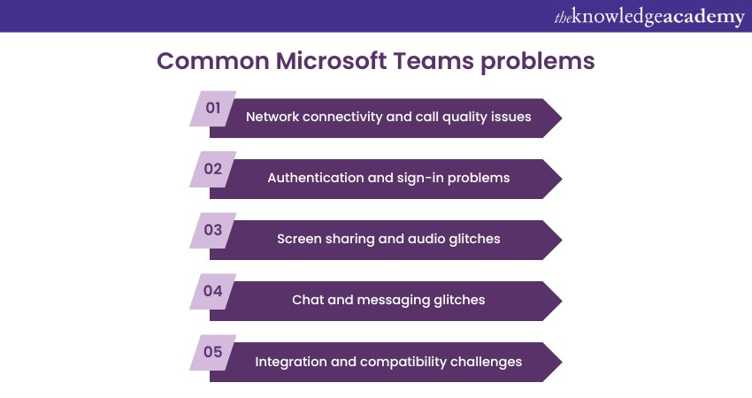
Advantages and challenges of Teams
Advantages
• Real-time communication improves responsiveness and coordination across geographically dispersed care teams (Microsoft, 2025).
• Virtual meetings reduce travel requirements and support more efficient use of staff time and organisational resources (DHSC and NHS England, 2022).
• Integrated collaboration features encourage teamwork and knowledge sharing, contributing to improved service delivery (Stoumpos, Kitsios and Talias, 2023).
Challenges
• Excessive notifications may create information overload and reduce productivity if communication channels are poorly managed (Microsoft, 2025).
• Limited digital confidence among some employees may restrict effective adoption and require additional training investment (WHO, 2023).
• Dependence on internet connectivity and secure devices creates operational and security challenges that require ongoing management (NHS England Digital, 2026).

Slide 12
Digital safety action plan
Area | Goal | Key Actions
Secure Access | Prevent unauthorised access to care records (NCSC, 2024) | Implement Multi-Factor Authentication (MFA), strong passwords and role-based access controls (NCSC, 2024).
Email Awareness | Reduce phishing and cyberattack risks (DSIT and Home Office, 2025) | Deliver regular cyber-awareness training and encourage reporting of suspicious emails (NHS England Digital, 2026).
Data Management | Improve protection of sensitive care information (DHSC, 2022) | Use secure cloud storage, regular backups and controlled file-sharing procedures (CQC, 2024).
Confidentiality & Compliance | Maintain GDPR and information governance compliance (DHSC, 2022) | Conduct audits, monitor access permissions and provide confidentiality training (NHS England Digital, 2026).

Slide 13
Reference
Brørs, G., Larsen, M.H., Hølvold, L.B. et al. (2023) ‘eHealth literacy among hospital health care providers: a systematic review’, BMC Health Services Research, 23, article 1144. Available at: https://doi.org/10.1186/s12913-023-10103-8 (Accessed: 10 June 2026).
Care Quality Commission (CQC) (2024) Digital record systems: achieving good outcomes for people using adult social care services. Available at: https://www.cqc.org.uk/guidance-providers/adult-social-care/digital-record-systems-adult-social-care-services (Accessed: 10 June 2026).
Department for Science, Innovation and Technology and Home Office (2025) Cyber security breaches survey 2025. Available at: https://www.gov.uk/government/statistics/cyber-security-breaches-survey-2025/cyber-security-breaches-survey-2025 (Accessed: 10 June 2026).
Department of Health and Social Care (2022) Data saves lives: reshaping health and social care with data. Available at: https://www.gov.uk/government/publications/data-saves-lives-reshaping-health-and-social-care-with-data/data-saves-lives-reshaping-health-and-social-care-with-data (Accessed: 10 June 2026).
Department of Health and Social Care (2023) Digital working in adult social care: What Good Looks Like. Available at: https://www.gov.uk/government/publications/digital-working-in-adult-social-care-what-good-looks-like/digital-working-in-adult-social-care-what-good-looks-like-for-local-authorities-and-care-providers (Accessed: 10 June 2026).
Department of Health and Social Care (2023) Guidance to support digital transformation of social care. Available at: https://www.gov.uk/government/news/guidance-to-support-digital-transformation-of-social-care (Accessed: 10 June 2026).
Department of Health and Social Care and NHS England (2022) A plan for digital health and social care. Available at: https://www.gov.uk/government/publications/a-plan-for-digital-health-and-social-care/a-plan-for-digital-health-and-social-care (Accessed: 10 June 2026).
Local Government Association (2024) Implementing digital social care records. Available at: https://www.local.gov.uk/our-support/partners-care-and-health/digital-transformation/implementing-digital-social-care (Accessed: 10 June 2026).
Microsoft (2025) Get started with Microsoft 365 for healthcare organizations. Available at: https://learn.microsoft.com/en-us/microsoft-365/frontline/teams-in-hc?view=o365-worldwide (Accessed: 10 June 2026).
Microsoft Excel (2026) Free Excel scheduling templates. Available at: https://excel.cloud.microsoft/create/en/schedule-templates/ (Accessed: 10 June 2026).
National Cyber Security Centre (NCSC) (2024) Multi-factor authentication for your corporate online services. Available at: https://www.ncsc.gov.uk/collection/mfa-for-your-corporate-online-services (Accessed: 10 June 2026).
NHS England Digital (2026) Data Security and Protection Toolkit. Available at: https://digital.nhs.uk/cyber-and-data-security/cyber-security-services/data-security-and-protection-toolkit (Accessed: 10 June 2026).
Skills for Care (2024) Empowering care through technology: The vital role of digital skills in adult social care. Available at: https://www.skillsforcare.org.uk/news-and-events/blogs/empowering-care-through-technology-the-vital-role-of-digital-skills-in-adult-social-care (Accessed: 10 June 2026).
Stoumpos, A.I., Kitsios, F. and Talias, M.A. (2023) ‘Digital transformation in healthcare: technology acceptance and its applications’, International Journal of Environmental Research and Public Health, 20(4), p. 3407. Available at: https://doi.org/10.3390/ijerph20043407 (Accessed: 10 June 2026).
World Health Organization (WHO) (2023) Digital health literacy key to overcoming barriers for health workers, WHO study says. Available at: https://www.who.int/europe/news/item/18-09-2023-digital-health-literacy-key-to-overcoming-barriers-for-health-workers--who-study-says (Accessed: 10 June 2026).

