Slide 1
BMTP6003
Global Destination &
Resort Management
Destination Management

Slide 2

Today’s Session
Destination Management
Responsibilities
Destination Management Organisations
Introduction to Strategic Destination Management
Introduction to Destination Marketing
Looking to the future……

Slide 3
Destination Management
Proactive Visitor Centred Approach to the Economic and Cultural Development of a Destination that balances and integrates the interests of visitors, service providers and the community
(DMAI 2008)
Visitor Economy
Destination Management
Destination Marketing

Slide 4
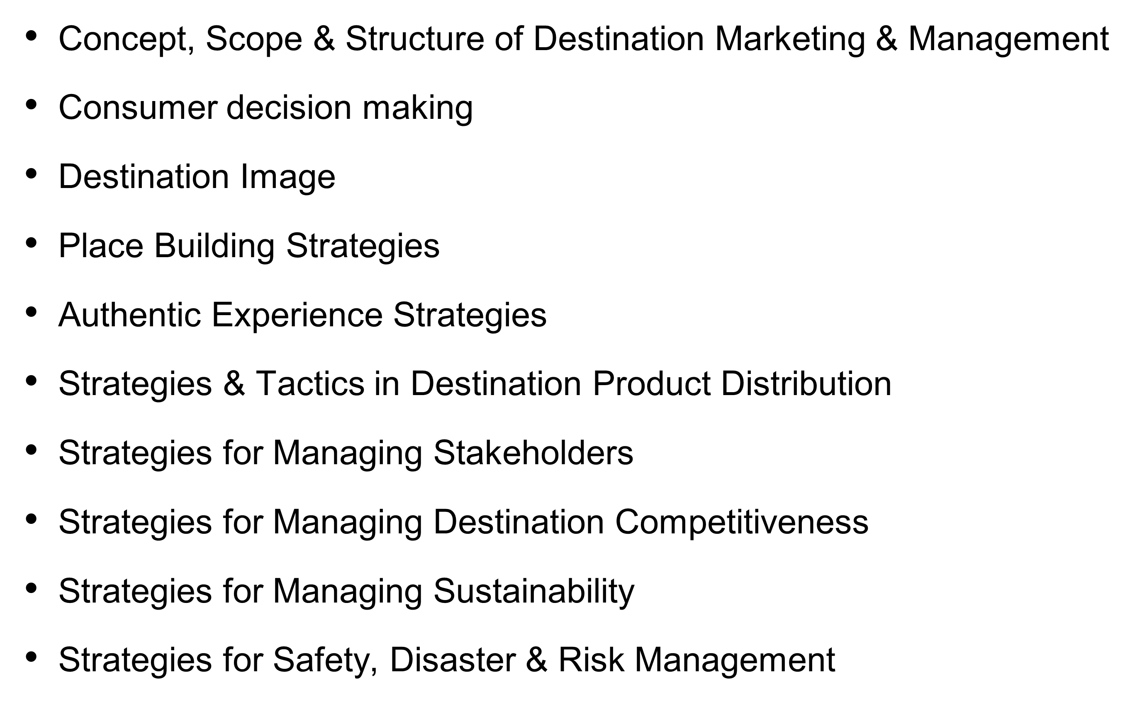
Destination Concepts

Slide 5
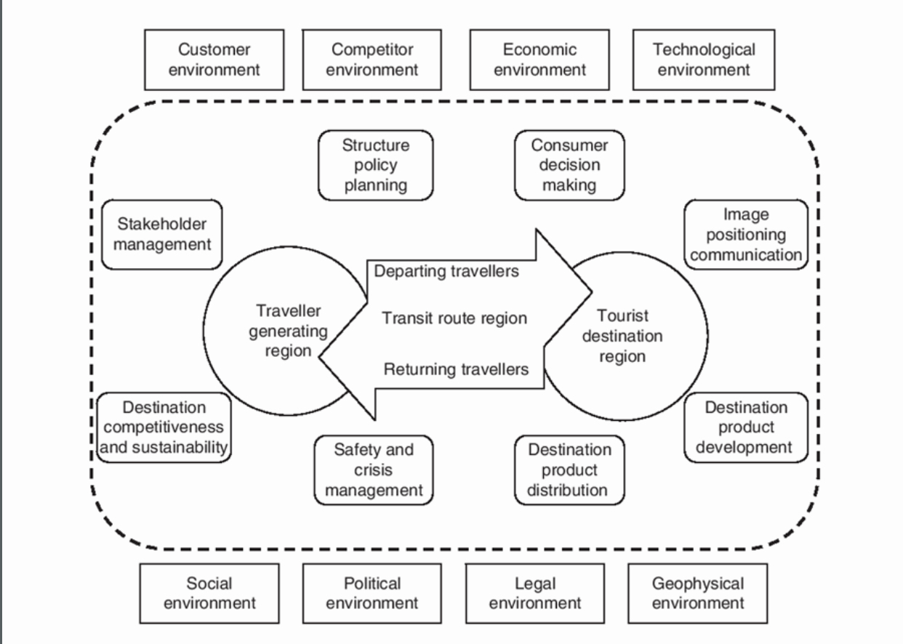
Wang (2018) Destination Marketing & Management

Slide 6
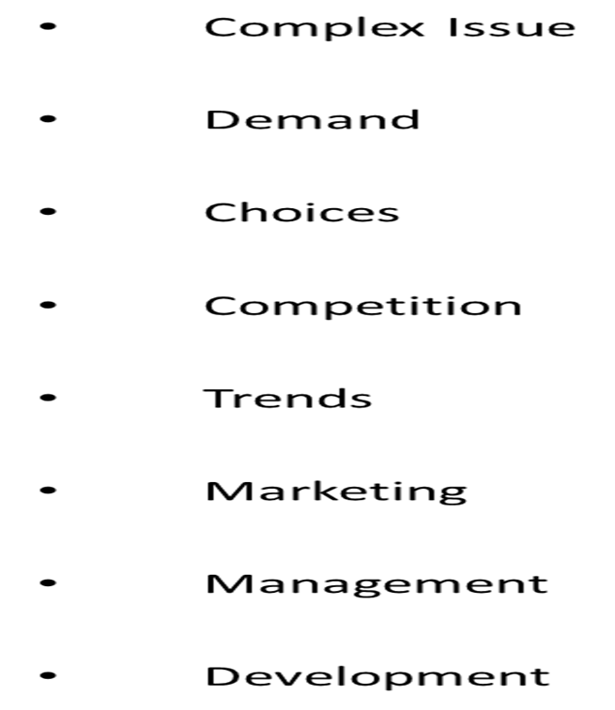
Managing Destinations & Resorts

Slide 7
Destination Structures & Responsibilities
Destination Management Organisations (DMO’s)
Responsible for
Promotion & responsible for Marketing
Govt Agency providing policy advice to Govt
Private sector umbrella industry organisation championing members causes
Pike (2008)

Slide 8

Destination Management Organisations DMO’s
National Tourism Office / Board / Administration - In charge of Tourism Development at National Level usually NTA in charge of Tourism Development & NTO is responsible for overall marketing nationally
State Tourism Office - Marketing role at federal level EG Andalusia Tourism
Regional Tourism Organisation - Represents concentrated Tourism Area Cities, Coastal Tourism Areas or Island & may be linked to Convention Bureaus responsible for marketing EG Costa Del Sol Tourism / Wales
Local Tourism Office / TIC can represent local tourism and local tourism association or be separate. May be linked to local authority of run by a cooperative or
Tourism association

Slide 9
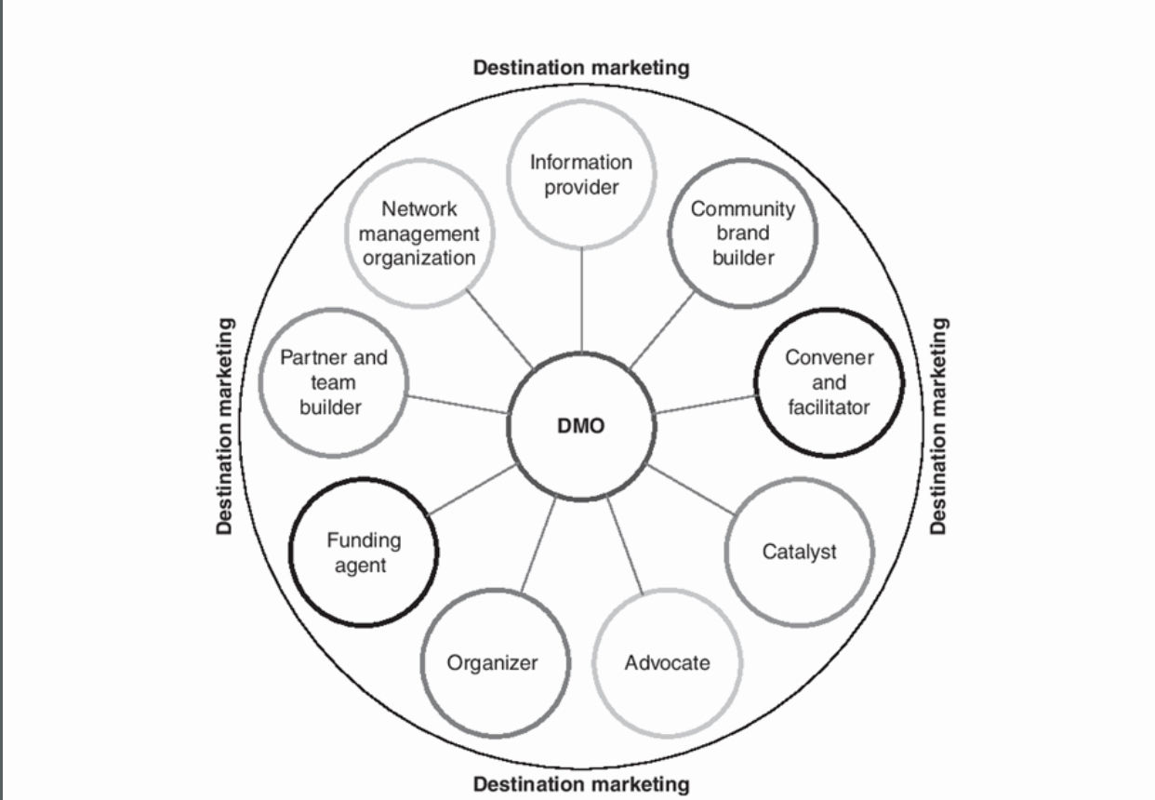
Destination Management Wang (2018)

Slide 10
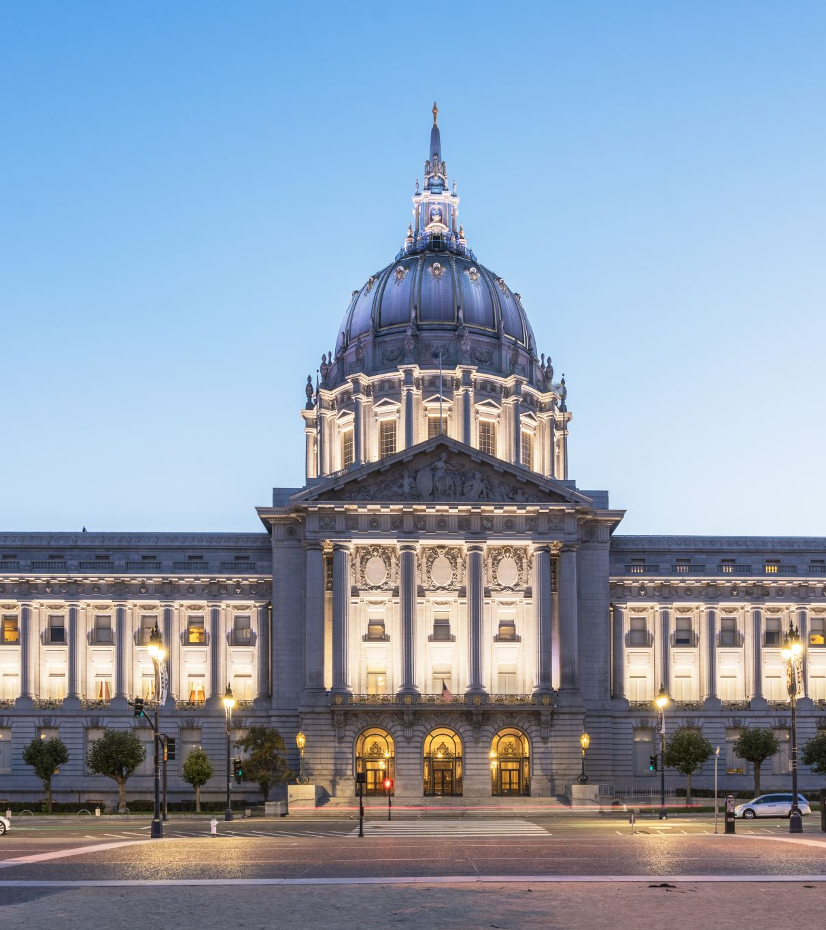
DMO Structures
Reflects funding, roles, responsibilities
Government Agencies
Quasi Autonomous Non Government Agencies
Dual Funded Non Profit Organisations
Members Trade Associations
Hybrids

Slide 11
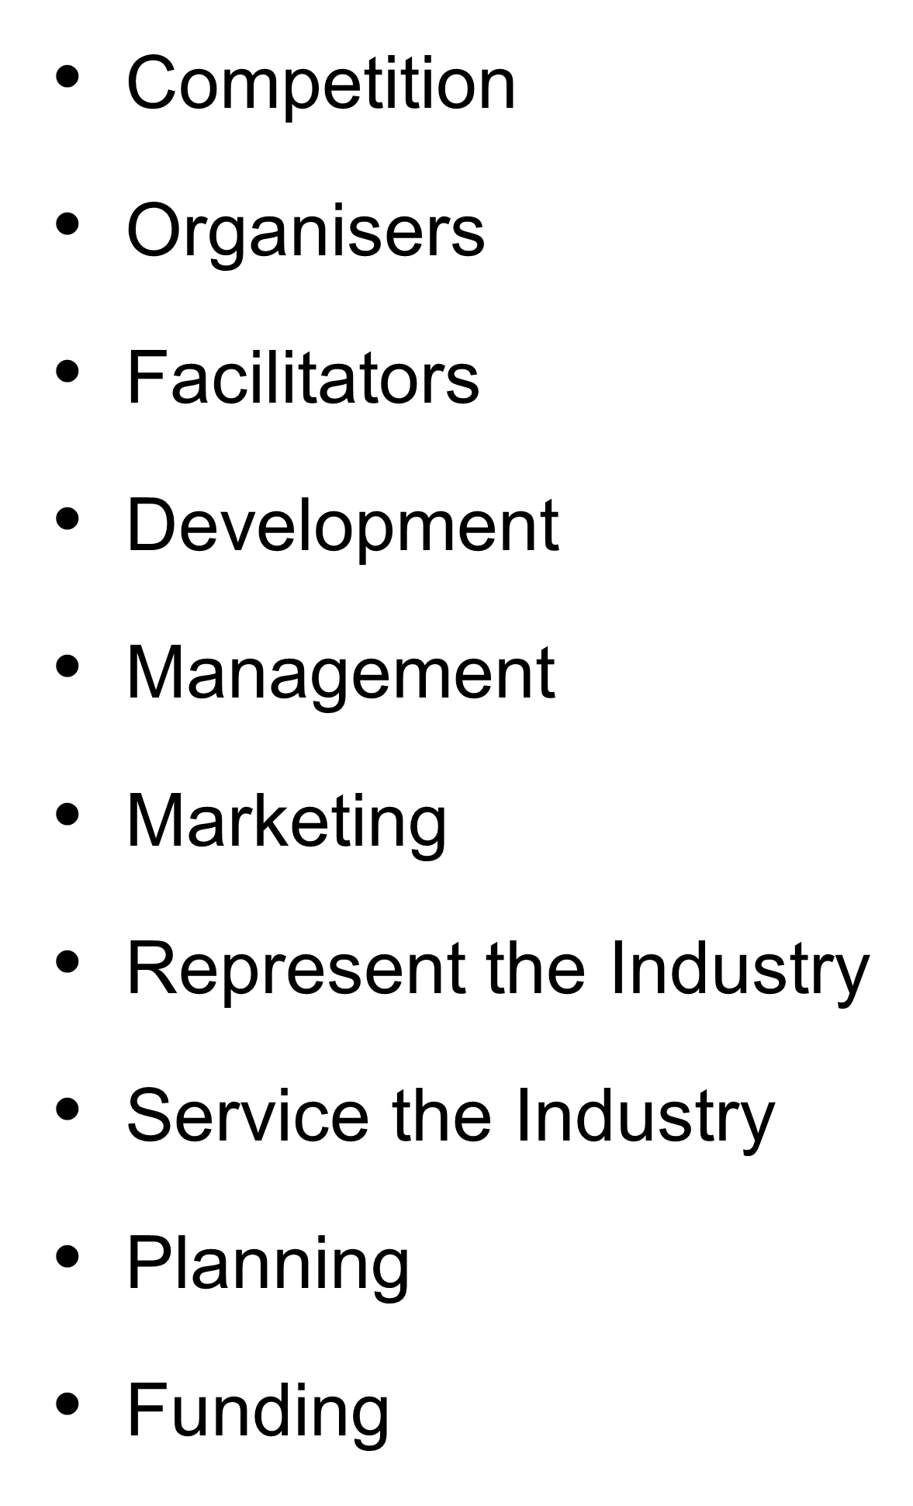
DMO Strategic Roles & Responsibilities

Slide 12
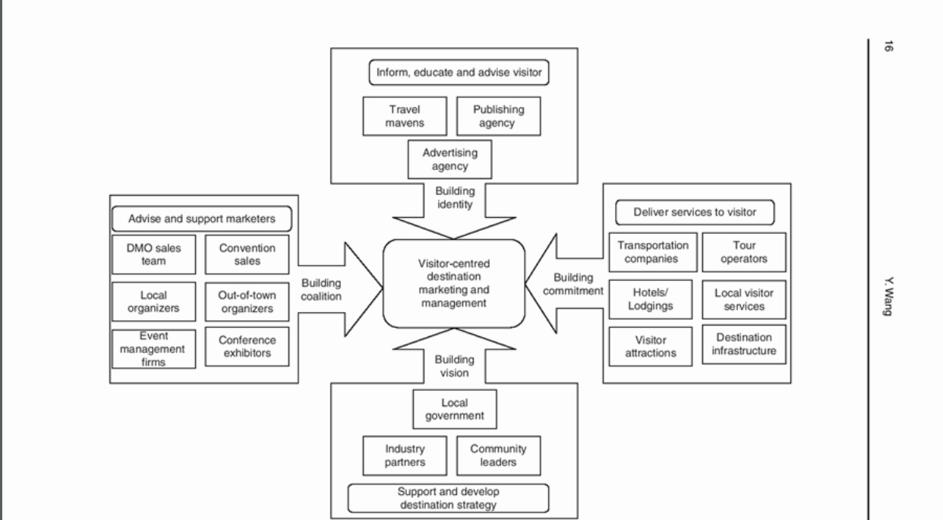
Wang (2018) Strategic Map of DMO
Marketing & Management

Slide 13

Management Functions
Planning
Product Development
Support local industry
Develop links
Events
Bidding

Slide 14
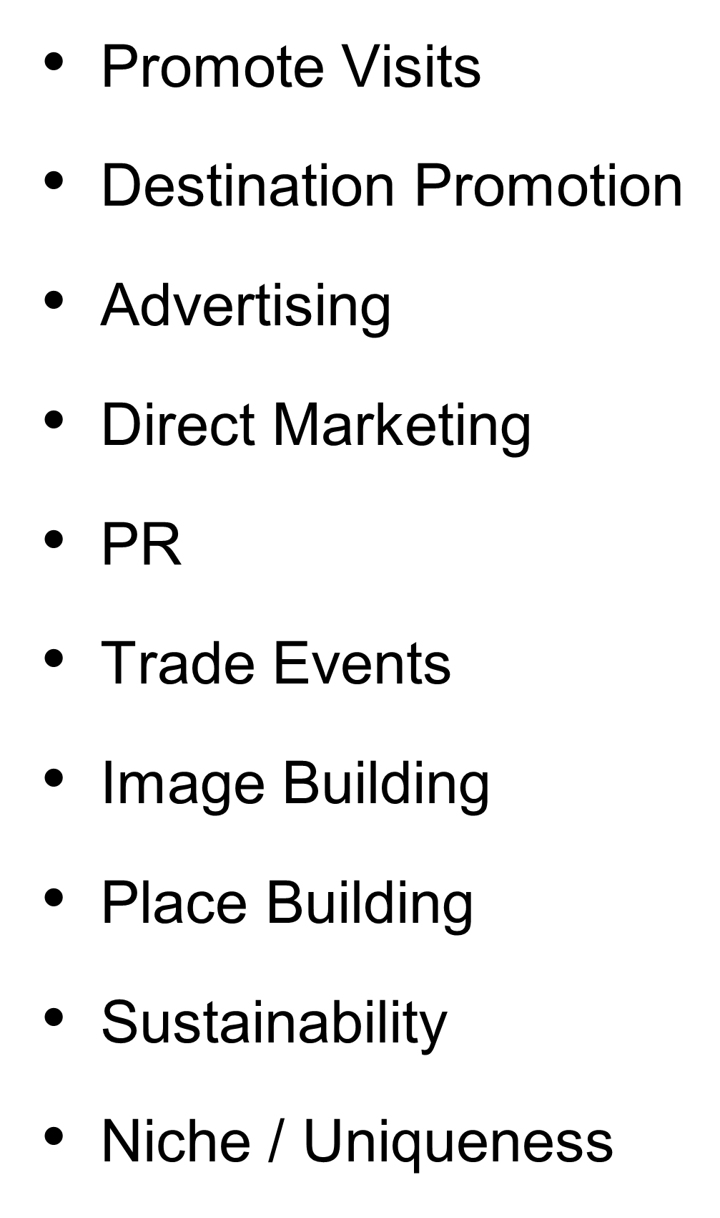
Marketing Roles & Responsibilities

Slide 15
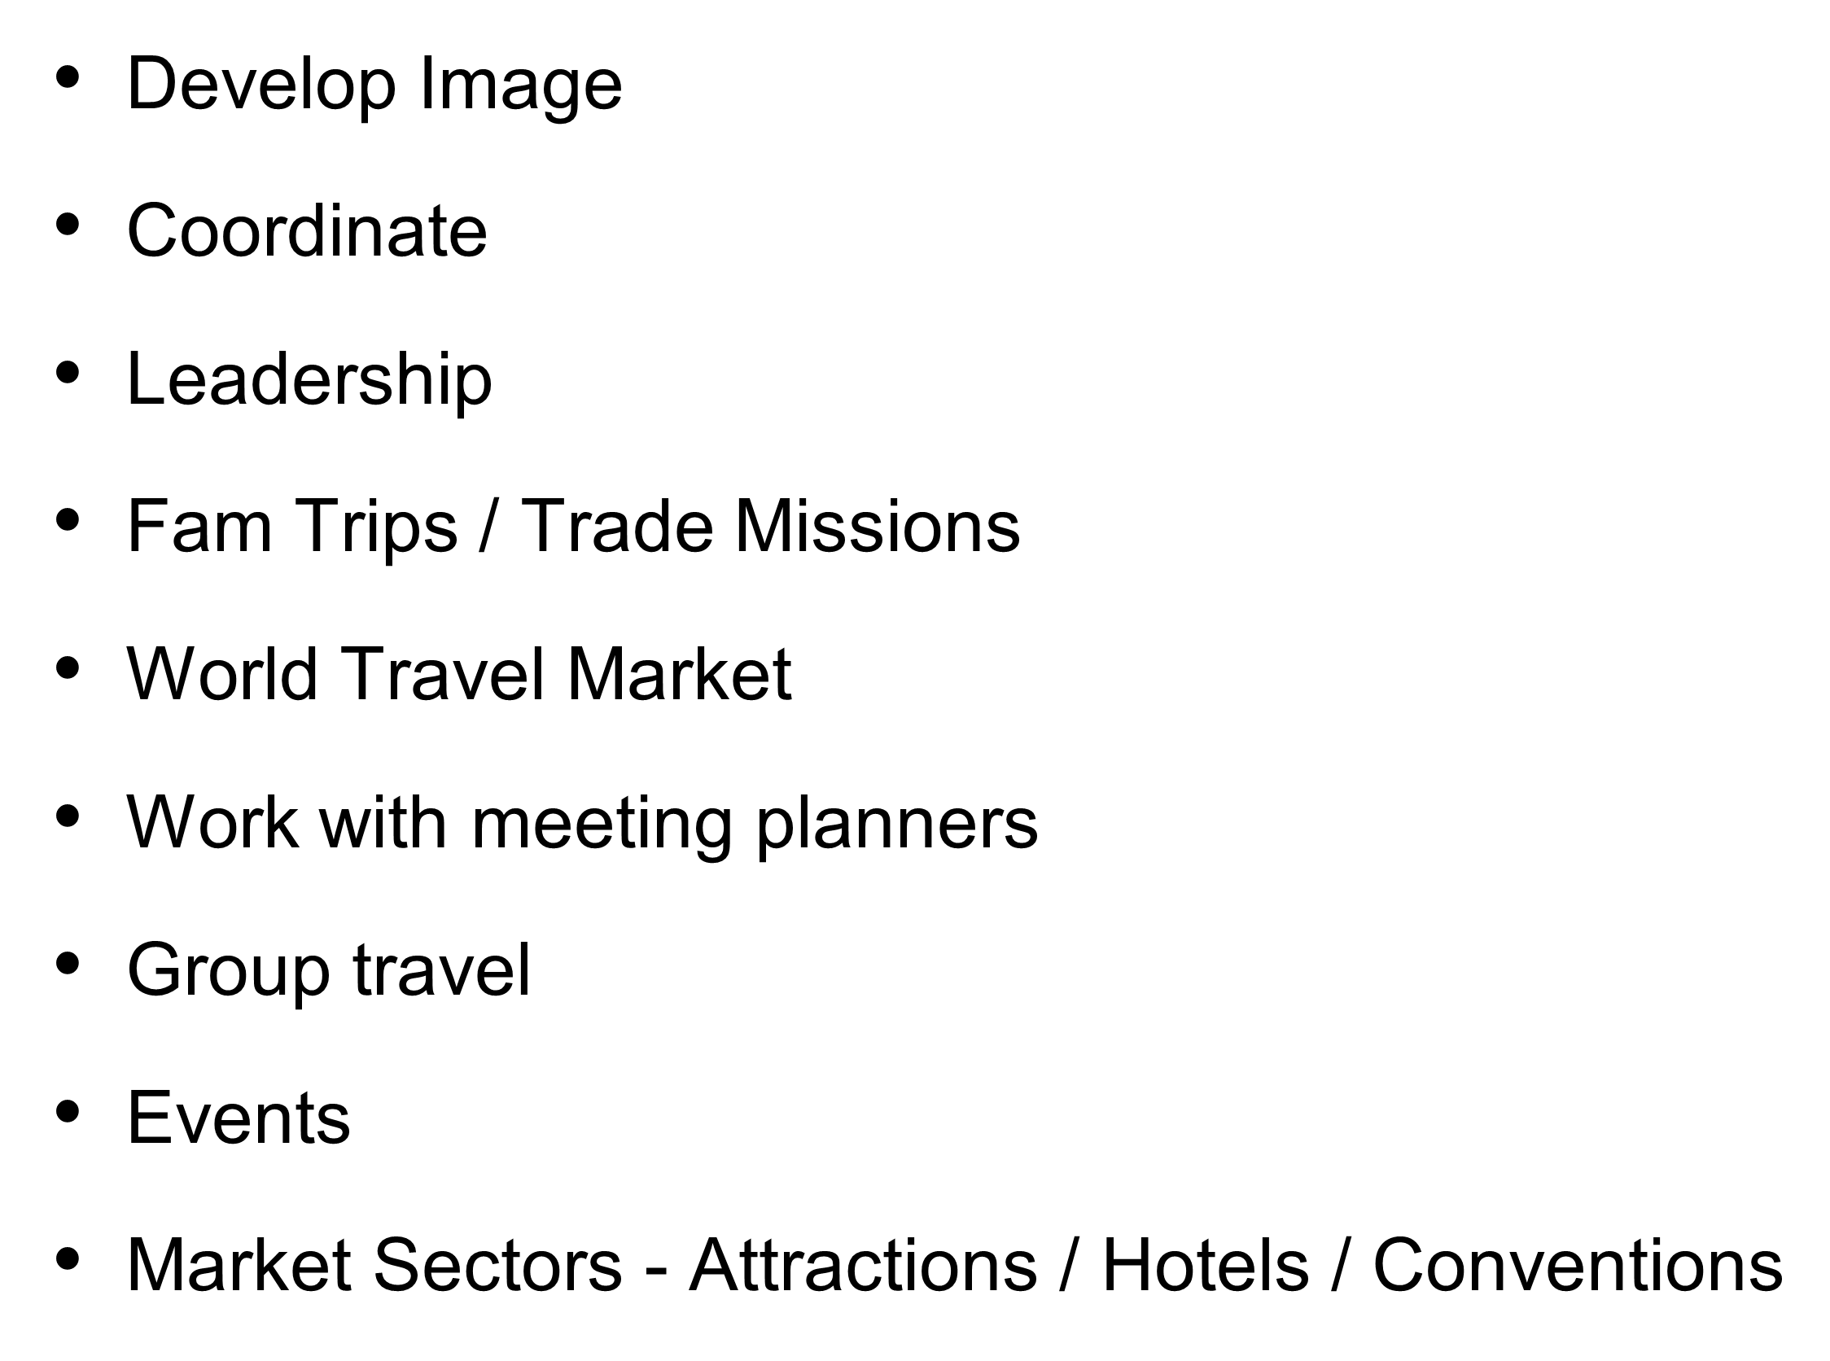
Marketing Functions

Slide 16
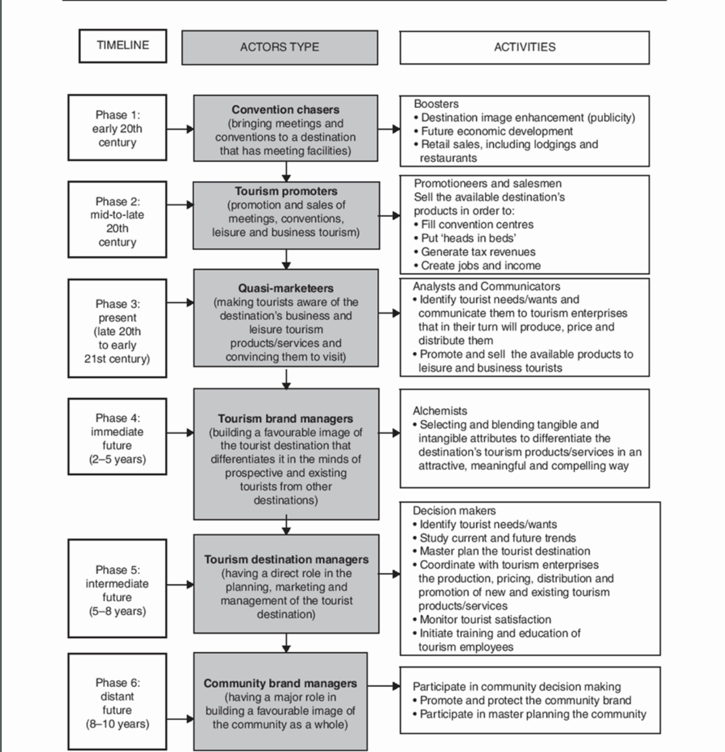
Evolution of Convention Bureaus Wang (2018)

Slide 17
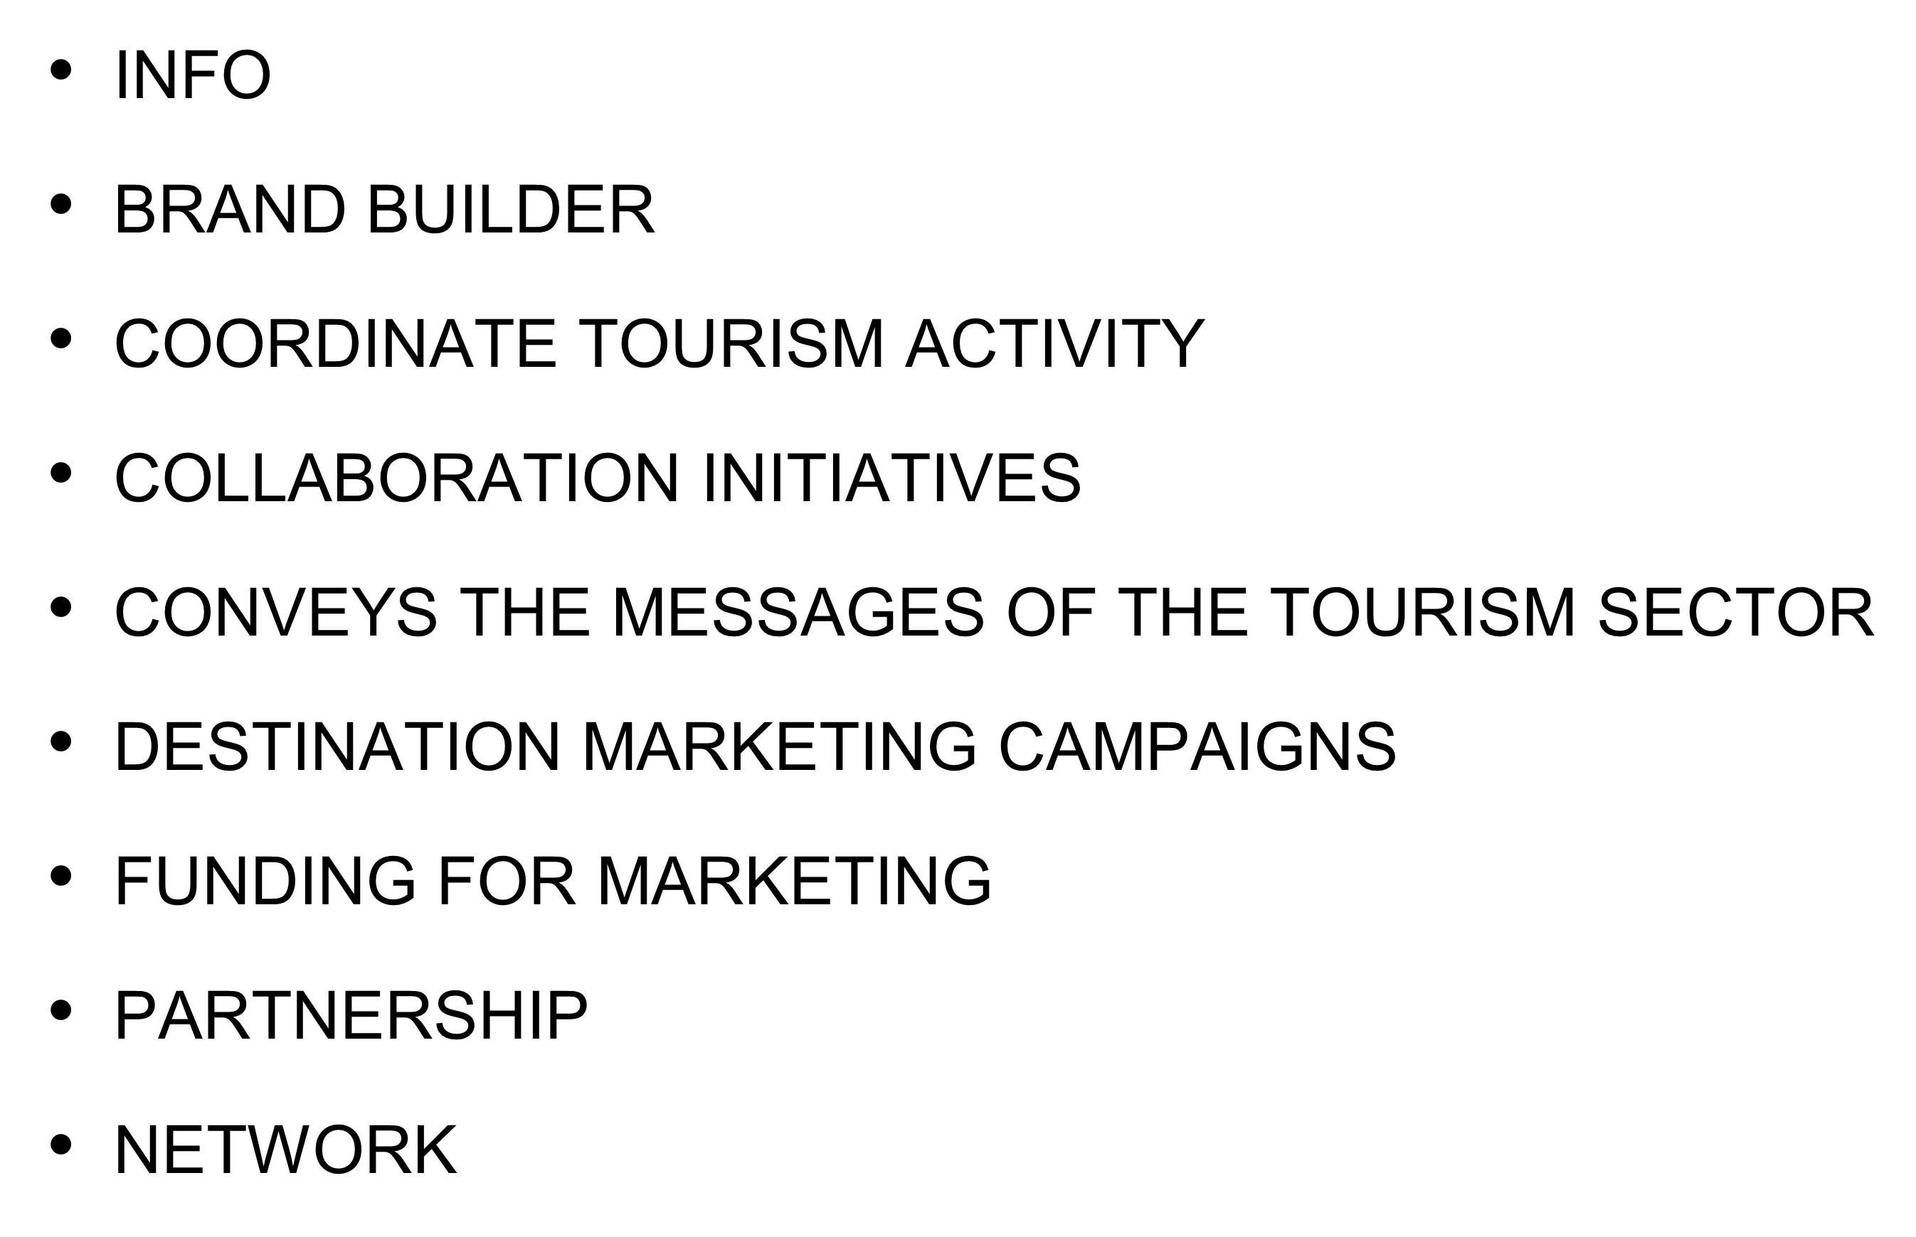
Strategic Marketing

Slide 18
Future …….Re-launch, Recovery, Take off!
BUILDING COALITIONS
BUILDING COMMITMENTS
BUILDING VISION & LEADERSHIP
BRAND BUILDER, RELEVANCE, VALUE PROPOSITION & VISIBILITY
WANG, Y (2018)

