Slide 1


Strategic management of apple
Ebony goddard 1920397
Glen behenna
Bmsp6006

Slide 2
Introduction
My name is Ebony Goddard today I will be presenting the strategies apple take to sustain a successful business
What areas need improvement within the organisation, also what positive aspects are of the company
And what other strategies apple could implement to add change tackle the negative areas within the business.
I hope you enjoy it!

Slide 3
What is strategic management
Strategic management helps an organisation implement ways to tackle and manage new projects or product development, having a good strategic plan also allows a company to innovate and expand.
Without strategic management a corporation like apple would not be able to see its environment internally and externally, this could have a negative effect on the planning and building of projects and their outcomes.

Slide 4
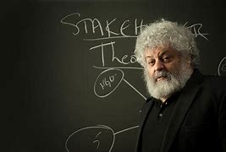
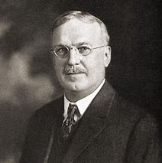
Theorist behind strategic management
There are many different theorists behind strategic management the main ones I will be focusing on is Albert Humphrey, Francis Aguilar, Edward Freeman.
I have choosen these 3 as they relate to the Stratigic theory I am implementing to apple.
Albert Humphreys was the founder of the swot analysis tool, this tool was developed for managers to be able to recognise the organisations strengths weaknesses, opportunities and threats.
This tool has been used for many years and has proven successful for a developing company
Francis Aguilar is the founder of pest analysis he developed this tool for organisations to look at their environment and find potential risks and threats which could harm the business.
Edward freeman is the founder of stakeholder analysis he developed this tool for corporations to have the ability to identify relevant stakeholders in order of importance.

Slide 5
Background of Apple
Apple was founded by Steve jobs in 1976
Apple has created many great technologies over the years including the apple iPhone, Apple Mac, iPod, and other great products
Apple is worth $2.08 trillion
They are creating future developments in cars they are looking to create a new smart car which can self drive and will be fully electronic which would be better for our environment and be more sustainable for the future

Slide 6
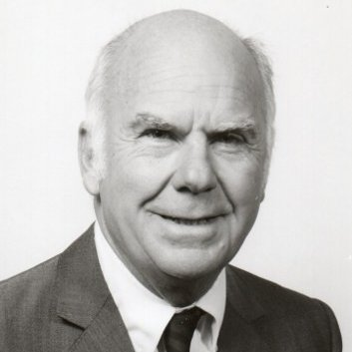
Albert humphreys
His views are that a swot analysis detects and internal-external strengths weaknesses oppertunities and threats.
He feels it’s important to look at these aspects closely as it’s what makes the organisation like apple understand if the project is viable and what consequence would it have on the business.

Slide 7
Swot analysis
Strengths Innovative technology New and loyal customers Development | Weaknesses High prices Compatible only to apple acessories Limited networking
Oppertunities Customer growth and loyalty Partnership and acquisition Expansion and improvements to products | Threats Legal threats Competitors Coronavirus pandemic

Slide 8
Pest Analysis
Political
Many countries now have access to Apple's products and services. The App Store, in particular, is available in 175 nations and territories. Apple's market is divided into Africa, Asia-Pacific, Europe, Latin America and the Caribbean, the Middle East, and Oceania for some products and services (Apple, 2020). Because of its global reach, Apple could encounter a wide spectrum of political pressures. These pressure could develop from disagreements between countries, national pandemics will slow the distribution of products and add pressures.
Economical
Increased labour expenses in China may erode some Apple goods' cost advantage. Stagnant middle-class earnings in several industrialised countries, notably the United States, may limit the potential market for higher-end consumer items like Apple's.(apple inc, 2015)
Social
In the future decades, areas of the world where people are unfamiliar with Apple products, such as Africa, will see the most growth in consumer spending.Consumers in those regions, as well as younger individuals in Apple's established markets, such as the US, lack the deep emotional tie to Apple products that drives sales. (apple inc, 2015
Technological
In recent years apple is working on a new project called project titans, this is the creation of a self-driving, fully electric vehicle which will not be fully produced until 2024, as a whole the company is always looking at ways to enhance the technological status in all avenues. (Apple insider, 2021)

Slide 9
Pest analysis
The main founder of the pest analysis is francis aguilar, his views are a pest can help an organization see the environment of the organisation and alert of any negative impacts which can effect a corporation like apple.
No matter how big or small the nature of the business is it is important to regularly do a pest analysis, to form and analyse the potential of the business future.
Looking at apple through a pest analysis, the organization is a multi-national organization which shows their success but under the exterior there are a few negative impacts on the environment which could pose as a potential threat in the future.

Slide 10
Stakeholder Analysis
Stakeholder interest
Keep informed Managers Partners/ shareholders | Manage closely Competitor's Suppliers Chinese/ Usa government
Minimal contact Employees of suppliers and distributors | Keep satisfied Customers Employees of apple Investor's
Stakeholder influence

Slide 11
Stakeholder analysis
Edward freeman is the founder of stakeholder analysis, his views are that a stakeholder analysis is important for an organization to be able to identify relevent stakeholder in order of importance to the corporation
Apple has many internal and external stakeholders as it is a large organization. By imputting them on a relevence chart we can recognize which ones ar of importance to the organization.

Slide 12
Strategies Apple could improve
I feel apple has many strengths and pitfalls but so do most organisations
But I believe apple should look wider into their environmental factors especially the legal aspect as they do not want to risk anymore lawsuits which could potentially ruin their reputation.
They need to look at projects closely and correct potential lawsuit threats.
By correcting mistakes, looking at their stakholders they will be keeping customers satisfied and investors will invest more into greater success.
But the main one for me I believe apple will keep themselves ahead of all competitors.

Slide 13
Conclusion
From the presentation I feel apple has a positive potential to succeed in the future, but they need to look closely at future projects and detect threats and weaknesses early in project planning not to develop any hiccups along the way.
This will help apple grow further and keep existing loyal customers.
Apple will have a greater chance for innovation in the future.

Slide 14
References
https://online.vu.edu.au/blog/why-strategic-management-important
https://www.mindtools.com/pages/article/newTMC_09.htm
https://www.professionalacademy.com/blogs/marketing-theories-swot-analysis/
Pest analysis https://www.mindtools.com/pages/article/newTMC_09.htm
Apple Inc. PESTLE Analysis
SWOT Analysis of Apple [Detailed] - Super Heuristics
Apple Car | Release Dates, Features, Specs, Rumors (appleinsider.com)
https://th.bing.com/th/id/OIP.UKTOFZw2IIR_nuqhq0rMBAAAAA?pid=ImgDet&rs=1
https://th.bing.com/th/id/R.3c29badb06ceacc45006935f01917a02?rik=l5sYwgE2oXjjQg&riu=http%3a%2f%2fintheblack.com%2f%7e%2fmedia%2fintheblack%2fallimages%2fmagazine-2015%2f04-april%2fstakeholder-feature.jpg&ehk=khMD2RJYa0kE2PmRgkeZJOrWfPCJPodG4DlKSGfLMwo%3d&risl=&pid=ImgRaw&r=0
https://new.tuzzit.com/public/image_ressource/albert_humphrey.jpg

