Slide 1
Effective Team Working and Communication(BMSW4002)
Assignment title: Presentation – Strategies for Effective communication in a Business Setting
Group Members:
Andrew -(2129056)
Sarah - (2127140)
Marie - (2126589)
Nimra - (2123954)
Esther - (2108030)
Lecturer’s Name: Daminabo Tokunbo
Submission date: 17/11/2022

Slide 2
Table of Contents
Introduction
Functions of communication
Benefits of communication
Channels of communication
Models of communication
Barriers of communication
How to overcome the barriers
References

Slide 3
Introduction
Communication
Communication is defined as the exchange of information between two or more parties.
There are numerous strategies that can be used to improve communication in teams.
This presentation will examine the models and channels that can be used by Tom to improve communication relative to the Amazon project
Theories of communications
Models of communication
Channels of communication
Notes:
The presentation will further look into the underlying theories of communication to identify the best model and channel of communication which is appropriate to be used by Tom. Also, the challenges of communication involved will be analyzed and how to overcome them.

Slide 4
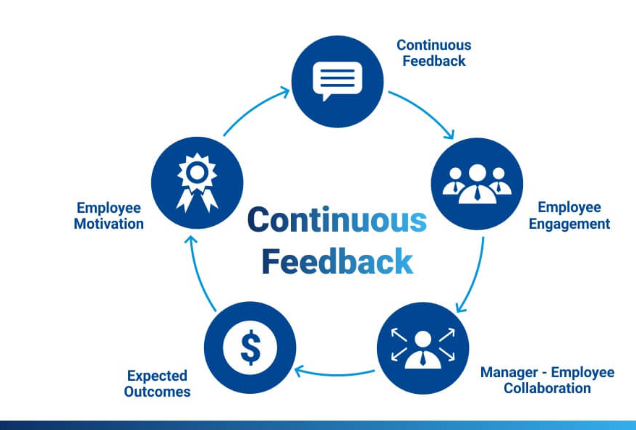
Functions of communication
RingCentral, 2022
Notes:
Any collaborative team process must have effective communication as a foundational component. Effective corporate communication is crucial to daily productivity. Workflows genuinely flow when everyone is aware of their individual roles and responsibilities, as the term implies. It also facilitates feedback concerning performance which is key in decision making.

Slide 5
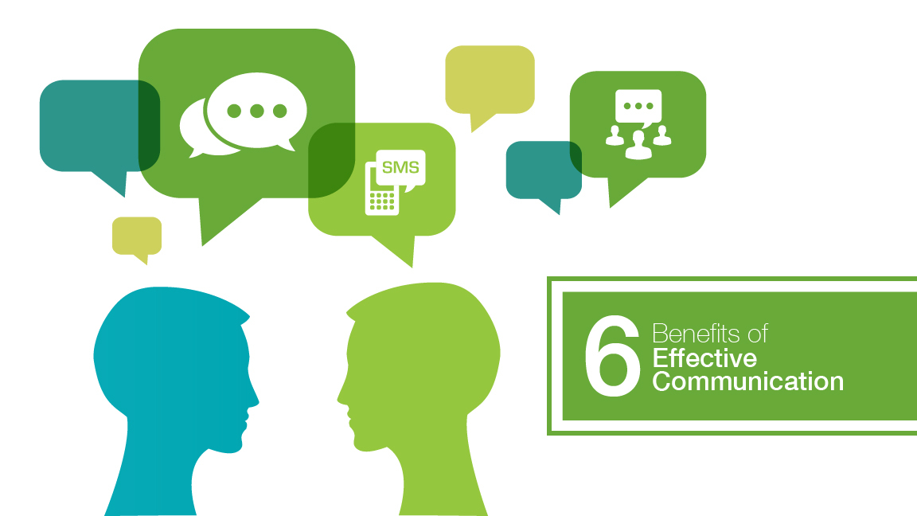
Benefits of communication
Promotes trust and offers a better way to solve conflict
Promotes professionalism
Better team engagement
Teamwork is improved
Promotes team loyalty
Promotes productivity
Yuen, 2017
Notes:
Leader create a good example for their teams when they set the bar for communication throughout the organization. These illustrations promote team work, loyalty, and trust. When Tom and the team talk to each other honestly, the workplace becomes more trustworthy and conflicts can be solved effectively whenever they arise. With good communication, Tom and the team can also boost their productivity since the team is highly engaged and everyone understand their roles and responsibilities.

Slide 6

How does this benefit amazon
Effective communication in the workplace is an integral part of an efficient and successful business. The main benefit to Amazon is increased productivity, which in turn generates higher profit for the company.
This is possible through team motivation and well-communicated and shared goals. Indeed editorial (2021) acknowledges this as "it ensures everyone understands their jobs and obligations, helps establish strong client and employee connections, and keeps people motivated and productive."

Slide 7

Channels of communications
Face to face
Video conferencing (teams, whatSAPP, Skype)
Audio conferencing ( telephone, radio, microphones)
Emails
Letters and memos
Spreadsheets
Blogs
Messaging and chat groups

Slide 8
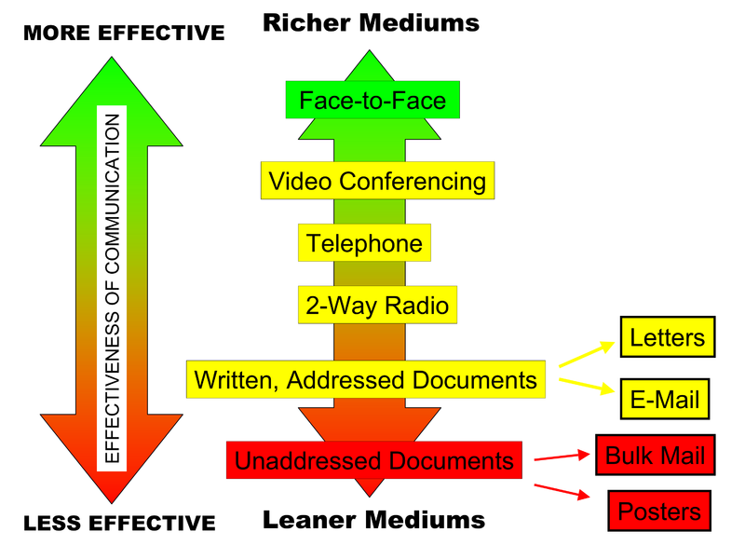
Channels of communication(Lendle-Daft theory)
The three primary channels of communication are:
  Spoken or oral,
  written (in hard copy print or digital versions), and
  Electronic and multimedia.
Communications through these channels can be formal, informal, or unofficial
Based on the Amazon’s case study. Tom should use electronic and multimedia channel of communication due to its richness.
The channel can help Tom communicate with teams from different geographical locations
Different channels of communication have different levels of richness (lumen, 2022)
Notes:
The medium, means, manner, or procedure used to send a message to its intended recipient is referred to as a communication channel. However , communication can be lean or rich according to the Lendle-Draft model channel richness hierarchy (lumen, 2022).
According to the theory of media richness, media can disseminate important information. Whether the information will be utilized in ambiguous or uncertain situations affects how well it may be transmitted. Furthermore, the theory states that the level of information richness varies across various mediums or types of communication. Media assets can thus be rated according to how well they can deal with ambiguity or uncertainty (Sheer, 2020).

Slide 9
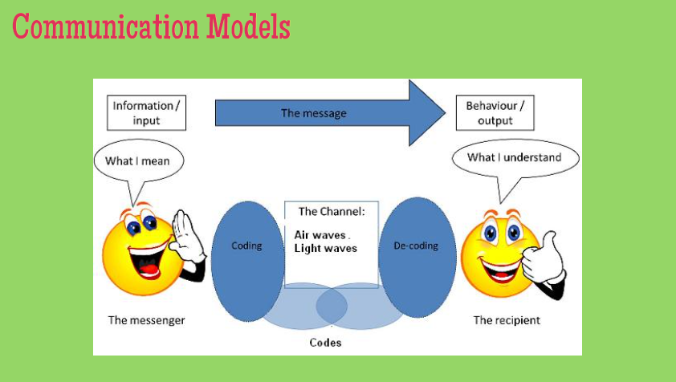

Slide 10
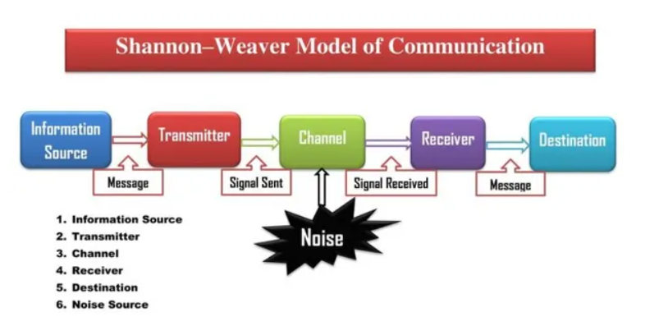
Shannon-Weaver model of communication
Components
  Source of information: Generates messages
  Transmitter: Creates signals from the message through encoding process
  Channel: The medium over which signals are transmitted.
  Receiver: “Decodes" (reconstructs) the message received from the signal
  Destination: The place the message is delivered
  Noise: This component, is a dysfunctional factor. It is the disruption to the message's path through the medium that could cause the signal received to deviate from the signal sent.
Kubota, 2019
Notes:
The Shannon weaver model consists of fundamental components like a source, an encoder, a medium, a decoder, a receiver, and noise. It explains how information travels from a sender to a receiver in a linear method.

Slide 11
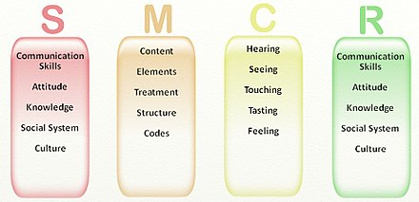
Berlo’s model of communication
Postulates the Sender-Message-Channel-Receiver (SMCR) model of communication.
The factors that affect communication are described at every stage
The model emphasizes encoding and decoding
The 4 components that affect communication are sender, message, channels and receiver.
As indicated, each component is influenced by several factors
Muyanga and Phiri, 2020
Notes:
Based on the Berlo’s model, the source encodes the message for the channel used for intended receiver of the message who decodes it. The source or the sender implies the origin of the message. The source transfers massage with the help of communication skills, attitude, knowledge, culture and social system as indicated by Muyanga and Phiri, (2020). Message involves converting the thoughts into word; a process known as encoding (Schement, 2017). The elements affecting the encoding process of a message are content, treatment, structure and code. Channel denotes the medium and how the information flow from the source to the receiver. This can be acknowledged through hearing the message, smelling or seeing it. When the message is received, the receiver makes an effort to ascertain what the listener is trying to say and then responds appropriately. The process is referred as Decoding.

Slide 12
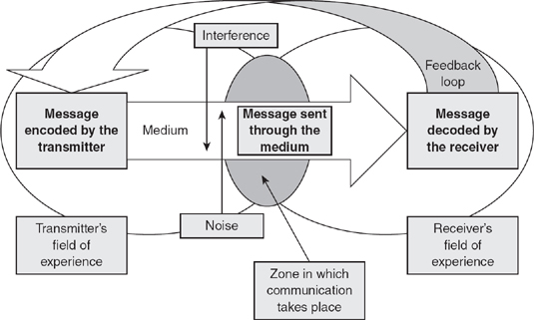
Schramm’s interactive model
The model puts more emphasis on encoding and decoding of the message
The model envisions communication as a 2-way circular communication between the source and receiver
The model expands more on Shannon-Weaver communication model.
Rubtcova and Pavenkov, 2021
Notes:
According to the Schramm model, communication involves a sender (also known as the transmitter) and a receiver. A message and a medium via which the message can be transferred are also present (Rubtcova and Pavenkov, 2021). Although the receiver may have a way to provide feedback on the message to ensure that it has been appropriately received and comprehended noise and interference can impair the message's capacity to be clearly understood.
Because it transforms the notion into information, encoding forms a crucial role in starting the communication process. Decoding is crucial since it aids in message comprehension for the recipient. Communication cannot be considered complete until the sender has heard back from the recipients.

Slide 13

Tom should use the Schramm’s Interactive and Berlo’s SMCR model for the Amazon Project
Berlo’s model: The factors that affect communication are described at every stage
Suitable for Tom’s project due to different time zone, culture, social system and attitude
Schramm’s model covers the feedback loops missing from Berlo’s
Schramm’s model envisions communication as a 2-way circular communication between the source and receiver.
Shannon – Weaver and Berlo’s model both a one - way communication model
Vdovin, 2022.
Notes:
Tom should use the Shannon and Weaver model of communication since it will help him analyze the linear representation of communication. As a result, the model offers him a framework for investigating the transmission and reception of messages in the Amazon team. The model has the capacity to illuminate how the send messages can become muddled and misunderstood between the transmission and reception of the message in the team (Siebers, 2019).
Shannon pointed out that reproducing a message sent from one place to another either perfectly or approximately, is the primary problem of communication (Debra, 2018). With this mathematical theory of communication Tom would be better able to pinpoint the spots where communication is distorted. This model is useful because it provides a thorough explanation of the notion of "noise." It demonstrates information interruption and aides in identifying communication gaps.

Slide 14
Communication barriers that can hinder Tom’s Amazon project team
Demographic barriers such as culture and language
Emotions like lack of trust, job insecurity
Beliefs and Biases
Overload of information
Complexity of the channel of communication used
Notes:
Since the project will be involved in three nations (Britain, France and Germany, demographic aspects like diverse culture between the nations can hinder effective communication. Also, emotions such as fear of job loss and job insecurity can prevent the members from giving their opinions or feedback to the group. When communication is based on mistrust, the members can fail to offer the important details about the project (Kim and Rim, 2019). Overload of information can make the group members miss the important key points about the project.

Slide 15
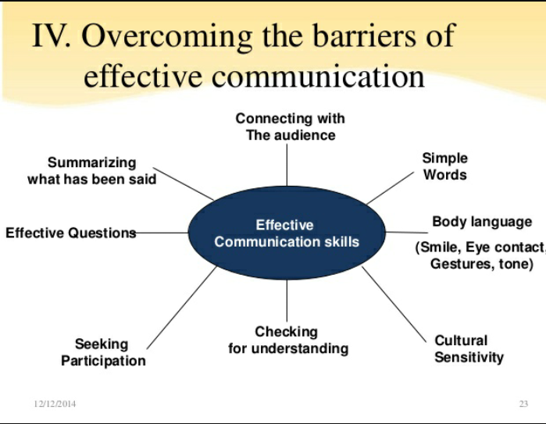
How Amazon can solve the communication barriers
Siddique, 2018.
Notes:
Prior to communication, ideas must first be clarified, and the members of the team must also understand its goal and comprehend the physical and social contexts of communication. The members should also be good listeners where simple terms are used in the communication process. therefore the first rule of communicating with an audience is to summarize any material or information that has been presented while using straightforward language. The cultural diversity and language should be emphasized.

Slide 16
Recommendations for Tom
Keep it real( be transparent)
Be timely- avoid rumours or assumptions
Be consistent( build trust)
Make the messages meaningful
Tailored messages –reinforce it
Use visuals to get points across
Encourage feedback
Empower your team members
Recognize achievement and share success
Create an open work environment
Make time for one to one conversation

Slide 17


Conclusion
Amazon is one of the leading e-commerce business in the global market founded by Jeff Bezoz
Tom Jackson’s Amazon project faced barriers in communicating effectively
Three models of communications and their benefits discussed in this presentation
Recommendations made to Tom Jackson on how to improve effective communication with the team members
Best channels of communication for this project is suggested due to site locations, culture
Face to face meeting highly important, team members can brainstorm, disagree to commit, while sharing their successes

Slide 18
References
Muyanga, C.C. and Phiri, J., 2020. Assessment of Effective Communication in International Schools in Developing Countries Based on the Berlo’s SMCR Model. Open Journal of Business and Management, 9(1), pp.448-459.
Schement, J.R., 2017. Communication and information. Between communication and information, pp.3-33.
Rubtcova, M. and Pavenkov, O., 2021, August. Lasswell and Osgood-Schramm models of mass communication. In the 3rd World Conference on Social Sciences on the (pp. 3-5).
Debra, J., 2018. A Critique of the Shannon-Weaver Theory of Communication and Its Implications for Nursing. Research and Theory for Nursing Practice: An International Journal.
Siebers, J., 2019. Being as communication: an exploratory model. In Models of Communication (pp. 173-184). Routledge.
lumen, 2022. Channels of Business Communication | Principles of Management Available at: https://courses.lumenlearning.com/wm-principlesofmanagement/chapter/channels-of-business-communication/ (accessed 11.11.22).
Sheer, V.C., 2020. Media richness theory. The International Encyclopedia of Media Psychology, pp.1-14.
Vdovin, A., 2022. How to Improve Communication Between Managers and Employees | DeskAlerts Available at: https://www.alert-software.com/blog/how-to-improve-communication-between-managers-and-employees (accessed 11.11.22).
Kim, S. and Rim, H., 2019. The role of public skepticism and distrust in the process of CSR communication. International Journal of Business Communication, p.2329488419866888.
Siddique, S., 2018. Communication barriers: Available at: https://medium.com/@sabasiddique123654/communication-barriers-9466a9042145 (accessed 11.11.22).
Kubota, M., 2019. What is “Communication”?―Beyond the Shannon & Weaver’s Model―. International Journal, 13(1), pp.54-65.
Yuen, E., 2017. 6 Benefits of Effective Communication. Available at: https://whatsupusana.com/2017/02/benefits-effective-communication/ (accessed 11.12.22).

Slide 19
Teamwork Evaluation | Team responses.
Who was in your team? | •Andrew Tolise 2129056 •Esther Akpanmkpuk 2108030 •Marie Mudijike 2126589 •Sarah N'guessan 2127140 •Nimra Malik 2123954
What were the key strengths of your team? | Good research skills Improve time observation Good communication skills
What were the challenges that you overcame as a team? | Agreeing on the best format and structure of the presentation Assessing personal and group learning Locating the relevant research materials
What would you do differently if you worked as a team again? | Group tasks will be divided based on the members strengths
How would you rate your team working? Out of 10? | 7/10

