Slide 1
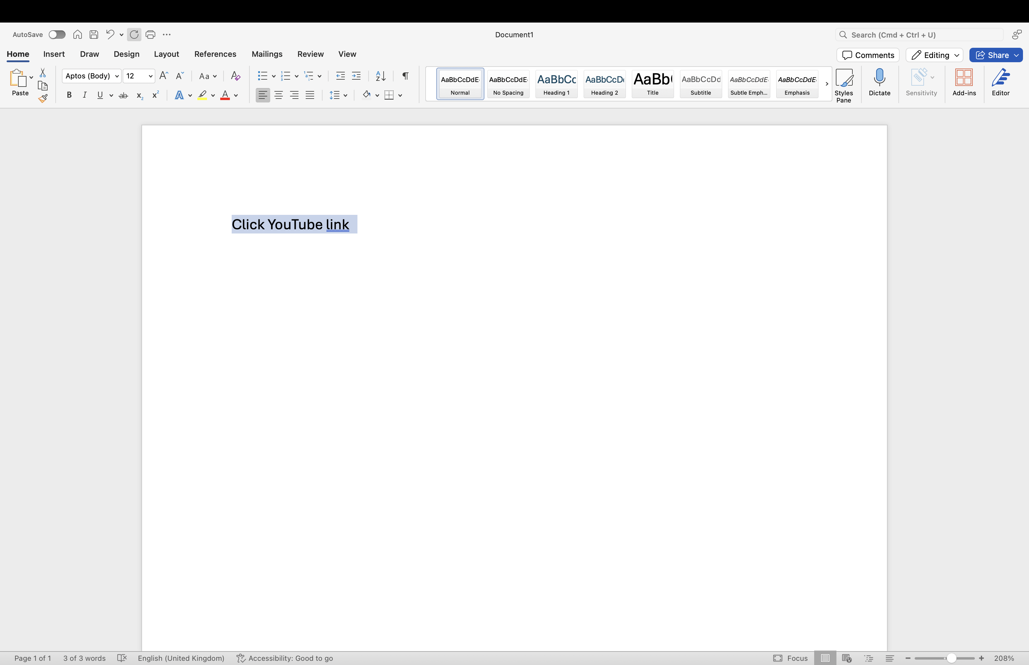
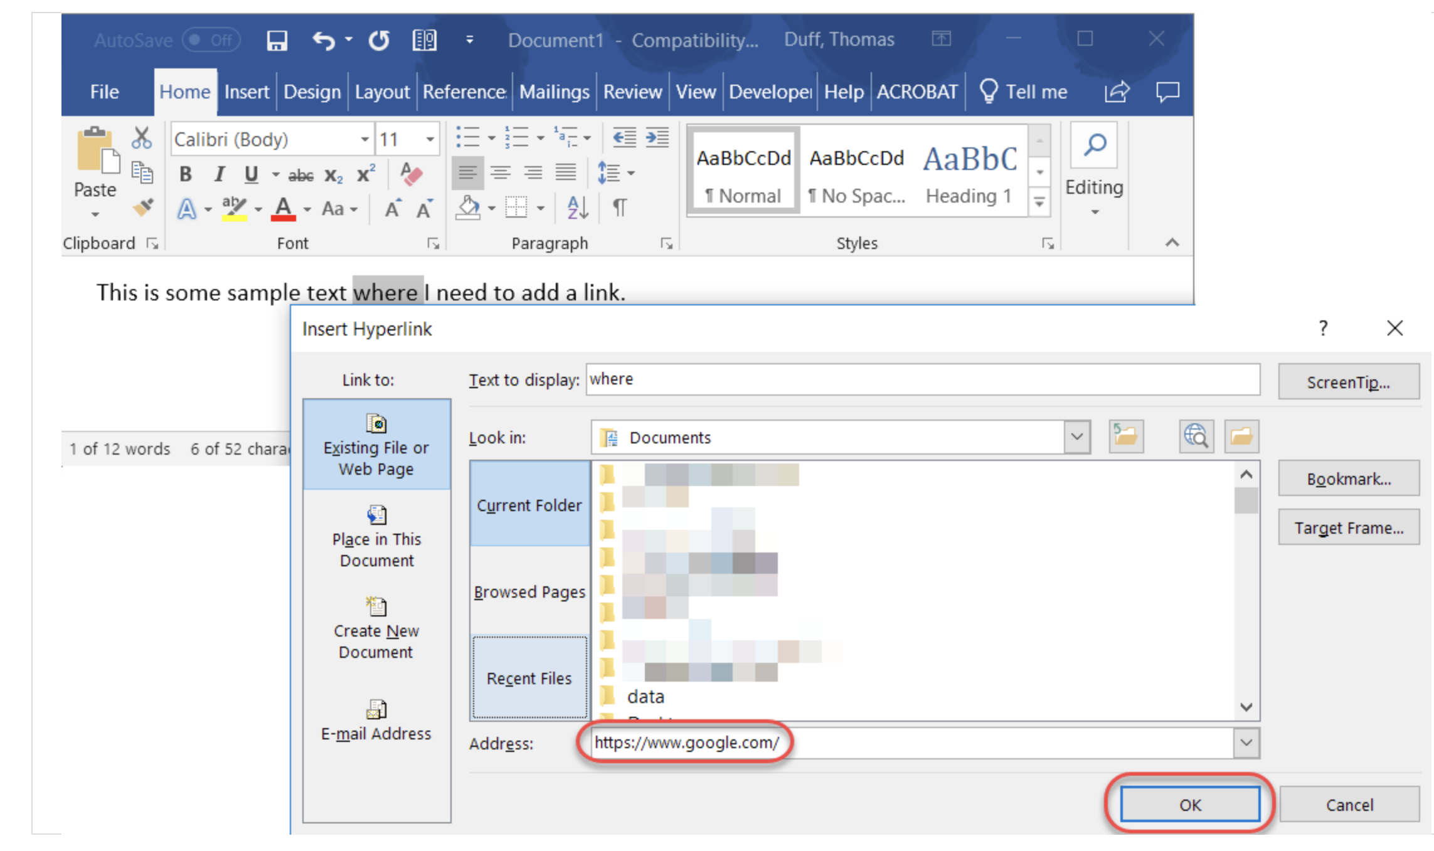
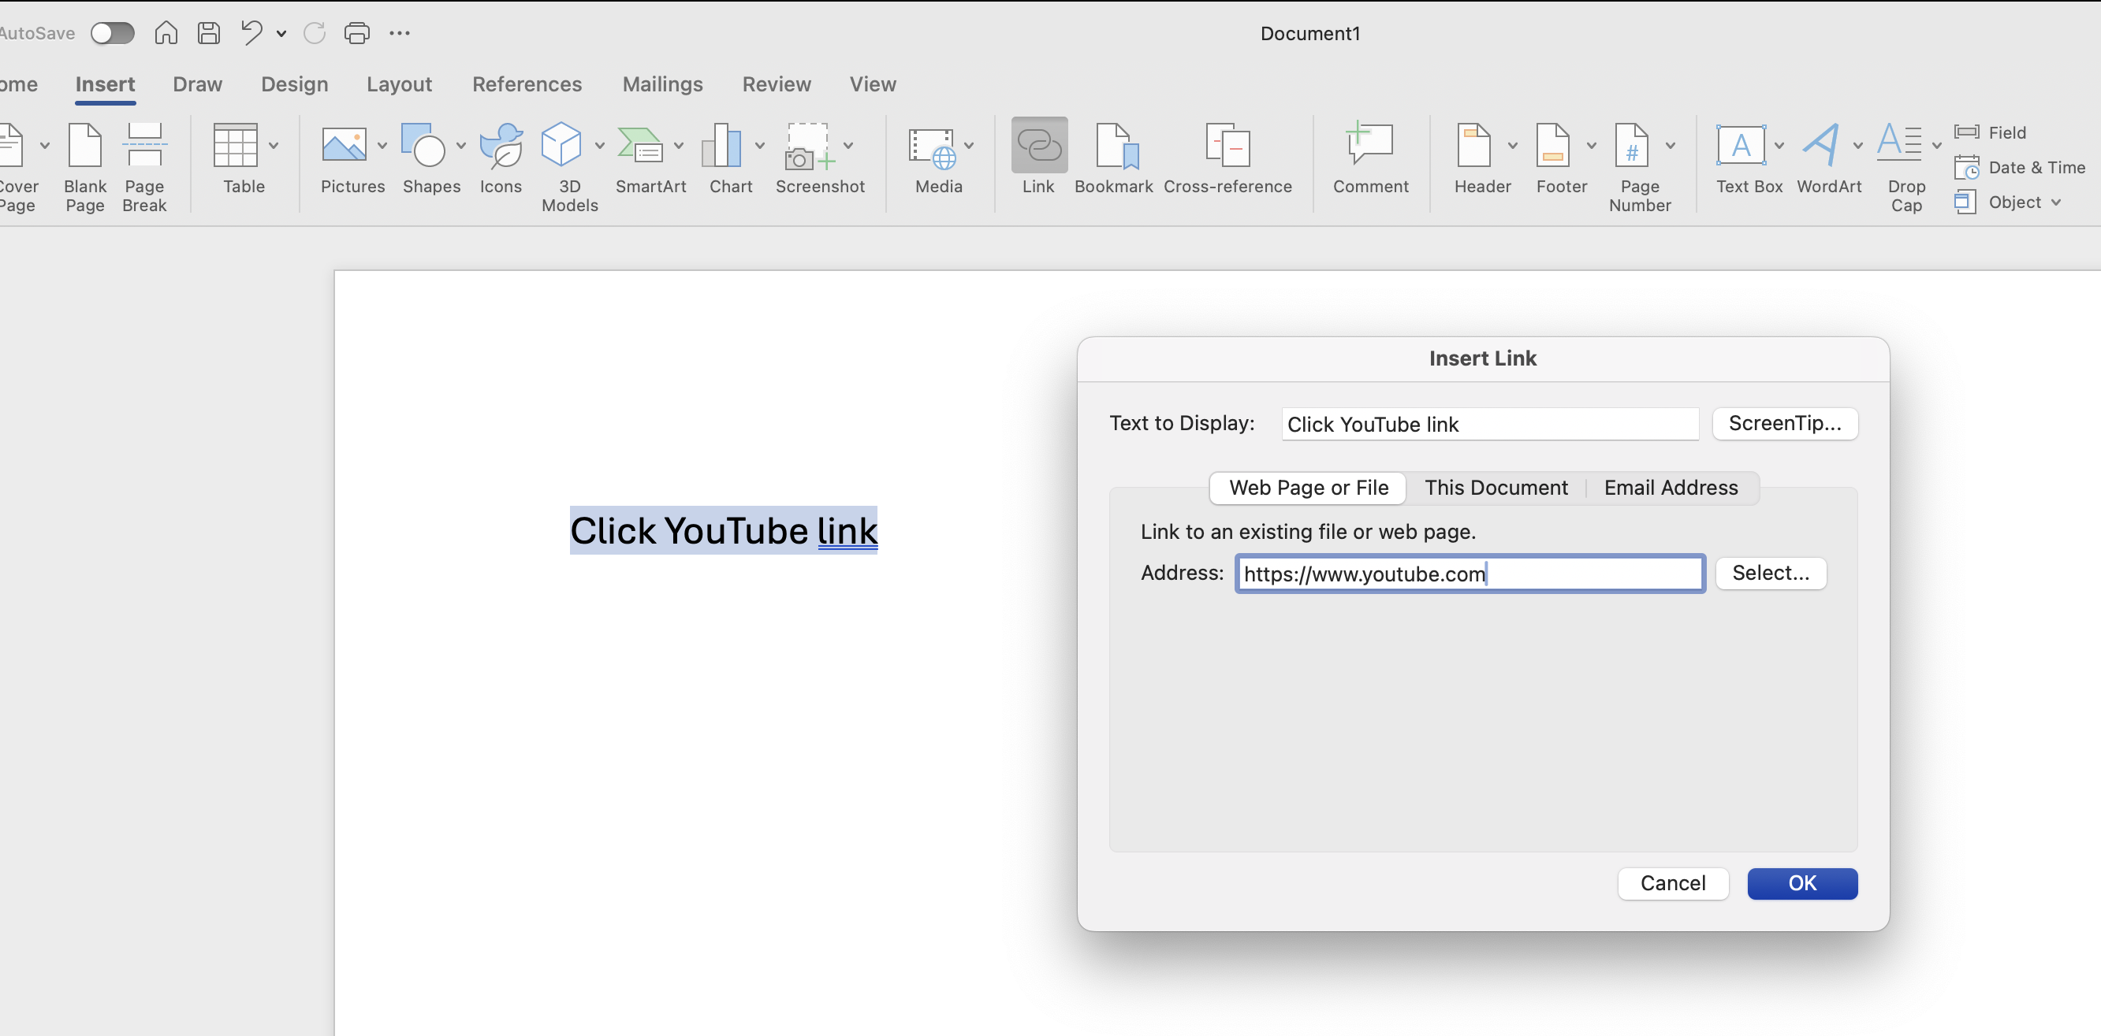

📎 How to Insert a Hyperlink in a Word Document
Step 1: Select Text or Object
Highlight the text or image you want to hyperlink.
Step 2: Open the Hyperlink Dialog
Go to the Insert tab → Click 'Link' or press Ctrl + K.
Step 3: Enter the Hyperlink
Paste or type the URL in the Address field.
Step 4: Click OK and Test
Click OK. Use Ctrl + Click to test the link.
Text with hyperlink should turn blue and be underlined to show the link has been successfully added
.
📘 Summary: Select Text → Insert Tab → Link → Enter URL → OK → Ctrl+Click to Test
💡 Tips:
• Link to websites, emails, bookmarks, or files.
• Example Email Link: mailto:yourname@example.com

