Slide 1
Module name and code
EFFECTIVE TEAM-WORKING AND COMUNICATION
BMSW4009
ASSESSMENT TITLE
Effective Communication Skills in the Workplace
LECTURER: MELANIE SQUIRE
Student ID: 2239816
Student Name: GEORGE MARIN
Date for Submission:30/06/2024

Slide 2
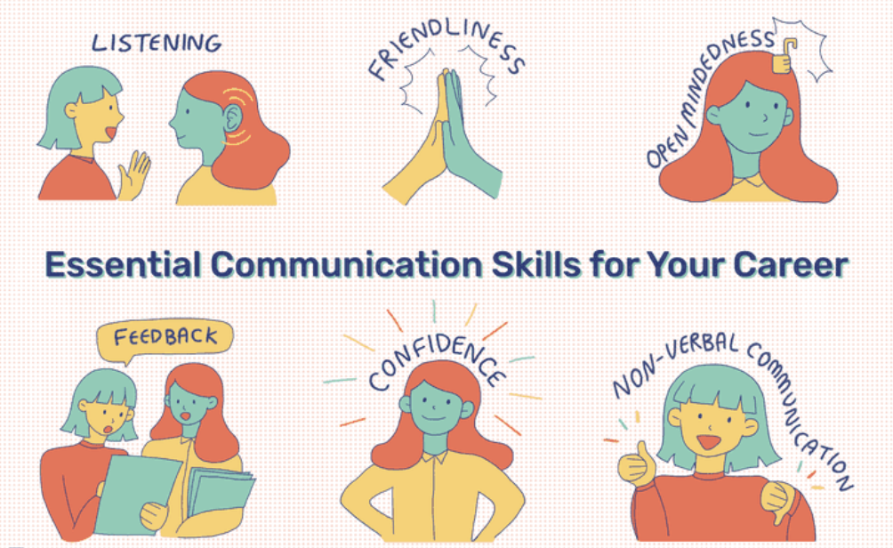
2. Essential Communication Skills
2.1 The Most Effective Communication Skill for Workplace
2.1.1 Active listening: To be a good communicator, one has to be a good listener. With better listening, enhances better understanding, further with a better solution to any problem (Khanna, 2020).
2.1.2 Non-verbal communication: Paying attention to a non-verbal communication through eye contact is the way of involving into the communication (Kapur, 2020).
2.1.3 Empathy: It is the key communication that involves better understanding in building and maintaining healthy relationship (Helens-Hart and Engstrom, 2021).
2.1.4 Clarity in verbal communication: Clarity on the speech, voice, word, and tone while making verbal communication is important to note (Kapur, 2020).
Notes:
Active listening: To be a good communicator, one has to be a good listener. With better listening, enhances better understanding, further with a better solution to any problem (Khanna, 2020).
Non-verbal communication: Paying attention to a non-verbal communication through eye contact is the way of involving into the communication (Kapur, 2020).
Empathy: It is the key communication that involves better understanding in building and maintaining healthy relationship (Helens-Hart and Engstrom, 2021).
Clarity in verbal communication: Clarity on the speech, voice, word, and tone while making verbal communication is important to note (Kapur, 2020).

Slide 3

2.2 Strategies to Improve Communication Skill
Strategies on continuous improvement on enhancing communication skills through deliberate effort and implementation of effective strategies. Few of the key strategies are:
2.2.1 Implementing seamless communication through technology: Implementing technology to its full potential can improve team collaboration significantly (De Grip, 2024).
2.2.2 Constructive feedback: A vital component of good communication is constructive criticism.
2.2.3 Fostering positive team culture: Cultivating effective communication in the culture of teamwork is crucial. When team members feel valued, respected, and included, they are more likely to contribute their ideas and perspectives openly (Kalogiannidis, 2020).
Notes:
Strategies on continuous improvement on enhancing communication skills through deliberate effort and implementation of effective strategies. Few of the key strategies are:
Implementing seamless communication through technology: Implementing technology to its full potential can improve team collaboration significantly (De Grip, 2024). With the help of technology tools, team members can stay connected, efficiently, collaborate on project and overcome communication barriers through real time video communication solution.
Constructive feedback: A vital component of good communication is constructive criticism. Team members can support one another's development and progress by giving each other detailed and useful feedback. Active listening, empathy, and bargaining are three conflict resolution strategies that can assist in resolving conflicts in a productive way and preserving harmony within the team. constructive feedback is highly beneficial for learning, development, and ongoing progress. Teams can improve and become more cohesive by proactively seeking and offering feedback.
Fostering positive team culture: Cultivating effective communication in the culture of teamwork is crucial. When team members feel valued, respected, and included, they are more likely to contribute their ideas and perspectives openly (Kalogiannidis, 2020). A supportive team culture creates a safe space for collaboration, innovation, and synergy.

Slide 4

2.3 Examples and Illustration of each skill with real world scenario
2.3.1 Non-verbal communication
Example: If an employee is looking straight into the eye of some other employee can make the situation uncomfortable.
Notes:
Non-verbal communication
Example: if an employee is looking straight into the eye of some other employee can make the situation uncomfortable.

Slide 5
References
De Grip, A., 2024. The importance of informal learning at work. IZA World of Labor.
Helens-Hart, R. and Engstrom, C., 2021. Empathy as an essential skill for talent development consultants. Journal of Workplace Learning, 33(4), pp.245-258.
Kalogiannidis, S., 2020. Impact of effective business communication on employee performance. European Journal of Business and Management Research, 5(6).
Kapur, R., 2020. Communication skills for workplace success. ResearchGate, November.
Khanna, P., 2020. Techniques and strategies to develop active listening skills: The armour for effective communication across business organizations. The Achievers Journal: Journal of English Language, Literature and Culture, 6(3), pp.50-60.

Slide 6
Thank you

