Slide 1

BMSW4006
Individual presentation Component 1
Managing Enterprise in the 21st Century
Student Number: 2021599
Asmut Price
2nd December 2021
Notes:
Hello everyone. My name is Asmut Price and my student number is 2021599. I will be providing a presentation on my business plan.

Slide 2
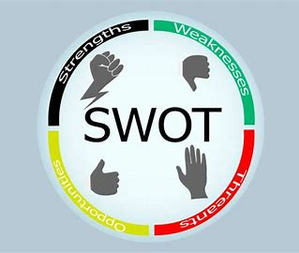
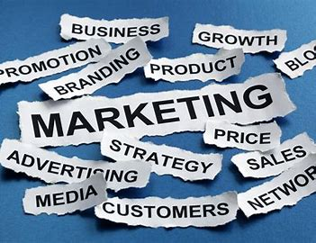

PRESENTATION
OVERVIEW
1 - Overview of business
2 - Sales & Marketing Strategy
3 - Market Research
Overview of Business
Mission Statement
Cash Flow
Goods
Services
Notes:
Presentation overview
Today I will be talking about the 3 main areas of my business plan.
These include:
An overview of the business which will include the mission statement, aims and objectives, summary of cash flow, and, goods and services provided by the business.
The second area will cover the sales and marketing strategy. This will discuss the business card and the use of social media platforms.
The 3rd and final area is the market research that was carried out using primary research methods.
A brief overview of the SWOT analysis will also be provided.

Slide 3

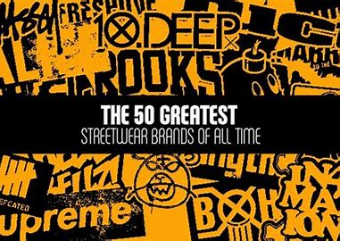
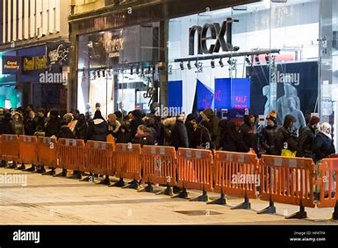



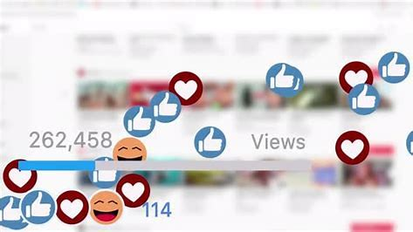
1. Business Overview
Mission Statement
street clothing
trainers
accessories
Offering
designer drops
faster, quicker
easier
followers, influencers, social media
increase variety of products
develop regular client base
develop company’s presence
Notes:
Overview of the business.
A mission statement outlines what services or goods the business provides (Cochran, et al., 2008).
For this business, it is to provide the latest street clothing, trainers and accessories to customers, cutting out the hassle.
The business aim is to become Wales no. 1 choice for designer drops.
Services offered are to provide designer drops, faster, quicker and easier. This business will remove the hassle of waiting online. No disappointment, just browse for the items you want from the ease of your bedroom. After all, who wants to be waiting in any kind of queue?
To achieve the aim of becoming Wales no. 1 choice for designer drops, there are 5 objectives.
Create a PR and marketing plan that targets the age range, 12 – 30-year-olds.
To develop the company’s presence on digital platforms, predominantly through the use of social media on a daily/weekly basis.
Raise the business profile by increasing the number of followers, including influencers, as influencers can help create a “buzz” which can help to increase the number of customers and followers (Brown, 2012).
Develop a regular client base of a minimum of 100 customers.
Increase the variety of products sold.
Goods sold by this business will include designer clothing such as Trapstar, Nike, Adidas and Gucci, to name a few. Items will include hoodies, joggers, jackets, trainers, watches and jewellery.
Cash flow – why is this important? Well, cash flow is the heart of your business as this could determine whether the business “makes or breaks it” (Opiela, 2006).
The cash flow involved in establishing and running this business, at set up, is quite minimal. Setting up social media platforms has no cost implication. To purchase stock to begin trading, will require a financial start up of £1,000. As a small business venture it will be operating as a sole trader. After 6 months trading, a review will take place to ascertain profit, loss, sales and stock take. The business is forecast yielding a profit of XXX after 12 months of trading.

Slide 4





2. Sales & Marketing
5
It’s a means of getting your business out there by sharing information and updating your customers with news about your business (Alan, 2020).
Notes:
The sales and marketing strategy.
Public relations, or PR as its more commonly known, is very important for businesses. It’s a means of getting your business out there by sharing information and updating your customers with news about your business (Alan, 2020).
The marketing strategy needs to have clear and distinctive advertising messages and ensure that it is planned, and it grabs the attention of the customers (Ali & Anwar, 2021). It needs to generate interest and create a buzz, getting potential customers excited about things to come.
This marketing strategy has 5 steps.
Step 1 – the business card – attractive, simple and to the point, detailing the website, the Instagram page and contact details.
Step 2 - a countdown generating interest to encourage followers and recruit customers, which will take place in the lead up to the official launch day.
Step 3 – drip feed information during the countdown period.
Step 4 - the big day arrives and its launch day – as this business will not have a physical location, it is important to take advantage of online platforms (Rabi, 2020). These include social media such as Instagram, Snapchat and Facebook.
One of the events taking place on launch day will include ‘tag a friend’ which consists of, liking a post on the business social media pages, tagging three friends in the post advertising the clothing and share the post on their own page to enter a free draw.
Step 5 - Collaborating with an influencer. The clothing industry views an influencer as a model customer (Dobrinić, 2020). This influencer would need to be a person or page that is popular amongst the age group of people who are being targeted and someone who can conduct an unboxing ceremony which is very popular.

Slide 5
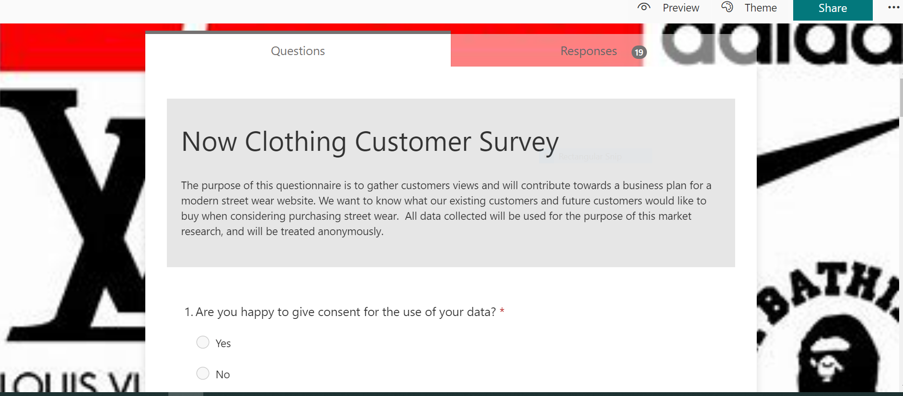
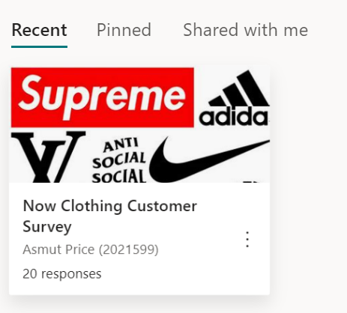
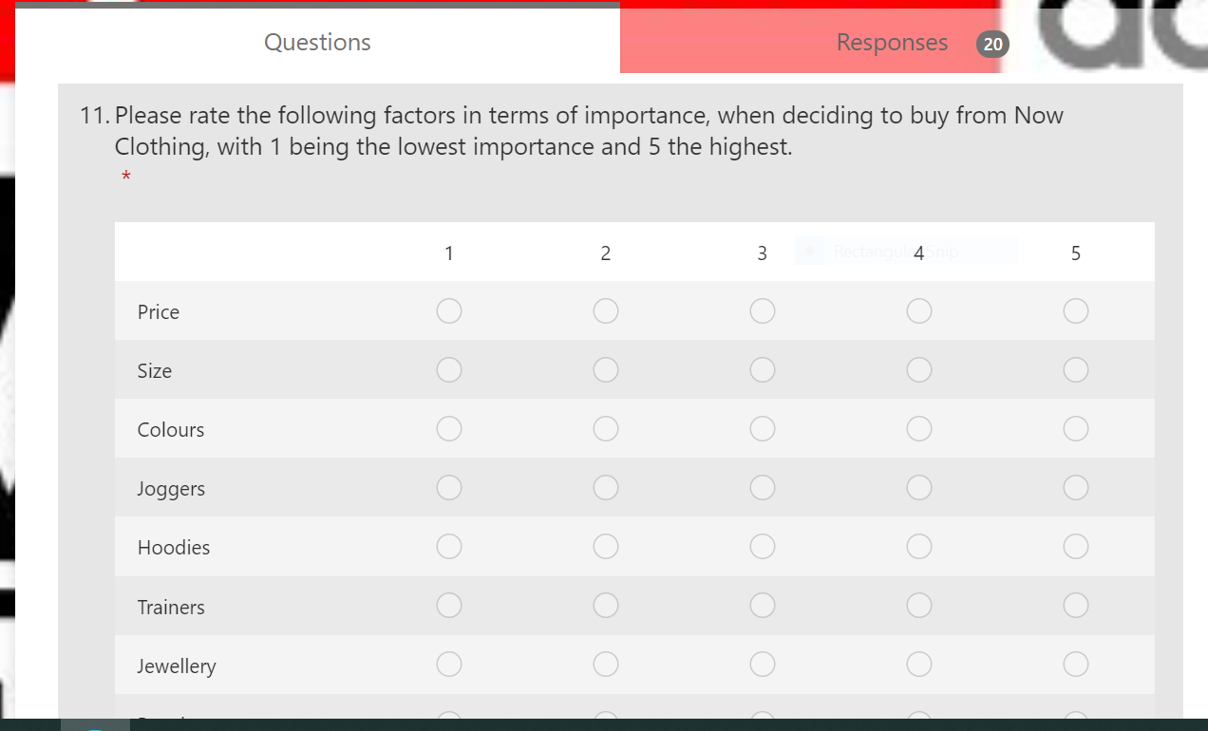
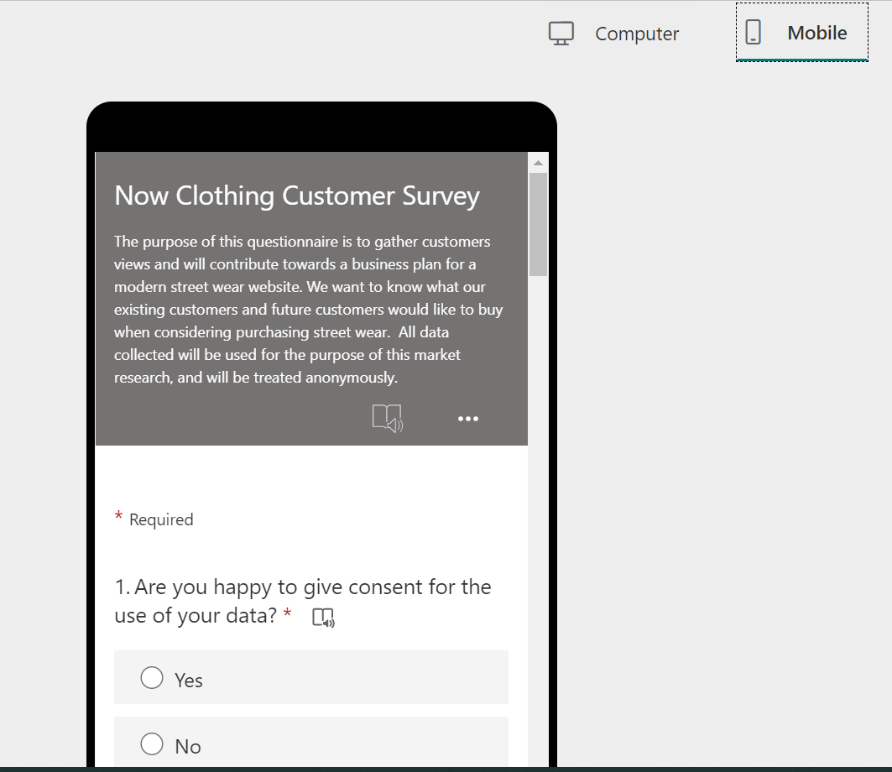
3. Market Research
The Questionnaire
Notes:
Market research is integral for any business. Market research aims to limit risks and is considered normal practice (Hague, et al., 2004). For the purposes of this business plan, market research was conducted using primary research method via quantitative research. Quantitative research focuses on the use of numbers and specific words using closed questions (Cohen, et al., 2000).
As such, a questionnaire was created which consisted of 11 questions.
These questions asked respondents about their age group, gender, location, favourite brands, spend budget and the types of clothing or accessories they were interested in purchasing.
The questionnaire was shared amongst the cohort studying Skills for the Workplace. However, as the response rate remained low, below 10, the questionnaire was then shared amongst family and friends, who ranged between the ages of 14 – 45.
The questionnaire ran for approximately 2 weeks with a total of 20 responses.
Respondents were able to complete the questionnaire using a pc or a mobile device and took an average of 2 minutes to complete.
Internet based surveys and questionnaires are very popular as they can reach a wider audience far quicker than traditional methods (Menon & Muraleedharan, 2020).

Slide 6

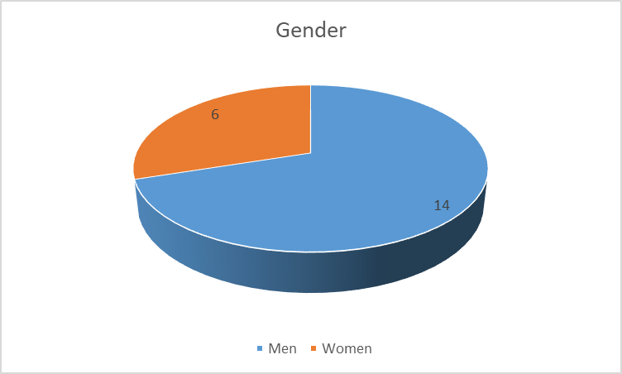
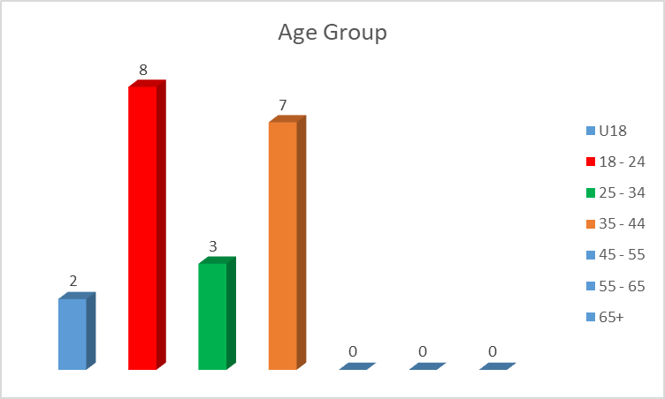
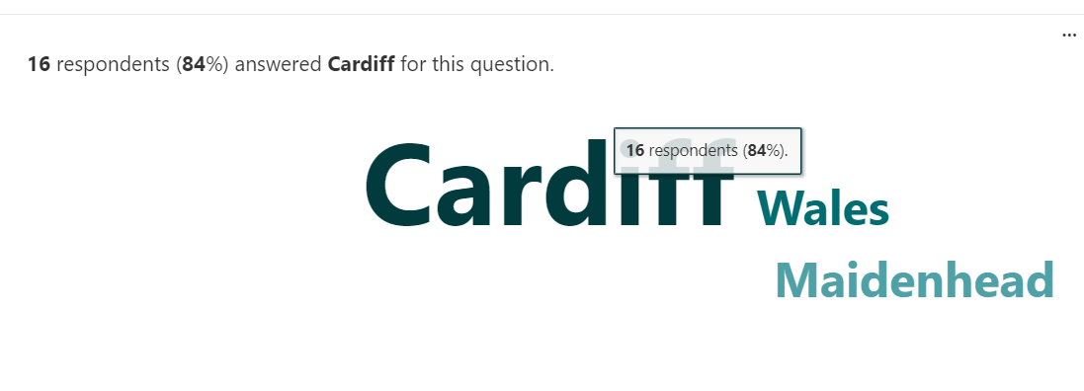
3. Market Research
Information about respondents – About You
Notes:
In line with General Data Protection Regulations, the opening question asked respondents if they consented to the use of their data, broad consent (Hallinan, 2020). 95% of respondents agreed.
The next 3 questions related to information about the respondent, their gender, age group and where they lived.
There were 14 men compared to 6 women.
The most common age group to respond to the questionnaire was 18 – 24, followed by the age group 35 – 44.
Respondents were asked where they lived. 16 respondents stated they lived in Cardiff, with 2 stating they lived in Wales and 1 in Maidenhead.

Slide 7
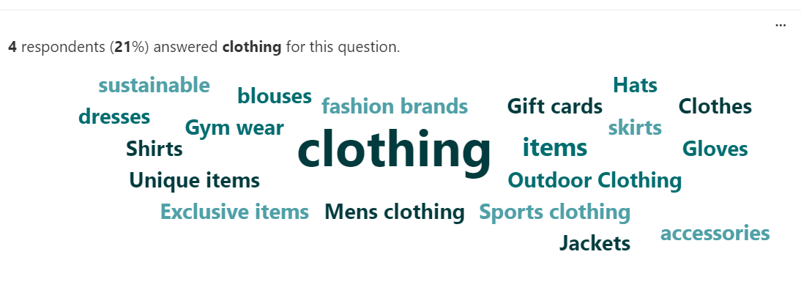
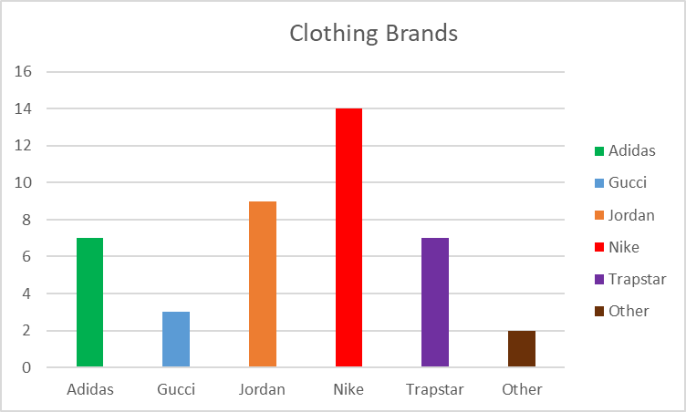
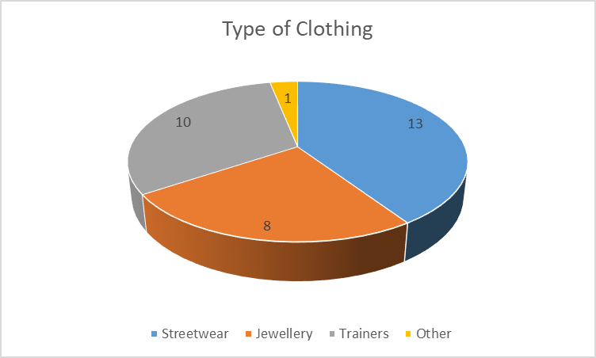
3. Market Research
Interested in
Notes:
The next 2 questions asked the respondents about the type of items they would be interested in purchasing.
When asked about designer brands, the overwhelming favourite was reported as Nike, followed by Jordan, with Trapstar and Adidas in joint 3rd place.
Streetwear was the most popular type of clothing, this included joggers, hoodies, jackets. The second most popular was identified as trainers.
Respondents were asked about what other items they may be interested in purchasing on the website, with clothing being the most sought after.

Slide 8
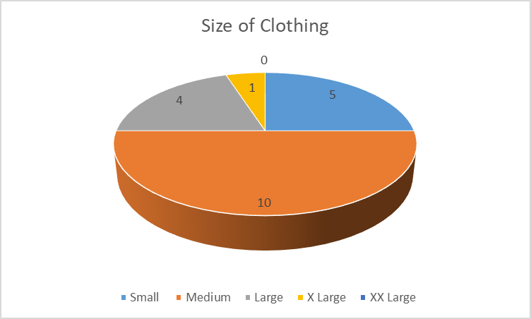
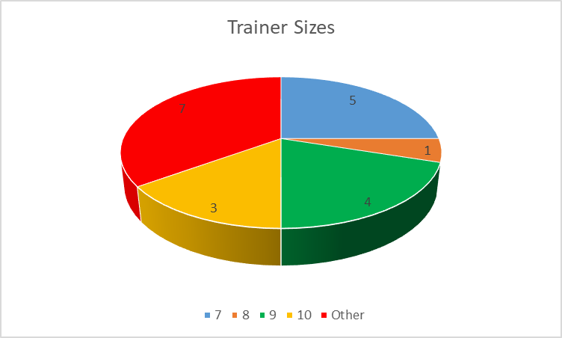
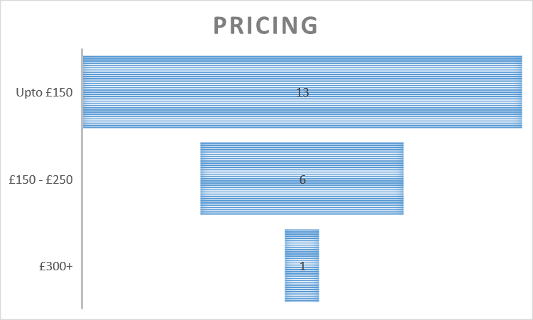
3. Market Research
Sizing
Notes:
With regards sizes in clothing and trainers, the most common size in clothing was found to be medium and in trainers, it was a size 9.
The findings also reported an interest in smaller and larger trainer sizes, smaller than a size 7, and larger than a size 10.
The question asking about prices showed that 13 respondents were content to spend up to £150, with 6 stating they would be prepared to spend between £150 – £250 and only 1 spending in the £300+ range.

Slide 9

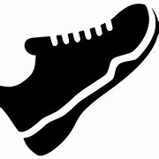

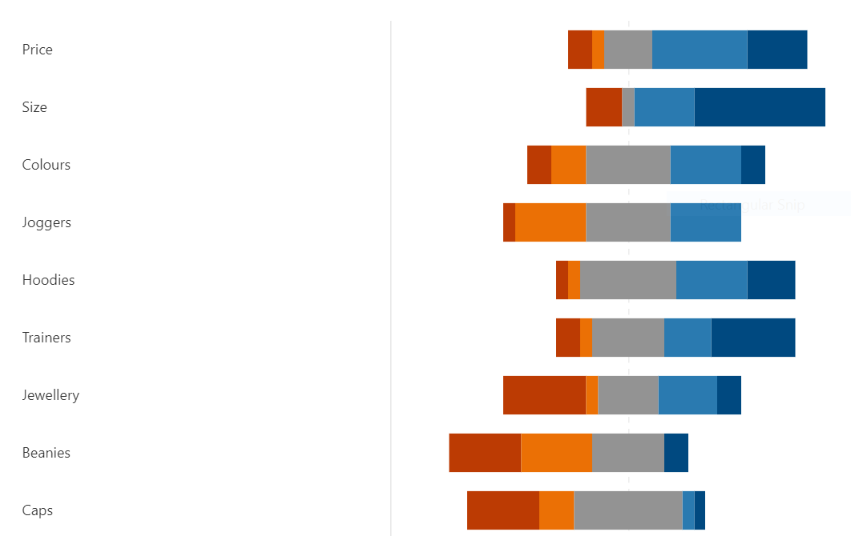

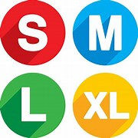
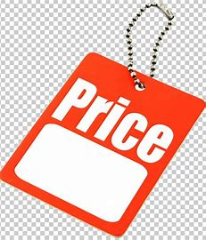
3. Market Research
And finally
Notes:
The final question asked respondents to rate factors in terms of importance, when deciding to buy from Now Clothing, with 1 being the lowest and 5 the highest.
As you can see from the graph, size, trainers and price were the most important factors.
This market research has contributed towards the business plan as it evidenced:
Nike, Jordan and Trapstar are the most popular brands, with streetwear and trainers the most sought after goods.
Size is clearly an important factor and is therefore vital to ensure that the most sought after sizes are available to purchase.
And pricing needs to be pitched at the correct level.
The market research has endorsed the business plan and reinforced the basis of the business.

Slide 10
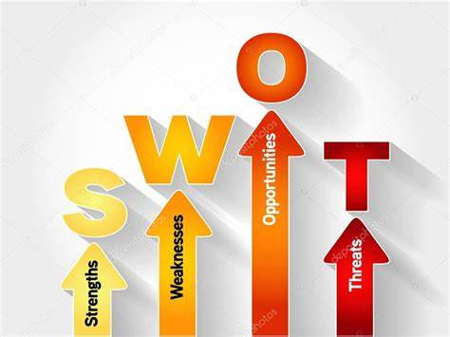
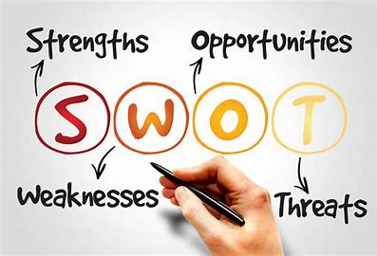
SWOT
STRENGTH
Ease of purchasing
WEAKNESS
Competitors
OPPORTUNITY
Range of stock
THREAT
Too much stock
Notes:
A swot analysis was completed. I have picked 1 point from each of the areas.
Strength – the ease of purchasing – there are no queues, no hassle, it’s simple.
Weakness – any competitors who are selling similar products.
Opportunity – the range of stock, the type of products, colour, sizes and designer brands.
Threat – Purchasing stock but then being unable to sell it, resulting in being left with outdated stock.

Slide 11

And now
3rd December 2021
Wales no. 1 choice for designer drops
Notes:
To summarise, we are on a mission to become Wales number one designer drop and look forward to seeing you at our launch date on 3rd December 2021.

Slide 12
REFERENCES
References
Alan, G. A. E., 2020. New Communication Approaches in the Digitalized World. Newcastle upon Tyne: Cambridge Scholars Publishing.
Ali, B. J. & Anwar, G., 2021. Marketing Strategy: Pricing strategies and its influence on consumer purchasing decision. International journal of Rural Development, Environment and Health Research (, 5(2), pp. 26 - 39.
Brown, E., 2012. Working the Crowd : Social Media Marketing for Business. s.l.:British Informatics Society Limited.
Cochran, D. S., David, F. R. & Gibson, C. K., 2008. A Framework for Developing an Effective Mission Statement. Journal of Business Strategies, 25(2), pp. 27 - 39.
Cohen, L., Manion, L. & Morrison, K., 2000. Research Methods in Education. 5 ed. London: Routledge.
Dobrinić, D., 2020. The Influence of Chatbots on Advertising Campaign Performance. International Journal of Marketing Science, Volume 3, pp. 18 - 34.
Hague, N., Hague, P. N. & Morgan, C.-A., 2004. Market Research in Practice: A Guide to the Basics. London & Sterling: Kogan Page Limited.
Hallinan, D., 2020. Broad consent under the GDPR: an optimistic perspective on a bright future. Life Sciences, Society and Policy, 16(1), pp. 1 - 18.
Menon, V. & Muraleedharan, A., 2020. Internet-based surveys: relevance, methodological considerations and troubleshooting strategies. General Psychiatry, 33(5).
Opiela, N., 2006. Keeping Small-Business Cash Flow on Track. Journal of Financial Planning, 19(7), pp. 26-28,30-32.
Rabi, M., 2020. Social Media Marketing For Online Graphic Clothing Business, s.l.: Bachelor’s thesis.
Notes:
These are the references used. And thanks for listening.

