Slide 1

ECES5015/C
Dod yn Addysgwr Cynradd
Becoming a Primary Educator

Slide 2
Deilliannau Dysgu /
Learning Outcomes
Ar ôl cwblhau’r modwl hwn yn llwyddiannus, dylai’r myfyriwr allu:
Dangos ymwybyddiaeth feirniadol o fframweithiau damcaniaethol allweddol ar gyfer dysgu ac addysgu, a deall sut maent yn sail i fodelau cyfredol o arfer proffesiynol effeithiol.
Upon the successful completion of this module, the student should be able to:
Demonstrate critical awareness of key theoretical frameworks for learning and teaching, and understand how they underpin current models of effective professional practice.

Slide 3
Deilliannau Dysgu/
Learning Outcomes
Nodi ac adfyfyrio’n feirniadol ar gyfrifoldebau, safonau a gwerthoedd proffesiynol mewn addysg.
Identify and critically reflect on professional responsibilities, standards and values in education.

Slide 4
Deilliannau Dysgu
Learning Outcomes
Dadansoddi polisi a gweithdrefnau cyfoes mewn addysg gynradd.
Analyse contemporary policy and procedures in primary education.

Slide 5

Tasg/Task
Gan gyfeirio’n agos at lenyddiaeth, archwiliwch egwyddorion dysgu ac addysgu effeithiol.
With close reference to literature, explore the principles of effective teaching and learning.

Slide 6

Ras yr Wyddor Dysgu ac Addysgu Teaching & Learning Alphabet Race

Slide 7
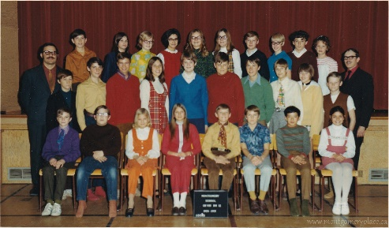
Mae Addysg yn Newid
Education is Changing
Ystyriwch sut mae addysg wedi newid dros y 50 mlwyddyn ddiwethaf.
Sut mae agweddau dysgu ac addysgu wedi newid yn yr amser yna?
Consider how education has changed over the last 50 years.
How have approaches to teaching and learning changed in that time?

Slide 8
Rhai o’r newidiadau…?
Some of the changes…?
Plentyndod – oedolyn – gydol oes;
Athro-ganolog i ddysgwr-ganolog;
Wyneb i wyneb i ddysgu dros bellter;
Addysg i ddysgu;
O’r ychydig i’r llawer;
Rhyddfrydig i alwedigaethol;
Childhood to adult to lifelong;
Teacher-centred to student-centred;
Face-to-face to distance;
Education to learning;
The few to the many;
Liberal to vocational;

Slide 9
Damcaniaethol i’r ymarferol;
Pwnc unigol i drawsbynciol i integreiddiol;
Gwybodaeth fel gwir i wybodaeth berthnasol;
Dysgu trwy ailadrodd i ddysgu adlewyrchol;
Darpariaeth lles (anghenion) i ofynion marchnad (dymuniadau);
Cwricwlwm clasurol i gwricwlwm rhamantaidd i raglen;
Dysgu fel proses i ddysgu fel cynnwys.
Theoretical to practical;
Single discipline knowledge to multi-disciplinary knowledge to integrated knowledge;
Knowledge as truth to knowledge as relative;
Rote learning to reflective learning;
Welfare provision (needs) to market demands (wants);
Classic curriculum to romantic curriculum to programme;
Learning as a process to learning as content.
Jarvis et al

Slide 10
Dyfodol Llwyddianus/CiG2022
Successful Futures/CfW2022
Mae Donaldson (2015) yn cydnabod y cysylltiad agos rhwng deilliannau o safon uchel a dysgu ac addysgu effeithiol.
“Mae’r canlynol, mewn gwahanol ffyrdd, yn cyfrannu at yr elfennau sy’n arwain at addysgu da: arbenigedd mewn pynciau a methodolegau; sgiliau crefft cadarn yn yr ystafell ddosbarth; dealltwriaeth o’r ffactorau cymdeithasol a seicolegol sy’n dylanwadu ar ddysgu; a’r gallu i symbylu ac ysbrydoli plant i ddymuno dysgu ac i ddysgu’n annibynnol.” (Donaldso, 2015, t.63)
Donaldson (2015) identifies the close link between high quality outcomes and effective teaching and learning.
“The elements of good teaching include in various ways: subject and methodological expertise; sound classroom craft skills; an understanding of the social and psychological factors that influence learning; and the ability to excite and inspire children to want to learn and to be able to learn independently.”
(Donaldson, 2015, p63).

Slide 11
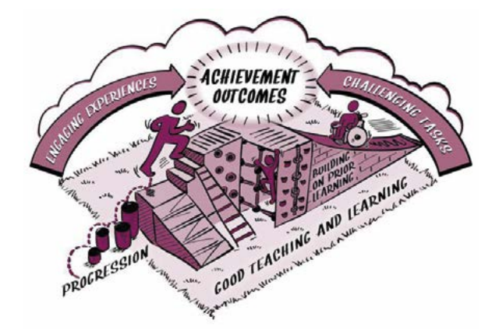
Donaldson, 2015, p66

Slide 12
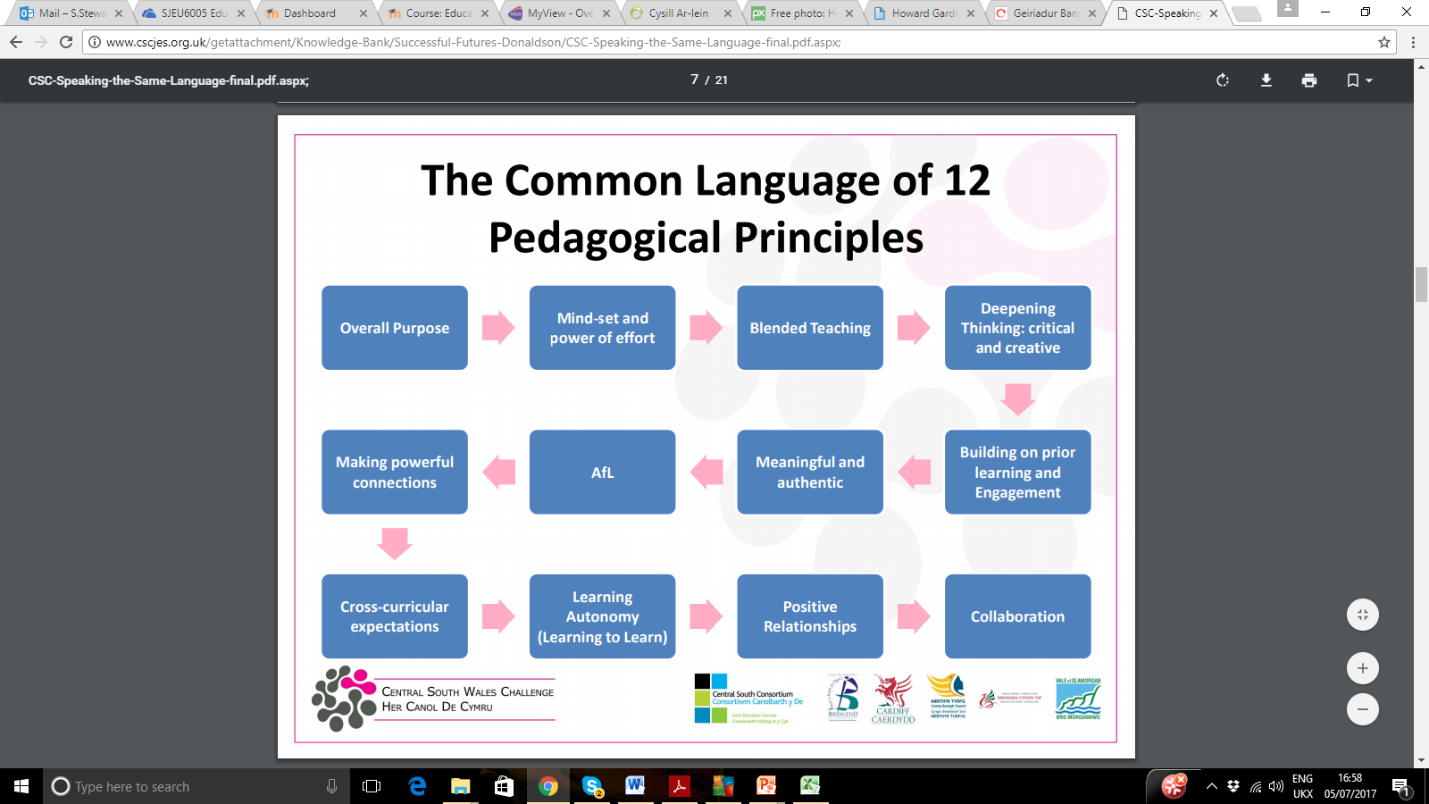
12 Pedagogical Principles
12 Nodwedd Pedagogaidd
Adfyfyriwch ar y 12 nodwedd a chysylltwch i’r hyn a ddysgwyd yn ystod y modiwl/rhaglen.
Reflect on each of the 12 principles and link to what we have learnt during this module/programme.
How many of the 12 pedagogical principles can you guess?
Ceisiwch dyfalu’r 12 nodwedd pedagogaidd!
CSWC, 2016)

Slide 13

Addysgeg ac Asesu
Pedagogy and Assessment
Mae’r perthynas rhwng addysgeg ac asesu hefyd yn rhan ganolog o’r broses dysgu ac addysgu.
‘[assessment for learning] is as relevant to good teaching and learning as it is to assessment’.
This makes clear the integral relationship between pedagogy and assessment, stating that ‘[assessment for learning] is as relevant to good teaching and learning as it is to assessment’.

Slide 14
Rôl Asesiad/The Role of Assessment
Mae Donaldson hefyd yn adnabod rol asesu mewn datblgyu ymarferion dysgu ac addysgu effeithiol.
Yn ogystal â hyn, mae’n helpu dysgwyr i godi safonau a meithrin uchelgais: gall dysgu fod yn effeithiol iawn os rhoddir adborth i ddysgwyr sy’n eu helpu i ystyried materion ac yn rhoi cyfarwyddyd iddynt ar y camau nesaf. Yn yr un modd, mae cydweithio ac adborth rhwng cyfoedion yn gallu creu amgylchedd diogel i gyfleu syniadau a rhoi prawf arnynt.”
Donaldson also identifies the role of assessment in developing effective teaching and learning practices.
“It also helps learners raise standards and nurture ambition: learning can be particularly powerful when learners are given feedback that helps them to think through the issues and provides them with guidance on next steps. Similarly, peer collaboration and feedback can provide a safe environment to articulate and test ideas.”
(Donaldson, 2015, p.68)

Slide 15
Dysgu i Ddysgu
Learning to Learn
“In times of change the learners will inherit the earth, while the knowers will find themselves beautifully equipped to deal with a world that no longer exists.”
Eric Hoffer
Ydych chi’n cytuno? Pam?
Do you agree? Why?

Slide 16

Metawybyddiaeth
Metacognition
Metawybyddiaeth yw pan fydd dysgwyr yn gallu meddwl yn benodol am eu prosesau meddwl a dysgu eu hunain.
Yn cefnogi dysgwyr mewn datblygu strategaethau i hunan-reoli ei gymhelliad ei hun tuag at ddysgu.
Yn fwyaf effeithiol pan ddefnyddir dulliau mwy cydweithredol o ddysgu.
Metacognition is when learners can think explicitly about their own thinking and learning processes.
Supports learners in developing a range of strategies to self-regulate their own motivation for learning.
At its most effective when approaches used are collaborative in nature.
(Education Endowment Foundation, 2017)

Slide 17
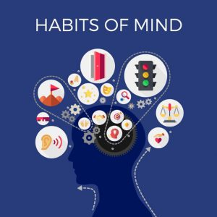

Arferion Meddwl
‘Habits of Mind’
Yr athro Art Costa ‘Habits of Mind’
Adlewyrchwch:
  Ydych chi’n cytuno/anghytuno gyda’r 16 arfer a awgrymir?
  Fyddech chi’n ychwanegu/ dileu urnhyw arferion?
  Adfyfyriwch ar eich dysgu eich hun trwy ystyried yr arferion meddwl?
  I ba raddau mae ymarferion dysgu ac addysgu presennol yn adlewyrchu’r arferion meddwl?
Professor Art Costa on Habits of Mind:
  Clip 1
  Clip 2
Reflect:
  Do you agree/disagree with the 16 habits suggested? Would you add/remove any habits?
  Reflect on your own learning using the habits of mind.
  To what extent do current teaching and learning practices reflect a HoM approach?

Slide 18
Tyfu Arferion Meddwl
Growing Habits of Mind
Mewn parau, trafodwch sut all ymarferwyr ddatblygu rhai o’r 16 arferion meddwl o fewn eu hymarfer:
Chwilfrydedd
Gwydnwch
Cydbwyso’r meddwl rhesymegol gyda dychymyg
Gallu gofyn am gefnogaeth a chymryd beirniadaeth
Gallu meddwl pethau trwyddo – bod yn adfyfyriol
  Costa a Kallick, 2008
With a partner, discuss how a practitioner could develop some of the 16 habits of mind within their practice:
Curiosity
Resilience
Balancing the logical mind with imagination
Being able to ask for help and take criticism
Being able to think things through – being reflective
Costa and Kallick, 2008

Slide 19

‘Building Learning Power’ (BLP)
From the ICE age to the ACE age…
Instruction Agility
Comprehension Capability
Examination Empowerment
(Claxton, 2014)

Slide 20
Dysgwyr Pwerus…
Powerful learners…
…are curious
…have courage
…are good at exploration and investigation
…require the freedom for experimentation
…have imagination
…know that the creativity of imagination needs to be yoked to discipline
…know the virtue of sociability
…are reflective
(Claxton, 2011)
Beth petai addysgu yn dilyn y model yma hefyd?
What if teaching followed this model too?

Slide 21
Building Learning Power
“This approach does not mean chucking out the content. The teacher just needs to develop a ”split-screen” way of thinking. On the left hand is the content; learning about relative clauses, estimating or the properties of potassium. On the right is today’s learning to learn objective; persisting with difficulty; self evaluation or critical thinking.” (Claxton, 2011)
Four R’s
Reciprocity/Resourcefulness/Resilience/ReflectivenessDwyochredd / Dyfeisgarwch / Gwydnwch / Myfyrdod

Slide 22
Defnydd yn yr Ysgol Cynradd
BLP in the Primary School
Dyma rhai esiamplau o sut mae ysgolion wedi defnyddio’r dull BLP.
Beth yw’r manteision ac anfanteision posibl o’r dull hwn?
Here are some examples of how schools have used the BLP approach:
  Example 1
What are the benefits and possible drawbacks of the approach?

Slide 23

Y Ddeuoliaeth Ffug/
The False Dichotomy
Wrth ganolbwyntio ar sgiliau, mae’n bwysig i beidio anghofio pwysigrwydd gwybodaeth hefyd.
Mae Donaldson (2015) yn dadlau bod hyn wedi bod yn ddeuoliaeth ffug o fewn ysgolion am rhy hir.
In focussing on skills, it’s important not to forget about the importance of knowledge too.
Donaldson (2015) suggests that this has been a false dichotomy in schools for too long.

Slide 24

Dysgu Cydweithredol
Collaborative Learning
Rhan annatod o ddull dysgu i ddysgu yw’r angen am gydweithrediad.
Pa ddamcaniaethau dysgu eraill sy'n cadarnhau pwysigrwydd yr agwedd gymdeithasol o ddysgu?
At the heart of a learning to learn approach is the need for collaboration.
What other learning theories confirm the importance of the social aspect of learning?

Slide 25
Jig-so
Jigsaw
Sut ydych chi yn diffinio dysgu cydweithredol?
How do you define collaborative learning?
15 gair/words
Trafodaeth Grŵp
Group Discussion
Mewn sefyllfa ddysgu gydweithredol mae disgyblion yn asiantau gweithredol.
Mewn amgylcheddau dysgu cydweithredol mae myfyrwyr:
gweithio'n aml fel tîm
mynd ati i ddatrys problemau ystyrlon
arddangos eu dysgu'n gyhoeddus
myfyrio ar yr hyn y maent yn ei ddysgu ac yn ei wneud
cymhwyso meini prawf ansawdd i'w gwaith
cymryd cyfrifoldeb am eu dysgu a'u perchenogaeth.
In a collaborative learning situation pupils are active agents.
In collaborative learning environments students:
frequently work as a team
actively solve meaningful problems
publicly exhibit their learning
reflect on what they are learning and doing
apply quality criteria to their work
take responsibility for and ownership of their learning.
Deilliannau Tȋm
Team Outcomes
Meddwl-Paru-Rhannu
Think-Pair-Share
'In classrooms where a sense of community is built, students are the crew not the passengers.'
Watkins, 2005

Slide 26

Nid gwaith grŵp yn unig…
Not just group work…
Beth yw’r gwahaniaeth rhwng gwaith grŵp a dysgu cydweithredol?
What’s the difference between co-operative group work and collaborative learning?
https://www.bing.com/videos/riverview/relatedvideo?q=What%e2%80%99s+the+difference+between+co-operative+group+work+and+collaborative+learning%3f&mid=0857011438B59D01A0660857011438B59D01A066&FORM=VIRE

Slide 27
Top tips for Teachers…
Tips top ar gyfer Athrawon…
'If individualistic learning dominates your classroom, your students will behave accordingly, even if you put them temporarily into cooperative groups.'
Johnson, Johnson and Holubec (ASCD 1994)
Y risg o grwpiau dysgu ffug
'If individualistic learning dominates your classroom, your students will behave accordingly, even if you put them temporarily into cooperative groups.'
Johnson, Johnson and Holubec (ASCD 1994)
The risk of Pseudo-Learning Groups

Slide 28

Yn y dosbarth cydweithredol…
In the collaborative class…
Llai o angen i athrawon reoli.
Mae’r nodau’n wahanol.
Mae cynorthwyo pobl ifanc i weithio a dysgu yn dda gyda’i gilydd yn dod yn nod bwysig yn ei hunan.
Mewn nifer o ddosbarthiadau, mae angen newid y nodau sylfaenol, er enghraifft:
  i greu cymuned ddysgu
  i wella’n dealltwriaeth gyda’n gilydd
  i gynorthwyo ein gilydd i ddysgu
  i ddysgu sut i ddysgu gyda’n gilydd.
Mae angen addysgu sgiliau newydd i’n disgyblion.
Teachers need to control less.
The goals are different.
Helping young people to work and learn well together becomes an important aim in itself.
In many classrooms, the underpinning goals must change, for example:
  to create a learning community
  to improve our knowledge together
  to help each other learn
  to learn how to learn together.
Students need to be taught new skills.
Watkins, 2005

Slide 29
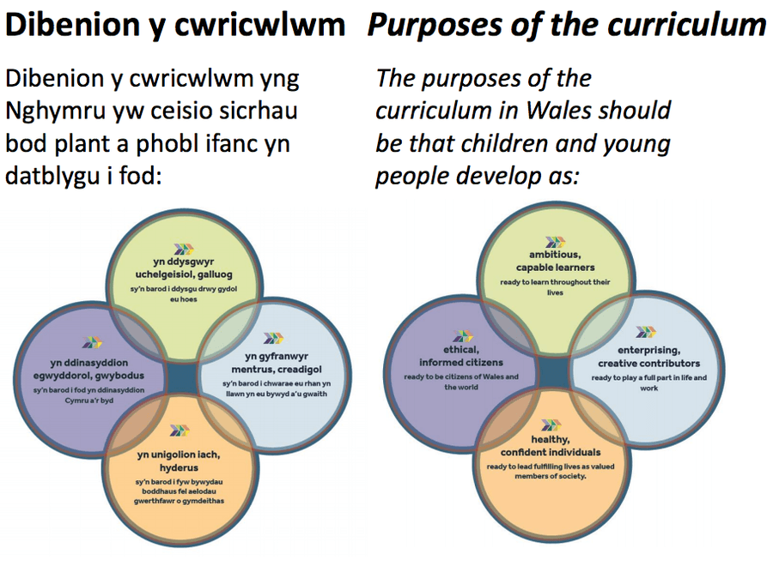
Pedwar diben y cwricwlwm /
Four 4 purposes of the curriculum

Slide 30
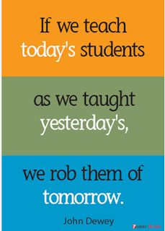
Diamond 9 Activity
Gweithgaredd Trefnu 9

Slide 31
Reference List
Rhestr Cyfeirnodi
Claxton, G. (2011) The learning powered school : pioneering 21st century education, Bristol: TLO Limited.
Education Endowment Foundation (2017) Metacognition and Self-Regulation, Available at: https://educationendowmentfoundation.org.uk/resources/teaching-learning-toolkit/meta-cognition-and-self-regulation/
Donaldson, G. (2015) Successful Futures, Cardiff: Welsh Government.
Kosta, K. & Kallick, B. (2008) Learning and leading with habits of mind : 16 essential characteristics for success, Alexandria: ASCD.
Watkins, C. (2005), Classrooms as Learning Communities: what's in it for schools, London: Routledge.

