Slide 1
Research for a Dissertation
Business Research Methods

Slide 2

Why
An undergraduate degree is evidence that the holder has a general knowledge of the named subject area
A Master’s degree is normally a postgraduate qualification, indicating that the holder has advanced knowledge of the named subject area.

Slide 3
Research Stages
Introduction
Literature Review
Methodology
Conclusion
Analysis
Findings

Slide 4
The Structure of a Dissertation
Title Page
Abstract
Table of Contents
Introduction
Background (if required)
Literature Review
Methodology
Findings: Presentation and Analysis
Discussion
Conclusions and Critical Reflection
Recommendations (if required)

Slide 5
Literature Review
Business Research Methods

Slide 6
The Contents of Week 2
Topic 1: The Role of Literature Review
Topic 2: The Strategy of Literature Review: narrowing down
Topic 3: The Tool of Literature Review: interrogate a paper (Zetoro)

Slide 7
What is a literature review?
An overview of published and unpublished materials which help answer two fundamental questions:
1. What are the current theoretical or policy issues and debates related to your topic?
2. What is the current state of knowledge about these issues and problems?

Slide 8
What is the Role of a Literature Review?
“The ‘literature’ is what is already known, and written down, relevant to your research project.”
(Robson & McCartan, 2016, p.52)
So, what is the role of Literature Review?

Slide 9

The “Landscape”of a subject
Understanding what the landscape looks like helps us identify which bit we want to explore in more depth

Slide 10
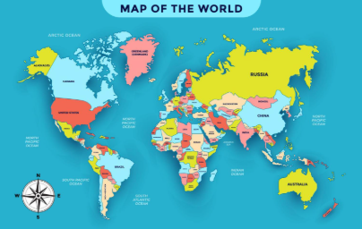
The Map of Your Research
Imagine you are an explorer setting out to find a new island (Your Research). Before you buy a boat, what is the first thing you do? You check the map. The Literature Review is your Map. It tells you:
Where others have already been (Existing Knowledge).
Where the "dead ends" are (Failed Theories).
Where the "blank spaces" are ( The Research Gap).
Many students skip this and just start writing. That is like sailing without a map. You might “discover” America, only to find out Columbus was there 500 years ago.
The Literature Review saves you from reinventing the wheel.

Slide 11

The "Wall" of Knowledge
Every article you read is a brick laid by a previous researcher. Your job is not to stare at the wall. Your job is to find the missing brick (The Gap).
Your Research Proposal: It is the promise to manufacture that one specific brick to fill the hole.
This is the difference between undergraduate and postgraduate. Undergraduates describe the wall. Masters students add to the wall. You cannot add to it until you know where the holes are.

Slide 12
What a Literature Review is
It is NOT: A summary of every book you have ever read.
It is NOT: A "Shopping List" (Smith said this, Jones said that...).
It is: A Critical Argument.
It argues why your research topic is necessary.
It proves that the current answers are insufficient.

Slide 13
The 4 C's Checklist
To understand the "Landscape" of your topic, look for these four things:
Concepts: What are the key theories? (e.g., Motivation, Leadership).
Contexts: Where has this been studied? (e.g., Mostly in the USA? Mostly in tech?).
Controversies: Where do authors disagree? (The "Fight").
Cunae (Gaps): What is missing? (The "Silence").
When you read, don't just read for facts. Read for the 4 Cs. If you find a Controversy (authors arguing), that is gold. If you find a Gap (silence), that is your research question.

Slide 14
QUIZ
1. Which of the following statements describes a Level 7 (Master's) Literature Review?"
A) "A summary of every single book I have read on the topic, listed one by one."
B) "A descriptive list of facts about the company I am studying."
C) "A critical argument that maps the existing theories to identify what is missing."
D) "A collection of quotes from famous people."
2. Read the text below. Which of the 4 Cs has the student identified here?"
'While traditional motivation theories (Maslow, Herzberg) argue that salary is a hygiene factor, recent studies by Pink (2018) argue that autonomy is the primary driver. There is a fierce debate in the literature regarding which factor is more dominant for Gen Z employees.'
A) Context (Where it is happening)
B) Controversy (The fight/disagreement)
C) Concept (The definition)
D) Cunae (The gap/silence)

Slide 15
3. A student proposes the following Research Question based on a “Gap” they found in the literature. Why is this specific project likely to receive a low grade despite being 'original'?
The Proposal: "While Transformational Leadership has been widely studied in large corporations, NGOs, and the military, there is currently no specific research regarding its impact on local neighbourhood knitting clubs. Therefore, I will investigate this gap."
A) Because knitting clubs are too small to gather statistically significant data.
B) Because there is no theoretical justification to expect that leadership dynamics in a knitting club would be fundamentally different from other small voluntary groups (It is a 'Trivial Gap').
C) Because knitting is not a business topic, so it cannot be studied in a Business School.
D) Because it is impossible to measure 'performance' in a knitting club.

Slide 16
Topic 2: The Strategy: How We Narrow Down

Slide 17
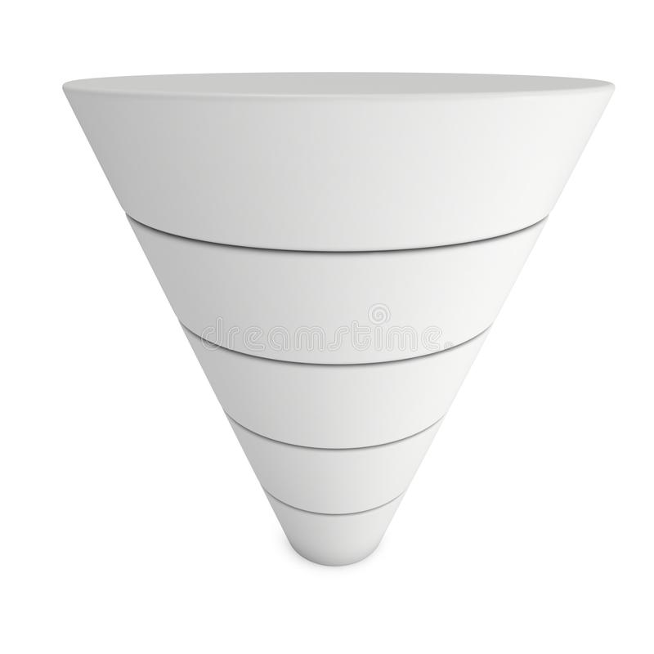
The Research Funnel
Initial Subject Idea
Research Questions

Slide 18
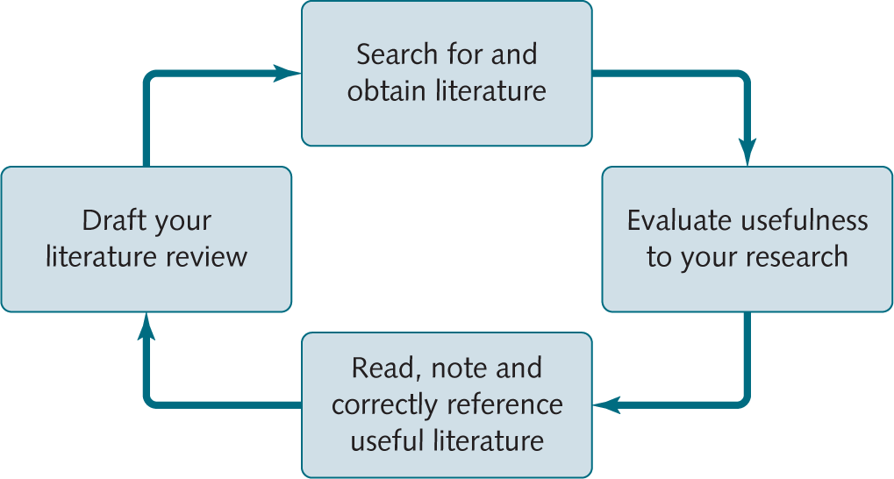
The process of critically reviewing the literature
(Saunders & Lewis, 2018)

Slide 19
The Specific Steps to Research Questions
Step 1: Dinner Parties
Step 2: The "Gap" Classifications
Step 3: The Research Questions: You write a question designed specifically to fill that gap.

Slide 20
1. The Dinner Party: Moving from List to Debate
Don't treat authors like a roll call. Treat them like guests at a dinner party.
Imagine Smith (2020) and Jones (2021) are at a table. Smith says remote work is great. Jones says it destroys culture. Your job is not to repeat them, but to chair the debate.

Slide 21
Your job is not to repeat them, but to chair the debate.

Slide 22
Is This a Good Literature Review?
Smith (2021) conducted a survey of 500 tech workers in London. He found that working from home increased individual task speed by 15%. He argues that this is because there are fewer distractions at home than in an open-plan office. Jones (2022) also researched remote working but focused on creative teams. She found that innovation dropped by 20% over a six-month period. She states that employees missed the 'watercooler moments' where ideas are shared informally. Brown (2023) looked at mental health in remote workers. He found that 40% of staff felt lonely. He suggests that managers should check in more often.

Slide 23
Why is this a fail?
Structure: It is just a list of summaries (Para 1 = Smith, Para 2 = Jones, Para 3 = Brown).
No Conversation: The authors are isolated. Smith doesn't "talk" to Jones.
No Critical Voice: The student is just a reporter, not a researcher.

Slide 24
The "Good" Version
There is a significant conflict in the literature regarding the definition of 'performance'. While Smith (2021) argues that remote working boosts task efficiency by removing office distractions, Jones (2022) counters that this comes at the cost of creative innovation, noting a 20% drop in idea generation. This suggests that while employees may work faster at home (Smith, 2021), they may work less effectively on complex problems due to professional isolation (Brown, 2023; Jones, 2022).
Why is this Level 7?
Thematic: It groups ideas (Efficiency vs. Innovation).
Synthesised: It uses bridge words (While, Counters, This suggests).
Critical: It identifies a conflict in the definition of "performance."

Slide 25
A list of "Connector Verbs"
To Agree: Supports, corroborates, aligns with, reinforces.
To Disagree: Challenges, refutes, counters, contradicts.
To Add Nuance: Expands upon, qualifies, extends, mediates.

Slide 26
Quizs
1. In the 'Dinner Party' metaphor for a Literature Review, what is your primary role as the researcher?"
A) To strictly record what every guest ordered (Describe each study in detail).
B) To ensure every guest agrees with each other (Remove contradictory studies).
C) To host and facilitate a conversation between the guests (Synthesise and debate).
D) To silence the guests and only speak yourself (Ignore references).
2. Read the following paragraph. Which common Literature Review error does it demonstrate?
Brown (2019) says that AI improves efficiency. Green (2020) states that AI reduces costs. White (2021) argues that AI creates new jobs.
A) The "Golden Thread" Error
B) The "Shopping List” Error
C) The "Critical Bias" Error
D) The "Lack of References" Error

Slide 27
3. The Task
Below are two findings from different authors regarding Social Media Marketing. Your job is to write ONE single sentence that synthesises them into a critical debate.
Author 1 (Lee, 2022): "Influencer marketing has a higher ROI than traditional ads because younger consumers trust personalities over brands."
Author 2 (Gomez, 2023): "The rising number of 'fake influencers' and paid bots has led to a 15% drop in consumer trust regarding influencer endorsements."

Slide 28
Instructions:
Identify the relationship (Do they agree? Disagree? Add nuance?).
Choose a connector verb/phrase (e.g., While, Challenges, Complicates).
Write your synthesized sentence.
Sample: While Lee (2022) argues that influencer marketing drives high ROI due to perceived trust, Gomez (2023) complicates this view, noting that the recent rise of 'fake influencers' is actually causing a significant decline in that very trust.

Slide 29
2. The "Gap" Classifications
one-sentence summary: identify what is missing.
Visual List:
The Evidence Gap: "We have theory, but no data."
The Context Gap: "This works in the US, but does it work in the UK?"
The Time Gap: "This research is from 2010 (Pre-COVID). Is it still true?"

Slide 30
3. The Research Questions
You write a question designed specifically to fill that gap.
Key Takeaway: Your Research Question is not an invention; it is a logical conclusion. It is the missing piece of the puzzle that you have identified.

Slide 31
Worked Example (The "Golden Thread")
1. The Dinner Party (Synthesis):
Current literature is divided. While Smith (2021) argues remote work improves individual productivity, Jones (2022) highlights a decline in team innovation. However, most studies focus on senior managers.
2. The Identification of the Gap:
There is a distinct lack of research regarding junior employees (The Population Gap), who rely on office mentorship for skill acquisition (The Conceptual Gap).
3. The Leading Research Question:
To what extent does remote working impact the skill acquisition of junior graduates in UK marketing firms?

Slide 32
Quiz
1. Read the following summary of the literature. What specific type of research gap has been identified?
Existing studies (Jones, 2020; Smith, 2021) have extensively documented the positive impact of AI on efficiency in large multinational corporations. However, there is a distinct lack of empirical evidence regarding how these technologies impact small family-owned businesses in rural areas.
A) The Methodological Gap (We need a different research tool)
B) The Population/Context Gap (We need to look at a different group or setting)
C) The Time Gap (The research is too old)
D) The Theoretical Gap (The theory is wrong)
2. You have identified a “Methodological Gap”: Previous research on burnout has relied entirely on quantitative surveys, which measure stress levels but fail to capture the deep, subjective feelings of employees. Which Research Question logically follows from this gap?
A) "To what extent does workload correlate with stress levels in employees?"
B) "How many employees suffer from severe burnout in the UK?"
C) "What are the lived experiences of employees suffering from burnout, and how do they make sense of their stress?"
D) "Is there a relationship between hours worked and burnout?"

Slide 33
3. Why is the following Research Question weak based on the accompanying Literature Review?
Literature Review Summary: "Recent studies (2022-2024) have already conclusively proven that 'Gamification' increases student motivation in university settings."
Proposed Research Question: "Does Gamification increase student motivation in universities?"
A) The question is too long.
B) The question is asking something that has already been answered.
C) The question focuses on universities instead of schools.
D) The question is too complex.

Slide 34
Topic 3: The Tool - Zotero Workshop
Why Zotero?
Store PDFs automatically.
One-click citations in Word.
Stop losing your references!

Slide 35
Workshop: Building Your Digital Library in Zotera
The Challenge: Please watch the video carefully and build a bibliography in 20 minutes.
https://www.youtube.com/watch?v=JG7Uq_JFDzE&t=526s

Slide 36
The "Scavenger Hunt" Challenge
Task 1: Setup
Create a Collection named: [Your Name]_Remote_Work
Create two sub-folders: Theoretical Models and Case Studies.
Task 2: Import (3 Methods)
2.1 Browser: Search "Remote work engagement" on Google Scholar and Use the Connector to save a PDF.
2.2 Identifier: Add this DOI via the "Magic Wand" icon: 10.1037/0021-9010.75.6.522
2.3 Manual: Manually add a book: Title: The Future of Work / Author: John Smith / Year: 2023.
The Output (Proof of Success)
Task 3: Word Integration
3.1 Open MS Word.
3.2 Write the sentence: "Remote work significantly impacts job satisfaction."
3.3 Use the Zotero plugin to cite two of the sources you just found.
3.4 Click "Add Bibliography" to generate your reference list.

Slide 37
Recap
Topic 1: The Role of Literature Review
Topic 2: The Strategy of Literature Review: narrowing down
Topic 3: The Tool of Literature Review: interrogate a paper (Zetoro)

Slide 38

Any Questions?
Notes:
literature_review.pdf (harvard.edu)

Slide 39
Many Thanks
email: l.zhang@uwtsd.ac.uk

