Slide 1
Welcome to the Presentation
Cert HE Business Skills for the Workplace
LCLM4003
Effective Teamwork and Communication
Group Presentation – Flight Foods Ltd

Slide 2

Introduction and Company Background
Company Overview
• Flight Foods Ltd manufactures and supplies ready meals to airlines.
• The company is medium-sized with a workforce of 40 employees.
• Employees come from five different cultural backgrounds.
• The company is experiencing a decline in market share due to customer complaints.
Main Problems Reported by Airlines:
• Undercooked food
• Poor packaging standards
• Meat found in vegetarian meals
• Poor food hygiene practices
Notes:
Flight Foods Ltd is a medium sized company producing and distributing ready meals to the airline. The primary responsibility of the company is to ensure safe and quality food products to the airline customers. But the company has seen a slowdown in their trade of late since a number of airlines have complained about poor food standards.
Complaints comprised under cooked food, inadequate packaging and where meat was detected in vegetarian dishes. These issues have hurt the company's reputation and given customers a lack of trust in the company (De Boeck et al., 2015).
A consultancy firm was engaged to go into the matter and investigate the cause of these problems. One of the major findings of the investigation has been the breakdown in communication between management and employees which is a major contributing factor to poor standards.
Flight Foods Ltd has around 40 employees working in the factory. The workforce is diverse in terms of their cultural backgrounds as they have 5 different ones and different ages (16 to 60 years old). While diversity can have lots of benefits, it can also present communication challenges when the organisation lacks effective communication processes.
Gary is the manager of the factory where he is in charge of employing staff and the hygiene of the food. But he has a lot of challenges as employees are not given suitable training prior to the job. Management expects the staff to work as soon as possible and Gary needs to teach them food safety procedures as well as operate day-to-day. This generates pressure and communication is difficult.

Slide 3

Barrier 1: Environmental Noise
Environmental Noise as a Communication Barrier
Problem Identified:
• The factory contains old and noisy machinery.
• Loud sounds make communication between Gary and employees difficult.
• Instructions may not be heard correctly, causing mistakes.
Impact:
• Employees misunderstand safety instructions.
• Food hygiene procedures are not followed properly.
• Production errors increase.
Notes:
Environmental noise is the first barrier that is found in the case study above. The factory has an adequate lighting, ventilation system, but some old machines are present in the factory, creating a noisy working environment (De Boeck et al., 2018).
Gary said that he frequently has to roam around the factory in order to explain instructions as machines start up. Due to the noise, he might not be heard clearly by employees or fail to understand the complete message.
This is a serious issue as there are strict procedures that need to be followed in the food manufacturing industry. Instructions regarding hygiene, food storage, cleaning procedures and safety guidelines need to be completely understood. These instructions can lead to improper employee understanding, ultimately leading to poor product quality, contaminating vulnerable foods, and customer complaints.
Also, the noisy environment limits the opportunity for effective feedback. Communication can become difficult for employees and they may be hesitant to ask questions. This means that errors can persist and go uncorrected.

Slide 4
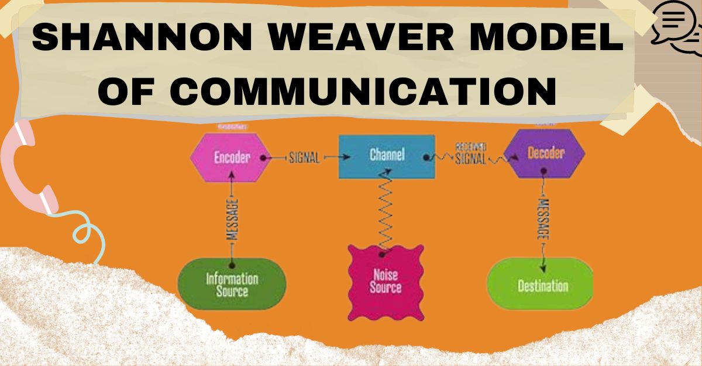
Relevant Communication Theory: Shannon and Weaver Model
Shannon and Weaver Communication Model
• Communication involves a sender, message, channel, receiver and feedback.
• Noise can interrupt the message during transmission.
Application to Flight Foods:
Sender: Gary
Message: Food safety instructions
Channel: Verbal communication in factory
Noise: Machinery sounds
Receiver: Employees
Notes:
The Shannon and Weaver Communication Model can be used to understand the influence that noise has on communication in Flight Foods Ltd.
This model has a sender, message, channel, receiver and feedback. Gary has to give instructions to employees, so in this case, he is the sender. The message contains valuable information relating to food hygiene and work practices. The channel is verbal communication since Gary primarily communicates verbally (De Boeck et al., 2019). The employees are the receivers who should read and follow these instructions.
But the communication is disturbed by noise from the factory machines. In this model, noise is defined as any factor that makes it difficult to successfully communicate the message. Employees are misled or fail to hear important information because of the sound of the machinery.
Thus, while Gary is giving the right directions, he may not always be able to get the right information to employees.

Slide 5
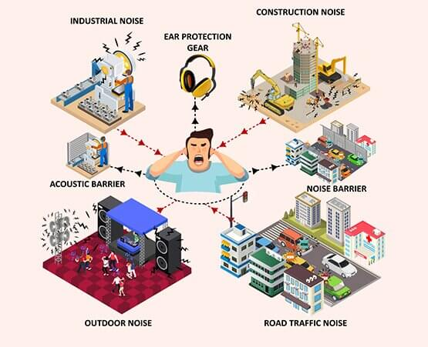
Solutions for Environmental Noise
Ways to Reduce the Barrier:
• Replace old machinery with quieter equipment.
• Create quiet areas for training and meetings.
• Use written instructions and visual demonstrations.
• Provide regular feedback sessions.
Notes:
Flight Foods Ltd need to enhance the communication environment within the workplace to minimise environmental noise. The company needs to think about replacing old machines with newer machines which are noiseless.
Employees cannot concentrate well in a noisy environment and therefore important training should not be undertaken on the factory floor. Rather, training should be conducted in a quiet space that allows employees to carefully listen to instructions.
The company should also employ visual communication techniques like posters, diagrams and practical demonstrations (Shannon and Weaver, 2021). Different methods of communication will enhance employee understanding of information in a workplace where verbal communication is challenging.
Feedback sessions should also be added to the process regularly to ensure that employees have grasped the instructions correctly.

Slide 6

Barrier 2: Language and Communication
Language and Communication Barriers
Problem Identified:
• Many employees speak limited English.
• Gary mainly communicates through English instructions.
• Employees may misunderstand important hygiene rules.
Impact:
• Incorrect food handling procedures.
• Employees perform tasks differently from instructions.
• Increased risk of contamination.
Notes:
The second larger communication barrier is that of language difficulty. Flight Foods Ltd has employees from various countries and a large proportion of staff have limited English language skills.
Gary reported that the majority of the workers speak in their native language and have only a few words in English. This is a problem as Gary primarily communicates in English.
If employees aren't completely familiar with the words being used by management, they may misinterpret instructions. This can have potentially serious ramifications in a food production setting as workers need to be aware of hygiene protocols and safety guidelines.
If, for instance, an employee doesn't understand how to store and clean food items, it can result in unsafe food products being sent to the customers of the airline.
The problem is the method of communication is not the one required by a multi-cultural workforce.

Slide 7

Relevant Theory: Berlo’s SMCR Model
Berlo’s Communication Model
Components:
• Sender
• Message
• Channel
• Receiver
Application:
Sender: Gary
Message: Hygiene rules
Channel: Spoken English
Receiver: Multicultural employees
Problem:
Differences in language ability reduce understanding.
Notes:
Berlo's Communication Model SMCR is an explanation of the language barrier experienced by Flight Foods Ltd.
Communication involves four important elements: Sender, Message, Channel and Receiver, Berlo said.
In this case, Gary is the sender. The message is the food hygiene instructions. It is delivered by the medium of spoken English.
Since there is a gap in communication between Gary and the employees, there is a problem. While Gary gives the correct information, employees may not read the message correctly due to language barrier (Berlo, 2017).
This leaves a communication gap between management and workers, and makes the likelihood of error greater.

Slide 8

Solutions for Language Barriers
• Provide food hygiene training in multiple languages.
• Use simple English instructions.
• Use pictures, symbols and demonstrations.
• Encourage employees to ask questions.
• Introduce bilingual supervisors.
Notes:
Flight Foods Ltd needs to find a better way to communicate to overcome language barriers.
The company should offer food hygiene training in an easy-to-understand manner and translated where needed. It is important to include pictures and symbols with important instructions as visual communication may be easier understood by staff with English language limitations (Hansson et al., 2019).
The business may also hire bilingual staff or supervisors to assist in conveying crucial data to other workers.
Managers need to make it a habit to check for understanding and ask questions so that everyone doesn't think they know what to do.
An improvement in language support will enable employees to carry out food safety procedures properly and minimize production errors.

Slide 9

Age and Generational Differences
Problem Identified:
• Workforce includes employees aged 16 to 60.
• Younger workers appear to misunderstand instructions more often.
• Different generations have different learning styles.
Impact:
• Younger employees may not respond well to traditional instructions.
• Older employees may rely on previous experience rather than new procedures.
Notes:
Another communication barrier that has to be addressed at Flight Foods Ltd is age difference and generational difference. Workers of various ages, including younger and more experienced older employees.
Various generations learn in different ways, communicate in different ways and have different experiences at work. Gary thinks that younger staff members may not be as good at following instructions as older staff members.
This can occur due to inexperience and the need for more hands-on experience among younger workers. Older workers might already know the expectations in the workplace due to years of experience (Lyons et al., 2015).
Managers may not communicate the same way with all employees, which could lead to some people not being able to understand all of the information.

Slide 10
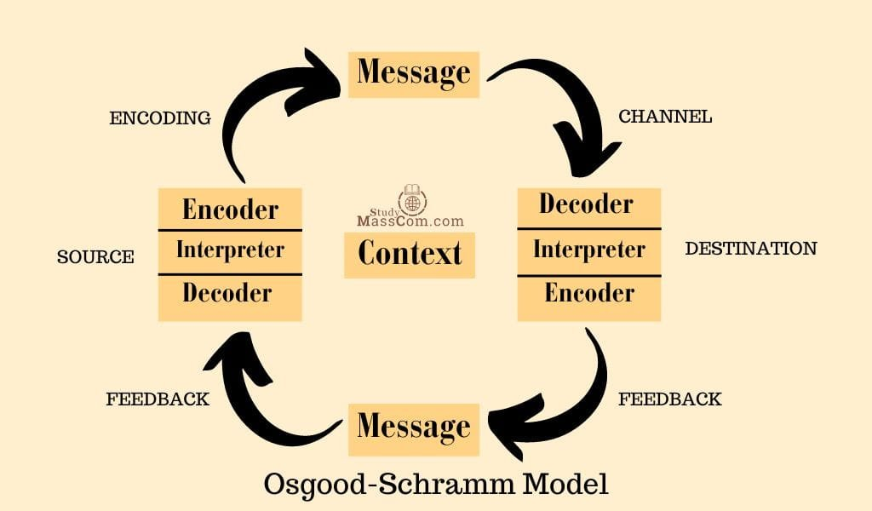
Relevant Theory: Schramm’s Communication Model Schramm Model
• Communication depends on shared experience and understanding.
• Different backgrounds influence how messages are interpreted.
Application:
• Gary’s experience in food hygiene differs from younger employees’ experience.
• Lack of shared understanding creates communication gaps.
Notes:
The effective communication model developed by Schramm states that there needs to be a common experience between the sender and receiver for effective communication.
Individuals comprehend messages according to knowledge, background and past experiences (Manning, 2018).
Gary has extensive knowledge and experience in food hygiene and food safety at Flight Foods Ltd. But some younger workers may not be as knowledgeable and experienced.
They may have different backgrounds and so will understand what they have been asked to do in different ways. This is a gap in communication between Gary and younger workers.

Slide 11

Solutions for Age Differences
• Use different training methods for different learning needs.
• Combine experienced and younger workers through teamwork.
• Provide mentoring programmes.
• Encourage open communication between generations.
Notes:
Flight Foods Ltd should offer various training methods for various employees to overcome the generational communication issues.
Practical demonstrations, guidance and closer supervision may be beneficial for younger workers. Mentoring schemes can be used to assist experienced staff members in supporting new staff.
Interage teamwork should also be encouraged within the company. Through the sharing of knowledge and experience, the organisation can develop greater intergenerational understanding.

Slide 12

Cultural Differences
Cultural Communication Barrier
Problem Identified:
• Employees come from five different cultural backgrounds.
• Different cultures may have different attitudes towards workplace rules and hygiene.
Impact:
• Employees may interpret instructions differently.
• Different cultural practices can affect food safety standards.
Notes:
Flight Foods Ltd has five cultural backgrounds of work staff. Cultural diversity is not only a good thing but can also be a communication hurdle.
Individuals may differ in their attitudes to authority, communication, and workplace behaviour due to their cultural differences (Men and Yue, 2019) .
For instance, some staff might be at ease making inquiries or voicing their views, whereas others might not be because of cultural expectations.
These differences can make it difficult for employees to communicate with managers and co-workers.

Slide 13
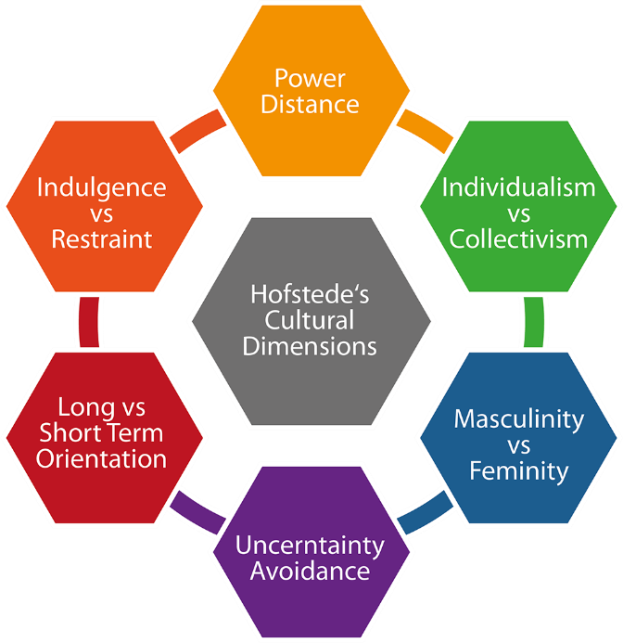
Relevant Theory: Hofstede’s Cultural Dimensions Hofstede’s Theory
Culture influences:
• Values
• Behaviour
• Communication styles
• Workplace expectations
Application:
• Employees may have different views about authority, rules and teamwork.
• Cultural differences create misunderstanding.
Notes:
The Cultural Dimensions Theory is Hofstede's theory that provides insights into how culture affects people's behavioural and communication patterns.
People who are from different cultures can have different ideas about what is appropriate and inappropriate in terms of authority, rules, and relationships at work, according to Hofstede (Hofstede et al., 2019).
Different cultures may have different interpretations of instructions at Flight Foods Ltd.
Hence, managers should be aware of cultural differences and establish common workplace standards that are followed.

Slide 14

Solutions for Cultural Barriers
• Provide cultural awareness training.
• Create clear workplace standards for everyone.
• Respect different cultures while maintaining food safety rules.
• Encourage teamwork among different cultural groups.
Notes:
Flight Foods Ltd should conduct cultural awareness training to eliminate cultural communication issues.
Workers need to be aware that they may have different backgrounds but they are expected to all adhere to the same standards of food safety.
To foster an environment that encourages the participation of all staff members, respecting all and fostering a sense of comfort for all in communicating with others is imperative for management (Nyarugwe et al., 2020).
By fostering a respect for cultural differences and setting clear expectations in the workplace, teamwork and communication will be enhanced.

Slide 15

Barrier 5: Emotional Barrier
Emotional Communication Barrier
Problem Identified:
• Gary experiences stress and frustration.
• He works under pressure without enough support.
• His emotional reaction affects communication with employees.
Example:
Gary shouted “Idiots!” when he found unsafe food practices.
Impact:
• Employees may feel blamed or discouraged.
• Communication becomes less effective.
Notes:
The last barrier to communication is emotional stress (Men and Yue, 2019). Gary is under high pressure as he has to ensure that food hygiene is kept up and there is not enough support.
If the workers persist in committing errors, Gary is frustrated and stressed. This frustration impacts on how he communicates with staff.
For instance, he found out that the chicken had been left out all night, and he was furious with employees and blamed them.
Gary is right to be concerned about food safety, but negative emotions can harm communication. Staff might be reluctant to report issues or ask questions.

Slide 16
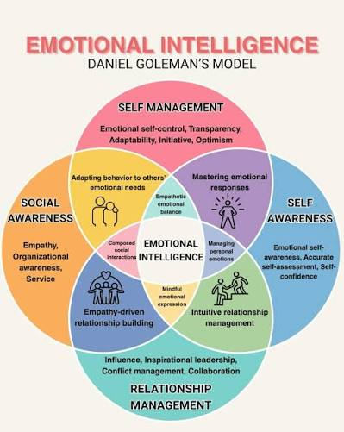
Relevant Theory: Emotional Intelligence (Goleman)
Goleman’s Emotional Intelligence Theory
Includes:
• Self-awareness
• Self-management
• Motivation
• Empathy
• Social skills
Application:
Gary needs to manage frustration and communicate more positively with employees.
Notes:
Emotional Intelligence Theory by Goleman is a theory that explains why it is important to consider emotions when communicating.
Emotional intelligence includes self-awareness, self-management, empathy and social skills.
An emotionally intelligent manager can manage his emotions and communicate better.
Gary should be aware of his frustration and deal with issues in a more positive manner (Goleman, 2018). He should not be making judgments about workers, but instead, find out what caused them to make a mistake and support them in improving.

Slide 17

Solutions for Emotional Barriers
• Provide leadership and communication training for managers.
• Encourage supportive feedback instead of criticism.
• Create a positive workplace culture.
• Allow employees to discuss problems openly.
Notes:
Flight Foods Ltd managers need to be given leadership and communication training to overcome emotional barriers. Gary needs to learn to provide constructive criticism rather than fault employees when things go awry. An enabling communication culture is needed to encourage workers to speak up about issues and seek clarification. It is important for managers to build EI skills to manage frustration, comprehend employee concerns and keep positive workplace relationships. Frequent feedback sessions can also increase the level of trust between management and employees. Such enhancements will aid in minimizing stress, bettering employee confidence and create more effective workplace communication (Goleman, 2018; Men and Yue, 2019).

Slide 18

Overall Recommendations
To Improve Communication at Flight Foods Ltd:
• Introduce structured food hygiene training.
• Improve communication channels.
• Reduce workplace noise.
• Use multilingual training materials.
• Encourage teamwork and inclusion.
• Develop effective leadership skills.
Notes:
Based on the analysis, Flight Foods Ltd needs to improve its overall communication system.
Before the employees start their work, the company should ensure to deliver appropriate food hygiene training. Communication techniques need to be tailored to the employees of different languages, cultures and experience (De Boeck et al., 2017).
The organisation should enhance its working environment by decreasing noise levels and thereby improve its communication system.
Additionally, managers need to be provided with leadership and emotional intelligence skills to reduce staff reticence and enhance communication.

Slide 19

Conclusion
Communication failures are a major cause of quality problems at Flight Foods Ltd.
Environmental, language, age, cultural and emotional barriers affect workplace performance.
Applying communication theories helps identify the causes of these problems.
Improving communication will increase food safety, customer satisfaction and market performance.
Notes:
Employees and management have barriers such as environmental noise, language, age, cultural and emotional problems.
These barriers are explained through communication theories like Shannon and Weaver, Berlo, Schramm, Hofstede and Goleman, which also give direction on how to minimize the barriers.
Flight Foods Ltd can enhance food safety methods, restore customer confidence and re-establish their role within the airline food market by making improvements to communication methods, effective training and developing better leadership practices.

Slide 20
References
Berlo, D.K. (2017) The Process of Communication: An Introduction to Theory and Practice. New York: Routledge.
De Boeck, E., Jacxsens, L., Bollaerts, M. and Vlerick, P. (2015) ‘Food safety climate in food processing organisations: Development and validation of a self-assessment tool’, Trends in Food Science & Technology, 46(2), pp.242–251. Available at: https://doi.org/10.1016/j.tifs.2015.09.006
De Boeck, E., Jacxsens, L., Mortier, A.V. and Vlerick, P. (2017) ‘Towards an extended food safety culture model: Studying the moderating role of burnout and jobstress, the mediating role of food safety knowledge and motivation in the relation between food safety climate and food safety behaviour’, Trends in Food Science & Technology, 62, pp.202–214. Available at: https://doi.org/10.1016/j.tifs.2017.01.004
De Boeck, E., Jacxsens, L., Mortier, A.V. and Vlerick, P. (2018) ‘Quantitative study of food safety climate in Belgian food processing companies in view of their organizational characteristics’, Food Control, 88, pp.15–27. Available at: https://doi.org/10.1016/j.foodcont.2017.12.037
De Boeck, E., Jacxsens, L., Vanoverberghe, P. and Vlerick, P. (2019) ‘Method triangulation to assess different aspects of food safety culture in food service operations’, Food Research International, 116, pp.1103–1112.
Available at: https://doi.org/10.1016/j.foodres.2018.09.053
De Boeck, E., Jacxsens, L., Vanoverberghe, P. and Vlerick, P. (2019) ‘Method triangulation to assess different aspects of food safety culture in food service operations’, Food Research International, 116, pp.1103–1112. Available at: https://doi.org/10.1016/j.foodres.2018.09.053
Goleman, D. (2018) Emotional Intelligence: Why It Can Matter More Than IQ. London: Bloomsbury Publishing.
Hansson, M., Carey, G. and Kjellberg, A. (2019) ‘The importance of communicating change’, Corporate Communications: An International Journal, 24(4), pp.670–685.
Available at: https://doi.org/10.1108/CCIJ-04-2019-0039
Hofstede, G., Hofstede, G.J. and Minkov, M. (2019) Cultures and Organizations: Software of the Mind. 3rd edn. New York: McGraw-Hill.
Lyons, S.T., Schweitzer, L. and Ng, E.S.W. (2015) ‘How have careers changed? An investigation of changing career patterns across generations’, Journal of Managerial Psychology, 30(1), pp.8–21. Available at: https://doi.org/10.1108/JMP-07-2014-0210
Manning, L. (2018) ‘The value of food safety culture to the hospitality industry’, Worldwide Hospitality and Tourism Themes, 10(3), pp.284–296.
Available at: https://doi.org/10.1108/WHATT-02-2018-0008
Men, L.R. and Yue, C.A. (2019) ‘Creating a positive emotional culture: Effect of internal communication and impact on employee supportive behaviors’, Public Relations Review, 45(3), pp.1–10. Available at: https://doi.org/10.1016/j.pubrev.2019.03.001
Nyarugwe, S.P., Linnemann, A.R., Ren, Y., Bakker, E.J., Kussaga, J.B., Watson, D., Fogliano, V. and Luning, P.A. (2020) ‘An intercontinental analysis of food safety culture in view of food safety governance and national values’, Food Control, 111, Article 107075.
Shannon, C.E. and Weaver, W. (2021) The Mathematical Theory of Communication. Urbana: University of Illinois Press.
Notes:
References
Berlo, D.K. (2017) The Process of Communication: An Introduction to Theory and Practice. New York: Routledge.
De Boeck, E., Jacxsens, L., Bollaerts, M. and Vlerick, P. (2015) ‘Food safety climate in food processing organisations: Development and validation of a self-assessment tool’, Trends in Food Science & Technology, 46(2), pp.242–251. Available at: https://doi.org/10.1016/j.tifs.2015.09.006
De Boeck, E., Jacxsens, L., Mortier, A.V. and Vlerick, P. (2017) ‘Towards an extended food safety culture model: Studying the moderating role of burnout and jobstress, the mediating role of food safety knowledge and motivation in the relation between food safety climate and food safety behaviour’, Trends in Food Science & Technology, 62, pp.202–214. Available at: https://doi.org/10.1016/j.tifs.2017.01.004
De Boeck, E., Jacxsens, L., Mortier, A.V. and Vlerick, P. (2018) ‘Quantitative study of food safety climate in Belgian food processing companies in view of their organizational characteristics’, Food Control, 88, pp.15–27. Available at: https://doi.org/10.1016/j.foodcont.2017.12.037
De Boeck, E., Jacxsens, L., Vanoverberghe, P. and Vlerick, P. (2019) ‘Method triangulation to assess different aspects of food safety culture in food service operations’, Food Research International, 116, pp.1103–1112.
Available at: https://doi.org/10.1016/j.foodres.2018.09.053
De Boeck, E., Jacxsens, L., Vanoverberghe, P. and Vlerick, P. (2019) ‘Method triangulation to assess different aspects of food safety culture in food service operations’, Food Research International, 116, pp.1103–1112. Available at: https://doi.org/10.1016/j.foodres.2018.09.053
Goleman, D. (2018) Emotional Intelligence: Why It Can Matter More Than IQ. London: Bloomsbury Publishing.
Hansson, M., Carey, G. and Kjellberg, A. (2019) ‘The importance of communicating change’, Corporate Communications: An International Journal, 24(4), pp.670–685.
Available at: https://doi.org/10.1108/CCIJ-04-2019-0039
Hofstede, G., Hofstede, G.J. and Minkov, M. (2019) Cultures and Organizations: Software of the Mind. 3rd edn. New York: McGraw-Hill.
Lyons, S.T., Schweitzer, L. and Ng, E.S.W. (2015) ‘How have careers changed? An investigation of changing career patterns across generations’, Journal of Managerial Psychology, 30(1), pp.8–21. Available at: https://doi.org/10.1108/JMP-07-2014-0210
Manning, L. (2018) ‘The value of food safety culture to the hospitality industry’, Worldwide Hospitality and Tourism Themes, 10(3), pp.284–296.
Available at: https://doi.org/10.1108/WHATT-02-2018-0008
Men, L.R. and Yue, C.A. (2019) ‘Creating a positive emotional culture: Effect of internal communication and impact on employee supportive behaviors’, Public Relations Review, 45(3), pp.1–10. Available at: https://doi.org/10.1016/j.pubrev.2019.03.001
Nyarugwe, S.P., Linnemann, A.R., Ren, Y., Bakker, E.J., Kussaga, J.B., Watson, D., Fogliano, V. and Luning, P.A. (2020) ‘An intercontinental analysis of food safety culture in view of food safety governance and national values’, Food Control, 111, Article 107075.
Shannon, C.E. and Weaver, W. (2021) The Mathematical Theory of Communication. Urbana: University of Illinois Press.

Slide 21



