Slide 1
Fake? Religion

Slide 2
‘Authentic Fakes’ – where religion meets popular culture
Mahan notes that
Traditionally, religious studies has tended to focus on the doctrine or practice of established religious groups and cultural elites. Yet in recent years, scholars of religion, like their counterparts in other fields of cultural study, have begun to focus more on the lives of everyday people … to the way ordinary people experience their religious lives … they discover a variety of relationships between religion and popular culture (Forbes and Mahan, 2005, 288ff).

Slide 3
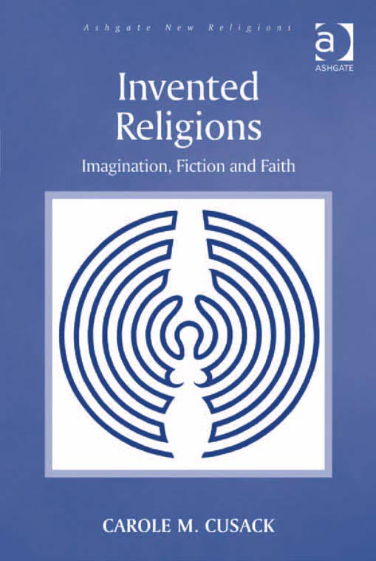
Cusack (2010, 1): ‘The notion of ‘invented religion’ is deeply provocative, in that it contradicts the traditional understanding of religion as a phenomenon that trace its origins to divine revelation (as is the case with Judaism, Christianity and Islam), or with origins so far in the past that individual founders are unknown but venerability is assured (as is the case with Hinduism), and asserts that teachings that are not only new but are admitted to be the product of the human imagination deserve that most lofty of designation, ‘religion’.

Slide 4
And ‘In the West little scholarly attention has been paid to those religions that announce their invented status. That is understandable, as they are openly defying the web of conventions that surround the establishment of new religions, which include linking the new teaching to an existing religious tradition, arguing that the teaching is not really ‘new’ but rather a contemporary statement of a strand of ancient wisdom, and establishing new scriptures as authoritative through elaborate claims of external origin, including translation, chanelling and the chronicling of visions. Invented religions refuse such strategies of legitimation’

Slide 5


Popular culture as religion
Popular culture as replacing religion

Slide 6
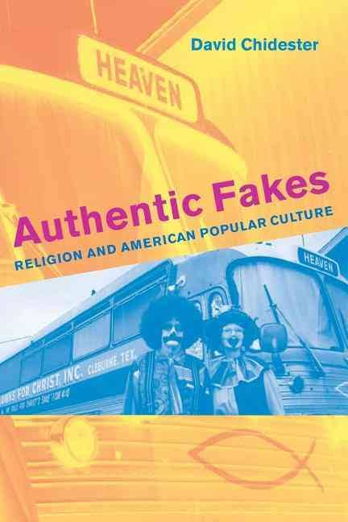

Religion: serious, sacred, transcendent
Popular culture: ordinary, frivolous, playful
= Tension
‘…these religious fakes still do authentic religious work…’
The are groups ‘not formally or legally recognised as religious institutions but nevertheless look like religion’.
Eg Baseball, Coca Cola, Rock ‘n’ Roll
(Chidester, 2005, viii)

Slide 7
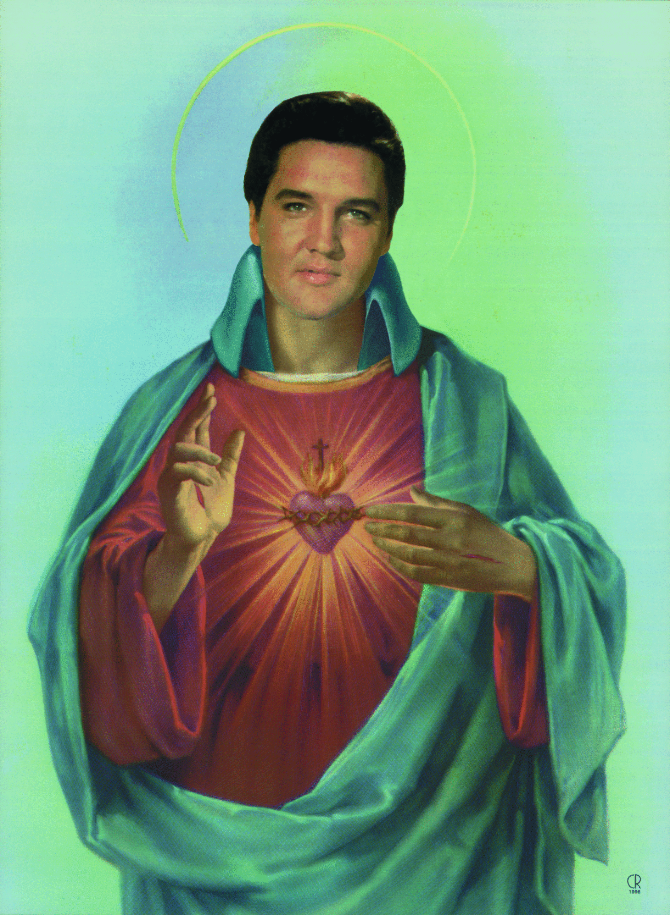
Elvis – Graceland (Mecca) - artefacts – rituals
First Presleytarian Church of Elvis the Divine
The Church of Baseball (Chidester, 36):
Rules, enduring institution, sacred space, sacred time, continuity through life, belonging, ritual (prayer on both sides)
“…baseball is a church, a community of believers’, and there are ‘unbelievers in baseball’ (Chidester, 37).

Slide 8
Plastic religions – flexibility, a ‘capacity to be moulded into different forms’ (Chidester, 52). Disposable.

Slide 9


‘…even ordinary objects can be transformed into icons…’ (Chidester, 33)
Eg Coca Cola, Disney’s Mouse, McDonald’s golden arches, Nike’s ‘swoosh’.
Plastic religions – flexibility, a ‘capacity to be moulded into different forms’ (Chidester, 52). Disposable.

Slide 10
‘The Fetish of Coca Cola’ (Chidester, 40):
‘Medicine’, ‘tonic’, ‘heavenly dew’, secret flavouring, shape of the bottle, Santa Clause, missionaries all over the world.
For US soldiers in World War Two – an important icon of home.
1960s advert: ‘Build a better world in perfect harmony’.
‘Cocacolonization’ (Chidester, 135): coke is ‘both a desired object and the objectification of desire’.

Slide 11
McDonalds and Coca Cola adapted to suit the countries they entered – translations and ingredients. Disney (stories, symbols, myth, icons, paradise) remained a piece of America.

Slide 12
Is all religion fake? (Chidester, 190).
‘…even fakelore, or fake religion…can produce real effects in the real world’ (Chidester, 191).
Superstitution versus Religion – ignorance, fear, fraud, eg Christianity taking over Paganism.

Slide 13

Invented or virtual religion (Chidester, 192) – flourishing
‘Indigenous religions of cyberspace’.

Slide 14
Mazur & Koda, 2011, 307ff) – Disneyland is the middle class Hajj – trip to Mecca. Once in a lifetime. What families aspire to. More people in various years have visited Disneyland or Disney World than the Eiffel Tower, Taj Mahal, pyramids of Cairo, Tower of London, and more than tourism in whole countries. Washington DC is the official capital of the US but at one pint more went to DL and DW.
‘The distinction between religious and commercial activities has blurred…’ ‘… many people treat salvation like a product…’ and ‘commercial ventures … create competition for traditional religions’.
Religious marketplace, with the ‘growing role of the individual (rather than the community) as the locus of identity…’
In such a climate ‘Disney … might be understood as creating, maintaining, and even being depended upon for the images ideas, and emotions that were once reserved for tradition religious communities’.

Slide 15
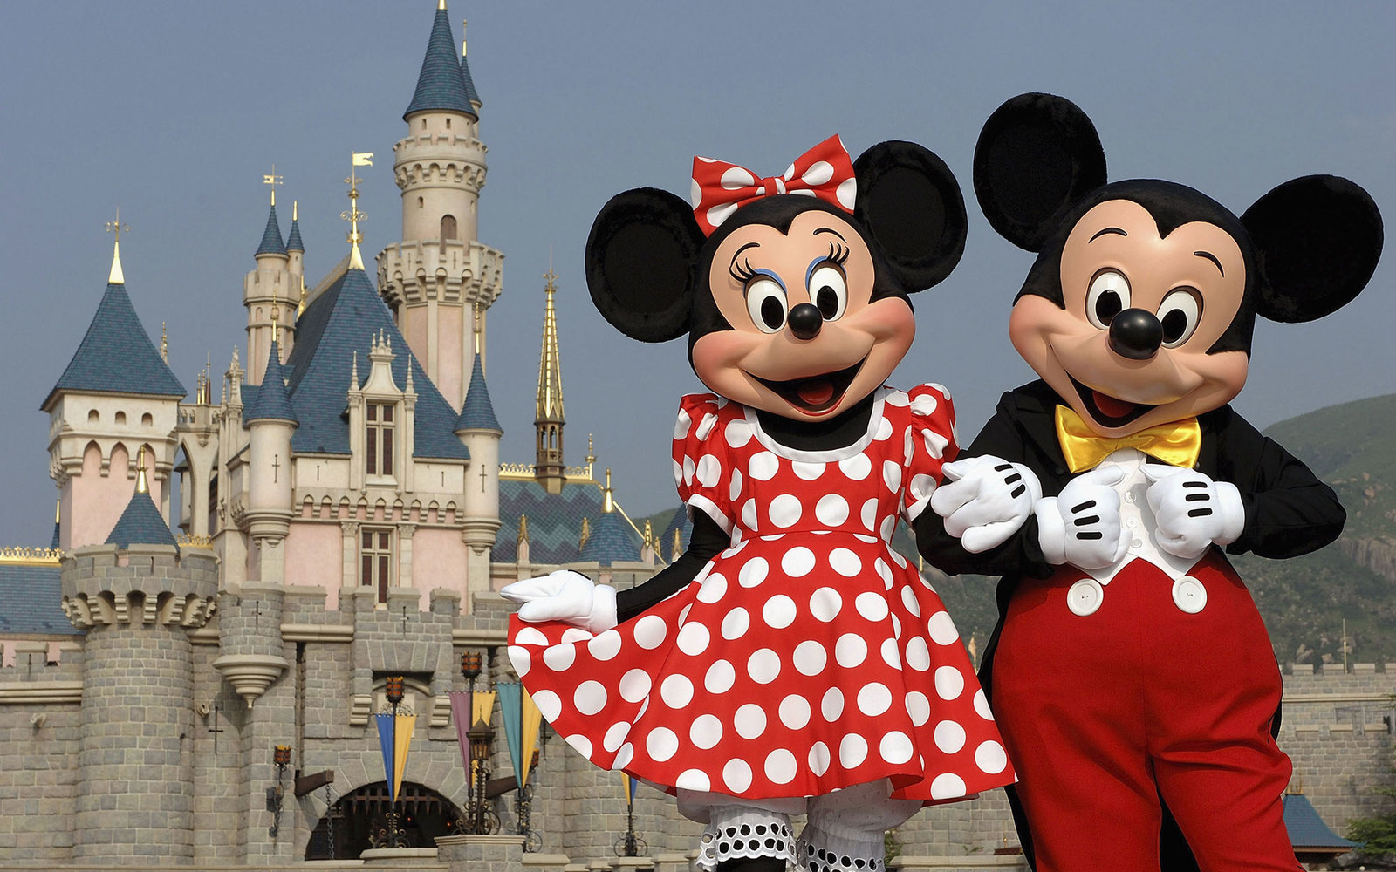
More obvious religious symbolism (Mazur & Koda, 2011, 310) – Walter Elias Disney as Christ figure, vision, innocence, message, children, kingdom of heaven on earth (‘peace and beauty’, (Mazur & Koda, 2011, 319)), disciples, cathedrals

Slide 16
Online religions look like any religion, including historical ones: founder, beliefs, symbols, rituals, beliefs
‘Here are fake religions…doing real, authentic religious work in cyberspace by negotiating what it means to be a human person in a human place’ (Chidester, ix)

Slide 17
“Invented religions are an inevitable outcome of a society addicted to the consumption of novelties, in which the exercise of creativity and innovation in the development of products is rewarded by wealth and fame” (Cusack, 2010, 18).
“All the invented religions…promote interesting explanatory narratives that replicate the conditions of traditional religious forms (myths, sacred histories)” (Cusack, 2010, 25)

Slide 18

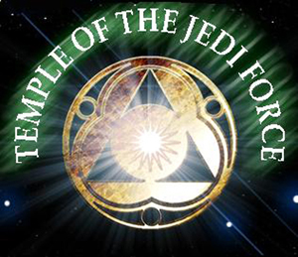
Jediism
George Lucas’ Star Wars
Census results
Yoda
The Force (religious concept) ch’i (Cusack, 2010, 121)
Star Trek huge – conventions, merchandise, language, etc. Hope and heroes, rites of passage (Cusack, 2010, 119).
“The model proposed in this book, that narratives fire the imagination of certain people who get together and instantiate the religion in the ‘real world’, taking a pragmatic stance and asking ‘does it work’ rather than ‘is it true?’ applies in the case of Jediism” (Cusack, 2010. 125).

Slide 19
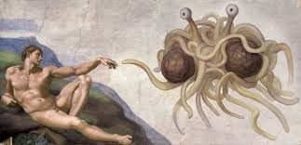
Bobby Henderson 2005, Protest against Creationism Intelligent Design – any deity can be the designer (Cusack, 2010, 113)
The Gospel of the Flying Spaghetti Monster.
The Eight I’d Really Rather You Didn’ts
Pastafarianism/Pastafarians
He Boiled for Our Sins
R’amen
Pastover
Humans descended from pirates.

Slide 20
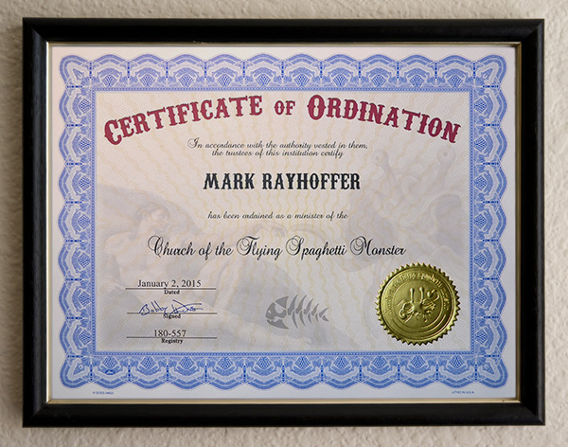
Rapidly gained popularity: 1) appeal of claims 2) humour – spaghetti with meatballs for eyes and recreation of Michaelangelo’s The Creation of Adam, with the FSM’s ‘noodly apendage’ touching Adam’s hand 3) the stand against Creationism (Cusack, 2010, 133).
Wasn’t meant to be a ‘real’ religion but there is religious discourse – draws attention to things (Cusack, 2010, 136).
Sects – eg the Mystical Order of the FSM, the Moomonist Church of His Spaghettiness, the First Church of the FSM (Cusack, 2010, 137).

Slide 21
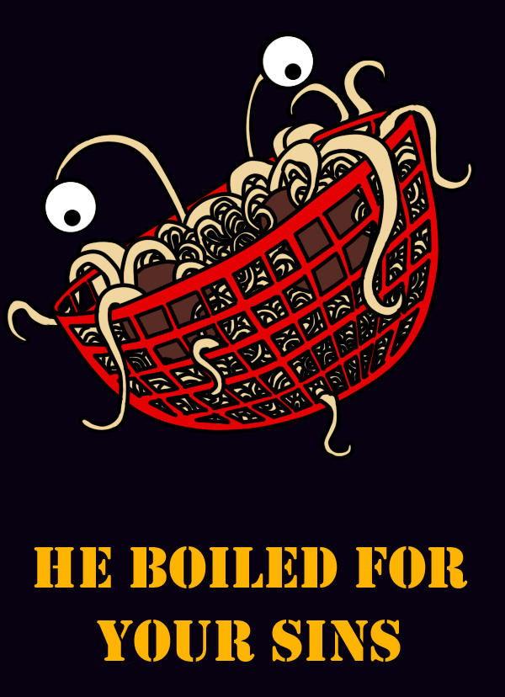

Slide 22

Tupperware
Earl Tupper 1942.
1950s ‘A community of sacred allegiance’ (Chidester, 55).
A woman’s ‘sacred domestic space’ (Chidester, 55) – being invaded by salesmen did not work.
Sit facing the items as a congregation facing the alter. Handle the items.
Tupperware party organisers – pilgrimage to HQ

Slide 23
Bibliography
Chidester, D. (2005) Authentic fakes: Religion and American popular culture. Berkeley, Calif: University of California Press.
World, London, Thorsons.
Cusack, Carole M (2010) Invented Religion, London: Ashgate.
Forbes, Bruce David & Jeffrey H Mahan eds Religion and Popular Culture in America, (Berkeley and Los Angeles: University of California Press, 2005, 2nd edn)
Hunt, Stephen (2002) Religion in Western Society, Basingstoke, Palgrave.
Lewis, James R., Legitimating New Religions (New Jersey: Rutgers University Press, 2003).
Mazur, Eric Michael & Kate McCarthy, God in the Details: American Religion in Popular Culture, Abingdon: Routledge, 2011, 2nd edition).
Mazur, Eric Michael & Tara K Koda, ‘The Happiest Place on Earth: Disney’s America and the Commodification of Religion’, in Mazur, Eric Michael & Kate McCarthy, God in the Details: American Religion in Popular Culture, Abingdon: Routledge, 2011, 2nd edition).

