Slide 1
Music 3 Week 7
Musical Form

Slide 2
Breaking Down Structure
Music exists in time; as an aesthetician, Susanne K. Langer, put it in Feeling and Form, “music is time made audible.”
The proper perception of a musical work depends in the main on the ability to associate what is happening in the present with what has happened in the past and with what one expects will happen in the future.
https://www.britannica.com/art/musical-form

Slide 3
Breaking Down Structure
The frustration or fulfilment of such expectations and the resulting tensions and releases are basic to most musical works.
https://www.britannica.com/art/musical-form

Slide 4
Breaking Down Structure
Musical form depends, therefore, on the disposition of certain structural units successively in time. The basic principles can be discerned from a brief consideration of melody, which may be defined as an organized succession of musical tones. This succession of tones consists of component parts, structural units, the principal of which is the phrase.
https://www.britannica.com/art/musical-form

Slide 5
Fundamentals of Musical Composition - Arnold Schoenberg
Fundamentals of Musical Composition represents the culmination of more than forty years in Schoenberg's life devoted to the teaching of musical principles to students and composers in Europe and America. For his classes he developed a manner of presentation in which 'every technical matter is discussed in a very fundamental way, so that at the same time it is both simple and thorough'.

Slide 6
Fundamentals of Musical Composition - Arnold Schoenberg
This book can be used for analysis as well as for composition. On the one hand, it has the practical objective of introducing students to the process of composing in a systematic way, from the smallest to the largest forms; on the other hand, the author analyses in thorough detail and with numerous illustrations those particular sections in the works of the masters which relate to the compositional problem under discussion.

Slide 7
The Phrase
The smallest structural unit is the phrase, a kind of musical molecule consisting of a number of integrated musical events, processing a certain completeness, and well adapted to combination with other similar units.
The term phrase means, structurally, a unit approximating to what one could sing in a single breath.
Fundamentals of Musical Composition - Arnold Schoenberg, Further Information:
https://monoskop.org/images/d/da/Schoenberg_Arnold_Fundamentals_of_Musical_Composition_no_OCR.pdf

Slide 8
The Melody
A melody, ordinarily consists of a succession of phrases, in which there may occur repetition (the same phrase repeated), contrast (a completely different phrase), or variation (the phrase altered, but in such a way that its identity remains perceptible). The relation between these component phrases is important for form.
https://www.britannica.com/art/musical-form/Principles-of-musical-form

Slide 9
The Motive
The Motive generally appears in a characteristic and impressive manner at the beginning of a piece. The features of a motive are intervals and rhythms, combined to produce a memorable shape or contour which usually implies an inherent harmony. […] A motive appears constantly throughout a piece: it is repeated. Repetition alone often gives rise to monotony. Monotony can only be overcome by variation.
Further Information: Fundamentals of Musical Composition - Arnold Schoenberg
https://monoskop.org/images/d/da/Schoenberg_Arnold_Fundamentals_of_Musical_Composition_no_OCR.pdf

Slide 10
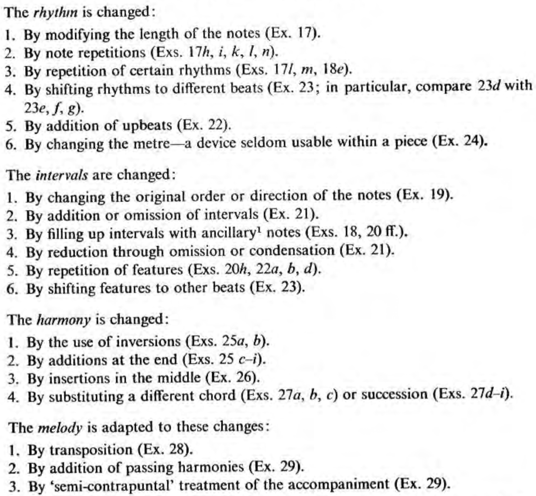
Motive
Variation
Ideas
https://monoskop.org/images/d/da/Schoenberg_Arnold_Fundamentals_of_Musical_Composition_no_OCR.pdf

Slide 11
How do we discuss or analyse Musical Form?

Slide 12
Musical Form
If we label our musical materials, ideas, or sections with letters of the alphabet we can show how musical forms are created.
With the process of repetition, contrast and variation there can be many musical forms

Slide 13
Examples of Musical Form

Slide 14
Strophic Form
Also called:
‘AAA’ Form
One Part Song Form
Chorus Form

Slide 15
Strophic Form
In Strophic Song Form, the melody is repeated for each of the verses. With each repetition of the melody, lyrics are sung by the singer where the lyrics change with each verse
The text usually features the same number of syllables in each verse

Slide 16
Strophic Form - Refrain
A refrain is a part of the verse. With refrains, the same words are repeated, with the same melody, at the same place within each verse, in all verses.
The refrain line is often the song title being used as the main lyrical hook (memorable phrase). The refrain is repeated, most commonly, as the last line of every verse section. The other main location of a refrain is as the first line of a verse.
The refrain line often answers, modifies the meaning, or comments on, ideas, questions and observations made within the verse.

Slide 17
Refrain Example
I am a man of constant sorrow
I've seen trouble all my day
I bid farewell to old Kentucky
The place where I was born and raised
(The place where he was born and raised)
Example:
https://open.spotify.com/track/0YwNdeDFbGP6AGwsQrtzdY?si=pif5nyWSRky3Y-Tu00t3eQ
Lyrics:
https://genius.com/The-soggy-bottom-boys-i-am-a-man-of-constant-sorrow-lyrics

Slide 18
Strophic Form
Examples?

Slide 19
Strophic Form – Nursery Rhymes
Row Row Row Your Boat
The Wheels on the Bus
A Sailor Went To Sea
Hush, Little Baby
If You’re Happy and You Know It

Slide 20
Strophic Form
- Songs
Scarborough Fair
Amazing Grace
Mack The Knife
English National Anthem
Man of Constant Sorrow

Slide 21
Strophic Form
- Christmas Carols
Deck The Halls
Silent Night
God Rest Ye Merry Gentlemen
While Shepherds Watched

Slide 22
Strophic Form
- Further Examples
https://everyguitarchord.com/song-structure-types-the-aaa-strophic-song-form/

Slide 23
Binary Form
A - B
Binary form is a musical form in two related sections, both of which are usually repeated.
This is usually performed as:
A-A-B-B // A-A-B-A or
||: A :|| ||: B :|| // ||: A :||: B-A :||

Slide 24
Binary Form
The first section will start in a certain key, and will usually modulate to a related key.
Compositions in major keys will typically modulate to the dominant, the fifth scale degree above the tonic
Compositions in minor keys will typically modulate to the relative major, the major key centered on the third scale degree above the tonic; alternatively the first section could close in the dominant minor, or with an imperfect cadence in the original key

Slide 25
Binary Form
Example:
http://teoria.com/en/tutorials/forms/binary/

Slide 26
Binary Form – Baroque Suite
1600 - 1750
Allemande
Courante
Sarabande
Air
Menuet
Gigue
Examples:
http://teoria.com/en/tutorials/forms/suite/

Slide 27
Ternary Form
A - B - A
Ternary form, sometimes called song form, is a three-part musical form consisting of an opening section (A), a following section (B) and then a repetition of the first section (A).
It is usually schematized as A–B–A.

Slide 28
Ternary Form
A - B - A
Examples:
http://teoria.com/en/tutorials/forms/ternary/index.php
http://teoria.com/en/tutorials/forms/ternary/03-schumann.php

Slide 29
Compound Ternary (or Trio) Form
In a compound ternary form each section is a dance movement in binary form (two sub-sections which are each repeated) and a contrasting trio movement also in binary form with repeats.
Example:
http://teoria.com/en/tutorials/forms/ternary/04-compound.php

Slide 30
Rondo Form
In rondo form, a principal theme (sometimes called the "refrain") alternates with one or more contrasting themes, generally called "episodes", but also occasionally referred to as "digressions" or "couplets". Possible patterns in the Classical period include: ABA, ABACA, or ABACABA. These are sometimes designated "first rondo", "second rondo", and "third rondo", respectively.
Eugene K. Wolf, "Rondo", Harvard Dictionary of Music, fourth edition, edited by Don Michael Randel. Harvard University Press Reference Library (Cambridge: Belknap Press for Harvard University Press, 2003)

Slide 31
Rondo Form
Composing in Rondo form provides a solid and interesting structure to any piece of music.
The contrasting sections give a sense of variety to the piece, whilst the return A Section helps give the piece a sense of coherence and unity.
Example: http://teoria.com/en/tutorials/forms/rondo/

Slide 32
Sonata Form
Sonata form is probably one of the most common forms in classical and romantic music. This form is commonly used in the first movement of sonatas, string quartets, symphonies and even concerts. It has three main sections:
Exposition
Development
Recapitulation

Slide 33
Sonata Form - Exposition
The themes are presented in the exposition. It generally has two sections, the first section in the main key and the second section in the key of the dominant or - in case of minor keys - in the relative major or dominant key. Each section can have one or more themes. The themes may be similar or contrasting. The exposition can begin with an introduction.
The first and second sections are connected using a transition. This transition modulates to the new key. Composers as early as Beethoven experimented with other keys for the second section.

Slide 34
Sonata Form - Development
In the development section, the composer develops the themes presented in the exposition.

Slide 35
Sonata Form - Recapitulation
The recapitulation is a varied repetition of the exposition. The most important difference is that the second section is now in the main key. The composer can add, remove or develop sections and make variations in the texture and orchestration in the case of orchestral works.
The movement ends with a coda that sometimes becomes a second development.

Slide 36
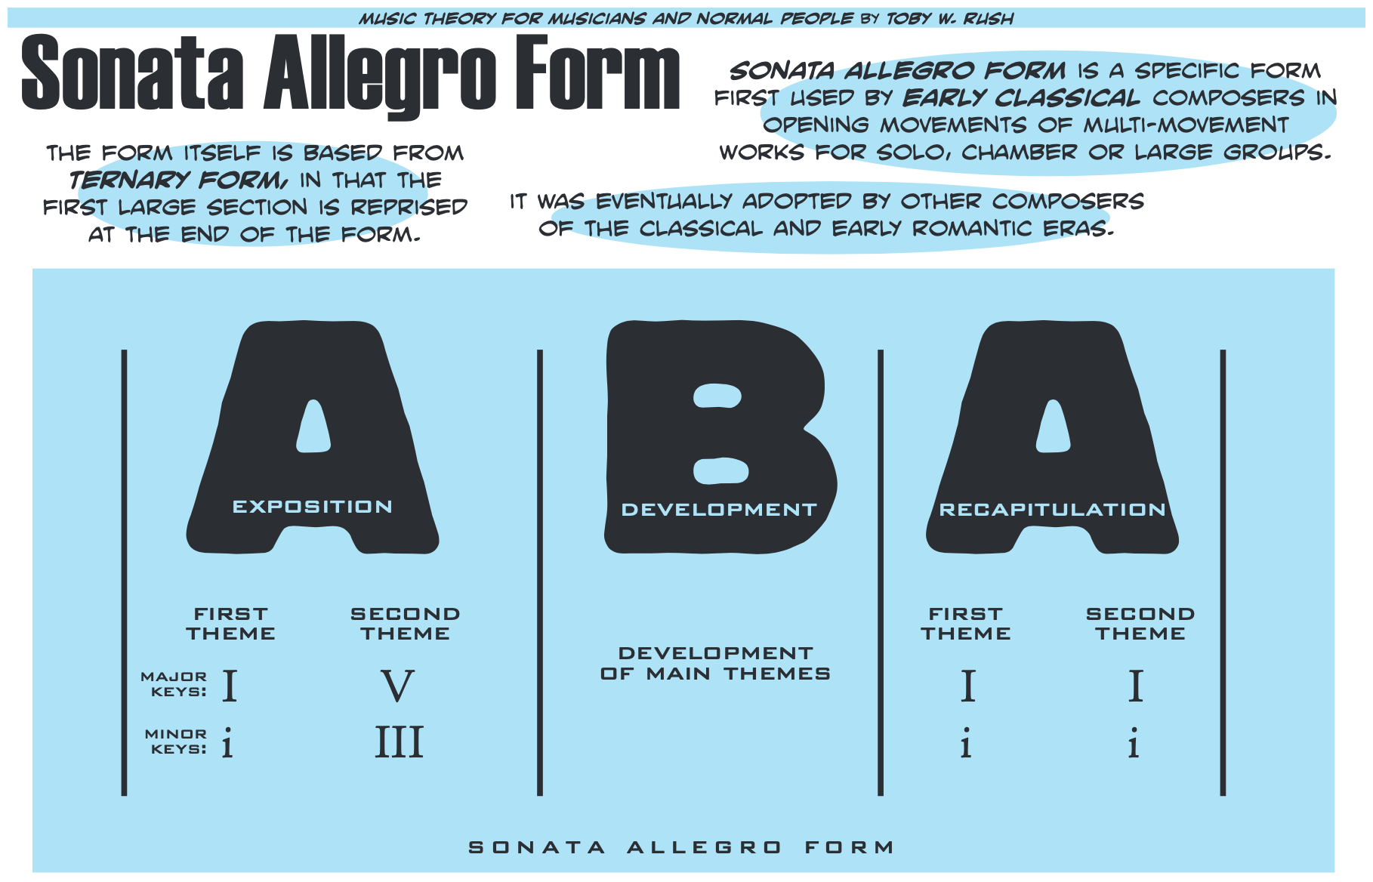

Slide 37
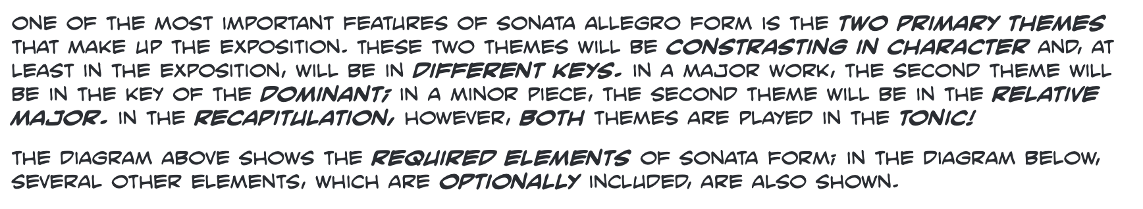

Slide 38
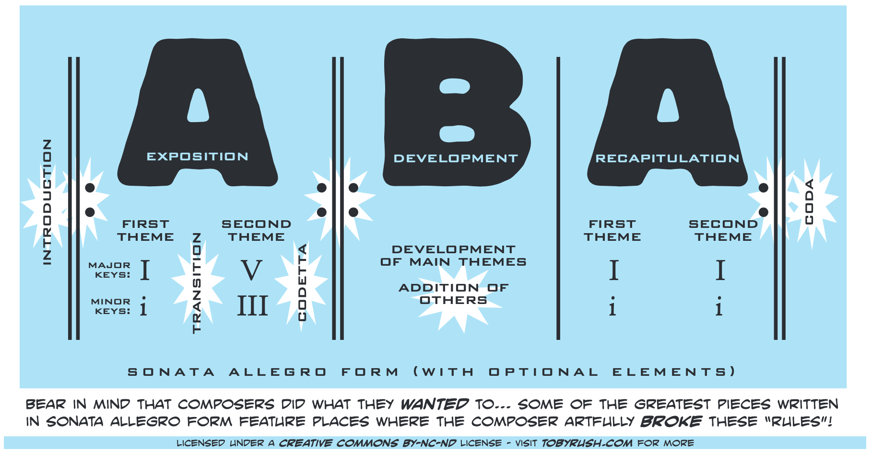

Slide 39
Sonata Form - Example
http://teoria.com/en/tutorials/forms/sonata/

Slide 40
Sonata Form - Explained
What is Sonata Form?:
https://www.youtube.com/watch?v=2G6xMcUUbEA

Slide 41
Theme and Variations
The structure is built upon a musical idea called the theme which is played at the start of the piece.
The theme can be as short as 8 bars in length or can be much longer.
It usually consists of a memorable melody with an accompaniment of some sorts.

Slide 42
Theme and Variations
Once the theme has been played the composer then repeats it, but varies it in some way. This is called Variation 1.
Once Variation 1 has been played, the composer repeats the theme again, this time varying it in a different way, thus producing Variation 2.
This process is repeated as many times as the composer chooses. Each variation is different, but can still be traced back to the original theme in some way.

Slide 43
Theme and Variations
Melody – composers will change the original melody in a number of different ways. These include adding notes (addition), taking notes away (subtraction) and inverting the melody (if the melody went up in pitch in the theme it is played going down in pitch in the variation). Another common technique is to add ornamentation such as trills.

Slide 44
Theme and Variations
Rhythm – composers will change the rhythm of a melody when it is played again.
Time Signature – a theme played in 4/4 and then changed to 3/4 will instantly lead to a variation.

Slide 45
Theme and Variations
Harmony/Tonality – Key changes are a great way of varying a theme. A composer may play the theme in a major key and then reharmonise it in a minor key (the relative minor is a common choice) or vice versa.

Slide 46
Theme and Variations
Other elements to look out for which can be varied are dynamics, tempo, instrumentation and texture.
https://www.musictheoryacademy.com/understanding-music/theme-and-variations/

Slide 47
Theme and Variations Examples:
A Time To Love by Ben Dunnett Example:
https://soundcloud.com/benjamin-dunnett/a-time-to-love
Variations on a Theme of Haydn for Orchestra by Johannes Brahms:
https://www.youtube.com/watch?v=BAuqxEMRapg
Variations on a Theme of Paganini, Op.35 by Johannes Brahms:
https://www.youtube.com/watch?v=1EIE78D0m1g
Other Examples:
http://teoria.com/en/tutorials/forms/variations/

Slide 48
Through-Composed
A structure where there is no repeat or return to any large scale musical section.

Slide 49
Through-Composed
In general usage, a 'through-composed' work is one based on run-on movements without internal repetitions. (The distinction is especially characteristic of the literature of the art-song, where such works are contrasted with strophic settings.)
Webster, James (2004). Haydn's 'Farewell' Symphony and the Idea of Classical Style: Through-Composition and Cyclic Integration in his Instrumental Music, p.7. Cambridge Studies in Music Theory and Analysis.

Slide 50
Through-Composed
Examples in Popular Music?

Slide 51
Through-Composed
Popular Music Examples:
Bohemian Rhapsody – Queen
Unreachable – John Frusciante
Happiness is a Warm Gun – The Beatles
Paranoid Android – Radiohead
Birdland – Weather Report

Slide 52
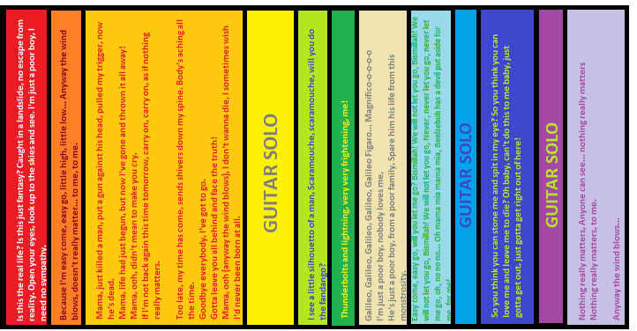

Slide 53
Other Through-Composed
Examples:
Many examples of this form can be found in Schubert's Lieder, where the words of a poem are set to music and each line is different, for example, in his Lied "Der Erlkönig" ("The Elf King"), in which the setting proceeds to a different musical arrangement for each new stanza and whenever the piece comes to each character, the character portrays its own voice register and tonality. Another example is Haydn's 'Farewell Symphony’.
Webster, James (2004). Haydn's 'Farewell' Symphony and the Idea of Classical Style: Through-Composition and Cyclic Integration in his Instrumental Music, p.7. Cambridge Studies in Music Theory and Analysis.

Slide 54
Contrapuntal Composition Techniques:
The Canon
The Intervention
The Fugue
Examples:
http://teoria.com/en/tutorials/forms/contrapuntal/

Slide 55
To understand musical form and use it is a three step process.
Know the musical form – both what it means, and some compositions in that form.
Use the musical form. You must practice using the form in your own work, so that you start to feel comfortable with it.
Integrate the musical form into your own compositional vocabulary. This only comes with time, as you write using the forms more and more.

Slide 56
No beginner is capable of envisaging a composition in its entirety; hence he must proceed gradually, from simpler to the more complex. [ . . . ] These musical blocks (phrases, motives, etc.) will provide the material for building larger units of various kinds, according to the requirements of structure. Thus the demands of logic, coherence and comprehensibility can be fulfilled, in relation to the need for contrast, variety and fluency of presentation.
Further Information: Fundamentals of Musical Composition - Arnold Schoenberg
https://monoskop.org/images/d/da/Schoenberg_Arnold_Fundamentals_of_Musical_Composition_no_OCR.pdf

Slide 57
Further Reading:
Form In Music - Wallace Berry:
https://www.amazon.com/gp/product/0133292851/ref=as_li_ss_tl?ie=UTF8&tag=masschairevio-20&linkCode=as2&camp=217145&creative=399369&creativeASIN=0133292851
Classical Form – William E Caplin:
https://www.amazon.com/gp/product/019514399X/ref=as_li_ss_tl?ie=UTF8&tag=masschairevio-20&linkCode=as2&camp=217145&creative=399369&creativeASIN=019514399X

Slide 58
Class Task: Create a Composition using ‘Theme and Variations’
Create a short musical idea – something that is “catchy” will help. Varying the melody is a good place to start. Your variation should sound different to the original theme, but should still be recognizable as being based upon the theme.
Try this a few times until you have produced a variation you are pleased with. When you have done this try varying the theme again, this time using a different technique such as rhythm.

