Slide 1
Certificate of Higher Education in Employability Skills
Problem Solving and Innovation (BMSW4014)
Chris Rogers and Scott James
June 2025

Slide 2
Agenda
Recap of Week 3
Understanding decision making.
Decision making models.
Factors influencing decision making.
Group decision making.
Making effective making recommendations.
Problem of the week.
Quiz.

Slide 3
Recap
SWOT analysis can be used individually, within a team, organisations.
Simple framework, encourages strategic thinking, flexible.
Risk of oversimplifying data, could make incorrect assumptions, should be replicated on a regular basis.
Leverage strengths to overcome weaknesses, seize opportunities and mitigate threats.

Slide 4
What is decision making?
A critical skill for managers and leaders. It involves evaluating options, considering risks, and choosing the best course of action.
Key components include data analysis, intuition and collaboration.

Slide 5

Decision making models
Rational Decision Making
Bounded Rationality Model.
Intuitive Decision Making.

Slide 6
Rational decision making
The opposite of intuitive decision making.
Utilises objective knowledge and logic.
Involves identifying the problem to solve, gathering facts, identifying options and outcomes, analysing them, considering all the relationships and selecting the decision.
Requires support through the use of methods and software tools.

Slide 7
Rational decision making – Example 1
Choosing a new car
Identify the problem – Your current car is old and unreliable, and you need a new vehicle for daily commuting.
Gather information – Research different car models, prices, fuel efficiency, safety ratings, and reliability scores.
Analyse the situation – Consider your budget, driving needs and preferences.
Develop options – Create a shortlist of potential cars that meet your criteria.
Evaluate alternatives – Compare the pros and cons.
Select a preferred alternative – Choose the car that meets your needs and offers the best overall value.
Implement the decision – Visit dealerships, negotiate the price and complete the purchase.

Slide 8
Rational decision making – Example 2
Choosing a new office location for a growing tech start up
The company has outgrown its current office space.
The management team establish criteria impacting their decision and allocate weights to each criteria.
They develop alternatives by identifying potential office locations.
They evaluate the alternatives based on their needs and select the best alternatives.

Slide 9
Bounded rationality model (1)
Developed by Simon in the 1950s.
Proposes that rational behaviour has its limits, which are based on the knowledge the person making the decision has at the time.
Emotions and other prejudices influence people.
Humans make decisions with limited information, cognitive abilities, and time restraints.
Three premises:
  Humans are cognitively strained.
  These constraints impact decision making.
  Difficult problems reveal the constraints and highlight their significance.

Slide 10
Bounded rationality model (2)
An example of bounded rationality is when people use heuristics.
Heuristics are mental shortcuts that humans use to make decision quickly.
These often lead to suboptimal decisions because they do not need to consider all available information.
People are likely to take more risks when they are happy and less likely to take risks when they are frightened.

Slide 11
Bounded rationality – Example 1
Investment decisions
Investors may rely on past performance, advice from friends or family, or be swayed by emotions like fear of loss or overconfidence, rather than making decisions based on a rational analysis of risks and potential rewards.
This exemplifies how cognitive biases and imperfect information can lead to bounded rationality in financial decision-making.

Slide 12
Bounded rationality – Example 2
Supply Chain Management
Companies often make decisions for their supply chains where cost is just one of many factors influencing the process.
Decision-makers must balance financial considerations with other priorities like sustainability and reputation. This demonstrates how bounded rationality applies to organisational decision-making, where multiple competing objectives and limited information make it difficult to achieve perfect economic rationality.

Slide 13
Intuitive decision making (1)
Intuition is the ability to understand something instinctively, without the need for conscious reason.
Klein (2004) suggests that 90% of critical decisions are made using our intuition.
Can lead to problematic decisions due to the lack of a structured decision-making process.
Can be reasonable to use when making trivial or low value decisions.

Slide 14
Intuitive decision making (2)
Potential problems could include:
  Flawed information.
  Short term emotional bias.
  Insufficient consideration of alternatives.
  Prejudices.
  Lack of openness.
  Inappropriate application.

Slide 15
Intuitive decision making - Example
Steve Jobs, co-founder and former CEO of Apple, and the development of the iPod and iTunes in the early 2000s.
His intuitive approach included:
  Pattern recognition
  Quick judgement
  Gut feeling
  Experience-driven
  Big picture thinking

Slide 16
Activity
In groups, discuss the models covered. Which of the three models discussed would be the most appropriate when making strategic business decisions.
Rational Decision Making
Bounded Rationality Model.
Intuitive Decision Making.
What are the advantages and disadvantages of your chosen model?

Slide 17
Break

Slide 18

Factors influencing decision making
Cognitive bias (confirmation bias, anchoring bias) and their impact on decision quality.
Organisational culture.
Stakeholder interests.
Ethical considerations.

Slide 19
Cognitive bias
Confirmation bias – the tendency to look for information that supports, rather than rejects, one’s preconceptions, typically by interpreting evidence to confirm existing beliefs while rejecting or ignoring any conflicting data (Simkus, 2023).
Anchoring bias - causes people to rely too heavily on the first piece of information they receive (the "anchor") when making decisions or estimates. Once an anchor is set, subsequent judgments and decisions are made by adjusting away from that initial reference point, often insufficiently.

Slide 20

Group decision making
  Consensus: Striving for agreement among team members.
  Accountability: Clarify who is accountable for the decision.
  Voting Mechanisms: Understand voting rules (simple majority, two-thirds, etc.).

Slide 21
Activity
The Vroom-Yetton Decision Model, also known as the Vroom-Yetton-Jago Decision Model, is a practical framework designed to help leaders determine the most effective decision-making style based on situational context.
In pairs, research the model, and answer the following questions:
What are the 5 decision-making styles?
What are the 7 critical questions?
What are the benefits of using the model?

Slide 22
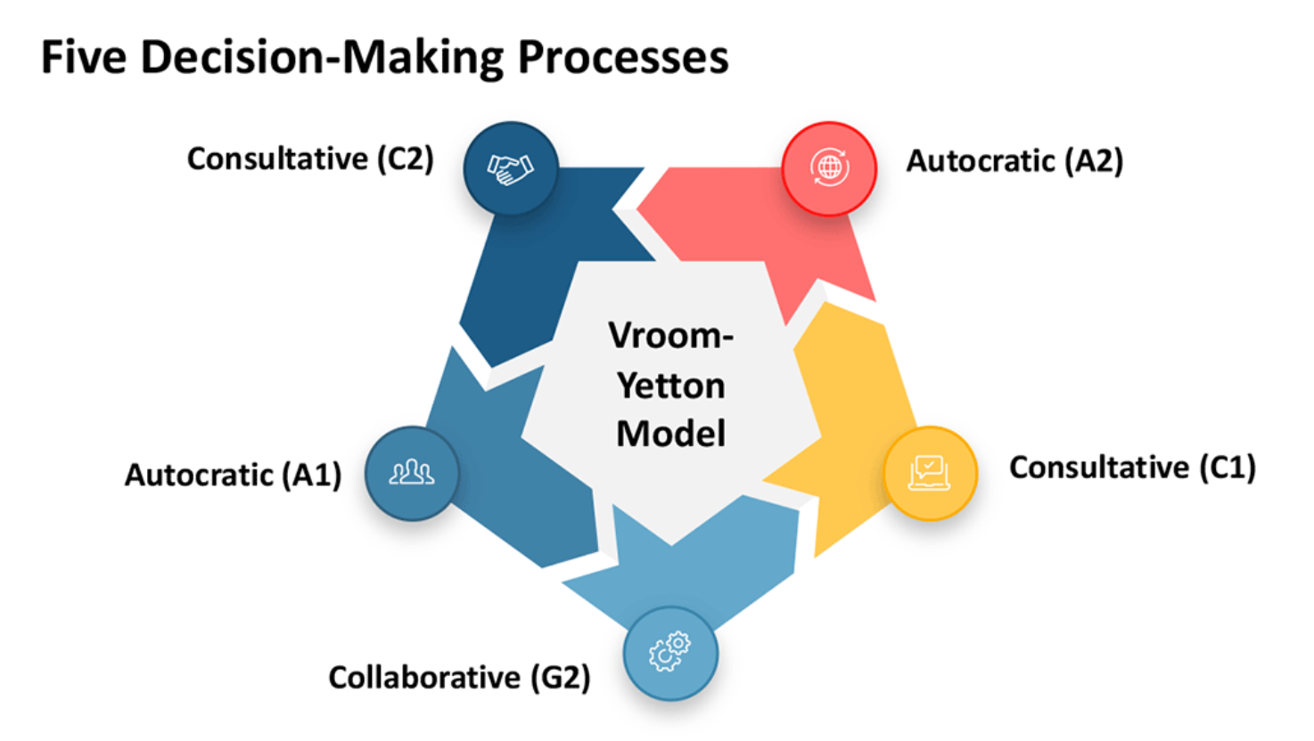

Slide 23
Vroom-Yetton - Critical Questions
Is there a quality requirement? Is the nature of the solution critical?
Do you have sufficient information to make a high-quality decision?
Is the problem structured? Are the alternative courses of action and methods for their evaluation known?
Is acceptance of the decision by subordinates critical to its implementation?
If you were to make the decision by yourself, is it reasonably certain that it would be accepted by your subordinates?
Do subordinates share the organisational goals to be obtained in solving this problem?
Is conflict among subordinates likely in obtaining the preferred solution?

Slide 24
Vroom-Yetton - Analysis
Benefits
Improved decision quality
Enhanced team involvement
Flexibility
Risks
Automation of the process
Lack of consideration for personal factors
Scalability issues

Slide 25
What to consider when implementing a resilient decision
What business relationships might be impacted?
What actions or tasks are required to implement the chosen solution?
Are there other decisions to be made to make the chosen solution a reality?
Does the chosen alternative have an impact on, or cause a conflict with, previously made decisions? If so, what decisions need to be revisited?
Who needs to know about the decision? Consider the stakeholders list.
What actions or tasks will be required to make the transition to the envisioned new solution when decision implementation is complete? How do you deal with moving from the current state to the new state?

Slide 26
Components of Effective Recommendations
Identify key elements when formulating recommendations:
  Research: Conduct in-depth research to support your recommendations.
  Data Analysis: Validate recommendations using relevant data and statistics.
  Market Trends: Assess current market trends and competitor strategies.
  Risk Assessment: Consider potential risks and benefits.

Slide 27
Presenting recommendations
Tips for presenting recommendations to stakeholders:
  Clarity: Clearly articulate the recommendation.
  Justification: Explain why the recommendation is beneficial.
  Alternatives: Discuss alternative approaches.
  Implementation Plan: Outline steps for execution.

Slide 28
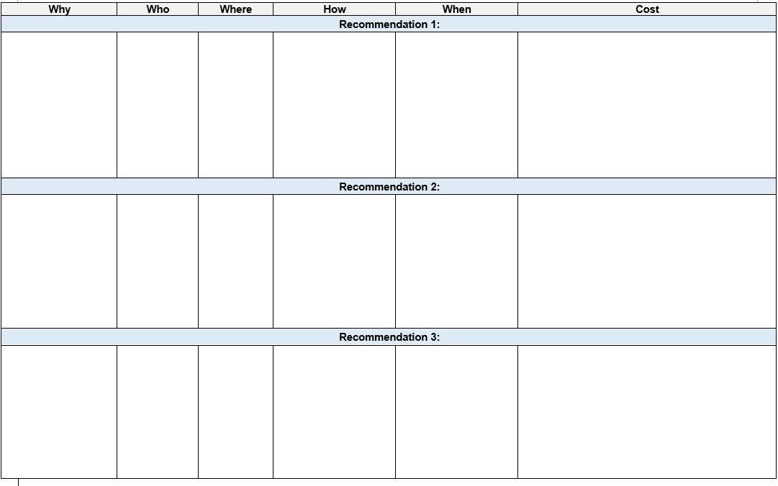
Implementation Plan- Example

Slide 29
Problem of the week
You are the CEO of TechInnovate, a medium-sized software company with 150 employees. The company specialises in developing customer relationship management (CRM) software for small to medium businesses. Due to a sudden global economic recession, many of your clients are cutting back on their tech spending, resulting in a 30% drop in sales over the last quarter.
List 3 possible actions to address the crisis.
Apply the Vroom-Yetton model and choose the style you think is best for this situation.

Slide 30
Resources
CIPD (2023) Evidence-based practice for effective decision-making. Available at: Evidence-based practice for effective decision-making | Factsheets | CIPD. (Accessed: 17 October 2024).
Klein, G. (2004) The Power of Intuition: How to Use Your Gut Feelings to Make Better Decisions at Work. Location unknown: Crown Currency.
Koechlin, E. (2020) ‘Human Decision-Making beyond the Rational Decision Theory’, Trends in cognitive sciences, 24(1), pp. 4–6. Available at: https://doi.org/10.1016/j.tics.2019.11.001.
Mls, K. and Otĉenáŝková, T. (2013) ‘Analysis of Complex Decisional Situations in Companies with the Support of AHP Extension of Vroom-Yetton Contingency Model’, IFAC Proceedings Volumes, 46(9), pp. 549–554. Available at: https://doi.org/10.3182/20130619-3-RU-3018.00546.
Myers, E. (2023) Anchoring Bias & Adjustment Heuristic: Definition and Examples. Available at: Anchoring Bias and Adjustment Heuristic in Psychology (simplypsychology.org) (Accessed: 17 October 2024).
Simkus, J. (2023) Confirmation Bias In Psychology: Definition & Examples. Available at: Confirmation Bias In Psychology: Definition & Examples (simplypsychology.org) (Accessed: 17 October 2024).
Stacey, R.D. (2011) Strategic management and organisational dynamics : the challenge of complexity to ways of thinking about organisations. 6th ed. Place of publication not identified: Financial Times Prentice Hall.

Slide 31
Thank You
Next Lecture
09/06/2025

