Slide 1
Global Green Tourism Summit 2025 - Welcome to Wales
Student Name: Lavinia Dumitrita Bidasca
Student ID number: 2240974
Module: International Meetings Management for the Hotel Industry (BMIH6007)
Lecturer’s name: Kathryn Flynn

Slide 2


Introduction:
Business Wales (2025) says our Global Green Tourism Summit 2025 - Welcome to Wales fits with the "Year of Croeso" theme to showcase Wales's friendly people, culture, and ecologically responsible projects.
Wales aims to lead green tourism with a focus on cultural identity and eco-friendly travel (The Guardian, 2022).
Our target is to attract 400 attendees from 15 countries, including international media, tourism boards, and sustainable hospitality enterprises (Global Sustainable Tourism Council, 2023).
Meet In Wales (2025) claims we can earn £50,000 in eco-tourism funding pledges for Welsh initiatives by promoting green travel.
Newport and its surroundings should see £100,000 in direct visitor spending, which will boost the local economy (Visit Wales, 2022).
Traditional Welsh folk music and bilingual signs will enhance the "Croeso" experience, according to Plaid Cymru (2025).
The summit should align with Visit Wales's strategy goals to bring private, public, and community partners together (Wales.org, 2021).
Clear goals are the first step to successful planning, stakeholder involvement, and event success (Wales.com, 2022).

Slide 3
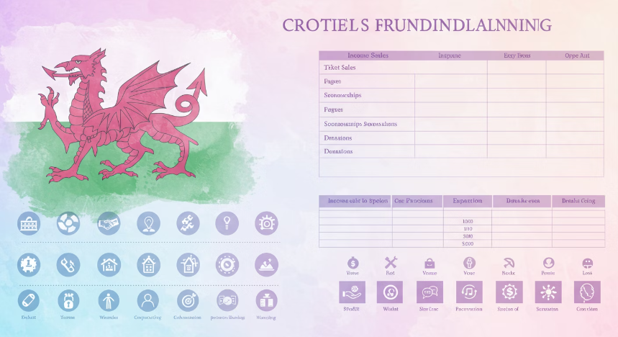
Event Fundraising
£18,000
Expected Net Profit
Based on realistic cost estimates and forecasted income
300
Break-even Attendance
Minimum number of guests needed to cover costs
10%
Emergency Fund
Reserved for unexpected AV demands or event personnel
A planned budget helps us forecast event revenue and keeps everyone informed (FT.com, 2021).
The biggest costs are renting the ICC Wales, paying speakers, and marketing to international tourists (Audit Wales, 2022).
How many people sign up will affect food, eco-friendly supplies, and protection costs (Green Tourism, 2021).
Conference revenue comes from delegates' fees, Visit Wales and Green Tourism UK sponsorships, exhibitor booths, and possibly subsidies (The Guardian, 2021).
Approximately 300 guests are needed to break even. More attendees mean more money (The Times, 2021).
(Visit Wales, 2025) A 10% emergency fund will cover unexpected AV demands or event personnel.
Monitoring actual spending against expected spending during planning allows for real-time budgetary modifications (MWT Cymru, 2021).
Due to realistic cost estimates and forecasted income, we expect a net profit of £18,000. The event is feasible (Visit Wales, 2021).

Slide 4




Venue Selection
Modern Facilities
Central Location
The ICC Wales in Newport was chosen for its modern facilities, space, and MICE-specific support services (Meet In Wales, 2021).
Its central location in Wales makes it accessible via train, vehicle, or adjacent airports for international visitors (The Guardian, 2021).
Eco-Friendly Design
Welsh Culture
Visit Wales, 2025's green tourist concept complements the venue's energy-efficient lighting and environmentally friendly design.
Bilingual signs and decorations will showcase Welsh language and culture throughout, offering visitors a true "Croeso" experience (Audit Wales, 2022).
On-site tech assistance, variable room layout, and breakout rooms for lectures, exhibitions, and networking are available (Visit Wales, 2021).
ICC Wales' proximity to hotels like the Celtic Manor Resort simplifies guest lodgings and transit (Visit Wales, 2021).
The complex's parking, Wi-Fi, and navigation improve the delegate experience (Wales.org, 2021).
These factors make ICC Wales the appropriate venue for our international green tourism gathering (Industry Visit Wales, 2025).

Slide 5




Target Audience
Government Tourism Groups
Eco-Friendly Hotel Chains
Official representatives from tourism ministries and boards
Sustainable hospitality businesses seeking new practices
University Researchers
Travel Journalists
Academic experts in sustainable tourism and cultural preservation
Media representatives from Lonely Planet and Nat Geo Traveller
We welcome government tourist groups, eco-friendly hotel chains, travel journalists, and university researchers (The Times, 2021).
Invites to Europe, North America, and Asia will demonstrate a global approach of sustainable tourism (North Wales Tourism, 2021).
LinkedIn, industry publications, and direct email invites will emphasise Wales's unique cultural identity (Visit Wales, 20251).
Visit Wales (2025) claims student passports will inspire young people to participate in sustainable tourism, leading to long-term involvement and new ideas.
Media credentials will be issued to Lonely Planet and Nat Geo Traveller writers and influencers for maximum coverage (Plaid Cymru, 202125).
Early registration perks, like lower fees, will help sell more tickets and make planning easier, according to Plaid Cymru (2025).
(Business Wales, 2025) Working with Welsh embassies and culture institutes abroad can increase tourism and awareness.
We carefully choose who to ask and provide clear value propositions to make the summit relevant and collaborative (Audit Wales, 2022).

Slide 6
Programme Content Planning
Morning Keynotes
Visit Wales (2025) states every morning begins with big speeches by experts and Welsh government members on green tourism policies.
Panel Discussions
To educate attendees, panel presentations will discuss "Community-Driven Ecotourism" and "Developing Low-Carbon Destinations" (Industry Visit Wales, 2025).
Hands-on Workshops
According to Green Tourism (2025), hands-on training on carbon offsetting, eco-accreditations, and visitor engagement will help people learn.
Welsh Language Sessions
Final Plenary
Naturetrek (2025) believes regular Welsh "taster" lessons will make visitors feel more connected to their destination.
(Henllys Lodge, 2025) The last plenary session will focus on overseas partnerships, project planning, and Welsh tourism investments.
The three-day summit will feature keynote speeches, panel discussions, workshops, and hands-on sustainability activities, according to Visit Wales (2025).
Afternoon breakout streams will allow people to learn more about specific topics, meet other professionals, or try local sustainable goods (The Times, 2025.1).
All delegates have a fulfilling experience because to the program's educational, cultural, and networking opportunities (North Wales Tourism, 2021).

Slide 7
Food, Entertainment, and Audiovisual Selection
Sustainable Catering
Welsh Entertainment
Eco-Friendly Technology
Welsh suppliers are prioritised in the catering plan, which uses organic and seasonal ingredients to reduce environmental impact (Ambition North Wales, 2021).
Industry Visit Wales (2025) says the entertainment will include traditional Welsh folk music, harp performances, and current Welsh acts that showcase the country's cultural diversity.
Audiovisual services will have energy-efficient LED screens, easy-to-use show systems, and strong Wi-Fi that supports hybrid or virtual parts by 2025 (FT.com).
The dishes will include vegetarian, vegan, and other dietary options to accommodate all guests and demonstrate our sustainability (ICC Wales, 20265).
Green Tourism (2025) recommends delegates use event apps for schedules, speaker bios, and interactive polls to reduce paper use.
We'll select "green-certified" caterers who minimise waste and use recyclable products (Ecobnb, 2021).
Strategic signs and charging stations will remind guests to reduce waste and carbon footprint (Henllys Lodge, 2021).
Eco-friendly catering, authentic entertainment, and sustainable AV solutions support our summit's green goals (Henllys Lodge, 2025).

Slide 8





Event Team Selection
Project Managers
Coordinate everything and ensure budgets, timelines, and stakeholder relations are met
Event Managers
Handle registration, badge distribution, and daily operations
Technical Experts
Oversee AV setup, hybrid streaming, and on-site IT systems
Marketing & PR Staff
Create "Croeso to Green Wales" campaign and manage media relations
Sustainability Planners
Implement eco-friendly methods throughout the event
Project managers coordinate everything and ensure budgets, timelines, and stakeholder relations are met (Visit Wales, 2021).
Event managers handle registration, badge distribution, and daily operations as delegates' first contact (Visit Wales, 2021).
Technical experts oversee AV setup, hybrid streaming, and on-site IT systems to ensure smooth technology (Visit Wales, 2021).
According to the Global Sustainable Tourism Council (2025), our marketing and relations staff creates our "Croeso to Green Wales" campaign, manages social media, and contacts the press.
(MWT Cymru, 2025) A sustainability planner uses eco-friendly methods throughout event planning and execution.
Financial officers track costs, manage sponsorship funds, and pay vendors on time to stay within budget (Wales.com, 2021).
Many hospitality workers will be cultural ambassadors, welcoming foreign tourists (Audit Wales, 2022).
This balanced team structure ensures that all parts work together to achieve summit goals (North Wales Tourism, 2021).

Slide 9




Supplier and Stakeholder Engagement
Identify Key Partners
Regular Communication
Establish Agreements
Maintain Relationships
Visit Wales, Newport City Council, local tourism boards, and community-based Welsh culture groups
Coordination meetings to inform partners of budget changes, milestones, and details
Contracts favoring local and green-certified vendors to support the Welsh economy
Open communication to build trust and ensure long-term partnerships
Visit Wales, Newport City Council, local tourism boards, and community-based Welsh culture groups are key players (The Times, 2021).
Regular coordination meetings will inform partners of budget changes, milestones, and details (Wales.org, 2021).
Sponsor communication aligns branding, marketing, and sustainable standards (North Wales Tourism, 2021).
Preferred supplier contracts will favour local and green-certified vendors. This demonstrates our Welsh economy loyalty (Plaid Cymru, 2021).
Working with bus and train companies will help delegates travel sustainably (FT.com, 2021).
Sharing information with local businesses encourages them to offer deals, which boosts the local economy (ICC Wales, 2021).
Positive supplier-stakeholder feedback will enable real-time changes and growth (ICC Wales, 2021).
Open and efficient communication builds trust, ensures everyone knows what to expect, and creates long-term relationships that will help future events (Plaid Cymru, 2021).

Slide 10
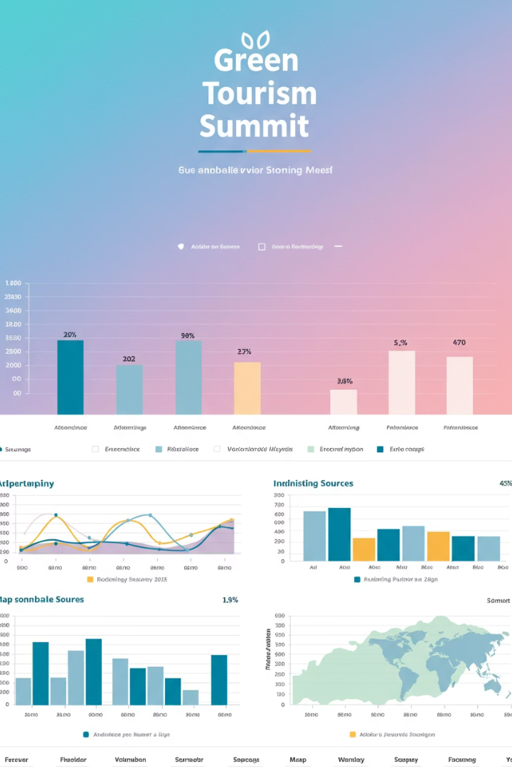
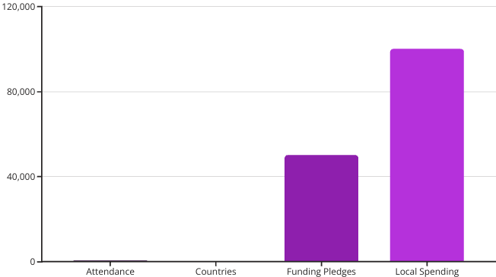
Measuring Success
We will track who signs up and attends to reach 400 guests from at least 15 countries (Naturetrek, 2025).
Promises to local Welsh eco-projects of at least £50,000 will be recorded (The Guardian, 2021).
The economic impact will be measured by visitors' direct spending, which aims to reach £100,000 in Newport and nearby areas (The Guardian, 2021).
After the event, delegates will complete surveys about the material, their cultural experiences, and operations (Ecobnb, 2021).
Sustainability measures like waste reduction, recycling, and carbon footprint tracking will be examined to improve (Henllys Lodge, 202-5).
Wales' global popularity will be determined by social media and news shares, likes, and comments (Visit Wales, 2021).
Qualitative data like stakeholder feedback, media reviews, and academic approval will enrich quantitative data (Meet In Wales, 2021).
These indicators demonstrate the summit's success, aiding future planning and relationship-building (ICC Wales, 2021).

Slide 11




Marketing and Advertising Plan
Bilingual Campaign
Social Media Strategy
Targeted Emails
Influencer Partnerships
Our marketing plan relies on a bilingual "Croeso to Green Wales" campaign that promotes kindness, hospitality, and sustainability, according to Naturetrek (2025).
The Guardian (2021) reports that tourist boards, universities, and environmentally conscious companies will receive targeted emails with early bird discounts.
Business highlights and behind-the-scenes updates will be posted on LinkedIn, Twitter, and Instagram (Wales.org, 2021).
Plaid Cymru (2025) says working with famous travel influencers and Welsh culture ambassadors will help them reach more varied audiences.
Press releases, blog posts, and keynote speaker interviews will build industry buzz and reputation before the event (ICC Wales, 20257).
Media partnerships with Lonely Planet and Nat Geo Traveller can secure summit features or live streams (Visit Wales, 2025).
Ambition North Wales plans to have an event website with simple registration, program dates, and eco-travel tips by 2025.
The Global Sustainable Tourism Council (2025) says this integrated marketing method ensures consistent messages, broad engagement, and global awareness of Wales's sustainable tourism.

Slide 12
Risk Management
Comprehensive Risk Plan
Financial Safeguards
Contingency Plans
Logistics issues, cancellations, and sudden travel rule changes are covered in a complete risk management plan (FT.com, 2022).
In case of event closure, speaker absence, or weather issues, insurance will be provided (Meet In Wales, 2021).
Alternative online streaming is available if you can't attend a hybrid session (North Wales Tourism, 2021).
Clear crisis communication processes keep delegates and stakeholders informed of updates and solutions (FT.com, 2021).
Meet In Wales (2025) says we will keep in touch with local officials for the latest health and safety rules.
Save 10% of the budget in case something goes wrong. This will cover last-minute speaker or staff costs (Audit Wales, 2022).
Several hired caterers and providers will keep services going if the supply chain fails (Ambition North Wales, 2021).
Strategically finding and reducing risks builds resilience, reduces problems, and protects the event's reputation (The Guardian, 2021).

Slide 13
Conclusion and Next Steps
Measure Outcomes
Ongoing Communication
Visit Wales (2025) suggests using success metrics like attendee feedback and funding pledges to improve future events.
Launch Registration
According to Ambition North Wales (2025), regular briefings and updates will keep our event team on the same page, reducing risks and maximising promotional opportunities.
Finalise Planning
North Wales Tourism (2025) will open the registration portal and finalise speaker lineups next.
Now that we have a goal, budget, and marketing plan, we can start planning and executing (The Guardian, 2021).
NatureTrek (2025) says working with eco-friendly sponsors and partners like Visit Wales will ensure organization-wide collaboration.
Visit Wales (2025) claims that the Global Green Tourism Summit 2025 – Welcome to Wales will boost eco-tourism in Wales.
A thorough financial, operational, and market analysis suggests the event will succeed (Visit Wales, 2021).
We promote Wales's "Croeso" ethos and long-term tourism goals by hosting an engaging, culturally immersive, and sustainable conference (Business Wales, 2025).

Slide 14
References
Ambition North Wales, 2025. Responsible Adventure. [online] Available at: https://ambitionnorth.wales/agri-food-and-tourism/responsible-adventure/ [Accessed 17 May 2025].
Audit Wales, 2022. Sustainable Tourism in Wales’ National Parks. [online] Available at: https://www.audit.wales/news/challenge-national-parks-wales-balance-encouraging-tourism-conserving-natural-environment [Accessed 17 May 2025].
Business Wales, 2025. Sustainable Tourism Wales. [online] Available at: https://businesswales.gov.wales/tourism/sustainable-tourism-wales [Accessed 17 May 2025].
Ecobnb, 2021. Green Hospitality: 10 Eco-Friendly Steps for your Hotel. [online] Available at: https://ecobnb.com/blog/2021/05/green-hospitality-eco-friendly-steps-hotel/ [Accessed 17 May 2025].
Financial Times, 2025. Tidy! Inside Cardigan's food revolution. [online] Available at: https://www.ft.com/content/21e18300-1aee-4c22-939d-bdfda18e4784 [Accessed 17 May 2025].
Global Sustainable Tourism Council, 2025. GSTC Criteria. [online] Available at: https://www.gstcouncil.org/ [Accessed 17 May 2025].
Green Tourism, 2025. Who We Work With. [online] Available at: https://www.green-tourism.com/who-we-work-with/[Accessed 17 May 2025].
Henllys Lodge, 2025. Eco-friendly luxury in rural Carmarthenshire, Wales. [online] Available at: https://henllyslodge.co.uk/ [Accessed 17 May 2025].
ICC Wales, 2025. Discover ICC Wales. [online] Available at: https://www.iccwales.com/organisers/discover-icc-wales[Accessed 17 May 2025].
Industry Visit Wales, 2025. Year of Croeso. [online] Available at: https://industry.visitwales.com/get-involved/visit-wales-themed-year-campaigns/year-croeso [Accessed 17 May 2025].
Meet in Wales, 2025. ICC Wales: Wales' International Convention Centre. [online] Available at: https://www.meetinwales.com/choose-wales/wales-for-associations/information-on-icc-wales [Accessed 17 May 2025].
MWT Cymru, 2025. Sustainable Tourism Wales. [online] Available at: https://www.mwtcymru.co.uk/latest-news/sustainable-tourism-wales [Accessed 17 May 2025].
Naturetrek, 2025. Sustainable Tourism. [online] Available at: https://www.naturetrek.co.uk/sustainable-tourism [Accessed 17 May 2025].
North Wales Tourism, 2025. Sustainable Tourism: A Framework for Wales. [online] Available at: https://northwalestourism.com/research-strategies/sustainable-tourism-a-framework-for-wales/ [Accessed 17 May 2025].
Plaid Cymru, 2025. Sustainable Tourism. [online] Available at: https://www.partyof.wales/2022_twristiaeth_tourism[Accessed 17 May 2025].
The Guardian, 2025. Deep joy: Wales embraces 'hwyl' in tourism campaign to rival Danish 'hygge'. [online] Available at: https://www.theguardian.com/uk-news/2025/jan/12/deep-joy-wales-embraces-hwyl-in-tourism-campaign-to-rival-danish-hygge [Accessed 17 May 2025].
The Guardian, 2025. Weather-proofing fund to help Welsh tourism industry brave soggy summers. [online] Available at: https://www.theguardian.com/uk-news/2025/apr/30/weather-proofing-fund-to-help-welsh-tourism-industry-brave-soggy-summers [Accessed 17 May 2025].
The Times, 2025. Harbourmaster hotel review: a Cardigan Bay trailblazer. [online] Available at: https://www.thetimes.co.uk/article/the-harbourmaster-cardigan-bay-wales-hotel-review-b8dmxbb3t [Accessed 17 May 2025].
Visit Wales, 2025. Funding information and advice available for tourism businesses. [online] Available at: https://industry.visitwales.com/supporting-you/funding-information-and-advice-available-tourism-businesses [Accessed 17 May 2025].
Visit Wales, 2025. Growing tourism for the good of Wales. [online] Available at: https://industry.visitwales.com/supporting-you/growing-tourism-good-wales [Accessed 17 May 2025].
Visit Wales, 2025. National Tourism Awards for Wales 2025. [online] Available at: https://industry.visitwales.com/get-involved/industry-engagement-events/national-tourism-awards-wales-get-involved-industry [Accessed 17 May 2025].
Visit Wales, 2025. Wales Tourism Summit 2025. [online] Available at: https://industry.visitwales.com/get-involved/industry-engagement-events/wales-tourism-summit-2025 [Accessed 17 May 2025].
Visit Wales, 2025. WTIF - Development Bank Wales FAQs. [online] Available at: https://industry.visitwales.com/supporting-you/funding-information-and-advice-available-tourism-businesses/wales-tourism-investment [Accessed 17 May 2025].
Wales.com, 2025. Year of Croeso campaign wants Welsh visitors to feel the "hwyl". [online] Available at: https://www.wales.com/news/united-kingdom/year-croeso-campaign-wants-welsh-visitors-feel-hwyl [Accessed 17 May 2025].
Wales.org, 2025. Guide to Eco-Tourism in Wales. [online] Available at: https://wales.org/guide-to-eco-tourism-in-wales/[Accessed 17 May 2025].

Slide 15
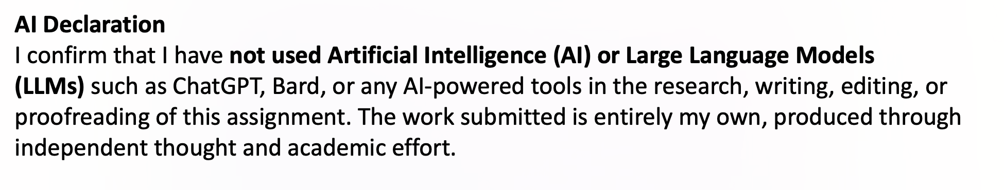

Slide 16
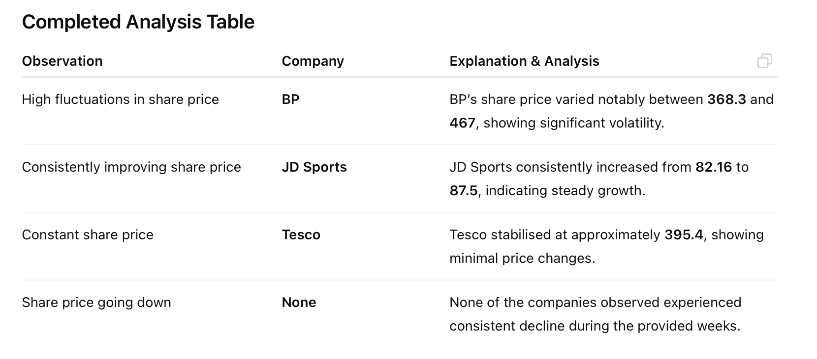
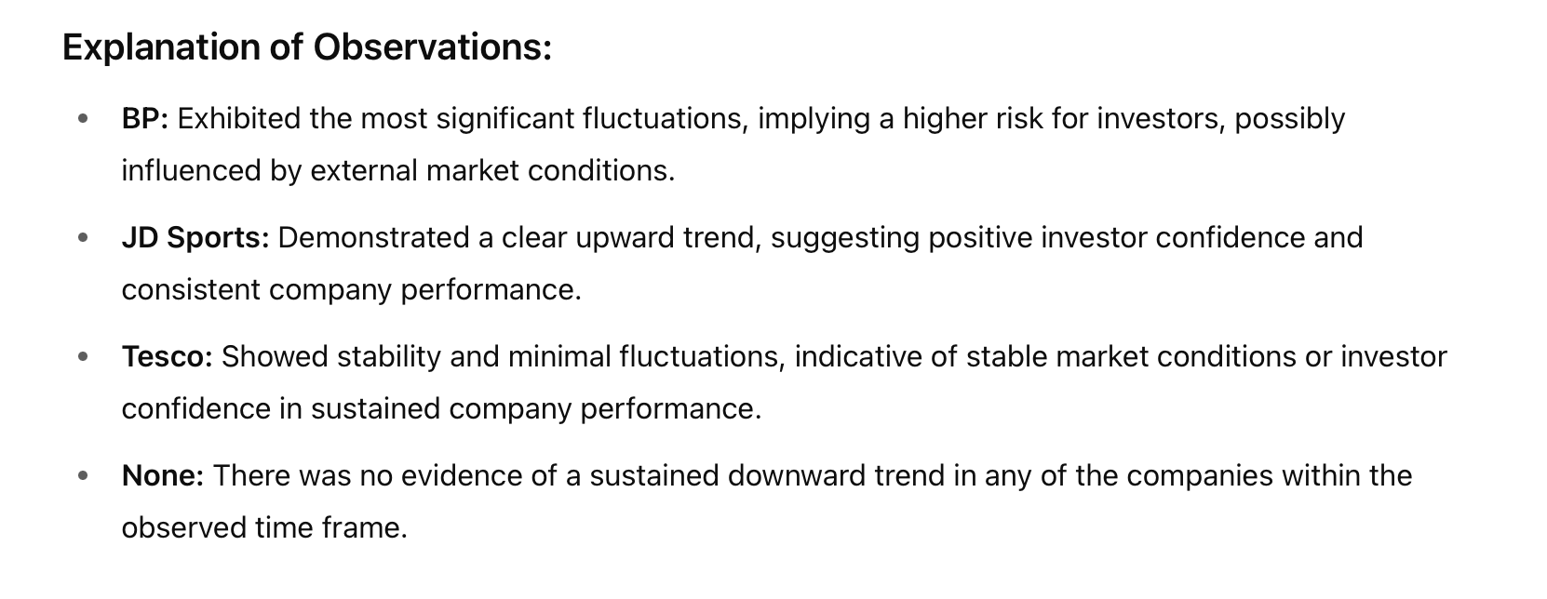

Slide 17


